Slide 1
Lecture 0:Introduction

Slide 2
Student Info
On an index card, write down the following info:
1)Name
2)Have you done programming before? What language? Classify, for each language, your level, e.g. beginner, intermediate or advanced.
(texting with emojis is NOT programming; hastaging is NOT programming.)
3)(Optional, answer only if it’s a “Yes”) Will you bring your own laptop to class everyday?

Slide 3
Materials
Computer at home.
Dr Java IDE or equivalent.
3-holed punch binder. All worksheets, quizzes and tests are stored in this binder.
No official textbook. All lecture notes will be posted on Google Classroom.

Slide 4
Google Classroom
Go to Google Classroom and enter the code xlcme3 to join the class.
All lecture notes and assignments, including worksheets, will be posted on Google Classroom. You will need to login with your BPS email.

Slide 5
CodingBat
CodingBat will be used to do some graded assignments. Go to the CodingBat Java at http://codingbat.com/java
Create an account.
Go to “prefs”(upper right hand, next to your login email)
Enter my email lnguyen8@bostonpublicschools.org under Teacher Share and click on “Share”. This will give me access to see your completed work.

Slide 6
Grading
Your grade for each term will consists of:
3 or 4 tests.
Labs on Dr.Java and CodingBat
Completed worksheets
Binder check
The homework policy can be found in your syllabus.

Slide 7
Homework
Have the syllabus signed and returned.
Login to Google Classroom and register into the class.
Create an account at CodingBat.
Get a 3-holed punched binder.
Install Dr.Java or a similar compiler at home.

Slide 8
What is computer science?
Computer Science
  The study of theoretical foundations of information and computation and their implementation and application in computer systems. -- Wikipedia
  Many subfields
    Graphics, Computer Vision
    Artificial Intelligence
    Scientific Computing
    Robotics
    Databases, Data Mining
    Computational Linguistics, Natural Language Processing ...
Computer Engineering
  Overlap with CS and EE; emphasizes hardware

Slide 9

What is programming?
program: A set of instructions
to be carried out by a computer.
program execution: The act of
carrying out the instructions
contained in a program.
programming language: A systematic set of rules used to describe computations in a format that is editable by humans.
  This textbook teaches programming in a language named Java.

Slide 10
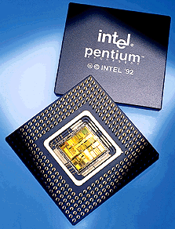
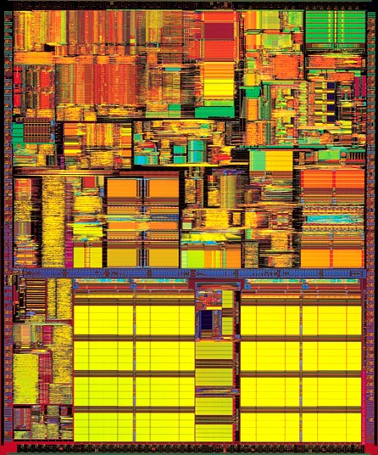
Processors
Computers are fast
  Pentium 4 chip from 2001 can perform approximately 1,700,000,000(1.7 Ghz) computations per second
  made up of 42,000,000 transistors (a switch that is on or off)
Computers are dumb
  They can only carry out a very limited set of instructions
    on the order of 100 or so depending on the computer's processor
    machine language instructions, aka instruction set architecture (ISA)
    Add, Branch, Jump, Get Data, Get Instruction, Store

Slide 11

Neumann’s Idea
John von Neumann - co-author of paper in 1946 with Arthur W. Burks and Hermann H. Goldstine,
  "Preliminary Discussion of the Logical Design of an Electronic Computing Instrument"
One of the key points
  program commands and data stored as sequences of bits in the computer's memory
A program:
1110001100000000
0101011011100000
0110100001000000
0000100000001000
0001011011000100
0001001001100001
0110100001000000

Slide 12
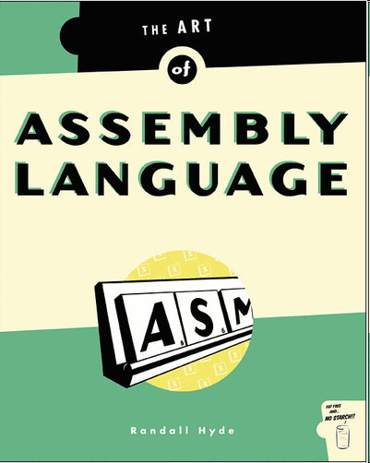
Low Level Programming
Programming with Strings of bits (1s or 0s) is not the easiest thing in the world.
Assembly language
  mnemonics for machine language instructions
  .ORIG x3001
  LD R1, x3100
  AND R3, R3 #0
  LD R4, R1
  BRn x3008
  ADD R3, R3, R4
  ADD R1, R1, #1
  LD R4, R1
  BRnzp x3003

Slide 13
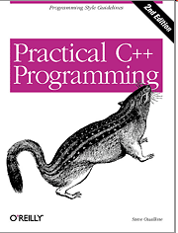
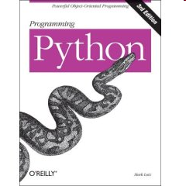
High Level Programming
Assembly language, still not so easy, and lots of commands to accomplish things
High Level Computer Languages provide the ability to accomplish a lot with fewer commands than machine or assembly language in a way that is hopefully easier to understand
  int sum;
  int count = 0;
  int done = -1;
  while( list[count]!= -1 )
  sum += list[count];

Slide 14
Programming Languages
There are hundreds of high level computer languages. Java, C++, C, Basic, Fortran, Cobol, Lisp, Perl, Prolog, Eiffel, Python
The capabilities of the languages vary widely, but they all need a way to do
  declarative statements
  conditional statements
  iterative or repetitive statements
A compiler is a program that converts commands in high level languages to machine language instructions

Slide 15
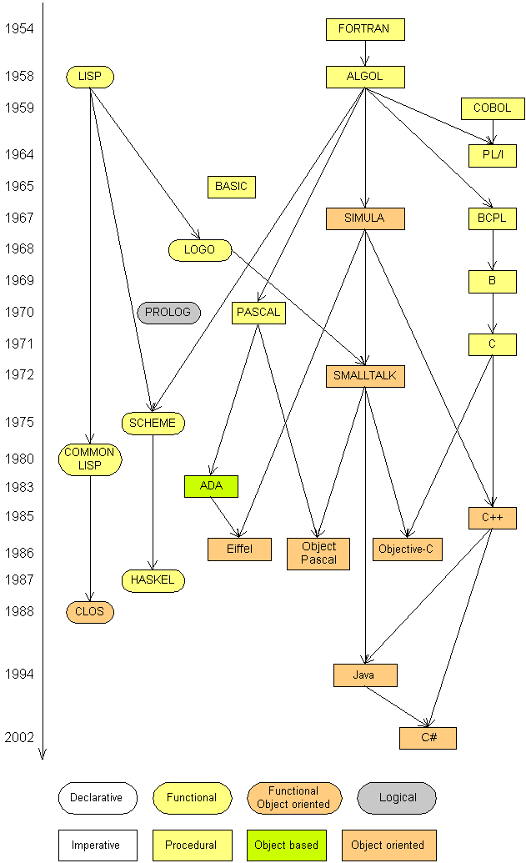
Programming languages
Some influential ones:
  FORTRAN
    science / engineering
  COBOL
    business data
  LISP
    logic and AI
  BASIC
    a simple language

Slide 16
Some modern languages
procedural languages: programs are a series of commands
  Pascal (1970): designed for education
  C (1972): low-level operating systems and device drivers
functional programming: functions map inputs to outputs
  Lisp (1958) / Scheme (1975), ML (1973), Haskell (1990)
object-oriented languages: programs use interacting "objects"
  Smalltalk (1980): first major object-oriented language
  C++ (1985): "object-oriented" improvements to C
    successful in industry; used to build major OSes such as Windows
  Java (1995): designed for embedded systems, web apps/servers
    Runs on many platforms (Windows, Mac, Linux, cell phones...)
    The language taught in this textbook

Slide 17

A Picture is Worth…
The output of the compiler is .class file
The Interpreter's are sometimes referred to as the Java Virtual Machines

Slide 18
Compile/run a program
Write it.
  code or source code: The set of instructions in a program.
Compile it.
  compile: Translate a program from one language to another.
  byte code: The Java compiler converts your code into a format named byte code that runs on many computer types.
  interpreter: A converts one instruction or line of code from one language to another and then executes that instruction
  When java programs are run the bytecode produced by the compiler is fed to an interpreter that converts it to machine code for a particular CPU. On my machine, it converts it to instructions for a Pentium CPU.

Slide 19



Compile/run a program
3. Run (execute) it.
  output: The messages printed to the user by a program.
source code
byte code
compile
output
run

