Slide 1
Prediction of Stem Water Potential in vineyards using PLANETSCOPE imagery and
geospatial data analysis
R. Cilli¹, E. Pantaleo^{1,2}, G.A. Vivaldi⁴, J. Ikken^{4,5}, V. Giannico⁴, F. Abbatantuono⁴, A. Tallou⁴, A. Monaco^{1,2}, N. Amoroso^{2,3}, R. Bellotti^{1,2}
¹ Dipartimento Interateneo di Fisica M. Merlin, Università degli Studi di Bari
² Istituto Nazionale di Fisica Nucleare (INFN), Sede di Bari
³ Dipartimento di Farmacia - Scienze del Farmaco, Università degli Studi di Bari
⁴ Dipartimento di Scienze del Suolo, della Pianta e degli Alimenti, Università degli Studi di Bari
⁵ The Rural Engineering Department, Agronomic and Veterinary Institute Hassan II, Rabat, Morocco;
Workshop Tematico ENEA-AIT, Bologna, 6-7 Giugno 2024

Slide 2
Outline
Area of Study and Scope of the Analysis
Datasets
Workflow
Results
Comparison of different feature sets
Independent tests (years 2022 and 2023)
Feature Importance and Explanation using SHAP algorithms
Conclusions

Slide 3
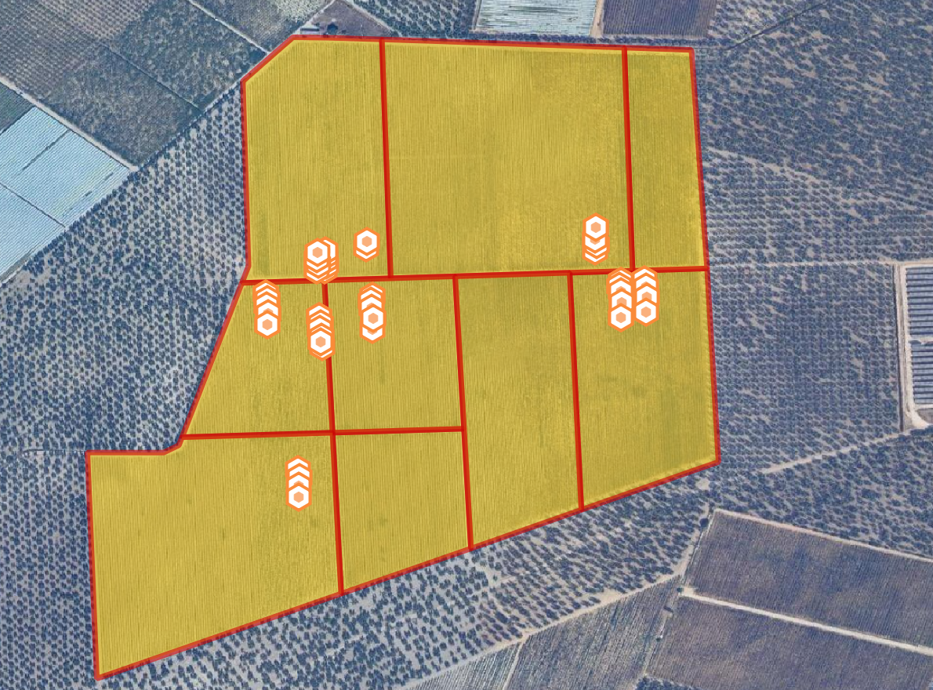
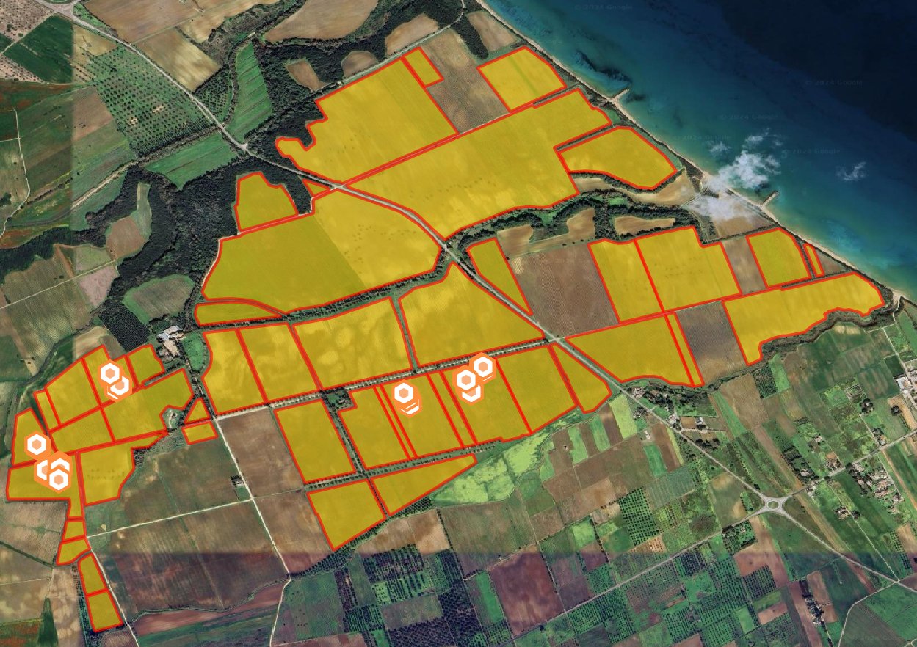
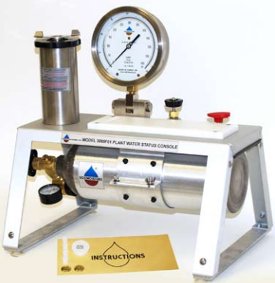
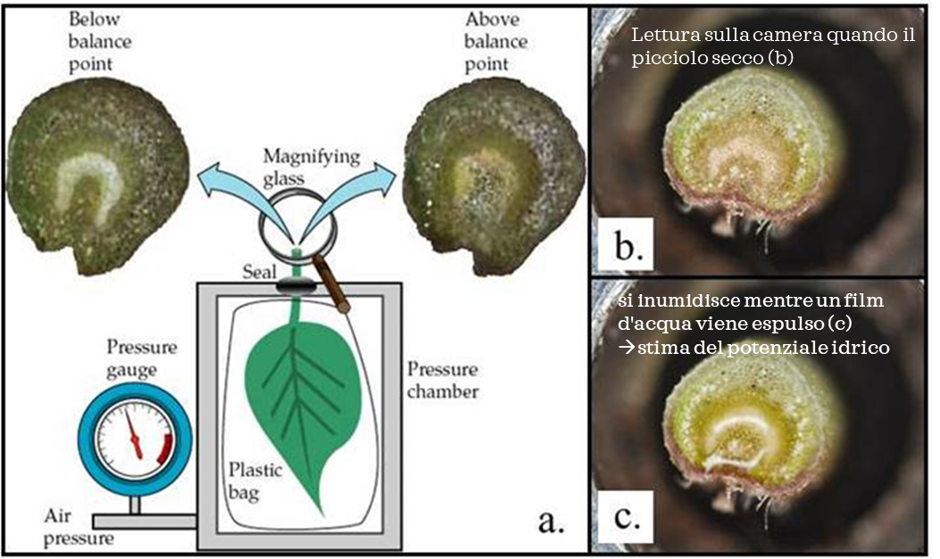
Area of Study and Scope of the Analysis
Prediction of water status of apulian grapes using spectral properties from PlanetScope.
We are interested in models capable of:
Generalizing to other vineyards of the Apulian landscape
Generalizing to other grape varieties
Generalizing to next cropping years
Water status is measured using a pressure chamber, where a stem segment is placed inside to determine the pressure to force water out of the xylem.
Andria, Italy
Brindisi, Italy

Slide 4
Datasets
Four data acquisition campaigns
Andria year 2022 and year 2023
Brindisi year 2022 and 2023
«Huge» dataset:
750 total ground measurements
45 sample points
24 Features
8 surface reflectances from PlanetScope
10 composite indexes
6 weather variables from AgERA5
Target Variable
Stem Water Potential (SWP) from ground measurements at solar midday
Andria, Italy
Brindisi, Italy

Slide 5
Workflow
Training and Validation sets were not defined by random shuffling to ensure generalization capabilities. At each round:
2 sets used to train a RF algorithm
2 set used for validation
Dataset of SWP and Spectra
Andria
2022
Andria
2023
Training Set
Validation Set
Model Evaluation
Random Forest
Regression Model
Average Regression Model
Brindisi
2022
Brindisi
2023
SHAP algorithm
Model Explanation
2 hold-out CV rounds (50-50 rule)
Set A
Set B

Slide 6
Results: Comparisons of different set of features (test)
Features | RVAR | Pearson’s r
Spectra | 0.397 | 25.4%
Indexes | 0.415 | 7.0%
AgERA5 | 0.403 | 26.3%
Spectra + Indexes | 0.377 | 30.6%
Spectra + AgERA5 | 0.364 | 45.3%
Indexes + AgERA5 | 0.378 | 37.7%
Spectra + Indexes + AgERA5 | 0.367 | 42.2%

Slide 7
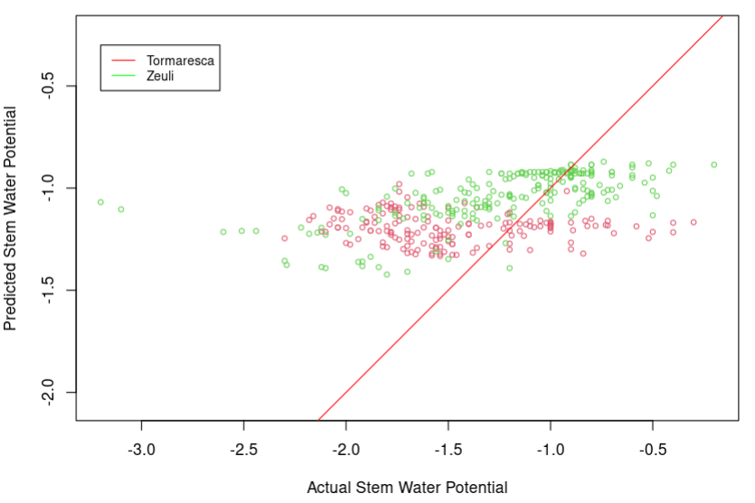
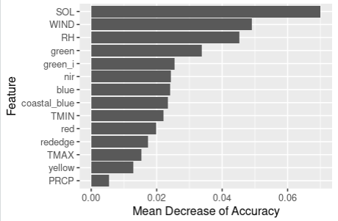
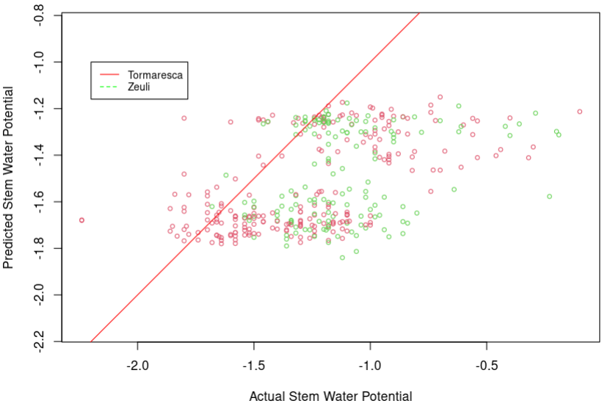
Results: 2022 and 2023 independent tests
Year 2022
RVAR = 0.43
BIAS = 0.21
CORR = 41.0%
Tormaresca
Zeuli
Average Feature Importance
Year 2023
RVAR = 0.46
BIAS = -0.3
CORR = 47.0%
Tormaresca
Zeuli
*Limitation of this study:
Model tested on several grape variety

Slide 8
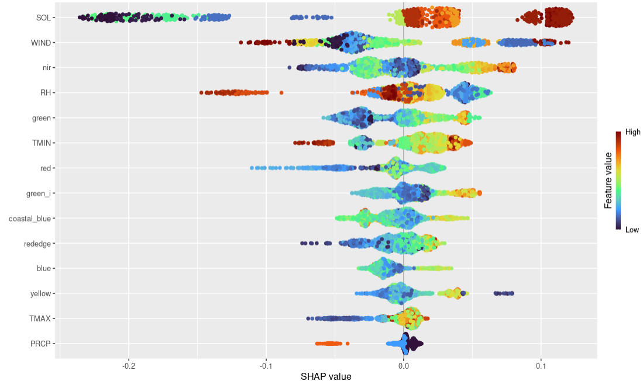
Results: Feature importance and Explanation with SHAP algorithm
Beeswarm plot of average SHAP values
TOP 10 predictors of SWP
Solar Radiation (0.095)
Wind speed (0.050)
NIR (0.030)
RH (0.030)
Green (0.025)
T min (0.025)
Red (0.020)
Green_i (0.017)
Coastal blue (0.015)
Red Edge (0.015)
Blue (0.013)

Slide 9
Conclusions
RF generalize well on independent acquisition campaigns but
Variance of predicted SWP slightly increase when performing the independent tests
We lack sufficient statistics for a proper estimation of confidence intervals of predictions and quality metrics
Next Steps
Collecting more ground measurements from next acquisition campaigns
Search for a better subset of input features to improve generalization
Search for better proxies of weather and phenology of plants

Slide 10
Thank you for your attention!
Roberto Cilli
Email: roberto.cilli@uniba.it

Slide 11
Results: Comparisons of different set of features (test)
Features | RVAR | Pearson’s R
Spectra | 0.397 | 25.4%
Indexes | 0.415 | 7.0%
AgERA5 | 0.403 | 26.3%
Spectra + Indexes | 0.377 | 30.6%
Spectra + AgERA5 | 0.364 | 45.3%
Indexes + AgERA5 | 0.378 | 37.7%
Spectra + Indexes + AgERA5 | 0.367 | 42.2%
Solar Radiation + Precipitation + NIR | 0.333 | 58.1%

Slide 12
Workflow
Dataset of SWP and Spectra
2022 Dataset
2023 Dataset
Training Set
Validation Set
Model Evaluation on 2022 data
Random Forest
Regression Model
Average Regression Model
Model Evaluation on 2023 data (test)
SHAP algorithm
Model Explanation
100 hold-out CV rounds (80-20 rule)

Slide 13
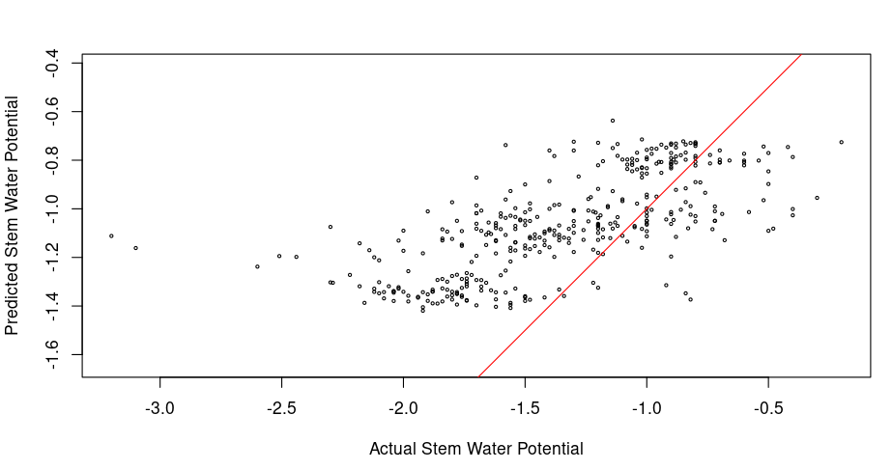
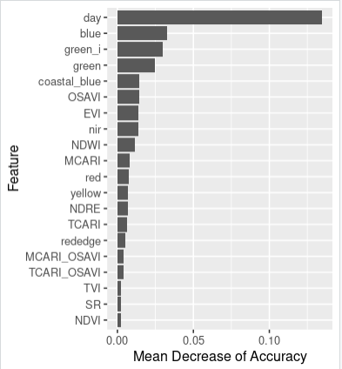
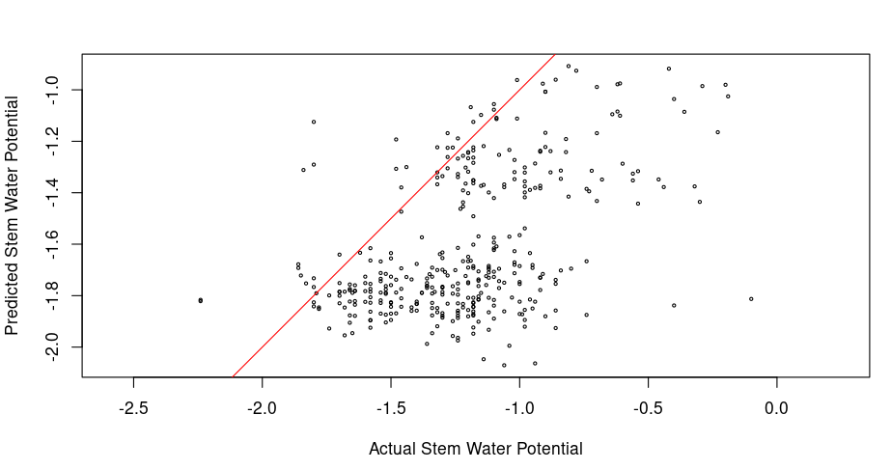
Results: 2022 and 2023 independent tests
Year 2022
RVAR = 0.31
BIAS = 0.29
CORR = 66.5%
Average Feature Importance
Year 2023
RVAR = 0.33
BIAS = -0.4
CORR = 50.0%
*Aggiungere colori Zeuli – Tormaresca
*Menzionare eteregeneità varietale

Slide 14
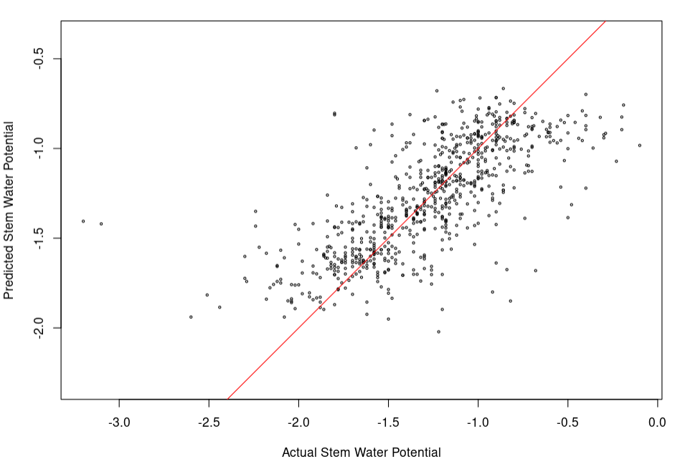
Results: Learning and Validation Phase
*Day + Spectra + Indexes + AgERA5 + XY
Average Performance in CV (random shuffling):
RMSE: 0.28
Pearson’s R: 0.74%

Slide 15
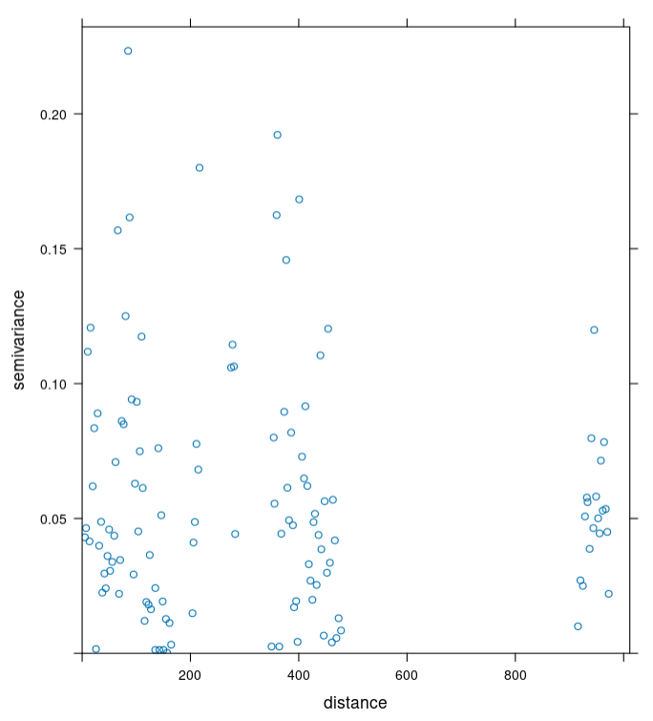
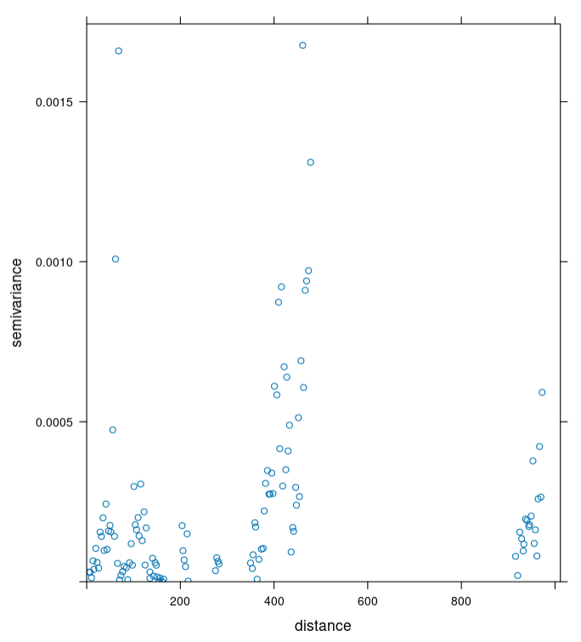
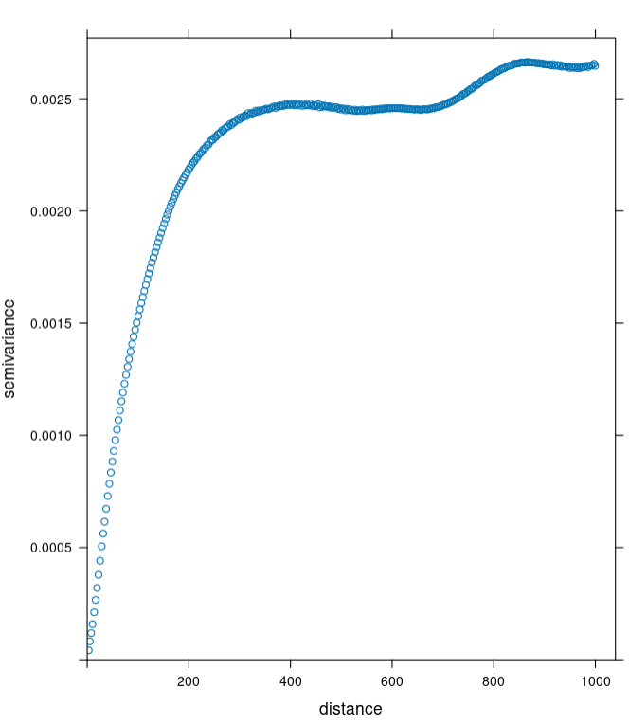
Results: Spatial Correlation Length
Semivariogram of SWP
Semivariogram of NIR (ground points)
Semivariogram of NIR (Planet Map)
Semivariogramma calcolato @ 3m di spatial lag:
Nessuna lunghezza di autocorrelazione SWP – Forse Possiamo eseguire random shuffling esempi
Lunghezza autocorrelazione bande ottiche: circa 400m
Set di feature spazialmente ridondanti usate per predizione di variabile non ridondante
Distribuzione campioni non perfetta per questo tipo di analisi [questo lo omettiamo a Bologna]

Slide 16
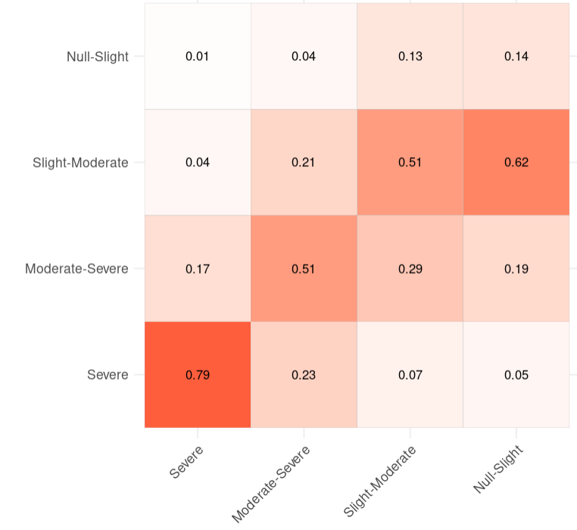
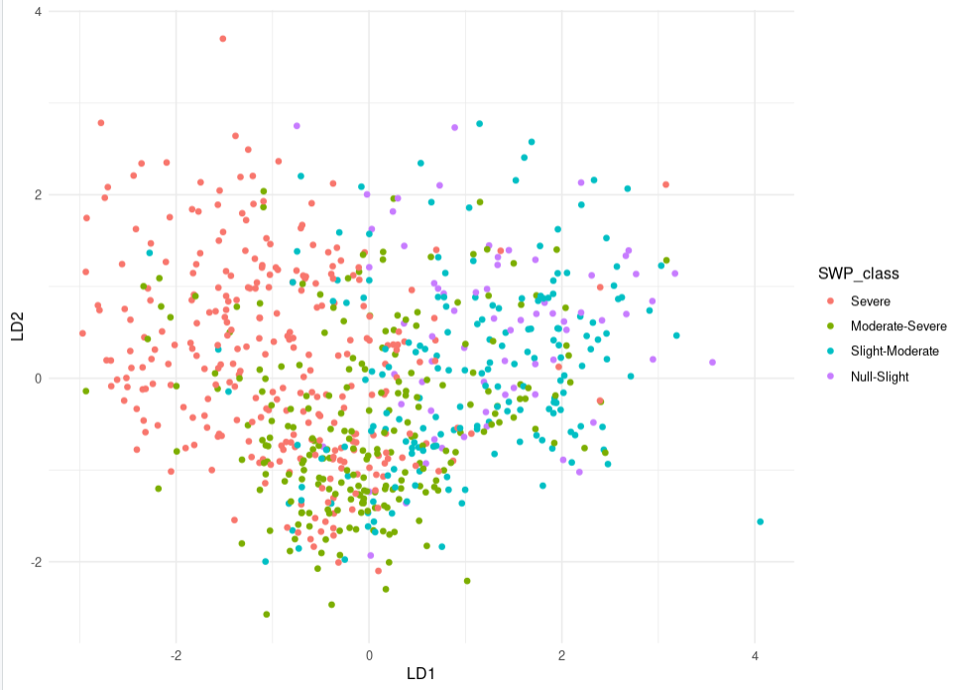
Results: Linear Discriminant Analysis and RF classifier
*Esperimento 2 – Spettri PlanetScope + Julian Day + Lon + Lat + SWP_offset
Cohen’s Kappa dopo 1000 round di hold-out CV 80-20: (0.305 – 0.402 – 0.496) 95% CI

Slide 17
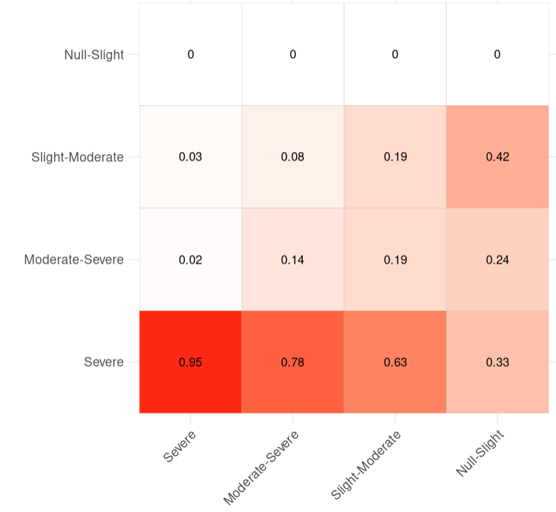
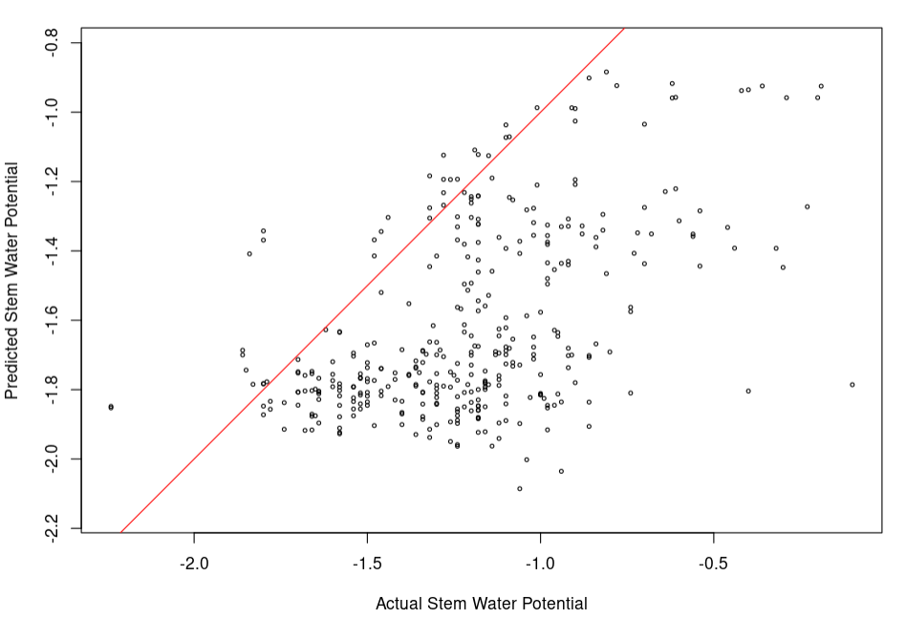
Results: Leave-one-year-out independent test
*Esperimento 2 – Spettri PlanetScope + Julian Day + Lon + Lat + SWP_offset – Leave One Year Out
Performance:
Bias: -0.4
RMSE: 0.3
Pearson’s R: 0.50%
Domanda: l’anno 2022 è stato più siccitoso del 2023?
Su Tormaresca (non mostrato) RF generalizza molto meglio
Senza Julian Day correlazione Zeuli + Tormaresca scende a 20%
Cohen’s Kappa anno 2023: 0.103

Slide 18
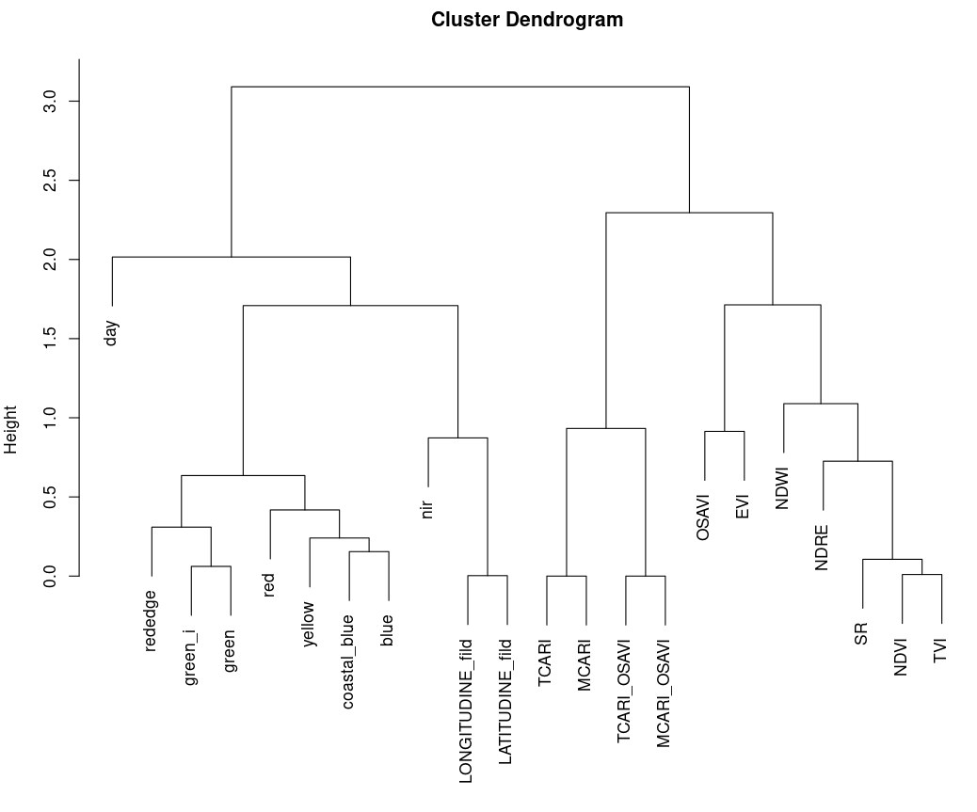
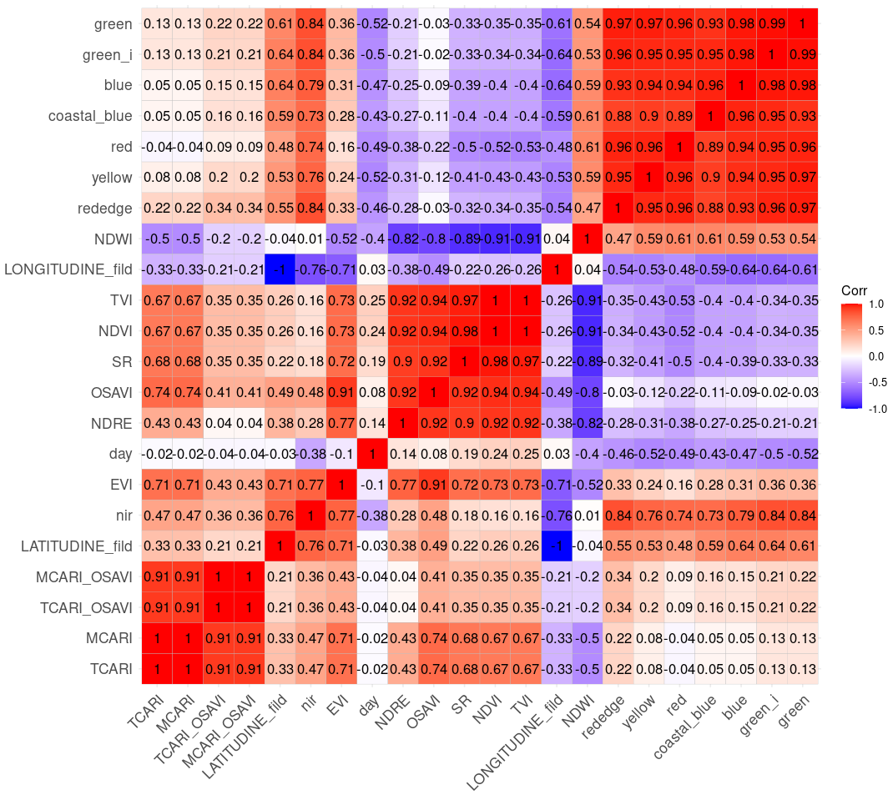






Backup
Selezione discrezionale di feature supportata da clustering gerarchico su matrice di correlazione di Pearson

Slide 19
Backup: Esperimenti con altri set di Feature (spacetimeCV)
____________________________________________________________
DAY + SPECTRA
RMSE = 0.335
BIAS = 0.001
COR = 51.3%
____________________________________________________________
DAY + INDEXES
RMSE = 0.344
BIAS = 0.01
COR = 54.6%
____________________________________________________________
DAY + SPECTRA + INDEXES
RMSE = 0.328
BIAS = 0.02
COR = 58.0%
____________________________________________________________
DAY + XY + SPECTRA + INDEXES
RMSE = 0.319
BIAS = -0.038
COR = 59.1%
_____________________________________________________________
DAY + XY + SPECTRA + INDEXES + WEATHER (AGRI-ERA5)
RMSE = 0.349
BIAS = -0.04
COR = 54.2%
_____________________________________________________________

Slide 20
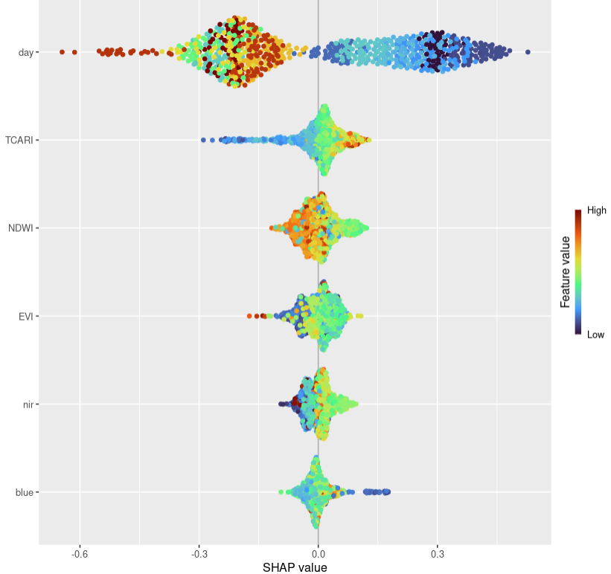
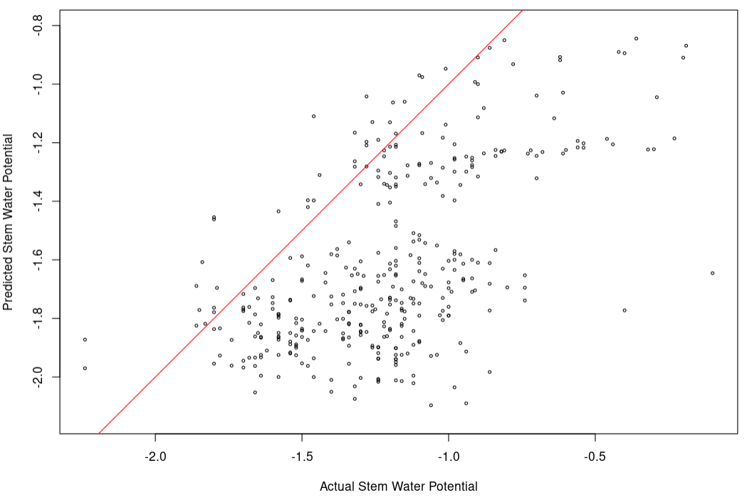
Backup
Distribuzione Importanze locali SHAP
2022+2023
Test indipendente su 2023 (leggero miglioramento)
Performance:
Bias: -0.4
RMSE: 0.29
Pearson’s R: 0.56%

Slide 21
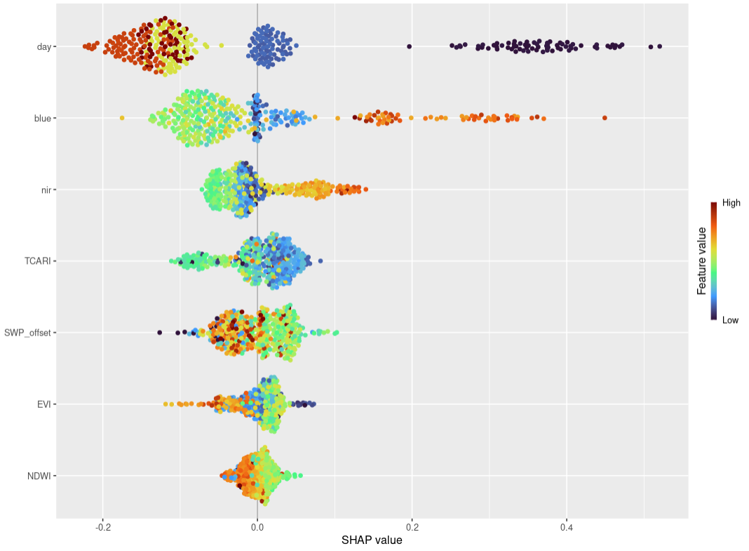
Backup
Distribuzione Importanze locali SHAP
Solo 2023
Test indipendente su 2023 (leggero miglioramento)
Performance:
Bias: -0.4
RMSE: 0.29
Pearson’s R: 0.56%

Slide 22
Target Variable: Stem Water Potential (SWP)
Stem Water Potential
(SWP)
Una camera a pressione misura la forza necessaria per spingere l'acqua fuori da una foglia idratata
SCHOLANDER’S PRESSURE CHAMBER
Water status is measured as a difference between vapor pressure in the plant and a reference

Slide 23
Dataset of SWP and Spectra
Training Set
Validation Set
Model Evaluation
Random Forest
Regression Model
Average Regression Model
SHAP algorithm
Model Explanation
4 hold-out CV rounds (75-25 rule)

