Slide 1


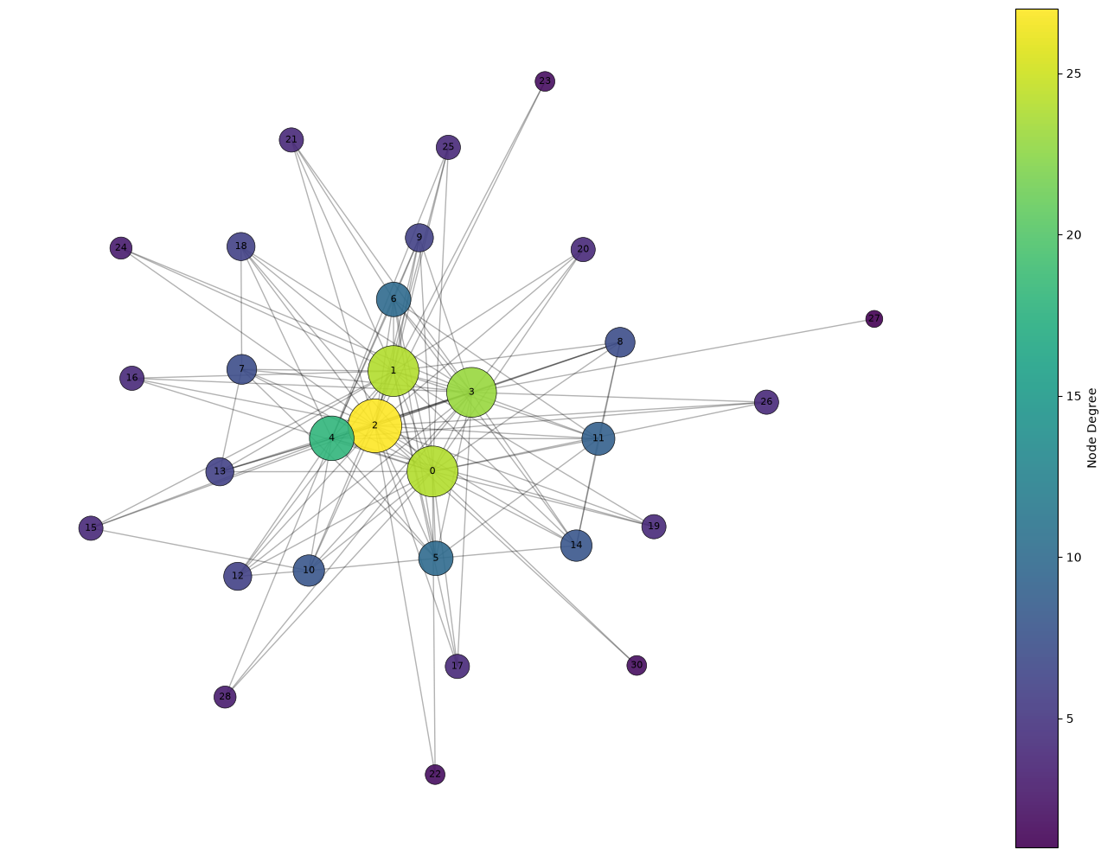
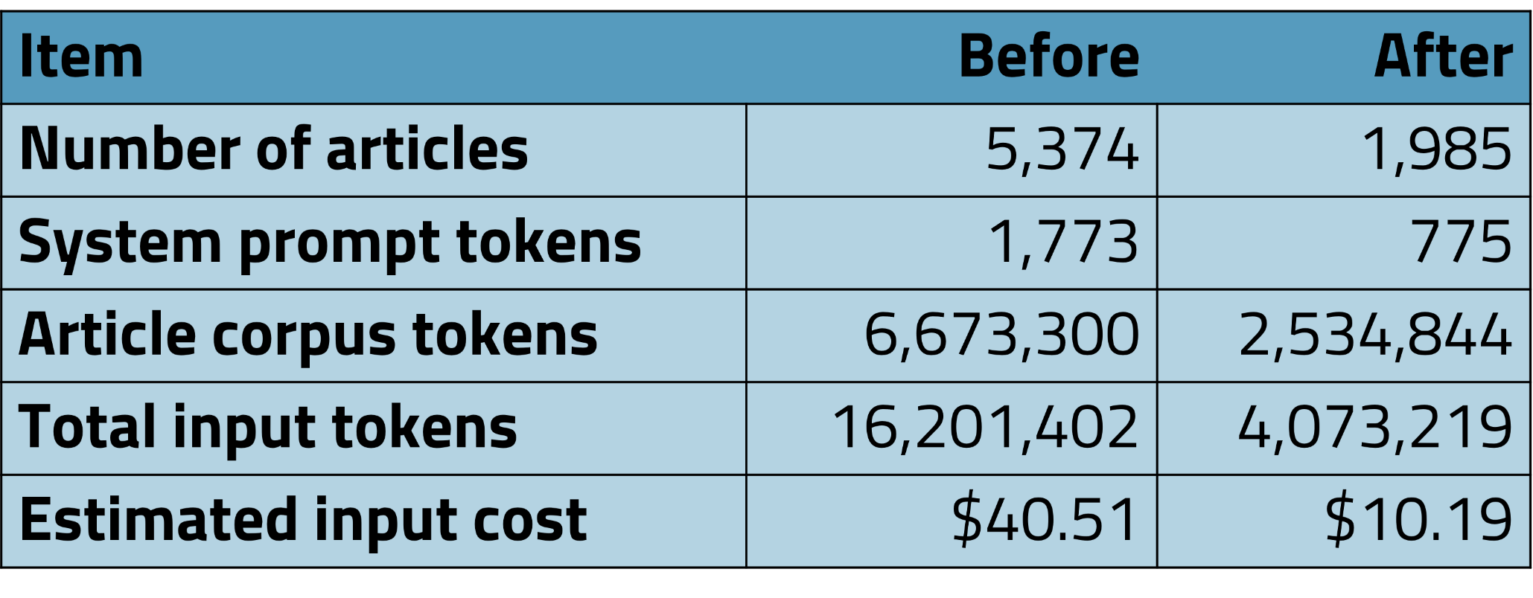



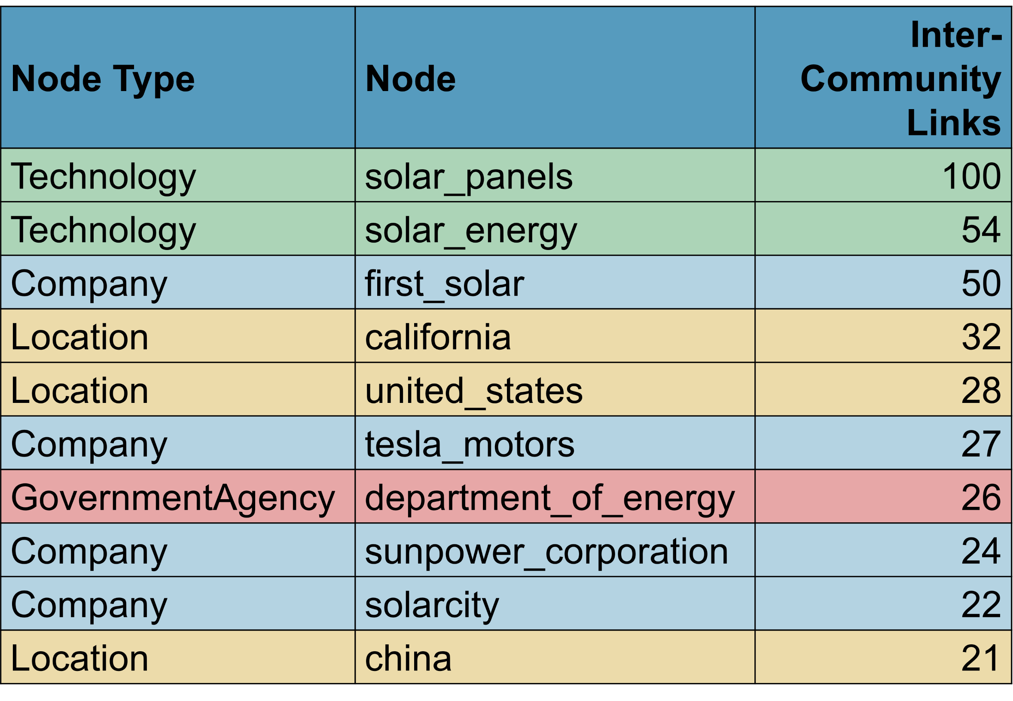



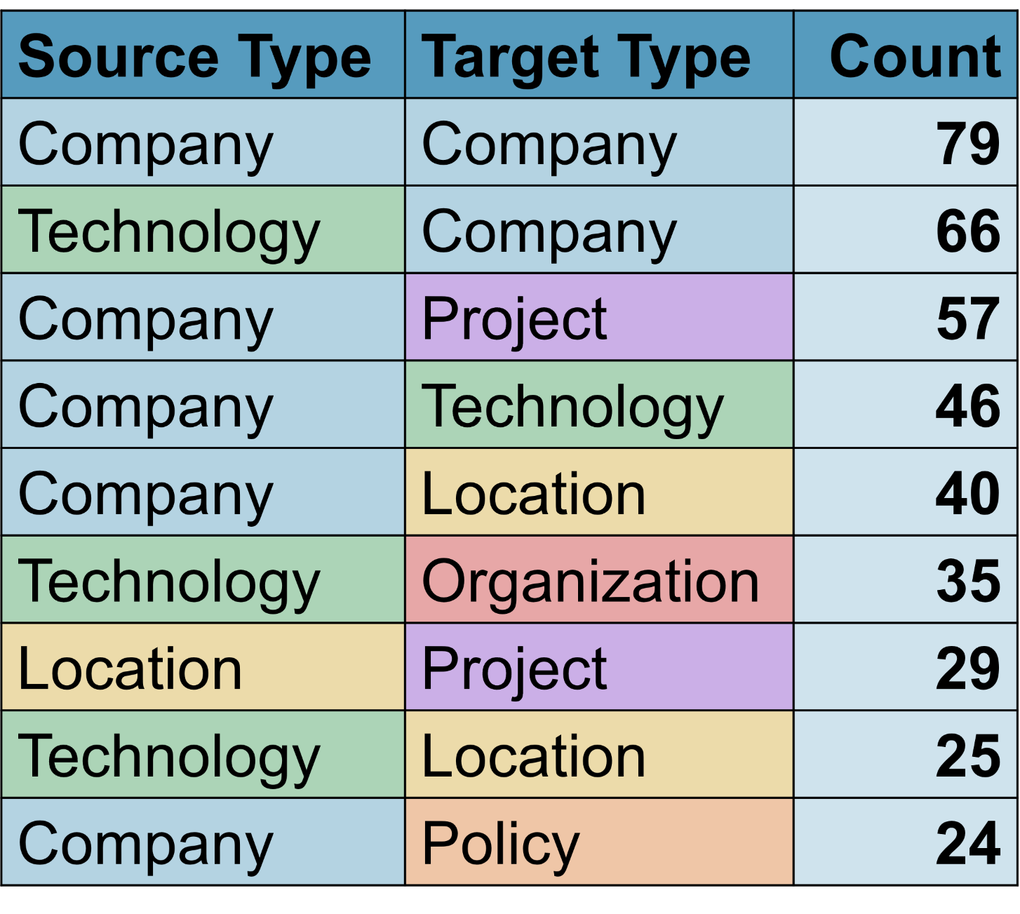



Knowledge Graphs for Solar Energy News Analysis
Rachel Kan, Chris Dunham
Cornell University, Syracuse University
Introduction
Methodology
Results
Limitations
The global solar energy industry consists of interconnected organizations, technologies, policies, and markets that are difficult to analyze from unstructured information sources. This project uses OpenAI’s GPT-4o to extract entities and relationships from Cornell Newsroom articles [1] and construct a solar energy knowledge graph. Graph analysis and community detection are then applied to identify major themes, influential entities, and connections within the international solar energy ecosystem.
Data Collection/Filtering
Cornell Newsroom articles were screened using domain-specific solar energy keywords and scraped for full-text analysis. Articles with fewer than two solar keyword mentions were excluded, reducing GPT-4o token costs (Figure 1).
Network Graph of Communities with >10 entities
Articles are limited to 1998–2017, preventing analysis of recent trends (e.g., artificial intelligence).
The dataset also includes only 38 major publications and excludes non-English sources, limiting coverage and diversity.
Future Work
Future work includes analyzing reporting patterns across news organizations (e.g., topics, geographic focus, and coverage).
The same pipeline can also be applied to other topics using topic-specific filtering and network analysis.
The solar energy knowledge graph may be used to ground LLM outputs in a compound AI system [3].
Questions
How do solar energy industries interact across world borders? In particular, what types of entities connect these communities directly and indirectly?
How can information be extracted from a large corpus of articles to analyze communities and relationships in the solar energy industry?
Fig. 1: Reductions in dataset size and cost with filtering pipeline
LLM-Based Information Extraction
GPT-4o was used to extract entities and semantic relationships from solar energy articles, as LLMs outperform traditional methods on network extraction tasks [2]. A structured prompting framework (system prompt, user prompt, and JSON schema) defined 8 node types and 19 edge types while optimizing token usage.
0 | American residential markets (495 nodes)
1 | U.S.–China manufacturing and trade (437 nodes)
2 | U.S. solar policy (403)
3 | International solar tech/projects (345 nodes)
4 | International pro-solar orgs (201 nodes)
most communities not directly connected
small number of highly central communities linked separate regions of the network
References
Methodology
[1] M. Grusky, M. Naaman, and Y. Artzi, “NEWSROOM: A Dataset of 1.3 Million Summaries with Diverse Extractive Strategies,” 2018. Accessed: Aug. 04, 2026. [Online]. Available: https://aclanthology.org/N18-1065.pdf
[2] J. Hoppa, “How to Convert Unstructured Text to Knowledge Graphs Using LLMs,” Neo4j Graph Intelligence Platform. Accessed: Aug. 04, 2026. [Online]. Available: https://neo4j.com/blog/developer/unstructured-text-to-knowledge-graph/
[3] T. Ma, B. Liu, and S. Yang, “Constructing New Power System Stock Indices via a Compound AI System: A Hierarchical RAG and Knowledge Graph Approach,” Proceedings of the 2025 6th International Conference on Computer Science and Management Technology, pp. 1007–1012, Dec. 2025, doi: 10.1145/3795154.3795318.
Knowledge Graph Construction
Extracted JSON outputs were converted into a knowledge graph with 4,002 nodes and 5,127 edges. Low-degree nodes were removed, similar entities merged with fuzzy matching and transformer-based similarity, and node size scaled by degree.
Articles containing solar energy bigrams are extracted
CNM revealed that clusters formed primarily around geographic regions and areas of focus (e.g. technology development, policy, manufacturing, and international collaborations).
Newsroom dataset for shortened summaries and article links
Articles with <2 solar keyword mentions are removed
Network Analysis
The greedy modularity maximization/Clauset-Newman-Moore (CNM) community detection algorithm was applied to identify groups of closely connected entities. 408 communities were found, of which 31 had over 10 member entities.
For more technical details, please see the project’s Github: https://github.com/rckan/syracuse-su26-project
Bigrams containing the word “solar” are extracted from article summaries
GPT-4o ingests prompts and articles to generate entities and relations
System prompt, user prompt, and JSON structured output schema
Company, technology, and project nodes appear most frequently in common edges, while government, policy, people, and article nodes are less common, suggesting news coverage emphasizes technological and economic developments over politics.
Acknowledgements
Special thanks to Prof. Chris Dunham for his guidance and support throughout this project, and to the Cornell Newsroom project for providing access to the underlying dataset. This work was conducted as part of the Syracuse University REU in Text Analytics for Social Scientists, funded by NSF ASSURE.
Extracted JSON outputs are converted into node and edge tables
Graphs generated using node and edge lists analyzed with CNM and connectivity
Fig. 3: Nodes with highest connectivity to other communities
Though company, technology, and project nodes are most often found in common edges, location nodes play a large role in the connections between communities.
Fig. 2: Counts of most common edge connection types

