Slide 1
Finishing a Basement
“What you didn’t know about finishing a basement”

Slide 2
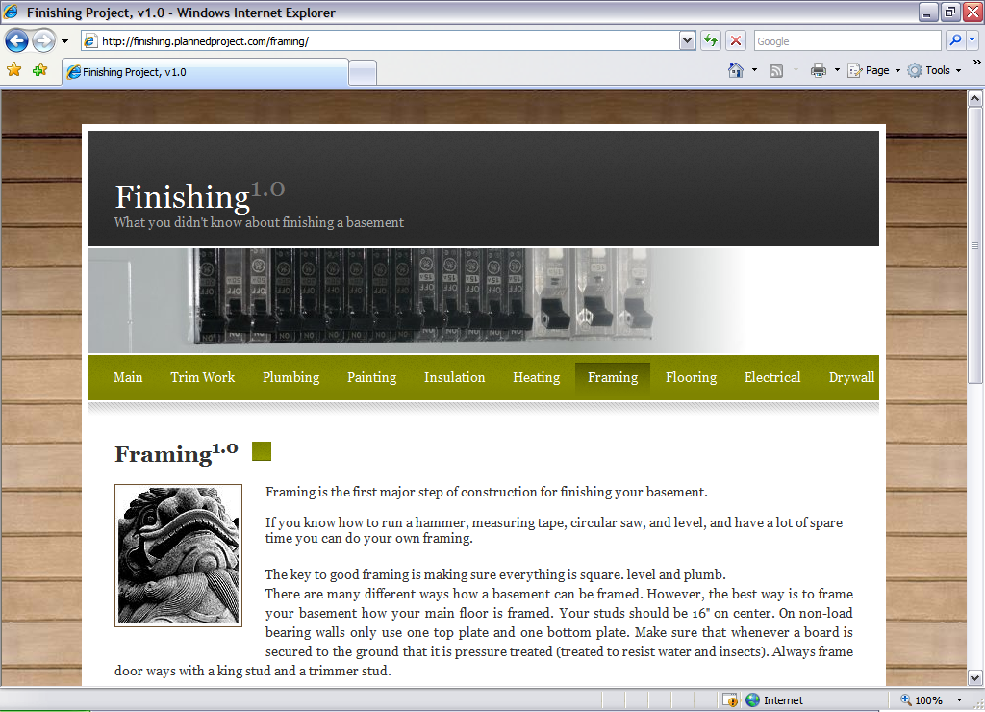
Layout
Easily obtainable information
Information is to the point

Slide 3

Links
Main
Trim Work
Plumbing
Painting
Insulation
Heating
Framing
Flooring
Electrical
Drywall

Slide 4
Main Page
Briefly describes why someone would want to finish a basement.
With this being the first page someone sees, it needs to grab their attention.

Slide 5

Subsequent Pages
Briefly describes information about the subject each page is identifying.
Gives tips on the subject.

Slide 6
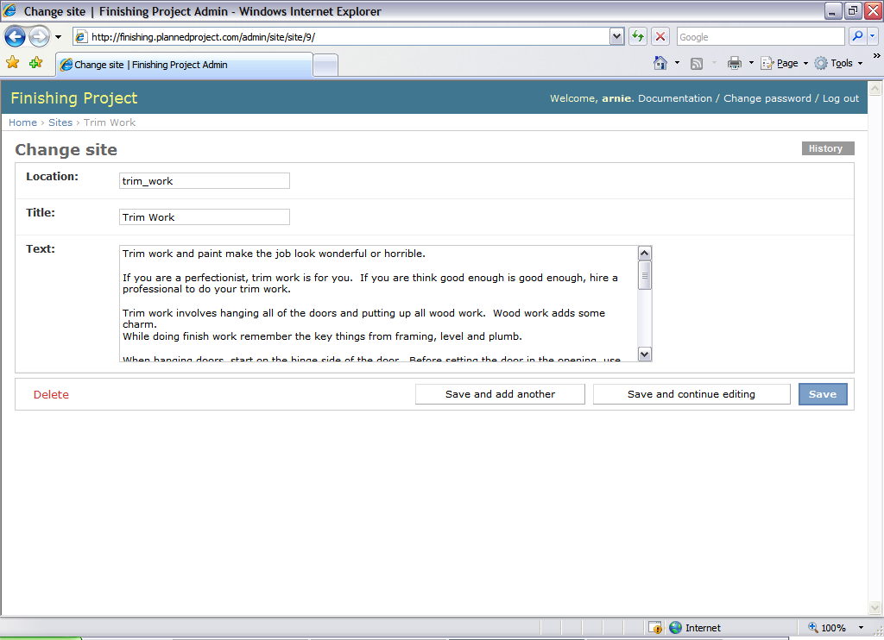
Backend
Ability for all group members to easily put information into the website.
Essentially
“the backbone”
of the website.

Slide 7
Key Points
It identifies key concepts a person is faced with before throughout the project.
  Permits
  Inspections
  Tools

Slide 8
Summary
Easily obtainable information
Expandable system
Helpful to the general public

