Slide 1
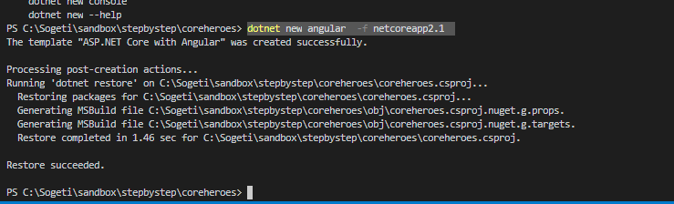
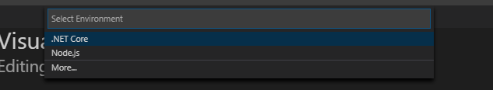
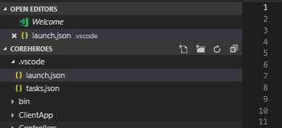
dotnet new angular -f netcoreapp2.1
F5->select .NET Core->f5

Slide 2
0. It’s easy.. right
“download” elastic
Open folder in vs code
Update yml – node name, enable cors
Start elastic
Ingest some data
Static html with jquery example

Slide 3
1. Git clone and run locally
In memory api
Walk through app
Service
Hero
Heroes
Dashboard

Slide 4
2. Elastic Heroes
Open elastic search (cloud)
Ingest data using curl from command line
Register httpclientfactory
Add controller and inject client factory
Implement get heroes
Implement search/put/post methods
Unregister in-memory-api
Alter some data and show in elastic and client

Slide 5
3. Track Clicks
Add object model
Add service
Register service (heroes, dashboard)
Implement click/add click
Add clicktracking controller
Open kibana
Create index profile
Show time based analysis

Slide 6
4. User feedback with enrichment
Open kibana
Talk about how we might use information gathered
Start a monitoring dashboard for top heros by clicks
Add timerbase service
Register timer service
Do some work (selenium)?

Slide 7
5. Summary
This was not a UX or Angular competition
We talked about using elastic and adding value to a site via feedback
There is much much much more
Searching analyzers
Ingestion pipelines
Query – boosting, multiple…
Faceting/navigation
Anomaly detection
Graph

Slide 8
Delete the spa app src folder under Client App and replace with tour of heroes source (from tutorial) so we have some functionality – with the in memory service implementation
Npm install
npm install angular-in-memory-web-api –save
npm audit fix

Slide 9
Track clicks
Add clicktrack controller to api
ng generate service clicktrack
Add trackeditem model
Inject the service in the constructor of dashboard
Add click method to dashboard.components.ts
Add click even to the
<a *ngFor="let hero of heroes" class="col-1-4" (click)="click(hero)" routerLink="/detail/{{hero.id}}">
Repeat for heroes
Open kibana
Run app - click
add index pattern
Time base dashboard
Click some more

Slide 10
TimedHostedEnrichment service
Add TimeHostedEnrichmentService to aggregate and enrich clicktrack information to alter the search results based on user interaction
Register TimeHostedEnrichement service
services.AddHostedService<TimedHostedEnrichementService>();
Start app.. View logs
Validate
Add sorting to the get query in the controller

