Slide 1

A Ridiculously Overarchitected Hello World Website
Using Kubernetes and Azure Web Services
as presented by a complete neophyte

Slide 2
Setup that I did for this talk
Create free azure account (or paid, you do you)
Install docker locally
Install azure command line tool
Notes:
Go to console after this

Slide 3
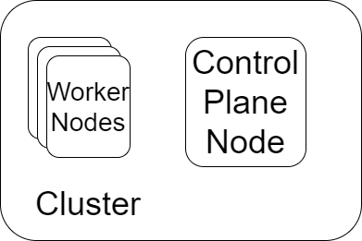
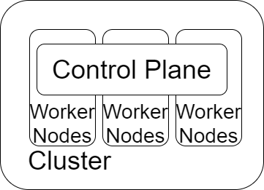
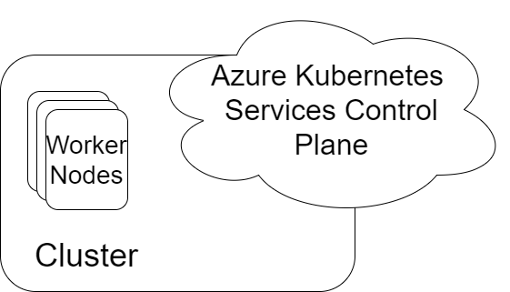
What’s a cluster? What’s a node? What’s a Kubernetes?????
K8s is a system for automating deployment, scaling, and management of containerized applications
The ‘containerized applications’ run on worker nodes, which are VMs with k8s tooling.
A group of worker nodes + a control plane = a working k8s cluster.

Slide 4
Azure Kubernetes Services (AKS) makes sure the extra k8s bits get installed onto the VMs we create, and handles the control plane stuff.
Control plane? Authentication, polling for changes, managing node state, etc etc
‘kubectl’ commands are communicating with the control plane, which then does stuff on the nodes

Slide 5
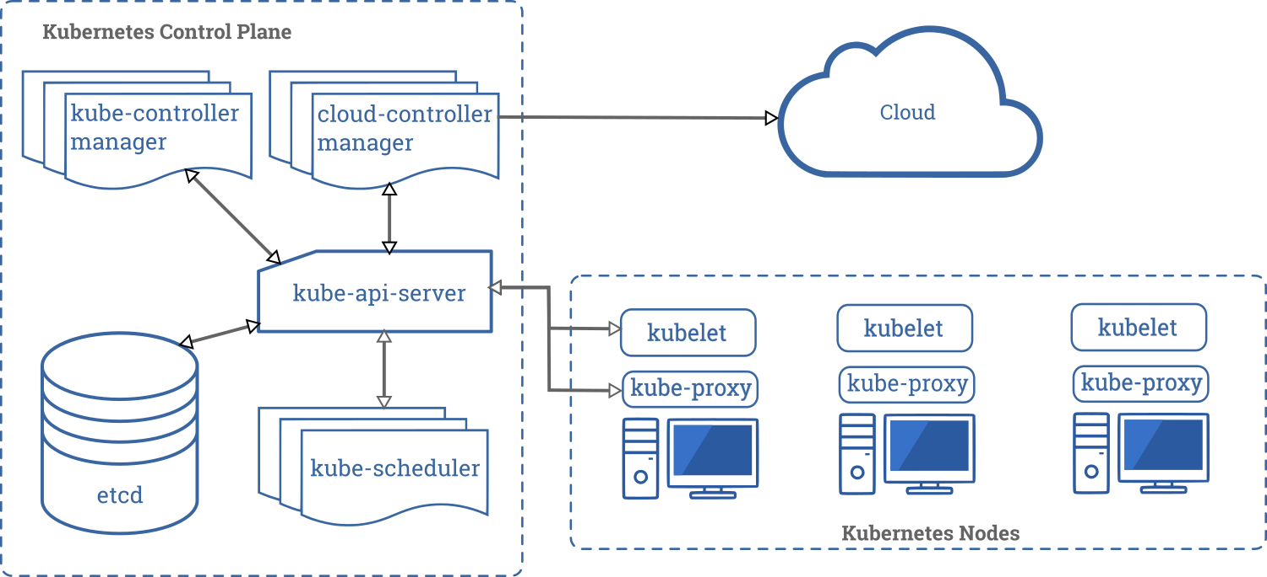

Implementation details!!!

Slide 6
az group create --name $RESOURCE_GROUP --location australiasoutheast
Creates a resource group.
Azure concept – logical grouping of resources for cost control, easy administration, quick teardown etc.
az aks create --resource-group $RESOURCE_GROUP --name $CLUSTER_NAME --node-count 3 --enable-addons http_application_routing --dns-name-prefix $DNS_NAME_PREFIX-$RANDOM --generate-ssh-keys --node-vm-size Standard_B2s
create a new managed Kubernetes cluster with three nodes
Notes:
Back to the console after this

Slide 7
az aks get-credentials --name $CLUSTER_NAME --resource-group $RESOURCE_GROUP
Fetches the ssh keys from the AKS cluster we just created and stores them locally , so that our local *Kubernetes* CLI tools know about our new cluster.

Slide 8
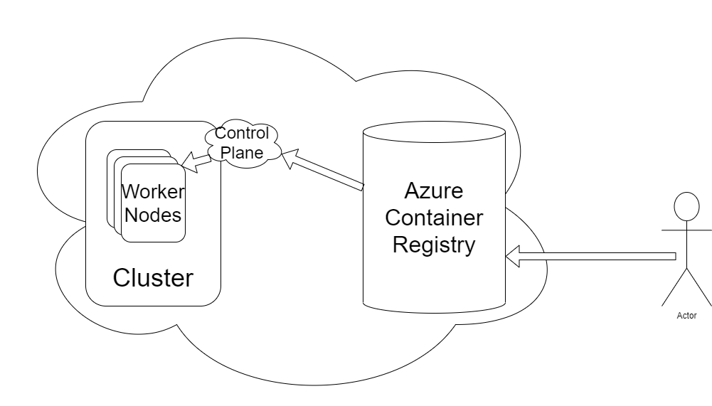
az acr create --resource-group $RESOURCE_GROUP --name $ACR_NAME --sku Basic
Azure container registry - a repository for container images
Make a registry, put it in our resource group, give it a name and a tier
az aks update --name $CLUSTER_NAME --resource-group $RESOURCE_GROUP --attach-acr $ACR_NAME
Link our cluster to our container registry
Notes:
Back to console to talk about website here

Slide 9
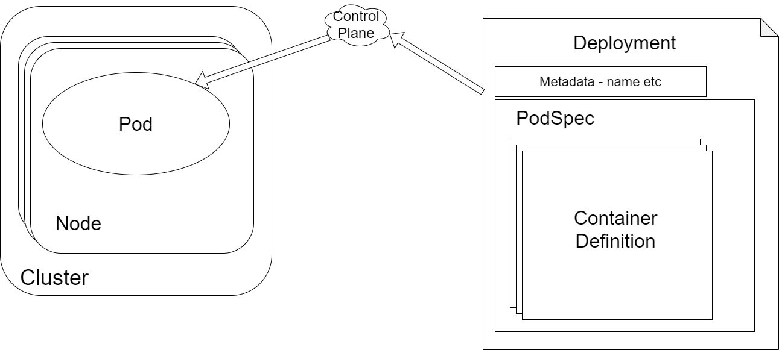
What’s a deployment?

Slide 10
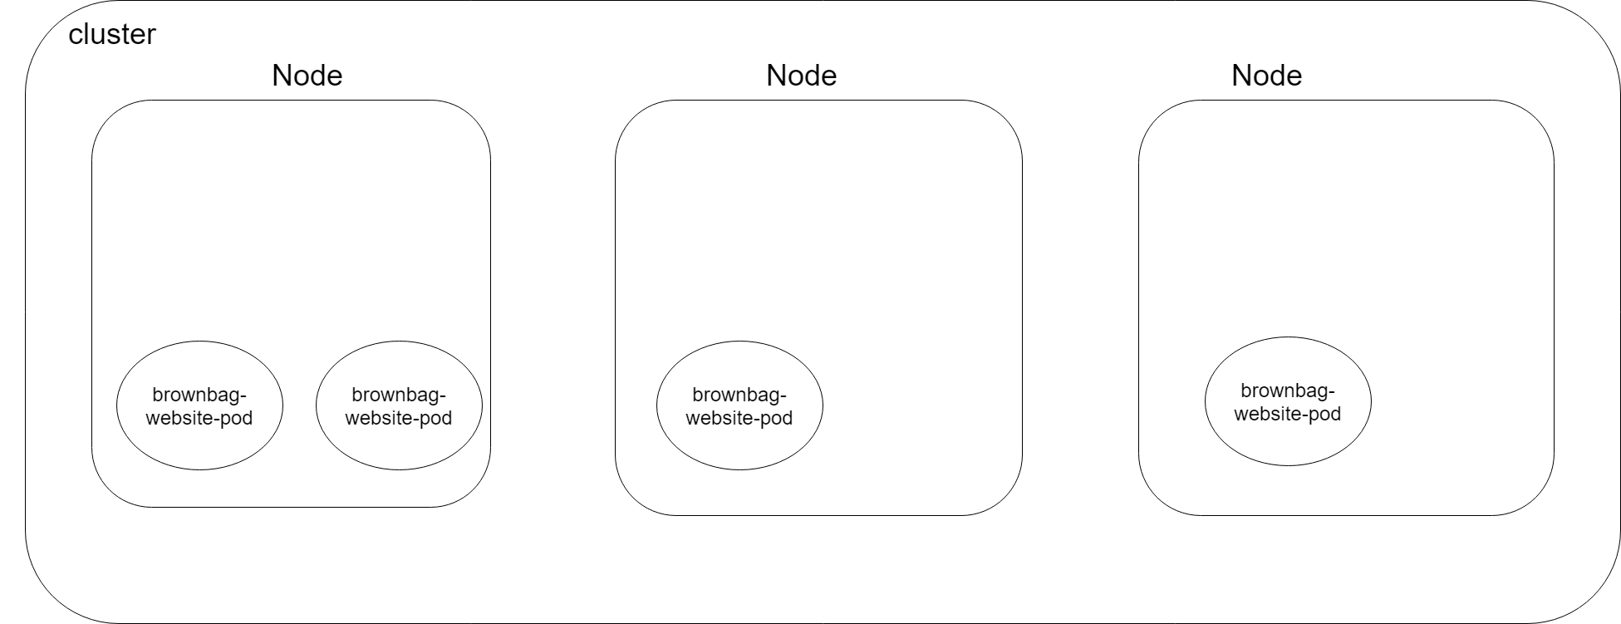

Slide 11

Important note re: networking

Slide 12
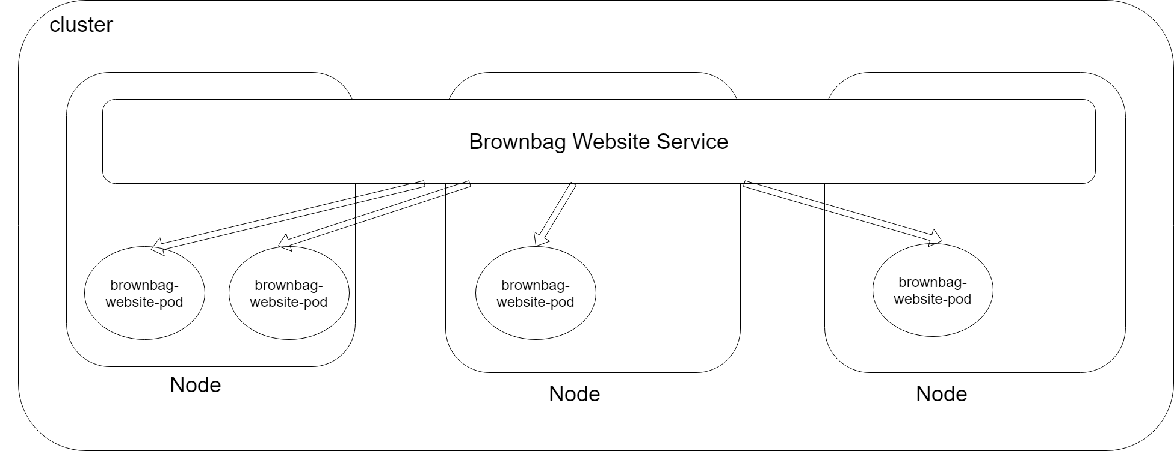

Slide 13
