Slide 1
House Price Predictions with XGBoost and Stacked Ensembling

Slide 2
Motivations
Location, location, location
Experience living near an airport
Feature engineering based on distance to airport, freeway, and city centers.
Exploration of new algorithms
XGBoost
Stacked ensembling
Housing tech companies/opportunities
Project might be of interest when applying to companies like RentHop, Zillow, Redfin, etc.
Notes:
My project was on real estate price prediction based on a Kaggle King County house prices data set.
It’s common to hear the saying, “location, location, location” when it comes to real estate. I lived near an airport and lodged in places that are way too close to train stations and freeways so I wanted to see just how much location mattered. So, I chose this data mining task so I could engineer features such as the distance to SeaTac airport and the traveling duration and distance to Seattle’s city center.
In addition to feature engineering, I wanted to explore some new algorithms. XGBoost is a go-to tool in Kaggle competitions so I wanted to learn more about it and the foundations it’s built on. The other model I wanted to try was stacked ensembling. When I was learning about bagging, I noticed boosting, and then I saw stacking here and there on the websites I visited. So, I was interested given the power of other ensembling methods.
Lastly, there are a number of housing tech companies and traditional real estate companies that are trying to leverage such technology. This was very evident by the Zillow competition a year ago, which had a $1.2 million prize pool after continuously being sued by angry sellers. Given the amount of related companies in the region, it seemed like this project is a good addition to the portfolio.

Slide 3
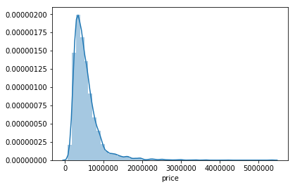
Problems to solve…
Metric:
What metric works best for this project?
Feature engineering
How to curate distance and duration data?
Did the features improve the model?
Models
What model works best?
Will predictions be fast enough for the internet user?
Is stacking as good as bagging and boosting?
Notes:
There were a few problems to solve.
The first was choosing the right metric for the job such as R², root mean squared error, and so on.
Then I had a couple questions about feature engineering. How do I bring in new valuable data for distances and durations? And now that I have these features, did it actually improve the model? Is it actually having an impact?
Also, when all models have been trained, what models work best? Was stacking as good as bagging and boosting which are more commonly mentioned in works on ensembles? Is the best predictor fast enough to be deployed as a web application when there is a 40% chance of website abandonment if a web page takes longer than 3 seconds to load?

Slide 4
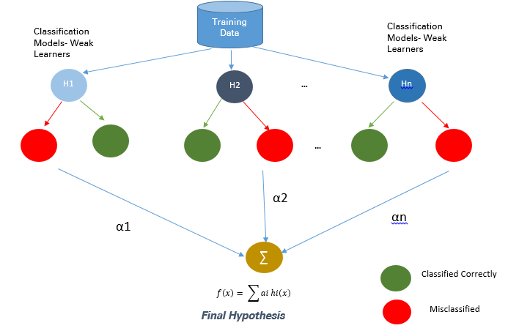
Methods
Feature engineering
Hand-labeled data
Metric:
Median absolute error, MAE
Eliminate overfitting
10-fold cross validation
Ensembling
Models:
Decision Trees
SVM
XGBoost
Stacked Regressor
Combination of first three models fed into the regressor
Example: Decision Tree + SVM -> Regressor -> Prediction
Source: Manjeet Singh https://medium.com/data-science-group-iitr/boosting-a0ab852754f2
Notes:
Features were engineered by labeling latitude and longitude across the i5 freeway and of city centers and airports. I sat down role-playing a dude driving up the i5 freeway from county limit to county limit. Labeling the freeway took a really long time. The airport and city center data was used with Google’s paid API for duration and distance of travel. The i5 freeway required the minimum of spherical distances since there were many points for the freeway.
To address the question of which metric to use, I examined the distribution of data and realized that many features were skewed right. There were a lot of houses around 300-750 thousand dollars but the price continued well up into the millions. As you may recall from statistics, median is usually the best way to find the average when a data set isn’t normally distributed. So, median absolute error, which takes the median of the absolute values of the errors, was chosen to be the metric for all comparisons and optimization in this project.
To address the concern of overfitting, I chose to use 10-fold cross validation and ensembling.
Cross validation is a process where the training data set is separated into k-amount of folds and then, starting from fold one to fold k, the model is trained upon the rest of the folds and this k^{th} fold is used for validation. This basically creates k number of models and the mean of median absolute errors for these models can be taken to get the average validation scores. CV was used to identify the best parameters for each machine learning algorithm and to identify the best models of all machine learning models. The process of training on different partitions of training data and comparing the model is what helps CV combat overfitting.
Ensembling kind of works like CV in theory and was also used to address overfitting concerns. I’ll cover this when I get to XGBoost.
The models used in this project were decision trees, support vector machines, XGBoost, and the three models fed into a stacked regressor. The decision tree is basically a tree that asks something like, “Are there more than 3 rooms”, and depending on the answer, it could either give an answer or ask another question over and over. The support vector machine, on the other hand, is an algorithm that tries to identify hyperplanes to identify boundaries between data, but uses something called a kernel trick to be able to create non-linear hyperplanes. These boundaries can basically decide the output.
Another algorithm used was XGBoost, which is based on decision trees and an ensembling method called boosting. Boosting trains a learner and when it’s weak, or misclassified as seen in the image to the right, it’s used with other weak learners to learn how to better generalize the data that was fed into them. If you’re confused, since data was differently sampled without replacement from the data set, this data is what it’s trying to focus on improving it’s generalization. So, it’s strong learners stay unchanged well its weak learners are trained to be stronger. XGBoost, which is based on boosting, uses an error optimization algorithm like gradient descent with regularization to improve the boosting algorithm, increasing speed and accuracy.
Finally, stacked ensemble regressors were created. This is a lot like the boosting chart to the right but it doesn’t use weak-strong learners built on samples of the training data. It’s a lot more simple in that it takes the outputs of multiple learners that the user decides and feeds it into some meta learner which in this case is just a linear regressor.

Slide 5
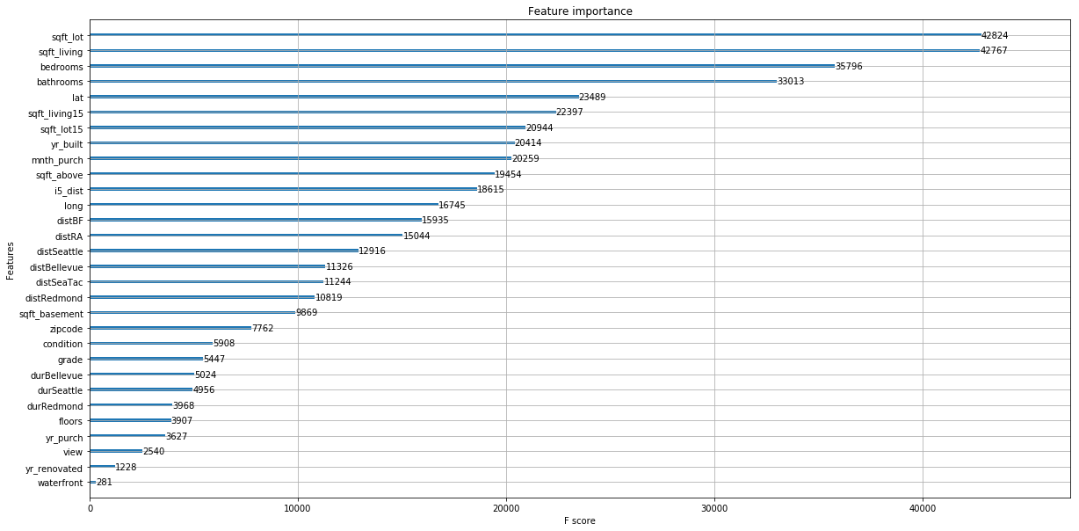
Results
Feature Engineering
New features improved MAE by $1,689.97 over base model/features.
Feature scores
#splits for distances just below median or higher
#splits for durations towards lowest quartile
Dropping features did not improve MAE (trees).
Notes:
The results of feature engineering was an improvement of MAE by about $1690 over the base XGBoost model and original features.
The feature scores show the significance of each feature by displaying the amount of splits in an XGBoost model. The results showed that the new distance features were around the median area of feature importance according to splits while durations were a bit lower. Dropping features made MAE scores worse.

Slide 6
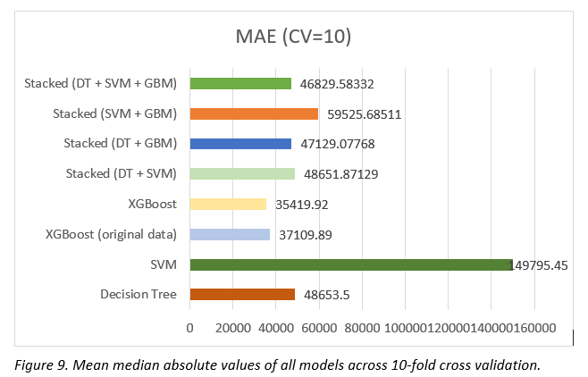
Results
Model performance
Stacked ensembles mostly performed worse
Surprising improvement for Decision Tree + SVM stacked ensemble
XGBoost best model overall
Training
Deeper boosted trees can take a very long time
Stacked ensembles must train all models involved and the meta learner
Prediction performance
XGBoost model makes predictions in 0.04 seconds (Intel 2600k)
Notes:
Model performance results showed that stacking performed worse than the base and best XGBoost model. That isn’t to say stacking is bad. I was pretty limited by the models that I was using in the stacking algorithm so it didn’t meet expectations in what I did. Also, the decision tree and SVM version performed a little bit better than the models that were used in them.
During training, trees obviously were the fasted while SVM and XGBoost took 5-10 minutes to train. The values varied as computational resources weren’t all available during training of all the models. Since the stacked ensembles train all models and their meta, regressor learner, it was the slowest of all the models.
In terms of web app ready algorithms, XGBoost is definitely something that can fill the shoes. It performs a single prediction in 0.04 seconds on my 6 year old computer with a 3.4GHz processor and 16GB of ram.

Slide 7
Conclusions
Stacked ensembling
Lots of overhead for little performance improvements.
Typically used in competitions but rarely in application.
XGBoost and boosted models
Amazing results with fast prediction times and slow training
Commonly used in practice and competition (XGBoost, LightGBM, etc.)
Available for GPU computing
Developed by Huskies
Notes:
There were a few takeaways from this project.
First, stacked ensembling has lots of overhead for little performance improvements. These improvements were rare in this project. Typically, though, it’s used in competitions and rarely used in industry.
Next, XGBoost and boosted models are amazing and so amazing that it’s used everywhere from customer interfacing applications to competitions. Training is slow but prediction times are fast and results can be top notch. The training part can is faster if you install the GPU version, which I didn’t do. To make it better, it was also developed by a few Huskies.

