Slide 1




RCM Cooperative
Monthly Meetups

Slide 2
Meeting Practice
Code of Conduct
Presentation and discussion will be recorded (discussion not published) - recording will be shared.
All links will be shared in zoom (slides, doc, form)
Add “w-” or “s-” in front of your zoom name to indicate your interaction preference
We’d love to see you, so please turn on your camera if you can - take a break if needed.
All questions are welcome through chat and by raising virtual hand (Zoom ✋)
You can take notes for future reference - we have shared notes. Please credit contributions!
Connect with each other others on RCM Cooperative slack
Notes:
Hello and welcome to RCM Coop Monthly Meetups!
We have a code of conduct, please have a look at from the link in the chat.
Our Code of Conduct sets out how we engage with each other, across the co-op and any spaces we facilitate.
We’re committed to a welcoming, harassment-free environment for everyone, and we take a restorative approach when things go wrong, focusing on repairing harm and rebuilding trust rather than punishment.
Concerns can be raised directly with our Directors, and all reports are handled with care and confidentiality.

Slide 3
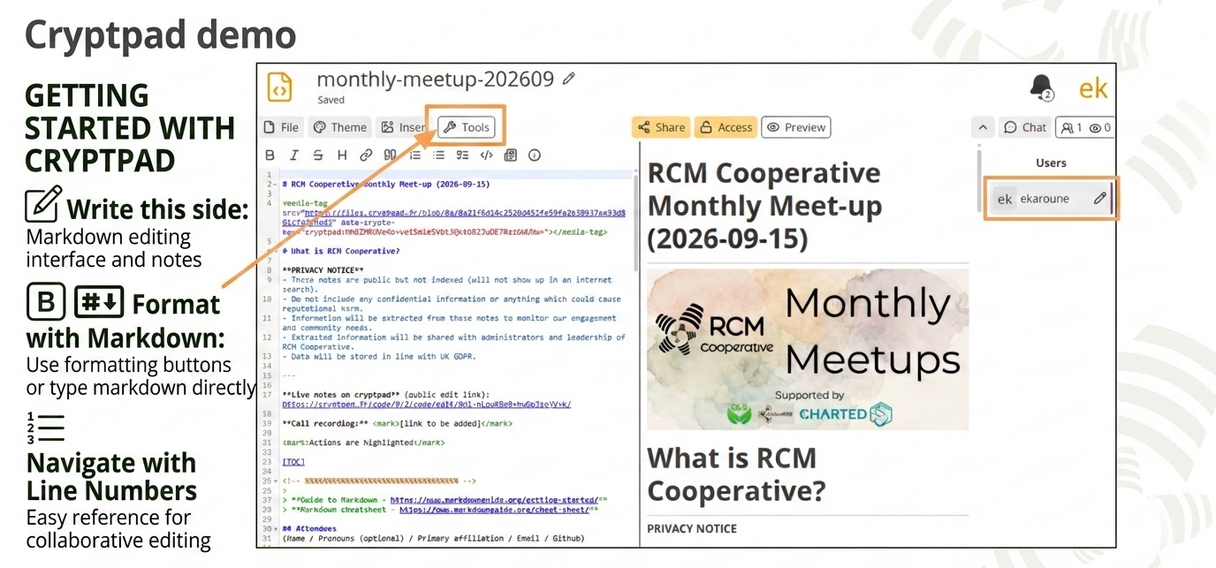

Slide 4



Learn about who’s here
Desk treasure hunt (2 mins)
Break out room (10 mins)
  Introduce yourself: Who you are and what you do
  Show and discuss your treasures!
Something [colour]
A [document]
Something [feature]
Notes:
Now we’d love to get to know who’s in the room!
We’re going to put you into small breakout rooms for a quick Treasure Hunt. 🔎
Once you’re in your groups, you’ll have two minutes to find three things:
something yellow — anything yellow — a book, and something natural.
Then the fun begins! Take a moment to introduce yourselves — who you are and what you do — and then show your group your treasures.
be mindful of everyone’s participation preferences: W for those who prefer to write their interactions, and S for those who prefer to speak.
Have fun with your Treasure Hunt, and we’ll see you back here in 10 minutes!

Slide 5

Thank you!
Feedback poll!
Suggest a monthly meetup topic!
[specific downstream impact of work in this session]
Notes:
What most interests you about the RCM Coop membership model?
Are the membership types feasible/workable? Is anything confusing about the model?
What benefits or incentives would be most valuable to you for being a community or core member?
We want them to say that there is a place for them in RCM coop
Note active: on the mailing list/slack
Active participation: Community Member
Want to do more: Core member

Slide 6
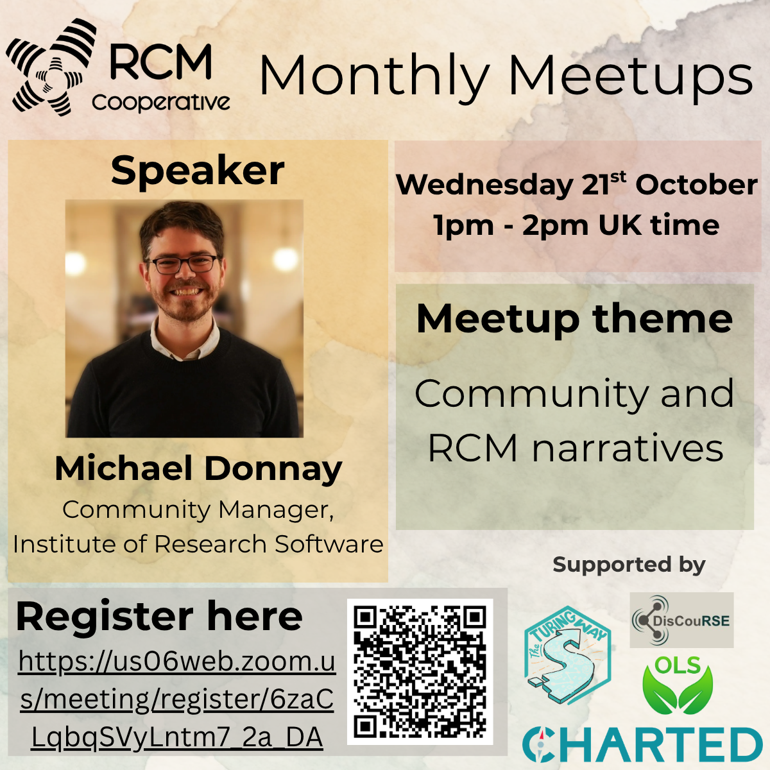
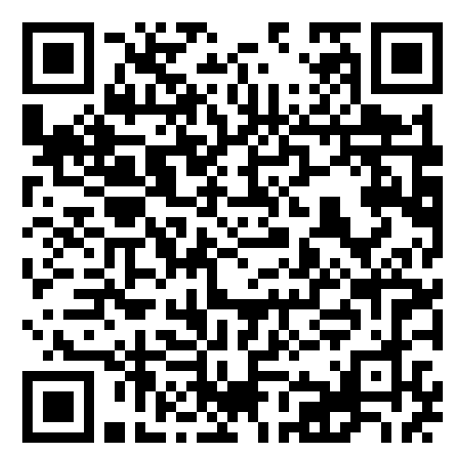
Next Monthly Meetup!
Register here
https://us06web.zoom.us/meeting/register/6zaCLqbqSVyLntm7_2a_DA

Slide 7

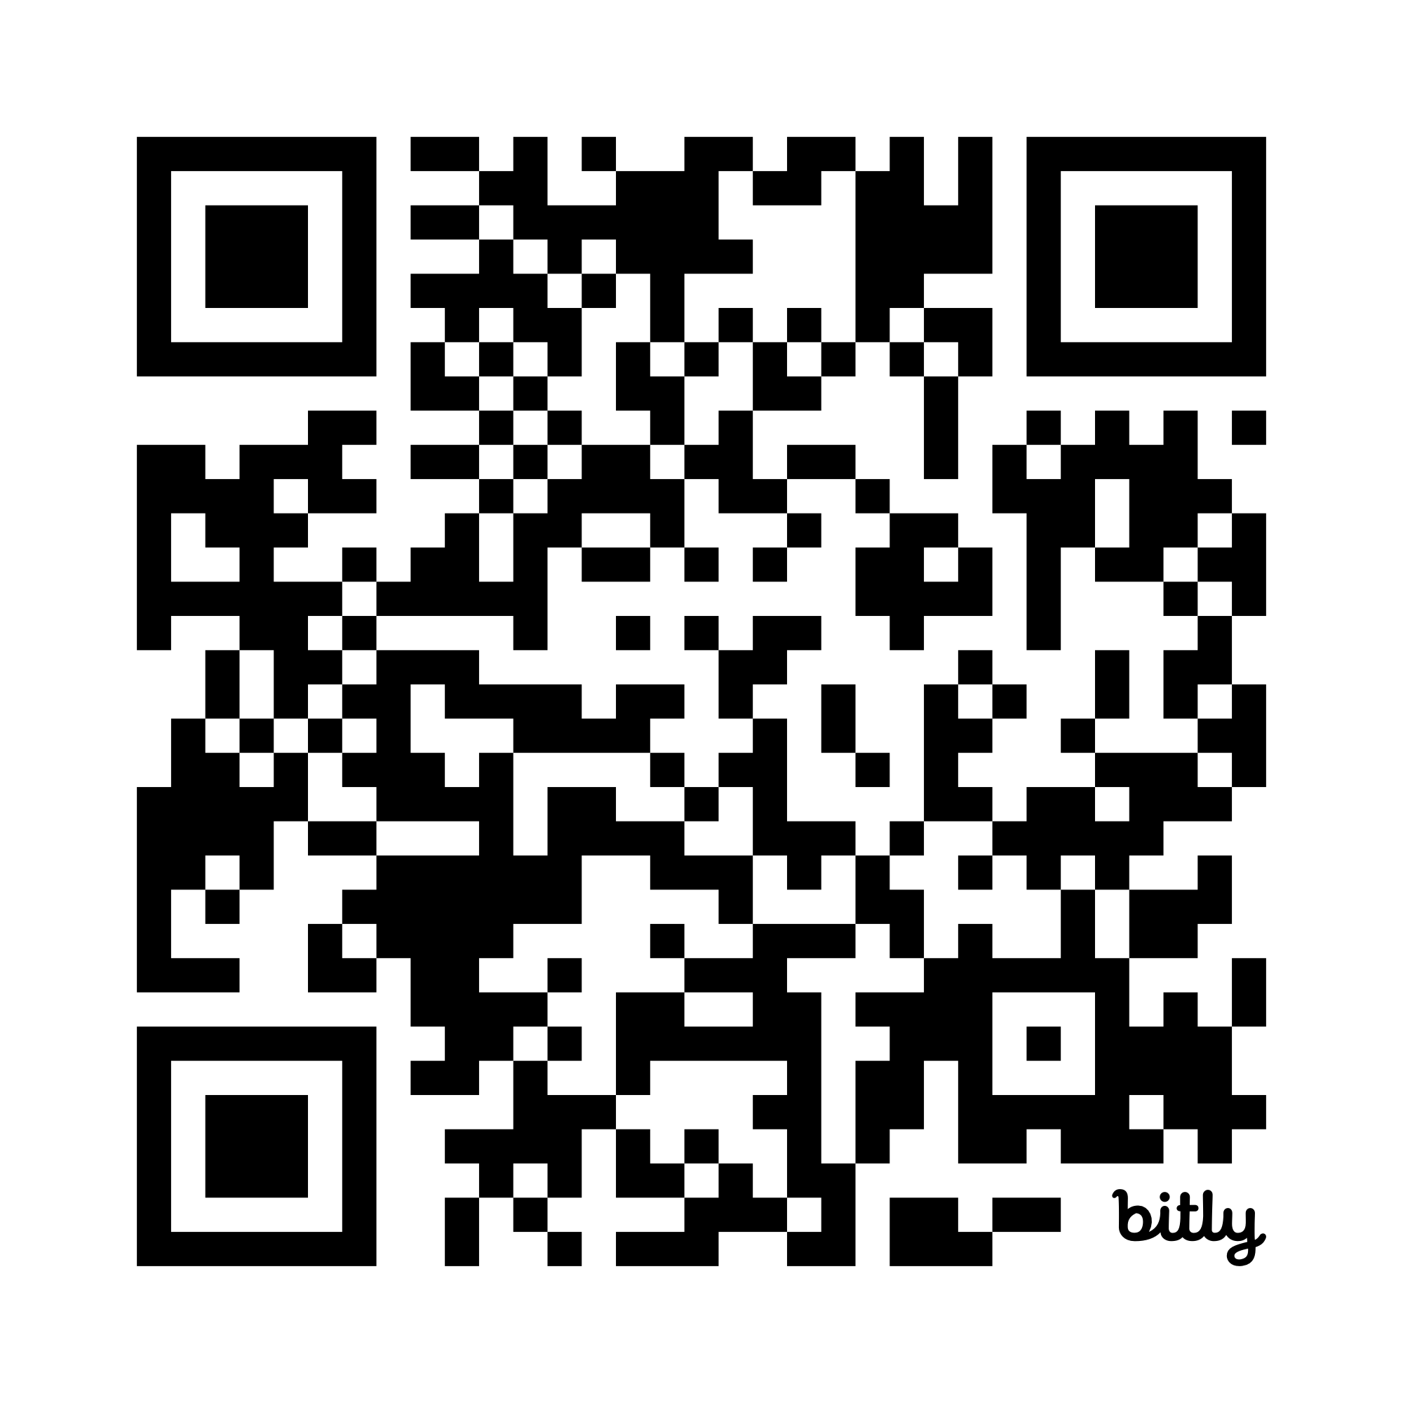
Get in touch
Website: https://www.rcmcooperative.com/
Join Slack: https://bit.ly/42z6snn
Emails:
  cassandra.gouldvanpraag@rcmcooperative.com
  emma.karoune@rcmcooperative.com
Monthly Meetup September 2026 | 10.5281/zenodo.22747725 | CC-BY-4.0

