Slide 1
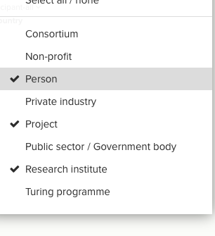





Slide 2


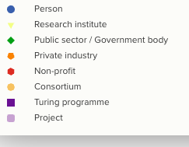






2079B4
FEF497
37A02D
FF7F07
E31A1C
FEBE6F
6A3D9A
CAB2D5
FFFFFF

Slide 3
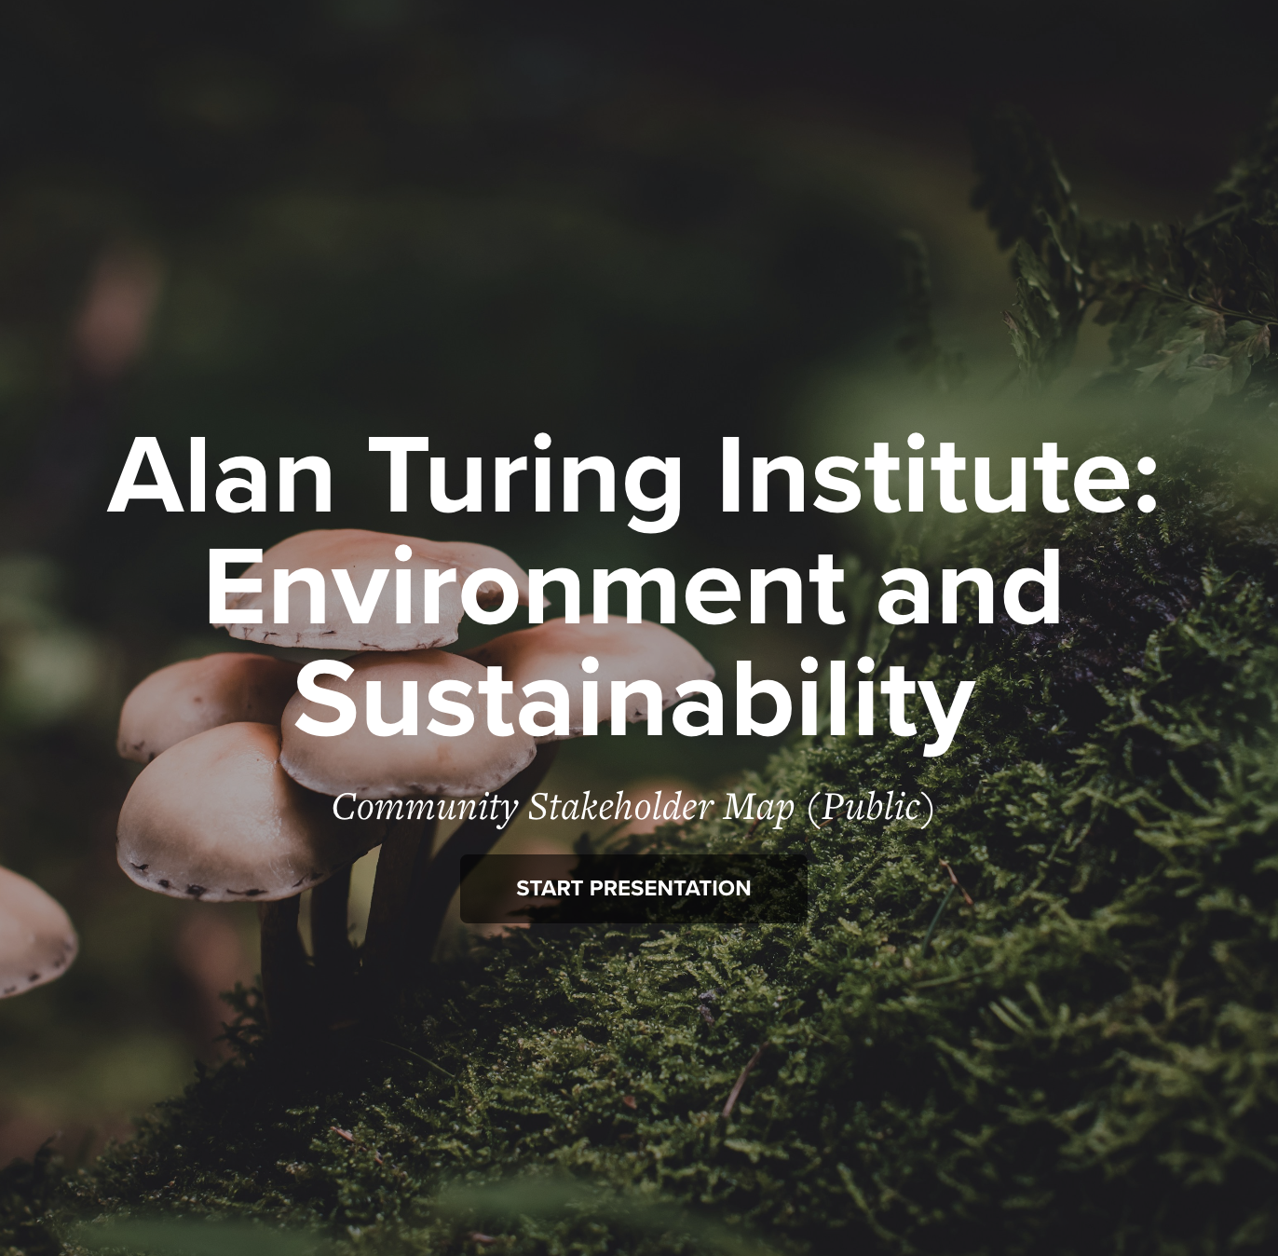
background-color: #F2F2F2;
37A02D
6A3D9A
FEBE6F
FF7F07
FEF497
2079B4
CAB2D5
E31A1C

Slide 4
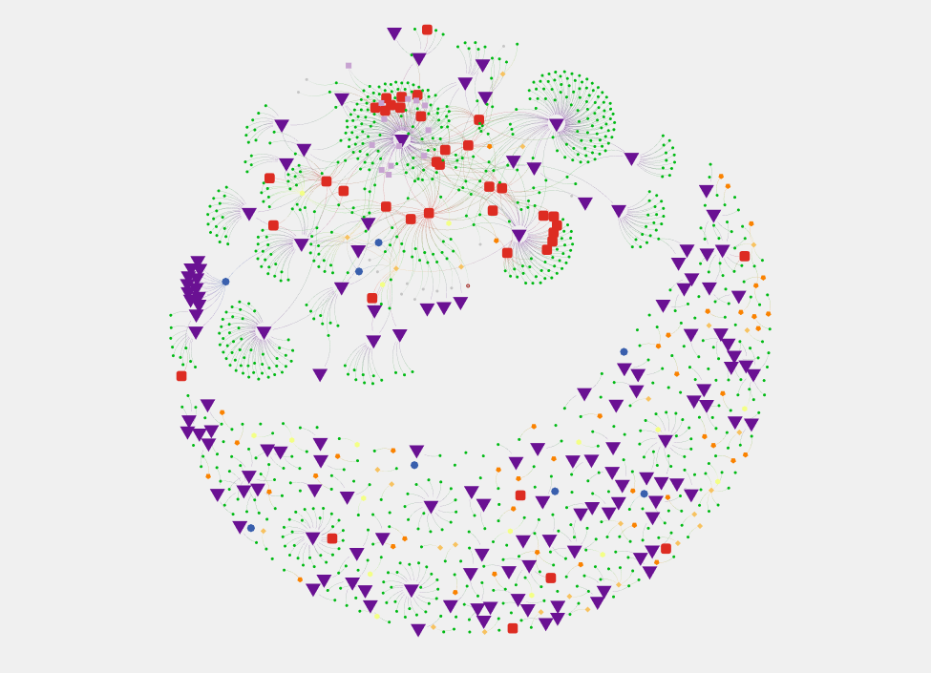

What does this community need?
Turing Team
Who are our Public Sector connections?
Is this you?!
Legend
Person
What work is happening here?
Research institute
Public Sector
Private industry
Non-profit
Consortium
Turing programme
What can we learn from this project?
Project

Slide 5
What does this community need?
Turing Team
Who are our Public Sector connections?
Is this you?!
Legend
Person
What work is happening here?
Research institute
Public Sector
Private industry
Non-profit
Consortium
Turing programme
What can we learn from this project?
Project

Slide 6
What does this community need?
Turing Team
Who are our Public Sector connections?
How can we engage these people?
Legend
Person
What work is happening here?
Research institute
Public Sector
Private industry
Non-profit
Consortium
Turing programme
What can we learn from this project?
Project

Slide 7
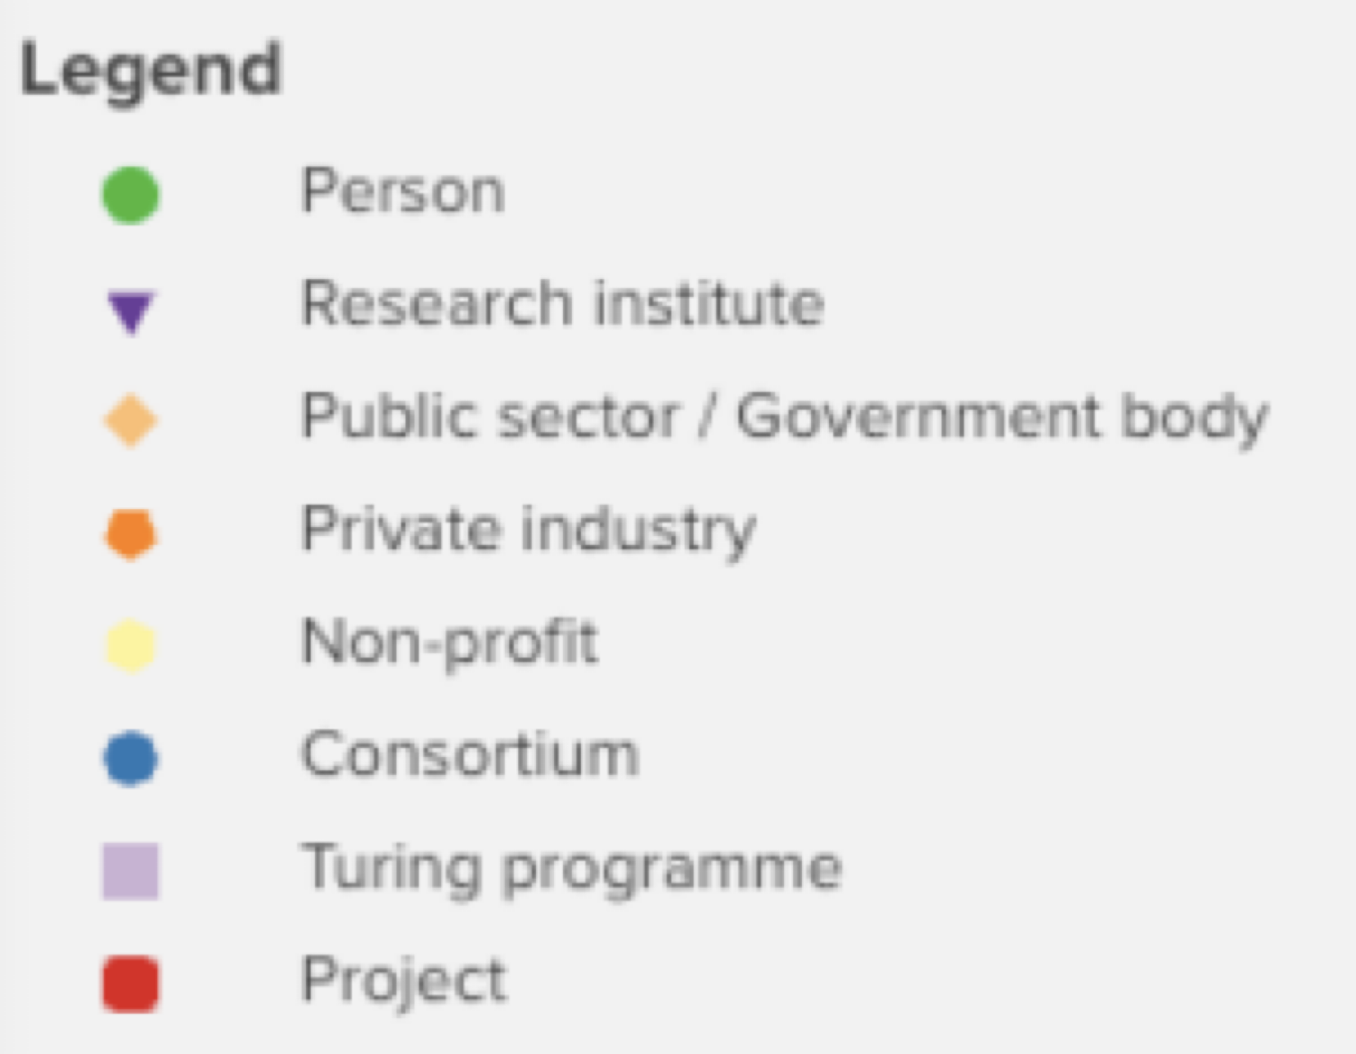
Legend
Person
Research institute
Public Sector
Private industry
Non-profit
Consortium
Turing programme
Legend
Person
Research institute
Public Sector
Private industry
Project
Non-profit
Consortium
Turing programme
Project

Slide 8
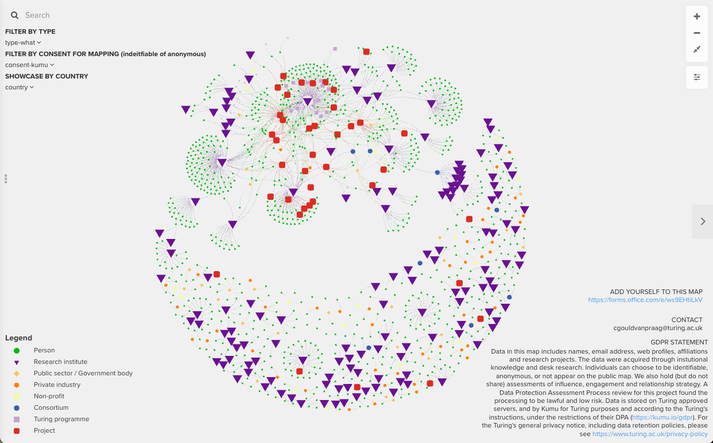
search
zoom
filter and showcase
next slide
show descriptions and metadata
GDPR

