Slide 1
LuLuLemon
Financial Forecasts & Analysis

Slide 2
Agenda
Income Statement Drivers & Assumptions
Income Statement
Balance Sheet Drivers & Assumptions
Balance Sheet
Supporting Schedules (Depreciation & Debt)
Statement of Cash Flows
Financial Ratios (Historical & Projected)

Slide 3
Historical Income Statement
 | 2023 | 2024 | 2025
Revenue | 9.6 | 10.6 | 11.1
COGS | 4.0 | 4.3 | 4.8
Gross Profit | 5.6 | 6.3 | 6.3
Operating Exp. | 3.5 | 3.8 | 4.1
EBIT (Operating Income) | 2.1 | 2.5 | 2.2
Net Income | 1.6 | 1.8 | 1.6

Slide 4
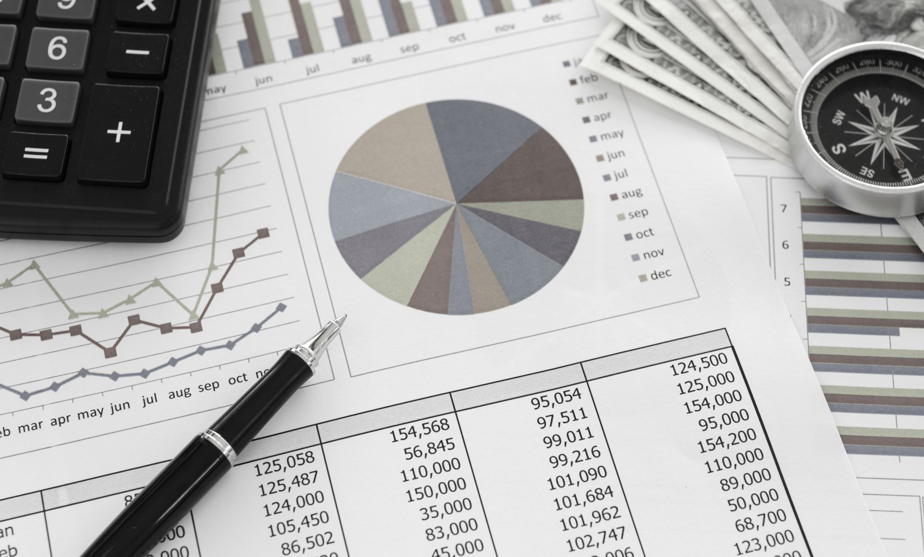
Revenue Drivers & Assumptions
Revenue Drivers & Assumptions
Revenue projected to grow 6–8% annually over the forecast period
Aligned with recent company guidance and moderating growth trends
Key Drivers
Continued international expansion
New store openings and product innovation
Strong brand positioning and pricing power
Key Risks
Slowing demand in North America
Increasing competition within the athleisure market
Potential margin pressure from promotions and costs

Slide 5

Income Statement Assumptions
Income Statement Assumptions
COGS: ~43–45% of revenue
Reflects stable gross margin in the mid-50% range
Operating Expenses:
Grow in line with revenue
Driven by marketing, store expansion, and digital investment
Tax Rate: ~30%
Consistent with historical levels
Interest Expense:
Assumed stable over forecast period

Slide 6
Projected Income Statement
($ in billions) |  | 2026 | 2027 | 2028
Revenue |  | $11.8 | $12.6 | $13.5
COGS |  | $5.3 | $5.6 | $6.0
Gross Profit |  | $6.5 | $7.0 | $7.5
Operating Exp. |  | $4.3 | $4.6 | $5.0
EBIT |  | $2.3 | $2.4 | $2.5
Net Income |  | $1.6 | $1.7 | $1.8

Slide 7
Projected Income Statement
Revenue growth remains steady but moderates vs. prior years
Margins slightly pressured short-term, then stabilize
Net income grows consistently with revenue

Slide 8
Historical Balance Sheet (In $ Millions)
Item | 2023 | 2024 | 2025
Assets
Cash & Cash Equivalents | $1,155 | $2,244 | $1,984
Accounts Receivable | $133 | $125 | $120
Inventories | $1,447 | $1,324 | $1,442
Other Current Assets | $424 | $368 | $434
Total Current Assets | $3,159 | $4,061 | $3,980
ROU lease Assets | $969 | $1,266 | $1,416
Plant, Property & Equipment | $1,270 | $1,546 | $1,781
Other Non-Current Assets | $210 | $219 | $426
Total Assets | $5,607 | $7,092 | $7,603
Liabilities
Accounts Payable | $173 | $348 | $271
Current Lease Liabilities | $208 | $249 | $275
Accrued & Other Current Liabilities | $1,111 | $1,034 | $1,094
Total Current Liabilities | $1,492 | $1,631 | $1,840
Non-Current Lease Liabilities | $862 | $1,154 | $1,301
Other Non-Current Liabilities | $104 | $75 | $139
Total Liabilities | $2,458 | $2,860 | $3,279
Common Stock & APIC | $475 | $576 | $639
Retained Earnings | $2,926 | $3,920 | $4,109
Accumulated Other Comp. Loss | ($252) | ($264) | ($424)
Total Liabilities & Equity | $5,607 | $7,092 | $7,603

Slide 9
Projected Balance Sheet (In $ Millions)
Item | 2026E | 2027E | 2028E
Assets
Cash & Cash Equivalents | $2,129 | $2,593 | $2,851
Accounts Receivable | $132 | $145 | $160
Inventories | $1,586 | $1,745 | $1,919
Other Current Assets | $444 | $489 | $520
Total Current Assets | $4,292 | $4,973 | $5,450
ROU lease Assets | $1,717 | $2,001 | $2,379
Plant, Property & Equipment | $2,110 | $2,465 | $2,900
Other Non-Current Assets | $469 | $515 | $567
Total Assets | $8,587 | $9,954 | $11,297
Liabilities
Accounts Payable | $304 | $340 | $381
Current Lease Liabilities | $316 | $357 | $407
Accrued & Other Current Liabilities | $1,203 | $1,324 | $1,456
Total Current Liabilities | $1,823 | $2,021 | $2,243
Non-Current Lease Liabilities | $1,604 | $1,893 | $2,285
Other Non-Current Liabilities | $153 | $168 | $185
Total Liabilities | $3,580 | $4,082 | $4,713
Common Stock & APIC | $652 | $665 | $678
Retained Earnings | $4,805 | $5,687 | $6,405
Accumulated Other Comp. Loss | ($450) | ($480) | ($500)
Total Liabilities & Equity | $8,587 | $9,954 | $11,297

Slide 10
Asset Drivers & Projection Assumptions
Cash & Cash Equivalents:
Cash grows from $1.98B to $2.85B because Lululemon’s high operational margins exceed its capital requirements. The upward trend proves the company is a is fully self-funded.
Accounts Receivable (A/R):
DSO (Days sales outstanding) : Constant 4-5 day Days Sales Outstanding because most customers pay immediately via credit card or cash at the point of sale.
Projected to grow at a steady rate annually to match the Revenue growth. Because Lululemon is a Direct-to-Consumer brand, the balance remains low as most cash is collected at the point of sale.
Inventories:
Driven by a steady 10-15% annual growth.
This growth is necessary to provide Safety Stock for the new stores projected in the PP&E line. It ensures the company maintains its Inventory Turnover efficiency while expanding into new global markets.
DIO (Days Inventory Outstanding): We measured it to be around 110 – 115 because it ensures enough safety stock" is available without creating a massive surplus that leads to markdowns.
ROU Lease Assets & PP&E:
Aggressive growth around 18-20% in 2026E, tapering slightly.
Justified by Lululemon’s International Expansion strategy. The increase in ROU Assets and PP&E supports the plan to quadruple international revenue by opening flagship stores in high-traffic hubs like China.

Slide 11
Liabilities and Equity Drivers & Projection Assumptions
Accounts Payable (A/P):
Growing at around 12% annually.
We projected A/P to grow slightly faster than Inventory.
DPO (Days Payables Outstanding): We projected this to be around 20 – 23 days because this reflects stable relationships with its Tier 1 manufacturers.
Lease Liabilities (Current & Non-Current):
Direct correlation with ROU Assets
Justification: These represent the present value of future rent obligations. As the store count increases, the liability grows to reflect the legal commitment to those new lease contracts.
Common Stock & APIC:
Stable, organic growth of around $13M annually.
This assumes no major dilution. The small annual increase represents Stock-Based Compensation for employees.
Retained Earnings:
Retained Earnings is the primary equity driver, and it is consistent with teammate's Income Statement.
Every year, we added the projected Net Income ($1.6B, $1.7B, $1.8B) and subtracted a $900M share buyback. This reflects Lululemon's strategy of reinvesting nearly 50% of its profits directly back into the company's equity base while returning the rest to shareholders by buybacks.

Slide 12
Depreciation Schedule
$ in millions | Straight-line method | D&A assumed at ~4% of Revenue
Item | 2025A | 2026E | 2027E | 2028E
Revenue (ref) | $11,100 | $11,800 | $12,600 | $13,500
D&A Rate (% Rev) | 4.0% | 4.0% | 4.0% | 4.0%
D&A Expense | $444 | $472 | $504 | $540
Net PP&E (Beginning) | $1,546 | $1,781 | $2,110 | $2,465
Capital Expenditures | — | $801 | $859 | $975
Less: D&A | — | ($472) | ($504) | ($540)
Net PP&E (Ending) | $1,781 | $2,110 | $2,465 | $2,900
No Debt Lululemon carries zero traditional long-term debt
~4% D&A Rate Consistent with Lululemon's historical depreciation patterns
Straight-Line Straight-line method applied across all PP&E uniformly

Slide 13
Debt Schedule
$ in millions | Lululemon carries zero traditional long-term debt — obligations are lease liabilities
No Traditional Debt — Lululemon operates with a debt-free balance sheet. All financing obligations are operating and finance lease liabilities arising from retail store and distribution center leases.
Item | 2025A | 2026E | 2027E | 2028E
Current Lease Liabilities | $275 | $316 | $357 | $407
Non-Current Lease Liabilities | $1,301 | $1,604 | $1,893 | $2,285
Total Lease Obligations | $1,576 | $1,920 | $2,250 | $2,692
Net Change in Obligations | — | +$344 | +$330 | +$442
Traditional Long-Term Debt | $0 | $0 | $0 | $0
Interest Expense (Debt) | $0 | $0 | $0 | $0
Debt-Free No principal repayments or interest charges on traditional debt
Lease Growth Lease obligations grow as Lululemon expands its global store footprint
Lease Interest Implicit lease interest is embedded in ROU asset amortization

Slide 14
Item | 2026E | 2027E | 2028E
Operating Activities
Net Income | $1,600 | $1,700 | $1,800
D&A Add-Back | $472 | $504 | $540
Δ Accounts Receivable | ($12) | ($13) | ($15)
Δ Inventories | ($144) | ($159) | ($174)
Δ Accounts Payable | $33 | $36 | $41
Δ Accrued & Other Liabilities | $99 | $76 | $101
CFO Total | $2,048 | $2,144 | $2,293
Investing Activities
Capital Expenditures | ($801) | ($859) | ($975)
Δ Other Non-Current Assets | ($43) | ($46) | ($52)
CFI Total | ($844) | ($905) | ($1,027)
Financing Activities
Stock Issuance (APIC) | $13 | $13 | $13
Net New Lease Obligations | $344 | $330 | $442
Δ Other Non-Current Liab | $14 | $15 | $17
Share Repurchases | ($1,430) | ($1,133) | ($1,480)
CFF Total | ($1,059) | ($775) | ($1,008)
Net Change in Cash ✓ ties to BS | +$145 | +$464 | +$258
Statement of Cash Flows
$ in millions | 2026E–2028E | Net change in cash ties to projected Balance Sheet

Slide 15
Historical Financial Ratios
2023 – 2025 | $ in millions | Computed from Income Statement & Balance Sheet
Ratio
Category
2023
2024
2025
Avg Gross Margin
Gross Profit Margin
Profitability
58.3%
59.4%
56.8%
~58%
Net Profit Margin
Profitability
16.7%
17.0%
14.4%
3-year average
Return on Assets (ROA)
Profitability
28.5%
25.4%
21.0%
Peak ROE
Return on Equity (ROE)
Profitability
50.8%
42.5%
37.0%
50.8%
Asset Turnover
Efficiency
1.71x
1.49x
1.46x
2023 — equity expanding
Days Inventory Out. (DIO)
Efficiency
132.0
112.4
109.7
Days Sales Out. (DSO)
Efficiency
5.1
4.3
3.9
DSO
4–5 days
Days Payable Out. (DPO)
Efficiency
15.8
29.5
20.6
Current Ratio
Liquidity
2.12x
2.49x
2.16x
Direct-to-consumer
Quick Ratio
Liquidity
1.15x
1.68x
1.38x
Current Ratio
> 2.0x
Financial Leverage
Leverage
1.78x
1.68x
1.76x
Interest Coverage
Leverage
N/A
N/A
N/A
All three years

Slide 16
Projected Financial Ratios
2026E – 2028E | $ in millions | Derived from Projected Income Statement & Balance Sheet
Ratio
Category
2026E
2027E
2028E
Avg Gross Margin
Gross Profit Margin
Profitability
55.1%
55.6%
55.6%
~55.5%
Net Profit Margin
Profitability
13.6%
13.5%
13.3%
3-yr projected avg
Return on Assets (ROA)
Profitability
18.6%
17.1%
15.9%
Return on Equity (ROE)
Profitability
32.0%
29.0%
27.3%
ROE Range
27–32%
Asset Turnover
Efficiency
1.37x
1.27x
1.20x
Gradual compression
Days Inventory Out. (DIO)
Efficiency
109.2
113.7
116.7
Days Sales Out. (DSO)
Efficiency
4.1
4.2
4.3
Current Ratio
> 2.3x
Days Payable Out. (DPO)
Efficiency
20.9
22.2
23.2
Current Ratio
Liquidity
2.35x
2.46x
2.43x
Sustained strong liquidity
Quick Ratio
Liquidity
1.48x
1.60x
1.57x
Long-Term Debt
Zero
Financial Leverage
Leverage
1.71x
1.70x
1.72x
Interest Coverage
Leverage
N/A
N/A
N/A
No traditional debt

Slide 17
Ratio Analysis
Key takeaways across profitability, efficiency, liquidity, and leverage
Profitability
Efficiency
Gross margin ~58% historically — among the highest in specialty retail
Net margin declining 16.7% (2023) → 13.3% (2028E) as opex grows with global expansion
ROE compressing 50.8% → 27.3% as equity base grows faster via retained earnings
ROA declining 28.5% → 15.9% reflecting heavy asset investment in international stores
DSO 4–5 days — near-zero, driven by the direct-to-consumer card-at-point-of-sale model
DIO improving 132 → ~110 days, reflecting stronger inventory management over time
DPO stabilizing 20–23 days — healthy supplier relationships without over-stretching payables
Asset turnover declining as the asset base grows faster than revenue in expansion phase
Liquidity
Leverage
Current ratio consistently above 2.0x — strong ability to meet near-term obligations
Quick ratio above 1.3x even after excluding inventory, confirming robust liquid position
Cash growing $1.15B (2023) → $2.85B (2028E), fully self-funded from operations
No reliance on short-term debt — operating cash flows comfortably exceed capex needs
Zero traditional long-term debt — interest coverage ratio is not applicable
Financial leverage ~1.7x driven entirely by operating lease liabilities, not financial debt
Lease obligations growing as store footprint expands internationally, especially in China
Conservative capital structure provides resilience and flexibility against macro downturns

Slide 18
Thank You

Slide 19

Questions?

Slide 20
Sources
https://corporate.lululemon.com/~/media/Files/L/Lululemon/investors/annual-reports/lululemon-2024-annual-report.pdf
https://corporate.lululemon.com/investors/financial-information/annual-reports
https://corporate.lululemon.com/investors/financial-information/results-center
https://corporate.lululemon.com/investors
https://www.sec.gov/Archives/edgar/data/1397187/000139718724000010/lulu-20240128.htm

