Slide 1


Master of Advanced Studies Applied Information & Data Science
Project 2: AI audit for health network
From Data to Solutions
ETH Zürich · 16. July 2026
Dimitrios Dekas, Ana Sofia Luna

Slide 2
Agenda
What we have learned
1
Motivation
Project scenario
2
Task
3
Final Hand in
4
MAS AID · ETH Zürich
TT. Monat 2026
2

Slide 3
01
What you have learned

Slide 4
What you have learned
LIME
Logit lens
For local explanations
why did the model score this one patient the way it did
Takes the model's hidden state at an intermediate layer and answers what concepts lead to the decision
SHAP
Spare auto encoder
For global explanations
what does the model rely on across hundreds of patients, on average.
Re-expresses a vector as a much larger but sparse set of features

Slide 5
02
Motivation

Slide 6

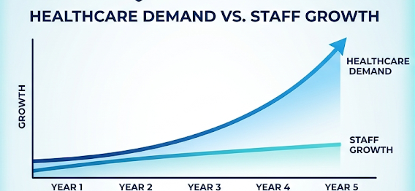
Future-Driven Diagnostics faces a problem
Problem
Slower appointment time: patients are available months in advance
Slower analysis results: Results of tests and analysis are taking longer and can but patients at risk
Doctors and nurses are overworked

Slide 7
Observations made from the hospital
MOTIVATION · Observations
The hospital detected 5 of the most commons reasons and procedure people seek medical attention. The hospital has accumulated seven AI systems:
cardiovascular risk score
hospital-readmission predictor
stroke triage flag
chest X-ray reader
skin-lesion screener
Breast-ultrasound screener
Colon-histopathology classifier
LLM-based clinical assistant
Improvement
Help diagnose patients quicker: Giving patients results quicker
Doctors will be able to attend more people overall

Slide 8
Audit consultant
MOTIVATION · Audit
Model | Metric | Performance Score
Cardiovascular Risk Score | Cardiovascular risk | 96.2%
Hospital-Readmission Predictor | Readmission predictor | 95.8%
Stroke Triage Flag | Stroke triage flag | 97.1%
Chest X-ray Reader | Chest x-ray reader | 96.5%
Skin-Lesion Screener | Skin-lesion screener | 95.5%
Breast-ultrasound screener | Ultrasound screener | 92.0%
Colon-histopathology classifier | histopathology classifier | 96.3%
New LLM-based Clinical Assistant | Clinical assistant | 97.3%
Every one of these systems reports strong accuracy. However no one has ever asked why they work.
Compliance won't let any of them near a real patient until someone can answer three questions for every single system
You are hired as an AI audit consultant to review the consistency of the models to send them into production.
What is it using to make these decisions?
Does this hold up or is it a shortcut that happens to correlate to the right answer?
How do we know the explanation is trustworthy?

Slide 9
03
Your task
7

Slide 10
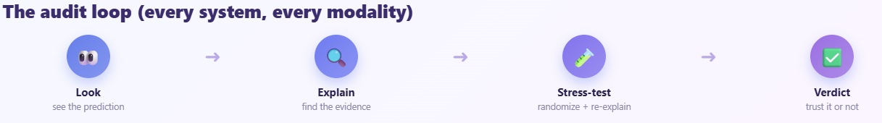
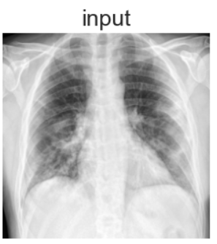
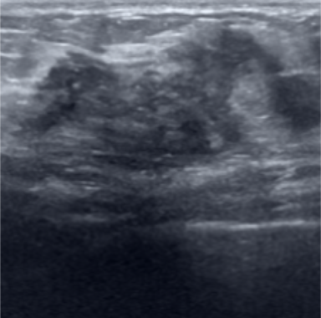
Goal
Audit report
time_in_hospital | num_lab_procedures | num_procedures | num_medications | number_outpatient | number_emergency | number_inpatient | number_diagnoses
0 | -0.13 | 2.03 | 0.97 | 1.35 | -0.29 | -0.21 | 4.23
1 | 0.87 | 0.45 | -0.79 | 1.72 | -0.29 | -0.21 | -0.50
2 | 0.87 | 1.37 | -0.20 | -0.50 | -0.29 | -0.21 | -0.50
3 | 0.87 | -1.02 | -0.20 | -0.00 | -0.29 | -0.21 | -0.50
4 | 2.55 | 1.52 | 2.14 | 2.70 | -0.29 | -0.21 | 1.08
MAS AID · ETH Zürich
TT. Monat 2026
8

Slide 11
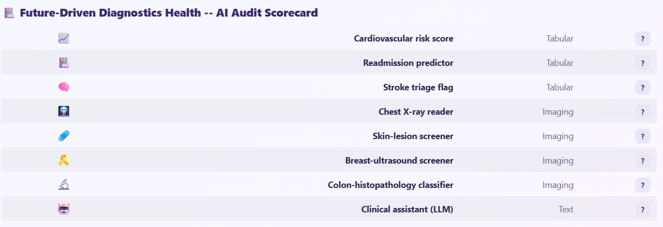
Hand in
Audit report
Guideline notebook for you to add your verdict
Create a small report with your observations and fill the final scorecard as 'Trustworthy', 'Caveats', or 'Not ready’ and answer the guideline questions
MAS AID · ETH Zürich
TT. Monat 2026
8

