Slide 1
Initial simulation

Slide 2

Demand generation
Demand:
Demand nodes
Uniformly distributed between in unit square
Can calculate the distances/travel times between pairs of nodes
Each demand node has Poisson arrival process with rate uniformly random between 0 and 1
Nurses have random starting locations
System starts “cold”
Much more to be done here
0.8 per hour
0.5 per hour
0.2 per hour

Slide 3
Routing logic
Nurse available?
yes
Routing:
Each customer is served in order they arrive
Served by the nearest nurse
If there are no nurses available the customer is served by the next nurse that comes available
Pick nurse
-nearest
Wait for nurse
No
Serve customer
-update all necessary states
Wait for cust
Demand generation

Slide 4
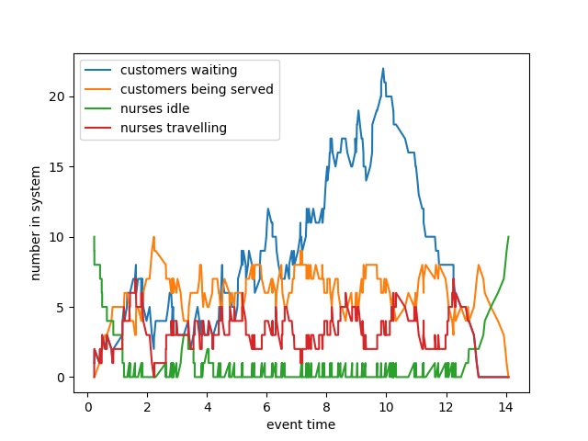
Time varying metrics

Slide 5
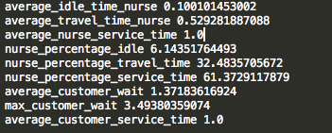
Aggregate metrics
Aggregate metrics:
Average time/percentage nurse is idle
Average time/percentage nurse is travelling
Average time/percentage nurse is serving customers
Average wait time customer
Max wait time customer
Average service time customer
What else?

Slide 6
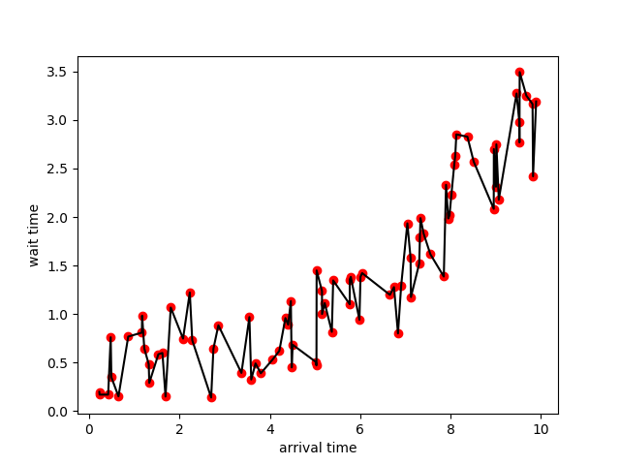
Simulation model

Slide 7
Next steps
Demand generation
Incorporate geodata (demand nodes should be located in zip code)
Data driven demand (according to minute clinic data)
Varying arrivals:
Time
Area
Routing
Incorporate travel time data (from google API)
Better routing rules than nearest/next available nurse
Variability in service time and travel time
Reporting
Improve visualizations
Include map/ real time simulation
Other ideas?

Slide 8
Key parameters
Number of nurses
Length of time horizon for simulation
Number of demand nodes
Service time
Travel time

Slide 9
Architecture
Main simulation
Demand generation
Routing functions
Reporting functions
randomly_generate_uniform_demand_nodes
dispatch_nurse
time_varying_system_
metrics
find_nearest_nurse
generate_customers
serve_customer
aggregate_system_metrics
generate_nurses

Slide 10
Objects
Customer: Attributes: id_number: (integer) An id representing the customer. location: (integer) An integer representing the discrete demand node a customer arrives at arrival_time: (float) The time the customer requests service service_time: (float) How long the customer will take to be served (constant for now) wait_time: (float) How long did the customer wait? time_nurse_arrival: (float) Time the nurse arrives time_finish_service: (float) Time customer finishes service
Nurse
Attributes: id_number: (integer) An id representing the nurse. location: (integer) Demand node a nurse is currently at (variable) busy: (boolean) whether the nurse is currently busy (variable) customer_finish_time: (float) what time will the current customer finish at? customers_served: (integer) How many customers has the nurse served? (variable) wait_time: (list of float) How long has the nurse wait for each customer? time_driving: (list of float) How long did the nurse drive for each customer? time_serving: (list of float) How long has the nurse serving each customer? dispatch_time: (list of float) When was nurse dispatched for current customer time_start_service: (list of float) When did nurse start serving current customer

Slide 11
Objects
Demand node: Attributes: id_number: (integer) An id representing the demand node (1...num_nodes) lon: (float) latitude of demand node lat: (float) longitude of demand node arrival_rate: (float) rate at which customers arrive to the node

