Slide 1

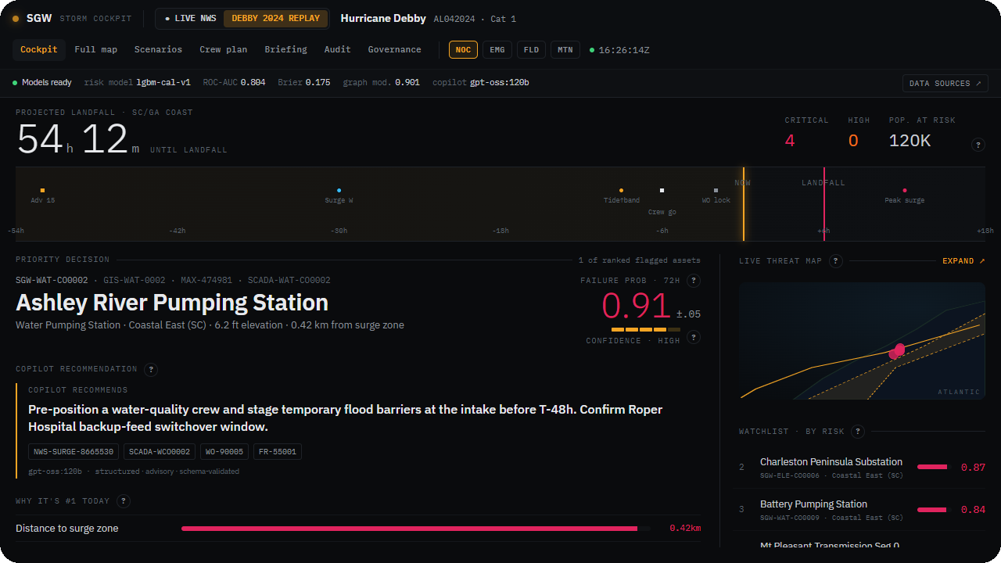
EXECUTIVE BRIEFING
Multi-Hazard Readiness & Response
AI-enabled decision support for severe-weather operations.
Copilot, never autopilot.
Live prototype · Hurricane Debby scenario
Prepared for SGW senior leadership · July 2026
Notes:
Frame the platform as decision support for severe-weather operations. It unifies fragmented data, applies the right model to each problem, explains every recommendation, and keeps a named person in command.

Slide 2




WHY NOW
Three pressures have made operational resilience a board-level issue
Rising event frequency
Scrutiny, not assurances
Your largest controllable spend
Hurricanes, floods, heatwaves and wildfires at rising frequency: 27 billion-dollar US disasters in 2024 — $182.7B in damages (NOAA).
Insurers and utility commissions now expect resilience they can see evidenced, not simply promised.
Unplanned outages, storm overtime and reactive maintenance are the biggest controllable costs.
SGW Multi-Hazard Readiness & Response
2

Slide 3

THE PROBLEM TODAY
During an event, the operational picture lives in the operator's memory, not in a system
FOUR SOURCES, FOUR TRUTHS
Four systems, no shared key
GIS systems
Maintenance platforms
GIS asset ID
work-order ID
Asset, maintenance, weather and field data sit in separate tools with different identifiers. The operator stitches them together by hand, one screen at a time.
Weather feeds
Field operations tools
geospatial, no asset ID
crew / roster ID
Slow, manual, and easy to get wrong under pressure.
Reconciled only in the operator's head
at exactly the moment minutes matter most.
SGW Multi-Hazard Readiness & Response
3

Slide 4






WHAT WE PROPOSE
One platform that unifies, predicts, explains and keeps your people in command
Unify
Predict
Explain
Decide
Fragmented systems become one operational picture.
The right model per problem: risk, forecast, anomalies, crews.
Plain-language recommendations with evidence and confidence.
A named person accepts, overrides or defers. Every choice logged.
Copilot, never autopilot. The platform never acts on its own. Every recommendation is advisory, and a named person stays in command.
SGW Multi-Hazard Readiness & Response
4

Slide 5

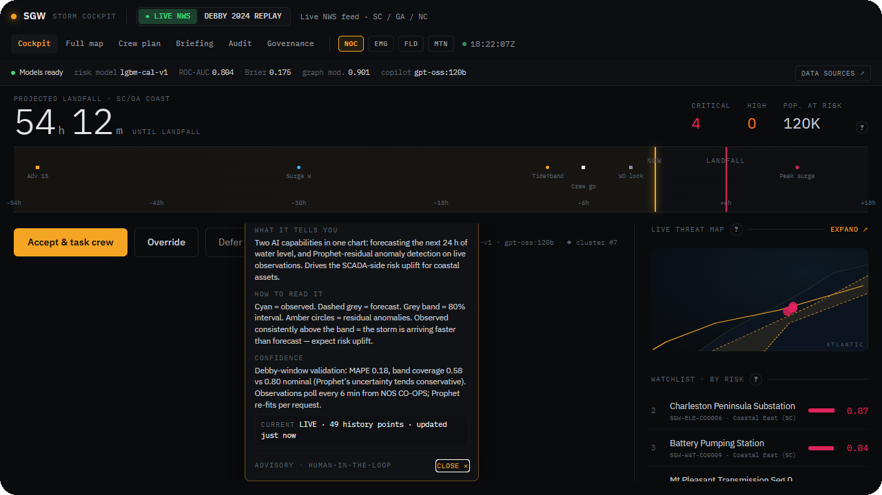
WHAT CHANGES ON THE GROUND
Before landfall, your teams act instead of assembling data
TODAY
WITH THE PLATFORM
Operational picture
slow, manual
one screen, fast
Preventative work
reactive
days of warning
Crew pre-positioning
ad hoc
optimised
Situation briefings
manual
instant
A prototype view: plain-language explanation with cited evidence.
Roles served: NOC controller · Field supervisor · Maintenance planner · Ops director
SGW Multi-Hazard Readiness & Response
5

Slide 6


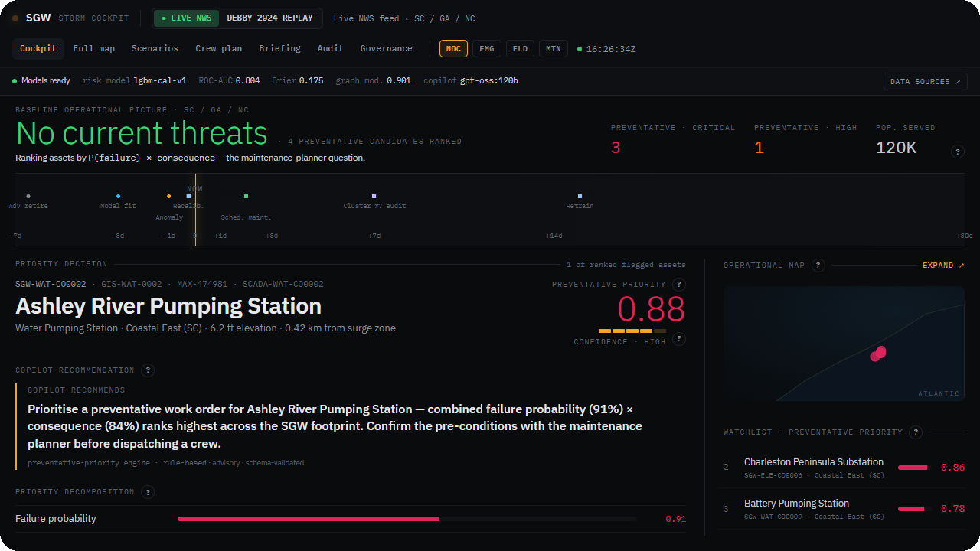
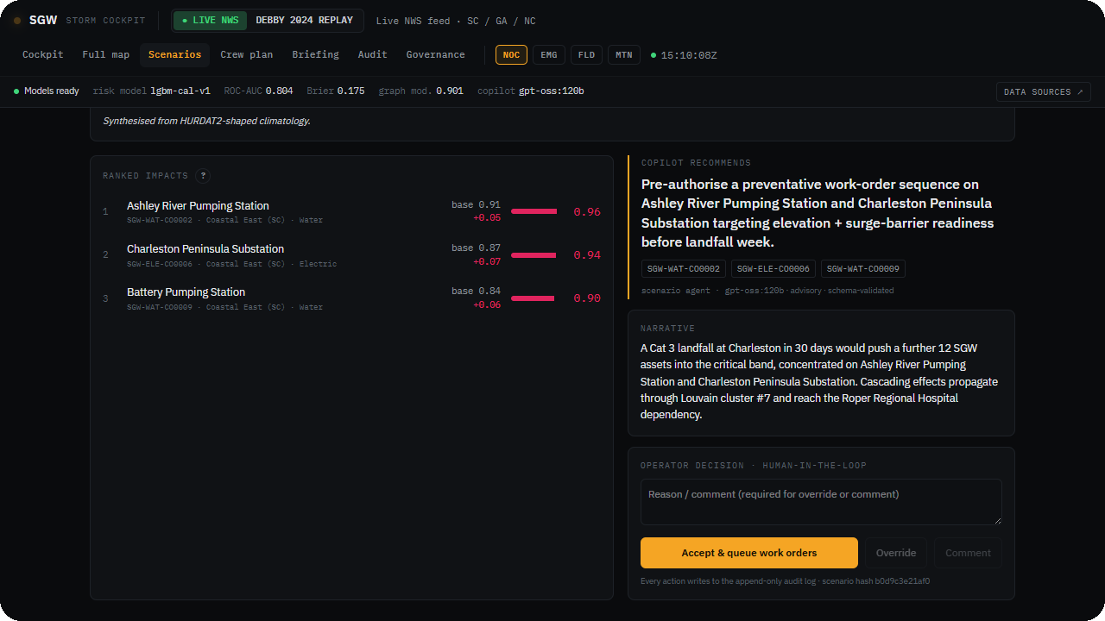
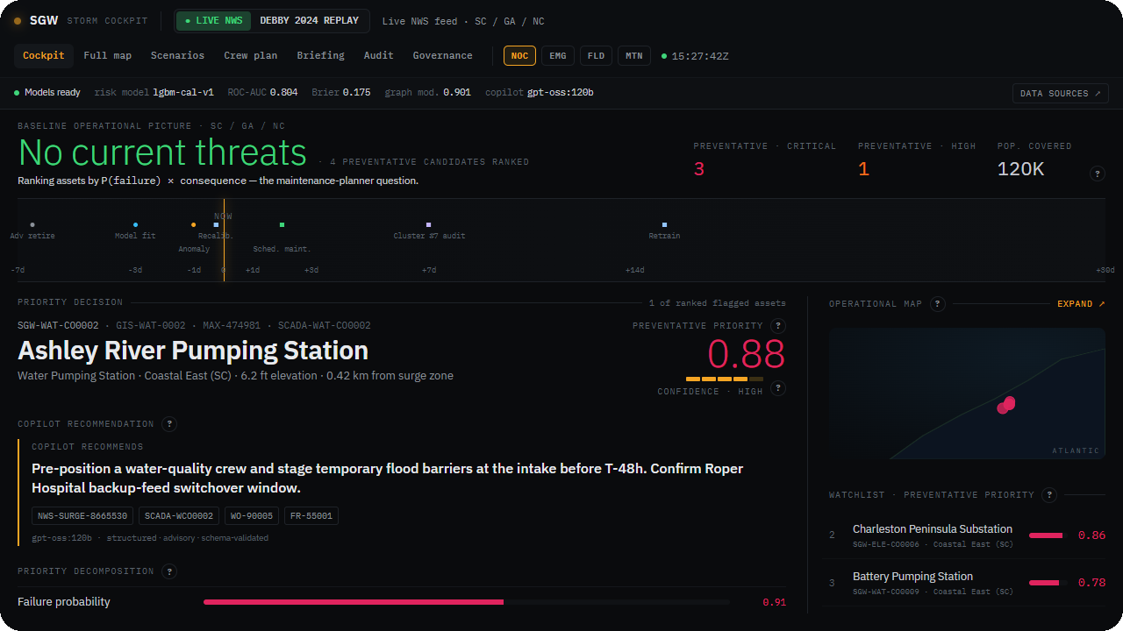
PROOF, NOT PROMISES
A working prototype, demonstrated end to end
Real-data replay
Live hazard alerts
Human in the loop
Cited model evidence
Operational cockpit
Cascading-impact analysis
Immutable audit log
Real weather data, human-in-the-loop decisions, and a complete audit trail.
SGW Multi-Hazard Readiness & Response
6

Slide 7

FINANCIAL IMPLICATIONS & ROI
Turn expensive emergency spend into cheaper planned spend
THE EVIDENCE BASE
THE PAYBACK LOGIC
Maintenance saving, predictive vs reactive ¹
Predictive maintenance saves 30–40% against reactive work (US DOE). One Florida utility filed ~$1.1B to recover the 2024 hurricane season — with ~70% of restoration cost in crew labour, the line this platform optimises. Shifting 10–15% of reactive spend to planned work offsets implementation within one season.
30–40%
Storm restoration cost spent on crew labour ²
~70%
Benefit per $1 invested in hazard mitigation ³
×6
We measure trust, not just usage
US economy-wide cost of weather outages / year ⁴
$18–33 billion
We track how often operators override the AI: enough to show the platform earns trust, not so little that it is followed blindly.
¹ US DOE FEMP, O&M Best Practices Guide (Rel. 3.0) — % of maintenance cost, vs a reactive baseline. ² UCS analysis of an FPL hurricane filing: ~$930M of ~$1.3B restoration cost.
³ NIBS, Natural Hazard Mitigation Saves, 2019 (FEMA-funded). ⁴ White House / US DOE, Economic Benefits of Increasing Electric Grid Resilience to Weather Outages, 2013 — 2003–12 average, inflation-adjusted.
The data layer delivers value before any AI runs, by resolving which system to believe.
SGW Multi-Hazard Readiness & Response
7

Slide 8

DELIVERY ROADMAP
Value by month six. Each phase funds confidence in the next
1
FIRST 6 MONTHS
2
MONTHS 6 TO 12
3
MONTHS 12 TO 18
Pre-event MVP
During-event triage
Post-event & full footprint
Run on SGW's real asset, maintenance and telemetry data
One-region pilot across all four hazards
Exit gate: warning lead time, override rate in band, reactive work shifted to planned
Live anomaly response and crew dispatch
Operator-approved work-order creation
Damage assessment from aerial imagery
Rollout across the full service area
SGW PROVIDES
Data access and a named steward, integration on the GIS and maintenance side, and change management for operators.
SGW Multi-Hazard Readiness & Response
8

Slide 9


GOVERNANCE & COMPLIANCE
Built to survive an audit, not just a demo
Human in the loop
Immutable audit log
Dispatch, shutdown and work orders are each confirmed by the right named role. The AI cannot accept its own recommendation.
Every recommendation and decision is written to an append-only, exportable record.
Model risk management
Bounded, reversible learning
Calibration, drift and fairness are monitored, with thresholds that trigger review.
The platform learns from operator decisions in a capped, visible and reversible way.
Aligned to NERC CIP, state PUC reporting, SOC 2 and the NIST AI Risk Management Framework. When the AI is wrong, any operator can override in one click.
SGW Multi-Hazard Readiness & Response
9

Slide 10

SCALABILITY
One platform. More regions, more domains, more workflows
Across regions
Across domains
Across workflows
Recalibrate per region. Adapters isolate the weather provider, so other countries are integration work, not a rebuild.
The same pattern moves from grid to water, wastewater and transport. Only the data changes.
One loop covers pre-event, during-event, post-event and routine maintenance.
Routine maintenance runs all year. The same engine works between storms, not only during them, so value continues outside storm season.
SGW Multi-Hazard Readiness & Response
10

Slide 11

RISKS & MITIGATIONS
What could go wrong, and what we've done about it
Data quality below assumption
Sparse rare-event history
Mitigation. A dedicated data-foundation workstream. The platform degrades gracefully with wider uncertainty and more human review. It never fails silently.
Mitigation. Demonstrated on a real hurricane replay. Forecasts carry uncertainty, and a person stays in the loop on every decision.
Operator adoption and trust
Model drift over time
Mitigation. An advisory posture with visible confidence and evidence. Override rates are tracked to confirm the platform earns trust.
Mitigation. Continuous monitoring of calibration, drift and fairness, with thresholds that trigger review.
SGW Multi-Hazard Readiness & Response
11

Slide 12
NEXT STEPS
A focused mobilisation to prove it on SGW's data
Copilot, never autopilot.
1
2
3
Data access and a steward
A short session with ops
An executive sponsor
So we can validate the approach on your real data.
To confirm the first workflow and region.
To lead change management with your operators.
Decision requested: approve a 6-month pre-event MVP mobilisation.
Prepared for SGW senior leadership · July 2026
Notes:
The decision requested is approval of a 6-month pre-event MVP mobilisation. The three cards are the low-commitment enablers we need to start: data access and a steward, a short ops session, and an executive sponsor.

