Slide 1
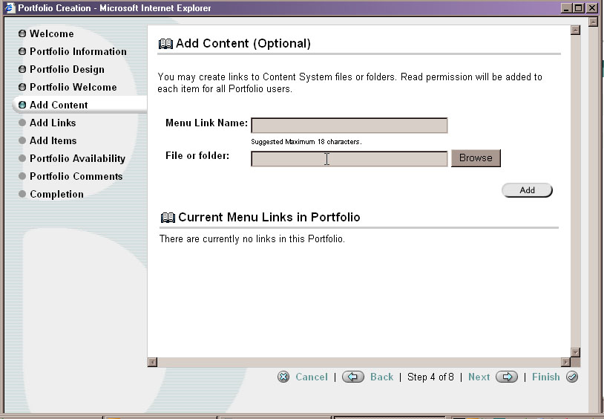
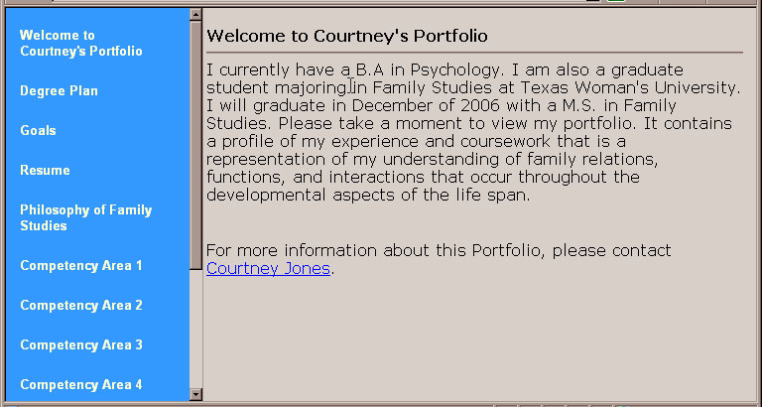
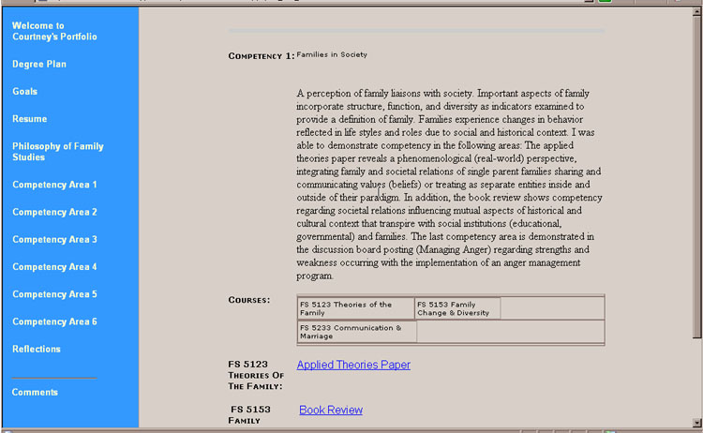
Blackboard Portfolio
Screenshots provided by Blackboard (Bb) guided students in placing files,
after the files had been uploaded to the Bb Content Management System (CMS).
Design choices were similar to the course shell options of using Text or Buttons for menu items and for selecting foreground and background colors.

Slide 2
ePortfolio: Three Trials
** excellent * acceptable | TS | Bb | TrueO
Step-by-step instructions | * | * | *
Additional published guides | * | * | Absent in our trial
Built-in Resource Guide maker (to tie to program) | ** | Could be designed | Guidelines were uploaded
Built-in communications via discussion board, email | ** | Linkable through LMS | Not available
Ease of use by students | ** | ** | *
Ease of use by faculty | * | ** | *
Built-in rubric maker | * | Absent in our trial | Rubrics were uploaded
Efficient online scoring | ** | Absent in our trial | Not functioning in our trial

