Slide 1
Interaction
Andragogical Strategies
(no other 75-cent terms)
© 2006 by Mary Bold, Ph.D., CFLE & Lillian Chenoweth, Ph.D.
Navigate PowerPoint slide show with PgUp and PgDn keys

Slide 2

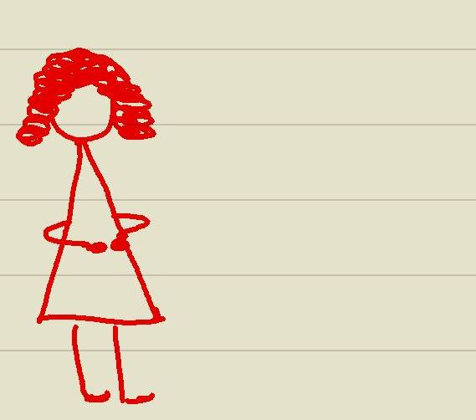
Miss A, our quintessential teacher, knew exactly what to do with children. But she was caught off guard when her adult students posed questions like,
Wouldn’t you prefer an executive summary for that assignment?
and
Will you go out with me?

Slide 3
The adult learner…
is independent
wants efficiency
seeks new knowledge
needs interaction for
optimal learning
wants a facilitator,
not a teacher

Slide 4
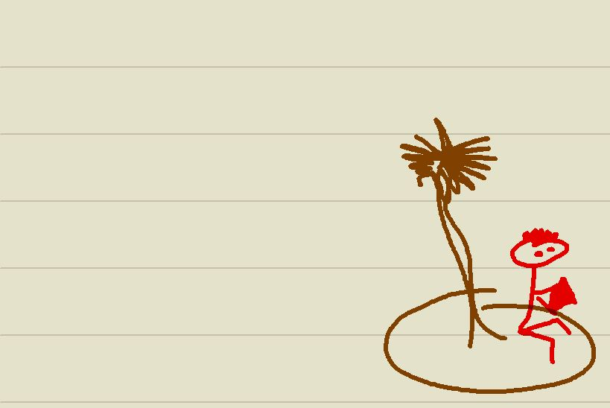
No man is an island…
but the online adult learner really is more independent
than we expect,
and that’s the case
in spite of (real) needs
for interaction and
facilitation

Slide 5
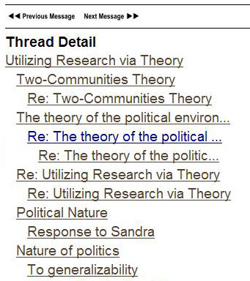
Promote Interaction on the Boards:
Require Good Subject Lines
+
+
+
+
+
+

Slide 6
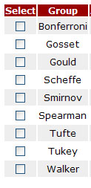
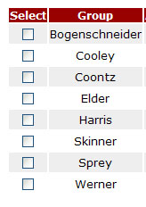
Promote Interaction in Groups:
Survey of Interaction Level

Slide 7
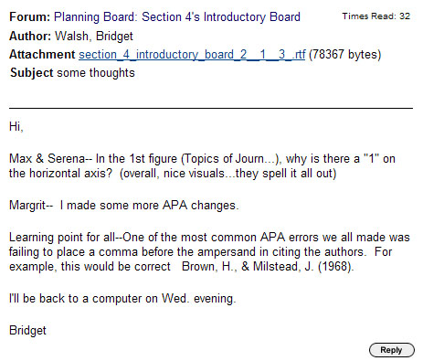
Promote Interaction in Groups:
Informal vs Formal Peer Edits

Slide 8
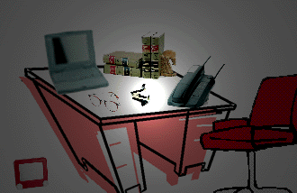
Promote Interaction with Instructor:
Hold Virtual Office Hours

Slide 9
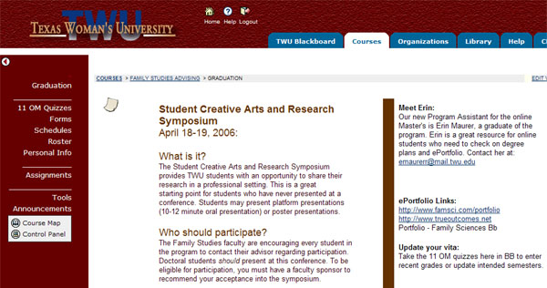
Promote Interaction with Instructor:
Set Up an Advising Shell

Slide 10
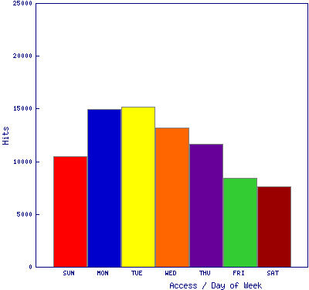
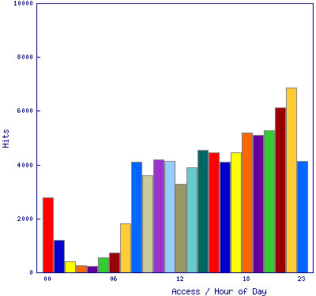
Promote Interaction with Instructor:
Course Statistics for When

Slide 11
Promote Interaction with Instructor:
Give Authentic Feedback
Janet, you are a strong writer and well suited to the writing requirements here.
Freakonomics board – your comments on gangs were well-researched and included your own professional experience. Nice blend! APA needs work in that ref list. If you print out your post and put it next to a hard copy of the APA support in Blackboard, you'll spot the errors easily.
Trochim #1 board -- Your treatment of fallacy was very good. You are off to a good start. Tend to the APA details and I predict a long line of strong posts.
Regards,
M. Bold

Slide 12
Promote Interaction with Instructor:
Make Instructor Notes
Jane Pioneer MS 1st : Baps ++ o
Jill Pioneer MS-last : Bs ++ o : :
Joe Pioneer docHS : Ap ++ o o o
June Pioneer docFS Aa drop e 9-4-05

Slide 13
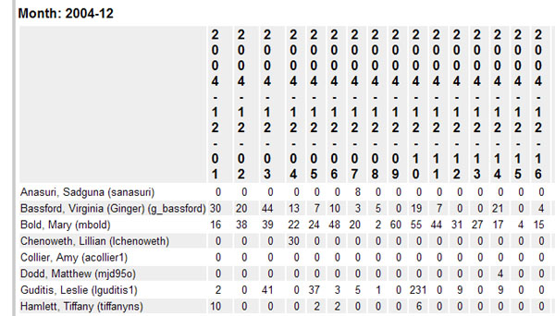
Promote Interaction and find MIAs:
Course Statistics

