Slide 1
Optimization of Water and Utility Resources
Ryan Perez, Nicholas Seah, Jake Aaknes,
Mehrpad Moattari, Ashkan Taghavi
Notes:
ryan

Slide 2

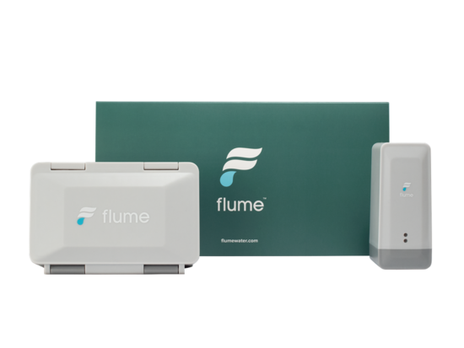
Flume Water Company & Device
Start-up specializing in intelligent water resource management systems.
Committed to fostering water conservation and optimizing water utilization efficiency.
Provides daily water consumption oversight and anomaly detection via an API interface channeled by the Flume Device.
Notes:
ashkan

Slide 3




Objectives
Enhance and expand Flume Dashboard's water usage analytics capabilities to optimize water consumption.
Aggregate Flume data with utility consumption and weather data to inform cost-saving practices.
Notes:
ashkan

Slide 4
Process: API Data Analysis
Secrets Manager
Glue
Glue
SageMaker
Streamlining Data Retrieval from Flume Device Using Glue Scripts.
Data Processing and Aggregation via AWS Glue for Visualization.
Flume API
Analysis Outcomes Derived from Glue Output Utilizing SageMaker Notebooks.
Utilizing Flume API for Data Ingestion into AWS Ecosystem.
S3
S3
Notes:
Ashkan

Slide 5
The Water Research Foundation
 | REUWS 1999 | REUWS 2016
Daily Per Capita (Indoor) | 69.3 GPCD* | 58.6
Gallons Per Flush | 3.48 | 2.6
Flushes per person per day | 5.05 | 5.0
Gallons per shower | 16.7 | 15.8
Shower duration | 7.8 | 7.8
REUWS* Overview:
Assessing Water Use Efficiency.
Identifying Critical Influences on Consumption Behavior Patterns.
Data sources:
Billing Data
Customer Interviews
Surveys
Home Audits
Retrofit Studies
Flow Data Recorders
*Gallons Per Capita per Day
*Residential End Uses of Water Study
https://www.waterrf.org/
Notes:
mehrpad

Slide 6

The Water Research Foundation
 | REUWS 1999 | REUWS 2016 | Flume Study 2021* | Ryan
Daily Per Capita (Indoor) | 69.3 GPCD | 58.6 | 46.5 | ?
Gallons Per Flush | 3.48 | 2.6 | 2.0 | ?
Flushes per person per day | 5.05 | 5.0 | N/A | ?
Gallons per shower | 16.7 | 15.8 | N/A | ?
Shower duration | 7.8 | 7.8 | N/A | ?
*Gallons Per Capita per Day
*Residential End Uses of Water Study
https://www.waterrf.org/
Notes:
mehrpad

Slide 7
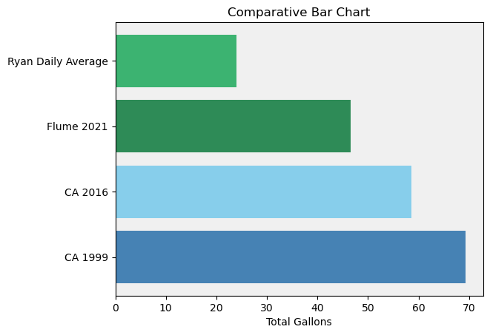
Overall Usage vs Studies

Slide 8
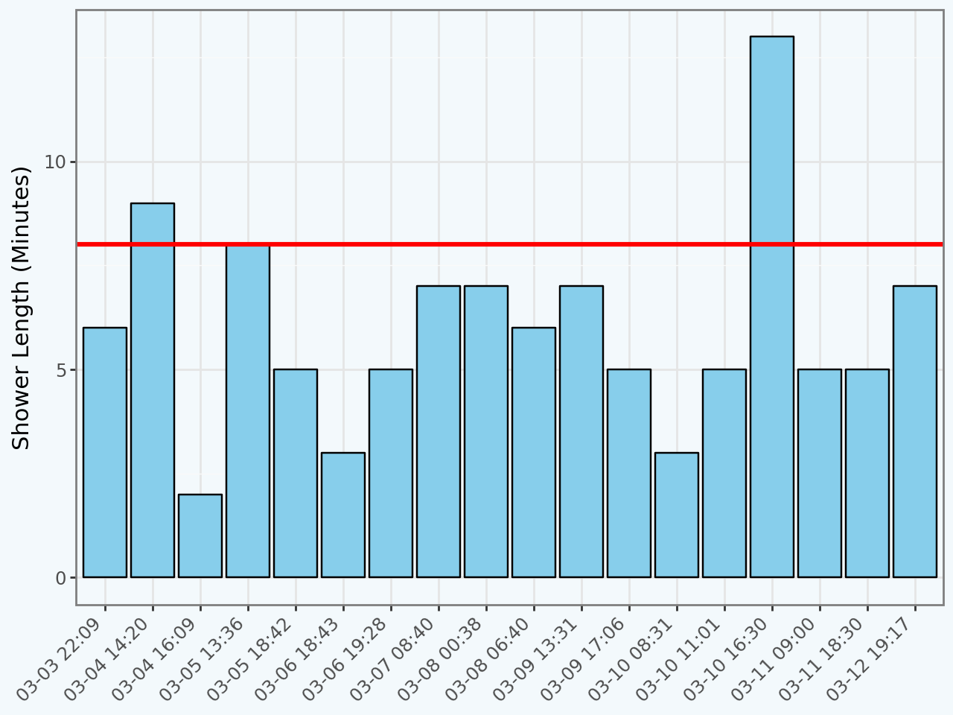
Shower Usage
REUWS 2016 Average
18 Showers from 3/3 to 3/12
Average shower time = 6.0 minutes.
Average water usage per shower = 8.75 gallons.
Notes:
nick

Slide 9
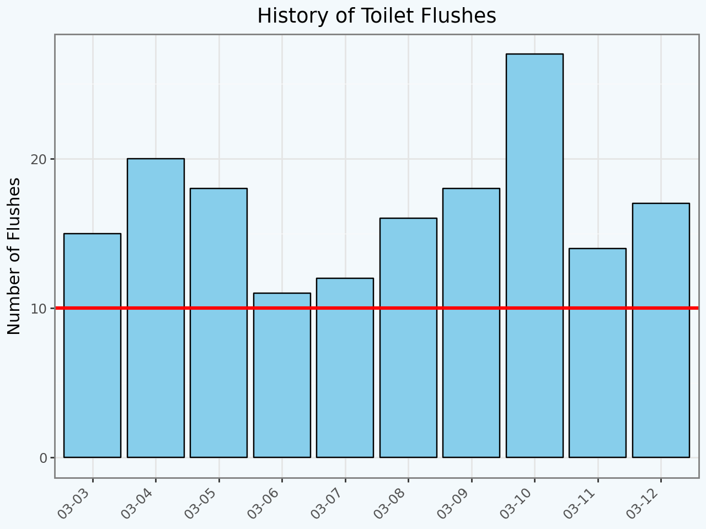
Ryan’s Frequent Bathroom Visits
Flume Project Meet Up
REUWS 2016 Average
Average water usage per flush = 1.09 gallons.
Average number of flushes per day = 16.78 flushes.
Notes:
Nick – add reason for the recommended shower length, maybe add visual?

Slide 10
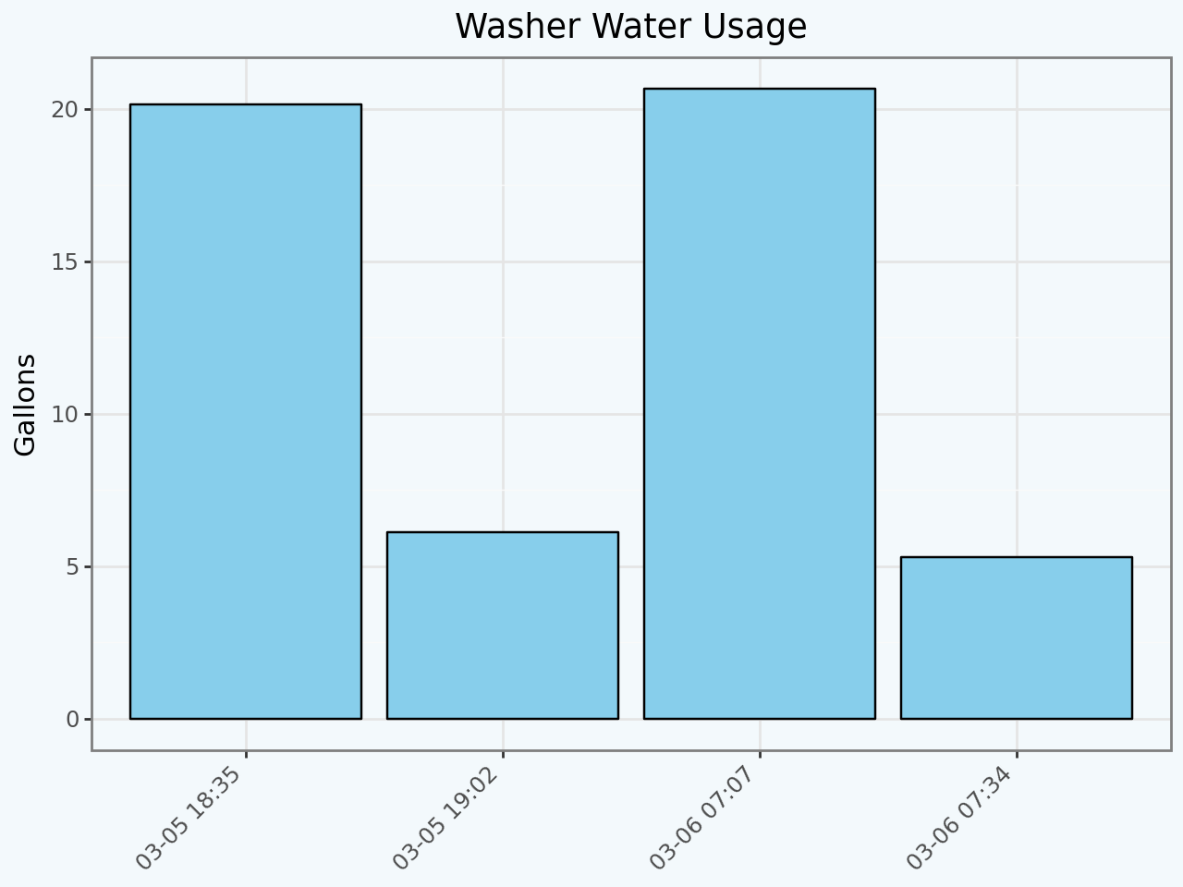
Washer Statistics
Main cycle
Rinse cycle
Average water usage per wash = 26.10 gallons.
Washer uses 12.34 % of all water usage.
Notes:
Nick – washers visual needs to be added (washer loads across x axis and total gallons usd per load on y axis)

Slide 11
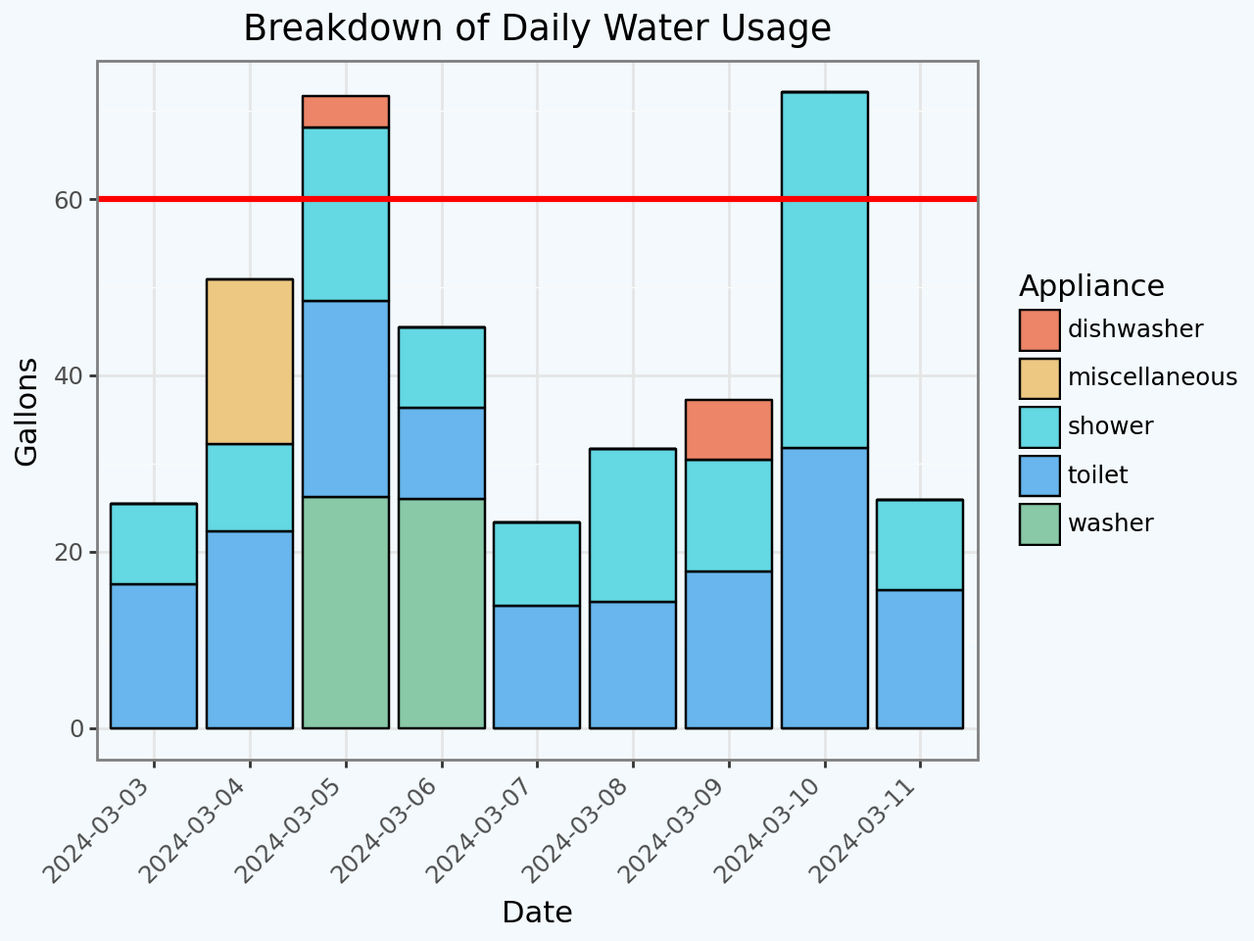
Daily Water Usage Proportions
Average Daily Water Use per Person
Shower Usage= 36%
Toilet Usage = 43%
Combined = 79%
Notes:
jake

Slide 12
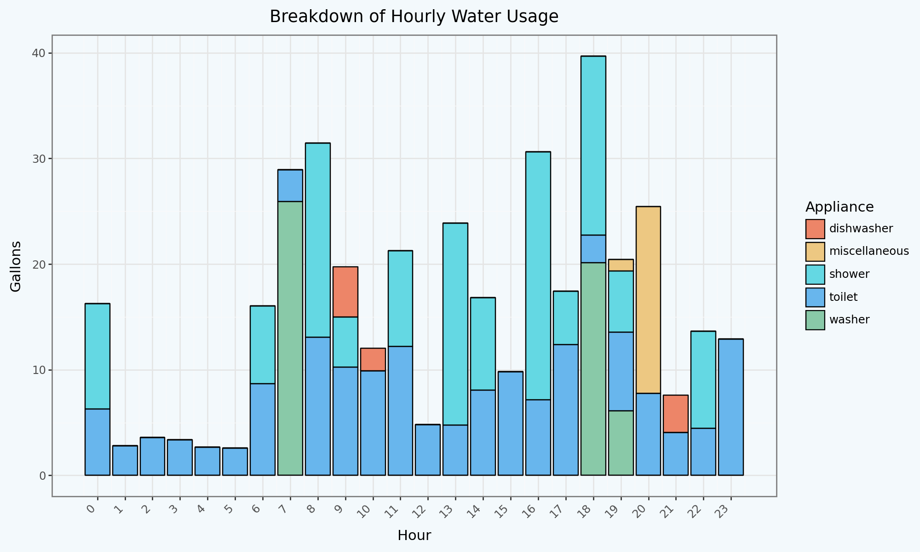
Hourly Water Proportions
6PM and 8am have the highest water usage during a day.
1am to 5am being the lowest.
Notes:
jake

Slide 13

Correlation Matrix

Slide 14
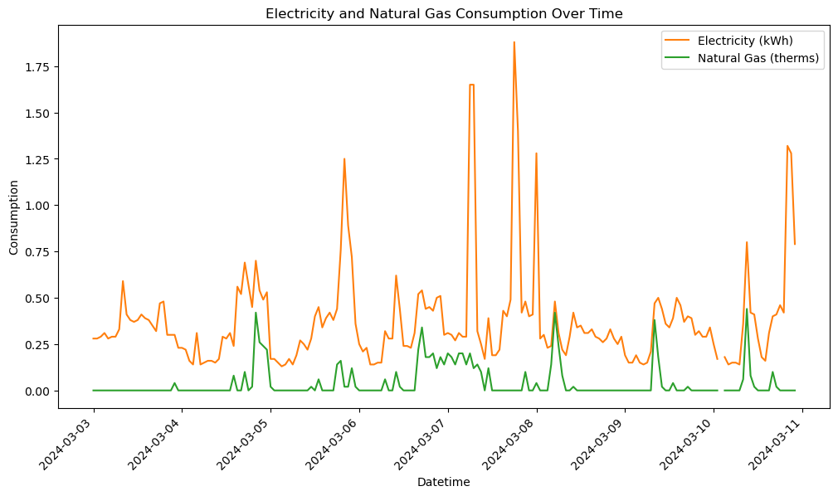
Electricity and Gas Utilities
Peak usages align between gas and electric
Notes:
jake

Slide 15
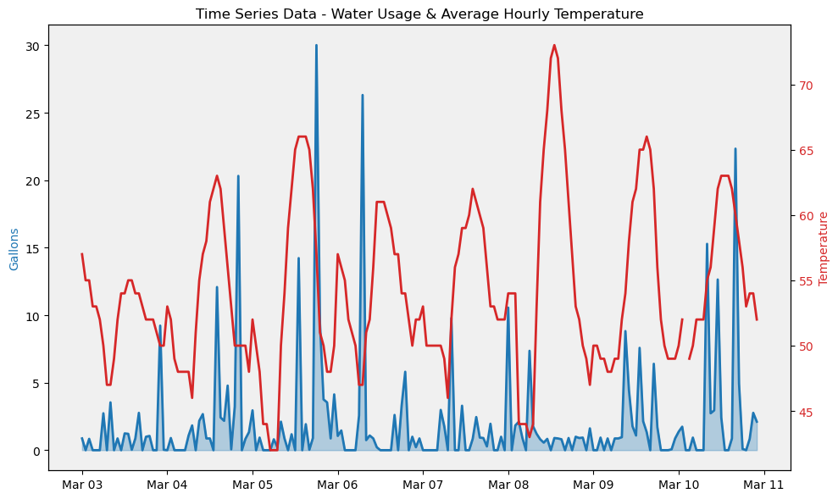
Water and Temperature
Washer loads
DST
Notes:
ryan

Slide 16
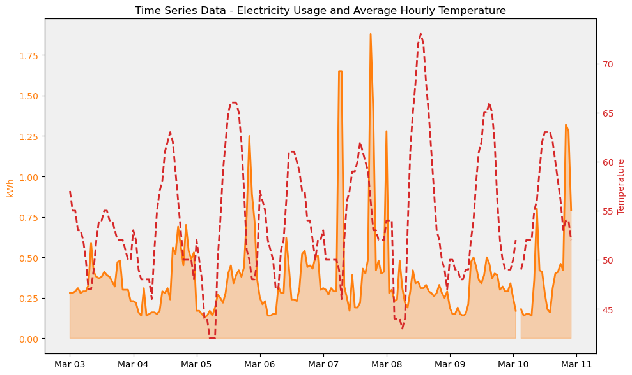
Electricity and Temperature
Peak temperatures associated with lower electricity usage
Notes:
ryan

Slide 17
Impact
 | REUWS 1999 | REUWS 2016 | Flume Study 2021* | Ryan
Daily Per Capita (Indoor) | 69.3 | 58.6 | 46.5 | 24.7
Gallons Per Flush | 3.48 | 2.6 | 2.0 | 1.06
Flushes per person per day | 5.05 | 5.0 | N/A | 16.8**
Gallons per shower | 16.7 | 15.8 | N/A | 8.8
Shower duration | 7.8 | 7.8 | N/A | 6.0
*Gallons Per Capita per Day
Residential End Uses of Water Study
https://www.waterrf.org/
** Does not account for guests in the home
Notes:
mehrpad

Slide 18
Next Steps
Continue to gain insights on daily usage patterns that are not available through the current Flume Dashboard
Predictive Analytics: Utilize machine learning to predict future utility usage, helping users adjust consumption to avoid peak rates
Behavioral Insights: Insights into daily habits to generate suggested changes to reduce cost
Notes:
ryan

Slide 19

Thank you! Questions, Comments, Feedback?
Notes:
ryan

