Slide 2
Tell whether the ordered pairs is FUNCTION OR NOT
f= (-1, 2), (2,2), (3,2),(4,2)
Function

Slide 3
g= (1, 3), (-1,4), (2,6),(2,6)
Not function

Slide 4
h= (1, 3), (1,6), (1,9),(1,1)
Not function

Slide 5
Evaluating function
and
graphing functions
Replace or substitute its variable with given number or expression.

Slide 6
Example:
Evaluate the function.
f(x) = 5x - 3
f(x) = 5x - 3
f(2)
=
5
(2)
-
3
(a) x = 2
f(2)
=
10
-
3
(b) x = -3
f(2) = 7

Slide 7
f(x) = 5x - 3
(b) x = -3
f(-3)
=
5
(-3)
-
3
f(-3)
=
-15
-3
f(-3)
=
-18

Slide 8
x
2
-3
y - axis
.
y
7
-18
7
0
-3
2
x - axis
.
-18

Slide 9
2
f(x) = x + 3x - 3
a. x = -3
b. x = -2
c. x = 3
2
f(x) = x + 3x - 3
2
f(-3)
=
(-3)
+
3
(-3)
-3
f(-3)
=
9
- 9
- 3
f(-3)
=
- 3

Slide 10
2
f(x) = x + 3x - 3
b. x = -2
2
f(x) = x + 3x - 3
2
f(-2)
=
(-2)
+
3
(-2)
-3
f(-2)
=
4
- 6
- 3
f(-2)
=
-5

Slide 11
2
f(x) = x + 3x - 3
c. x = 3
2
f(x) = x + 3x - 3
2
3
f(3)
=
3
+
(3)
- 3
f(3)
=
9
+
9
- 3
f(3)
=
15

Slide 12
x
-3
-2
3
.
y - axis
y
-3
-5
15
15
0
-3
-2
3
x - axis
.
-3
.
-5

Slide 13
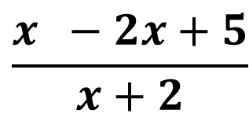
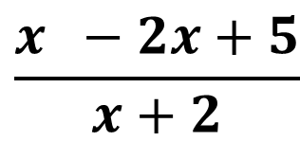
2
$$\frac{x −2x+5}{x+2}$$
2
f(x) =
$$\frac{x −2x+5}{x+2}$$
f(x) =
a. x = -1
2
(-1)
-
2
(-1)
+
5
a. x = -1
-1
+
2
1
+
2
+
5
8
=
1
1
=
8

Slide 14
2
g(x) = x -3x + 1
a. g(2x – 1)
b. g(3x + 2)
Solve:
2
(2x – 1)
-3
(2x – 1)
+
1
2
(2x – 1)
(2x – 1)
4x
- 2x
- 2x
+ 1

Slide 15
2
(2x – 1)
-3
(2x – 1)
+
1
(2x – 1)
(2x – 1)
-3
(2x – 1)
2
4x
- 2x
- 2x
+ 1
- 6x
+ 3
+ 1
2
4x
- 10x
+ 5

Slide 16
2
g(x) = x -3x + 1
b. g(3x + 2)
(3x + 2)
(3x + 2)
- 3
(3x + 2)
2
+ 1
9x
+ 6x
+ 6x
+ 4
- 9x
- 6
2
9x
+ 3x
- 1

