Slide 1
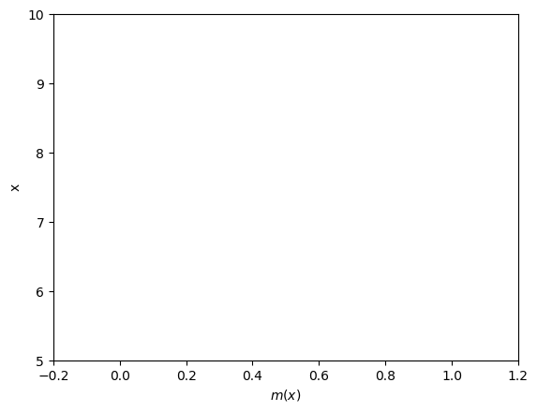



$$a$$
$$b$$
$$c$$

