Slide 1
ConceptNet in Context
Robyn Speer
February 8, 2020

Slide 2
Origins
Open Mind Common Sense
Created by Catherine Havasi, Push Singh, Thomas Lin, others, in 1999
Motivating example: making search more natural
“my cat is sick” -> “veterinarian cambridge ma”
Goal: teach computers the basic things that people know
Represent this knowledge in natural language, so non-experts can contribute it and interact with it
Hugo Liu first transformed Open Mind into a knowledge graph, ConceptNet
Notes:
search was very literal-minded, couldn’t rephrase queries in natural ways
natural language contrasts with prior projects such as Cyc

Slide 3
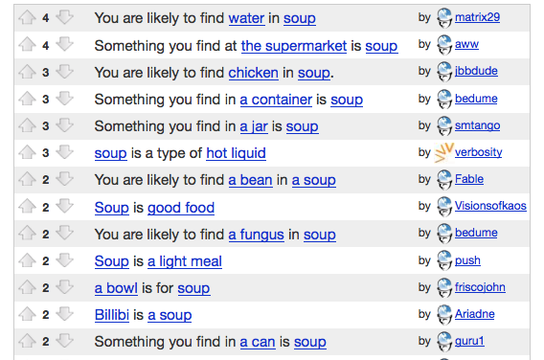
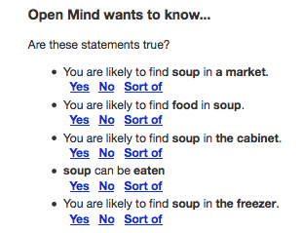
Collecting knowledge with crowdsourcing
Open Mind Common Sense,
around 2006

Slide 4

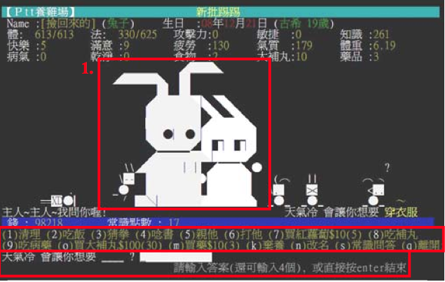
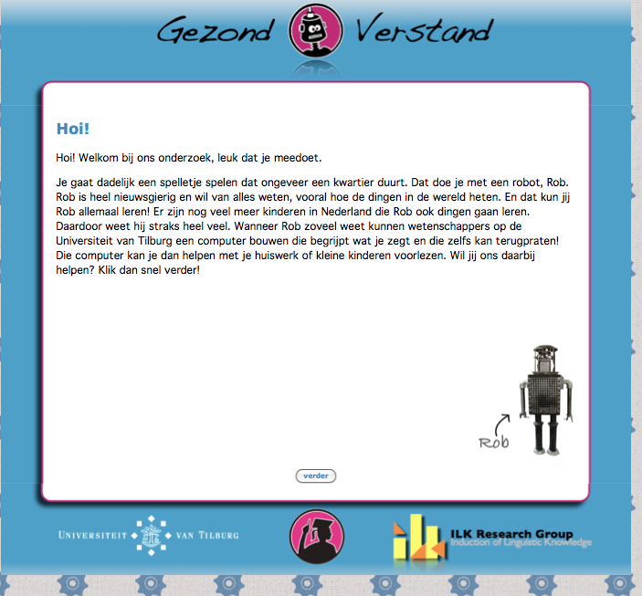
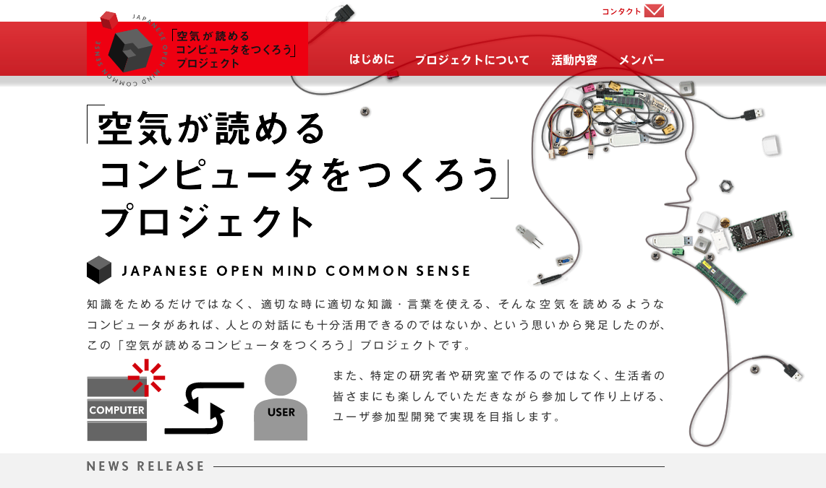

An international, multilingual project

Slide 5
Linked data
OpenCyc
YAGO
UMBEL
Lexvo
ConceptNet
WordNet
DBPedia
UBY
Wikidata
Wiktionary
Wikipedia

Slide 6
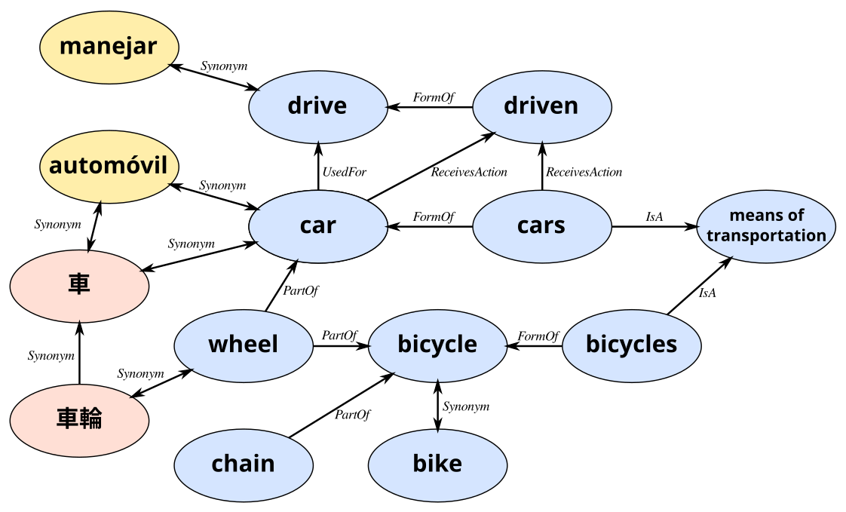
A small fragment of ConceptNet 5

Slide 7
ConceptNet’s data sources
Crowdsourced knowledge
Open Mind Common Sense, Wiktionary, DBPedia, Yahoo Japan / Kyoto University project
Games with a purpose
Verbosity, nadya.jp
Expert resources
Open Multilingual WordNet, JMDict, CEDict, OpenCyc, CLDR emoji definitions

Slide 8
How do we represent this in machine learning?

Slide 9
Knowledge graphs as word embeddings
We started representing ConceptNet as embeddings in 2007
Enabled new capabilities that were difficult to evaluate
When word embeddings became popular, they were instead based on distributional semantics (CBOW, skipgrams, etc.)
Retrofitting (Manaal Faruqui, 2015) revealed the power of distributional semantics plus a knowledge graph
Apply knowledge-based constraints after training
For some reason this works better than during training
Notes:
skipgrams capture a lot of understanding of word usage that isn’t going to be conveyed by manual input

Slide 10
Retrofitting with a knowledge graph
Terms that are connected in the knowledge graph should have vectors that are closer together
Many extensions now:
“Counter-fitting” moves antonyms farther apart (Mrkšić et al., 2016)
“Morph-fitting” accounts for morphology (Vulić et al., 2017)
Applied to the union of vocabularies instead of the intersection (our work)
tree
oak
furniture

Slide 11

Word embeddings with common sense built in
Hybrid of ConceptNet and distributional semantics, via our variant of retrofitting
Multilingual by design
Open source, open data
Notes:
We’re enthusiastic enough about retrofitting that we release the result of what we think is the best way to do it with ConceptNet

Slide 12
Building ConceptNet Numberbatch
Structured knowledge
Distributional semantics
Many data sources
Google News
Common Crawl
Open
Subtitles
word2vec
GloVe
fastText
ConceptNet
Retrofit
Retrofit
Retrofit
Join
Reduce dimensionality
ConceptNet
Numberbatch
Propagate to larger vocabulary
De-bias

Slide 13
Benchmarks
Hey wow, this actually works

Slide 14
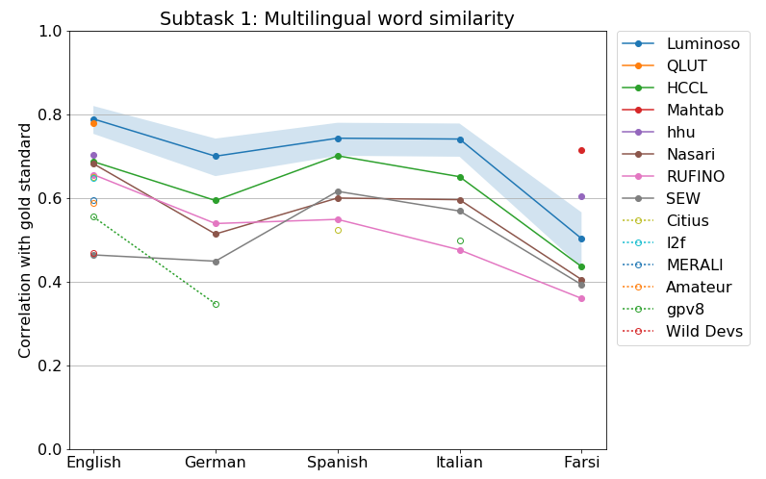
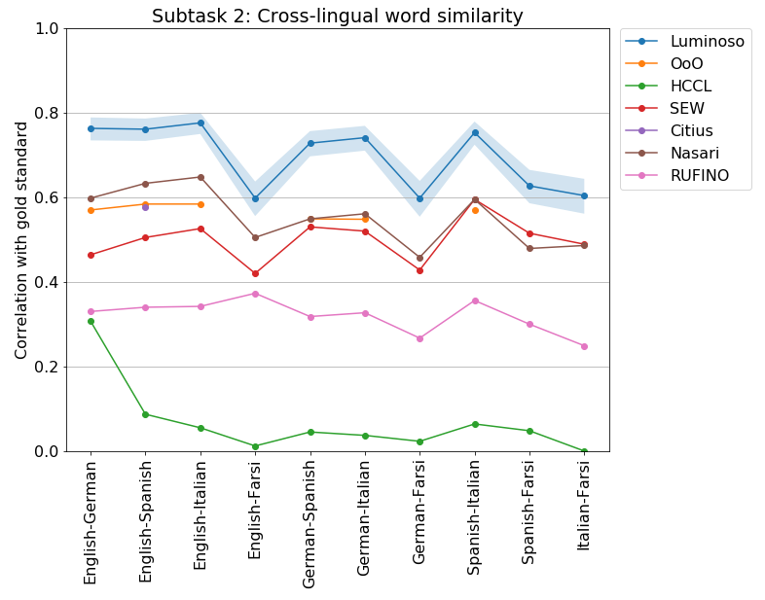
Intrinsic evaluation: Word relatedness (SemEval 2017)
Notes:
There was an explosion of new systems and new evaluations and it’s often hard to know which ones to compare. I like focusing on shared tasks like SemEval for that reason -- it means you can avoid unrealistic self-reported test results.

Slide 15
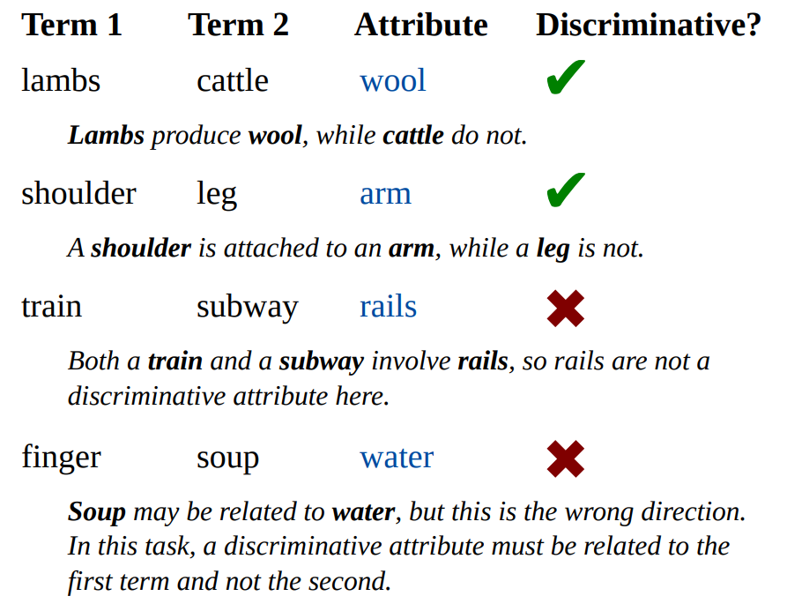
Intrinsic evaluation: Distinguishing attributes (SemEval 2018)
We got 74% accuracy (2nd place) by directly querying ConceptNet Numberbatch
Additional features trained on the provided training data didn’t help on the test set
All top systems used knowledge graphs

Slide 16
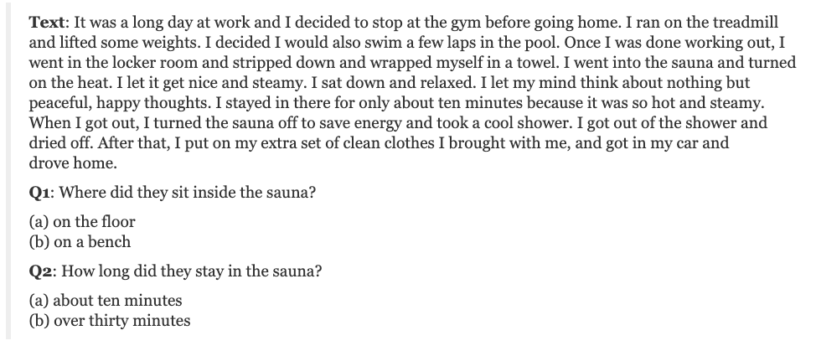
Extrinsic evaluation: Story understanding
SemEval-2018 task: answer simple multiple-choice questions about a passage

Slide 17
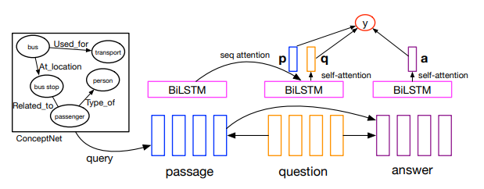
Story understanding at SemEval-2018
Winning system: TriAN (Three-way Attention and Relational Knowledge for Commonsense Machine Comprehension)
Liang Wang et al., Yuanfudao Research
Concatenated each input embedding with a relation embedding, trained to represent what ConceptNet relations exist between the word and the passage

Slide 18
Other benchmarks
Story Cloze Test
GPT-1 was a breakthrough, but Jiaao Chen et al. (2018) improved on it slightly with ConceptNet
OpenBookQA
ConceptNet didn’t help, but Ai2’s own science knowledge graph Aristo did (Todor Mihaylov et al., 2018)
CommonsenseQA
Generating synthetic training data using ConceptNet helps (Zhi-Xiu Ye et al., 2019)
Notes:
Excitingly mixed results

Slide 19
Has the situation changed?
Transformer models were big news in 2019
Language models such as BERT, XLNet, and GPT-2 indicate some level of implicit common sense understanding
Notes:
claim: Language modeling is the task that contains all other NLP tasks

Slide 20
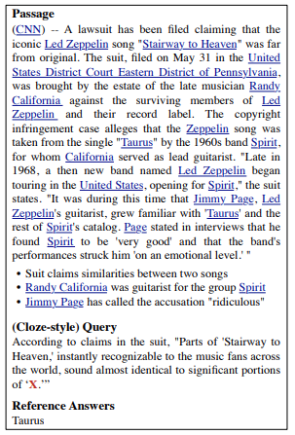
ReCoRD / COIN shared task (2019)
Run by Simon Ostermann, Sheng Zhang, Michael Roth, and Peter Clark for EMNLP
Answer questions based on news stories, some of which are intended to require common sense reasoning
Winning system: XLNet plus rule-based answer verification (Xiepeng Li et al.)
None of the top 3 systems used external knowledge
Notes:
(I understand the initials are coincidental)
So this was a relevant negative result for common sense

Slide 21
Why Do Masked Neural Language Models Still Need Common Sense Knowledge?
Presumably you just saw this talk by Sunjae Kwon
MNLMs seem to understand a lot but they still struggle with things that actually require common-sense
So try augmenting your system with an attention model of edges in a knowledge graph

Slide 22
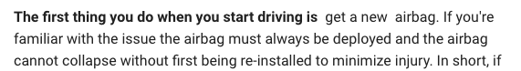
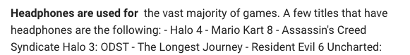

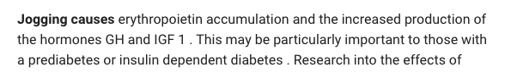
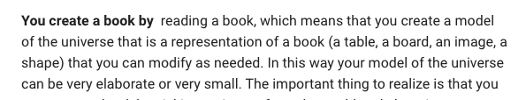
A simplistic answer to why we need knowledge
Language models describe text that is likely
Statements that are too obvious are unlikely
(nonsensical “knowledge” produced by the GPT-2 model at talktotransformer.com)

Slide 23
Other languages exist
Most neural language models only learn English, unless they’re specifically designed for translation
The corpora in other languages aren’t big enough or representative enough
ConceptNet’s representation connects many languages (100 languages have over 10k terms each)

Slide 24
Using ConceptNet

Slide 25
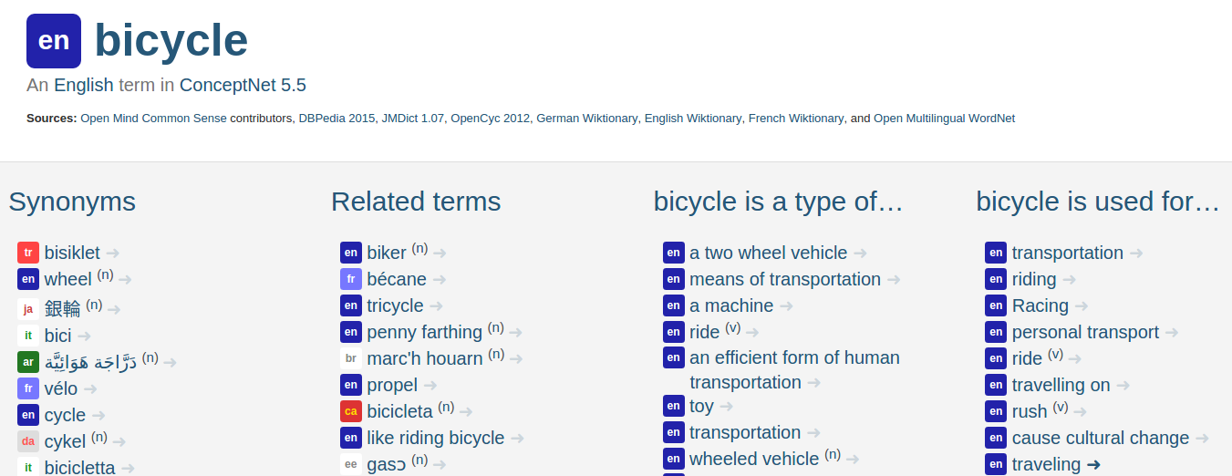
conceptnet.io – a browsable interface
Links to other resources such as the documentation wiki and the Gitter chat

Slide 26
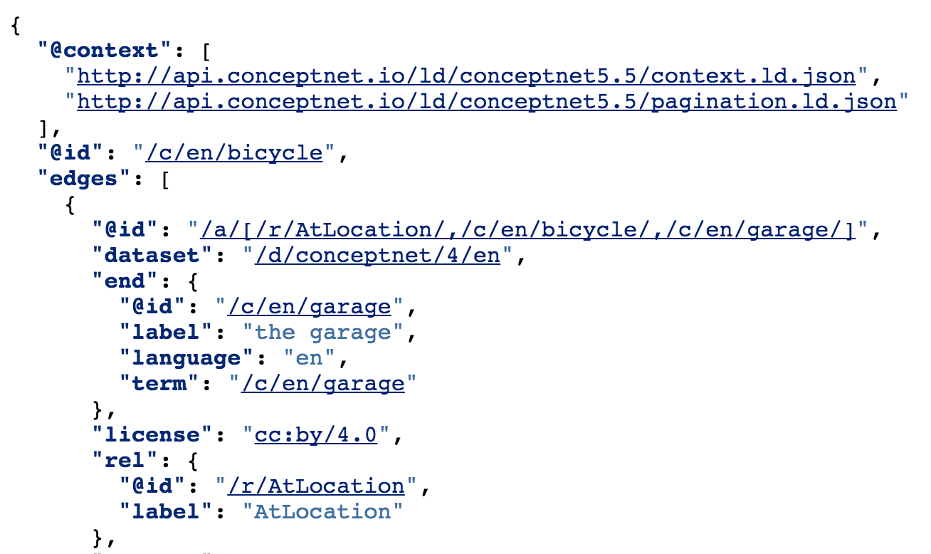
api.conceptnet.io – a Linked Data API

Slide 27
How should we represent ConceptNet in question answering?
Everything changes so fast that I can’t bless one technique
Encoding ConceptNet edges as if they were sentences, in an attention model, seems to work well in multiple systems
Alternatively, ConceptNet can augment training data
If the thing you need background knowledge for is straightforward enough… word embeddings and retrofitting are still an option

Slide 28
Recommendation: Combine ConceptNet with task-specific training data
ConceptNet isn’t going to know everything it needs to know for your task
Knowing so many specific things is beyond its scope
ConceptNet is noisy: it might know one thing about your topic except it’s wrong
Use it as a starting point or a constraint

Slide 29
Recommendation: Don’t assume completeness
ConceptNet has ~15 million facts in English
There are many more than 15 million facts of general knowledge
Word forms might be slightly different
Fuzzy matching (perhaps via embeddings) is important
“recyclable materials”
x
glass
ReceivesAction
recycled

Slide 30
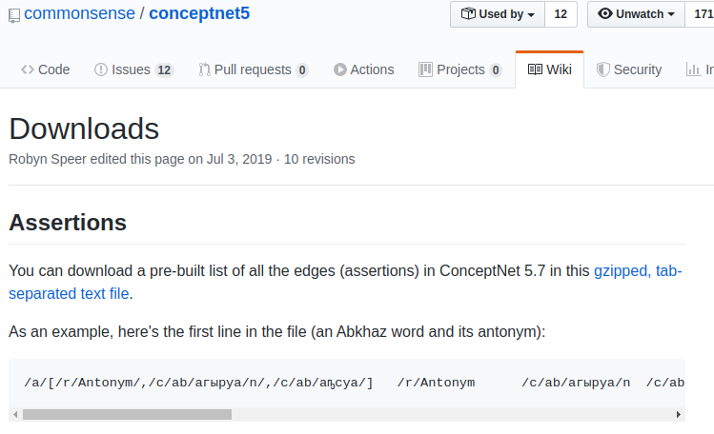
Recommendation: download the data
If you just need to iterate all the edges in ConceptNet, you don’t need all the Python and PostgreSQL setup
conceptnet.io -> Wiki -> Downloads

Slide 31
blog.conceptnet.io
Tutorials built using ConceptNet
Updates to ConceptNet and related open-source tools
AI fairness

Slide 33
Extra slides

Slide 34
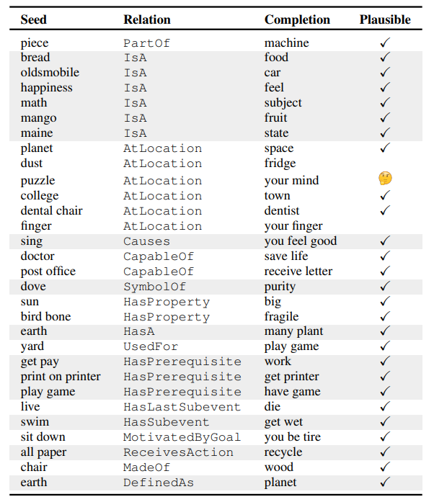
Inferring common sense with CoMET
Bosselut et al. (2019), at Ai2
Uses ConceptNet as a training set instead of a knowledge resource
Fine-tune a GPT language model to generate ConceptNet statements
(but only in English)
Notes:
A possible remedy to the sparsity of ConceptNet

Slide 35
Recommendation: make sure text normalization matches
Example text: “SETTINGS” (English)
Wrong: /c/en/SETTINGS, /c/en/setting, /c/en/set
Right: /c/en/settings
Example text: “aujourd’hui” (French)
Wrong: /c/fr/aujourd, /c/fr/hui
Right: /c/fr/aujourd'hui
Use conceptnet5.nodes.standardized_concept_uri, or the simple text_to_uri.py included with Numberbatch

Slide 36
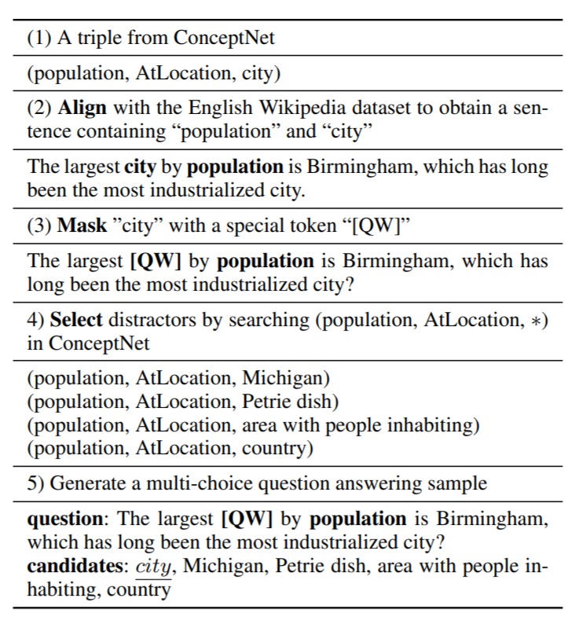
Align, Mask, and Select
Zhi-Xiu Ye et al. (2019)
Improve performance on CommonsenseQA by generating synthetic training questions from Wikipedia and ConceptNet
Distractors are other nodes in ConceptNet

Slide 37
Knowledge graphs in Portuguese NLP
Gonçalo Oliveira, H. (2018), Distributional and Knowledge-Based Approaches for Computing Portuguese Word Similarity
Knowledge graphs (including ConceptNet) improve Portuguese semantic evaluations
Best results come from combining multiple knowledge graphs representing different variants of Portuguese
Notes:
kinda obvious results, but it’s important

Slide 38
OpenBookQA (Ai2)
“Can a Suit of Armor Conduct Electricity?” (Todor Mihaylov et al., 2018)
QA over elementary science questions
ConceptNet did not improve baseline results
Ai2 built their own knowledge graph, Aristo, that focused on science knowledge and did improve the results

