Slide 1
Integrating Logical and Vector Representations and
Using Plan-Based Understanding for Complex QA
Raymond J. Mooney
University of Texas at Austin

Slide 2
Semantic Parsing
Mapping a natural-language sentence to a detailed representation of its complete meaning in a fully formal language that:
Has a rich ontology of types, properties, and relations.
Supports automated reasoning or execution.

Slide 3

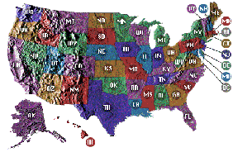
Geoquery: A Database Query Application
Query application for a U.S. geography database containing about 800 facts [Zelle & Mooney, 1996]
What is the smallest state by area?
Rhode Island
Answer
Semantic Parsing
Query
answer(x1,smallest(x2,(state(x1),area(x1,x2))))

Slide 4
My Most Popular Meme
Recently, I have become particularly well known for a certain strongly stated comment, which can be embedded into the following vector: (0.62384789, 0.232328242, 0.2394182754, 0.9234583745, 0.9034527345, 0.2348534598743, 0.789045724387, 0.34750893274895, 0.23475809273485723, 0.23452374958, 0.094358923475823475, 0.908452352348905, 0.024375823785, 0.980459238409582345) (click to decode).

Slide 5
My Most Popular Meme
"You can't cram the meaning of a whole %&!$# sentence into a single $&!#* vector!"
This was a statement in my opening invited talk at the ACL 2014 Workshop on Semantic Parsing, the slides are available on this site. As I said at the talk, you can use your language model of informal English to fill in the masked portions.

Slide 6
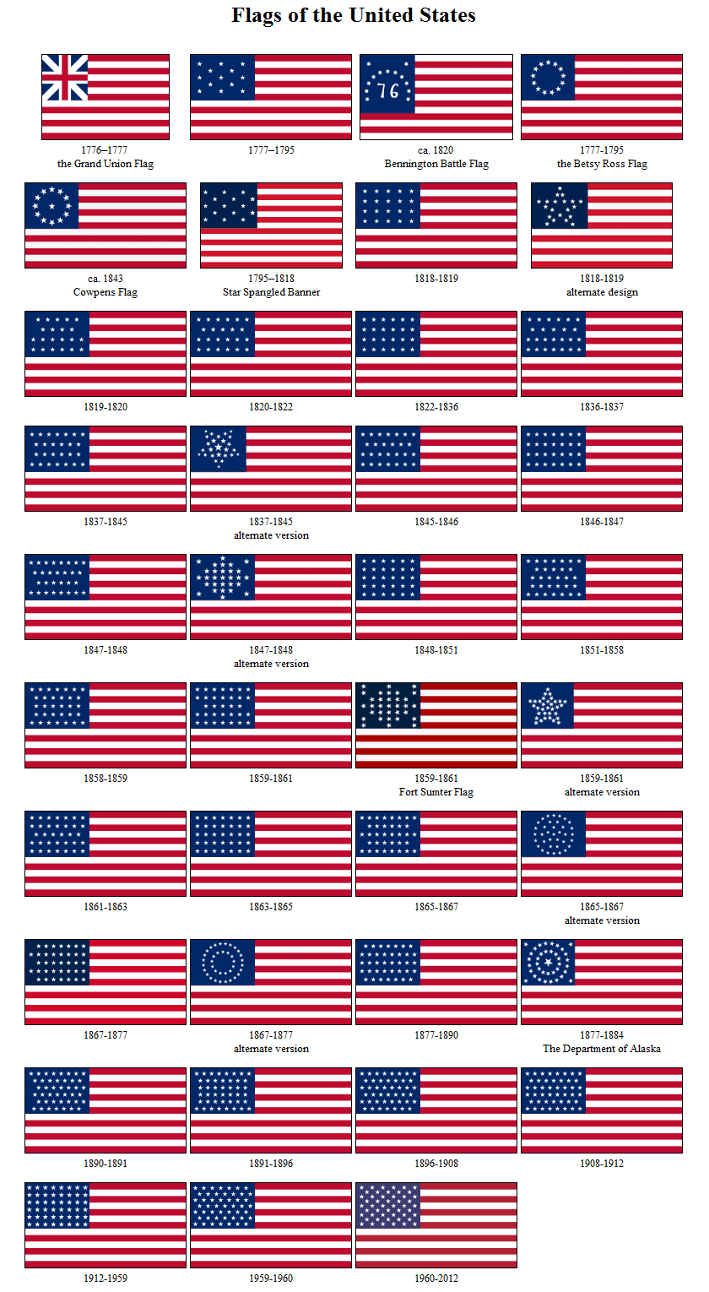
Can you effectively cram this VQA problem into a vector?
What was the number of stars minus the number of stripes on the US flag in 1900?

Slide 7
Integrating Logic and Vectors in Natural Language Semantics
Both logical and vector representations of natural language semantics have strengths and weaknesses.
Integrating both representations can improve reasoning for complex QA.

Slide 8
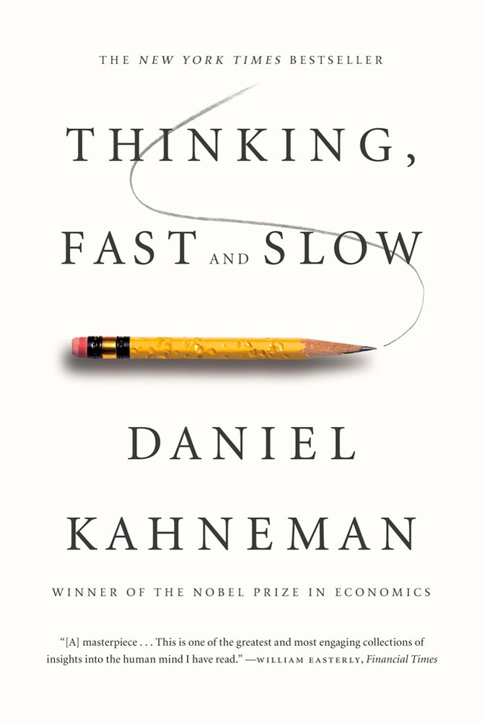
Integrating Pattern Recognition and Symbolic Reasoning
NNs model thinking fast ̶ pattern recognition.
GOFAI models thinking slow ̶ symbolic reasoning.
Need to integrate both for effective AI.

Slide 9
Integration Using Probabilistic Logic
We have integrated logic and vectors in NL semantics using MLNs and PSL:
Beltagy, I., Chau, C., Boleda, G., Garrette, D., Erk, K., and Mooney, R., “Montague Meets Markov: Deep Semantics with Probabilistic Logical Form,” *SEM-2013.
Beltagy, I., Erk, K., and Mooney, R.J., “Probabilistic Soft Logic for Semantic Textual Similarity,” ACL-2014.
Beltagy, I., Roller, S., Cheng, P., Erk, K., and Mooney, R.J., “Representing Meaning with a Combination of Logical and Distributional Models,” Computational Linguistics, 42:4 (2016).

Slide 10
Hybrid Semantics in Probabilistic Logic
Represent sentences using weighted logical forms in a probabilistic logic:
Markov Logic Network (MLN)
Probabilistic Soft Logic (PSL)
Automatically generate soft inference rules in this probabilistic logic from vector semantics.

Slide 11
System Architecture
Sent1
BOXER
LF1
Dist. Rule
Constructor
Rule Base
Sent2
LF2
Vector Space
MLN/PSL Inference
BOXER [Bos, et al. 2004]: maps sentences to logical form
Distributional Rule constructor: generates relevant soft inference rules based on distributional similarity
MLN/PSL: probabilistic inference
Result: degree of entailment or semantic similarity score (depending on the task)
result
11

Slide 12
Recognizing Textual Entailment (RTE)
Premise: “A man is cutting a pickle”
∃x,y,z [man(x) ∧ cut(y) ∧ agent(y, x) ∧ pickle(z) ∧ patient(y, z)]
Hypothesis: “A guy is slicing a cucumber”
∃x,y,z [guy(x) ∧ slice(y) ∧ agent(y, x) ∧ cucumber(z) ∧ patient(y, z)]
Inference: Pr(Hypothesis | Premise)
Degree of entailment
12

Slide 13
Distributional Lexical Rules
For all pairs of words (a, b) where a is in S1 and b is in S2 add a soft rule relating the two
∀x a(x) → b(x) | wt(a, b)
wt(a, b) = f( cos(a, b) )
Premise: “A man is cutting pickles”
Hypothesis: “A guy is slicing cucumber”
∀x man(x) → guy(x) | wt(man, guy)
∀x cut(x) → slice(x) | wt(cut, slice)
∀x pickle(x) → cucumber(x) | wt(pickle, cucumber)
∀x man(x) → cucumber(x) | wt(man, cucumber)
∀x pickle(x) → guy(x) | wt(pickle, guy)
→ →
13

Slide 14
Extension to QA
Could extend approach to QA by generating constructive proofs of existentially quantified queries in probabilistic logic as in logic programming (e.g. Prolog).

Slide 15
Neuro-Symbolic Integration
Can also integrate logical and vector approaches using deep learning.

Slide 16
Modular NN’s
An existing approach to integrating the two is Andreas et al.’s Neural Module Networks (NAACL 2016, ICCV 2017, ECCV 2018)

Slide 17
NMN’s to N2NMNs
NMNs used a fixed parser to construct the module layout, newer end-to-end version learns to construct the right layout.

Slide 18
Neural Theorem Proving (NTP)
NTPs (Rocktaschel and Riedel, 2017) are end-to-end differentiable deductive reasoners based on Prolog’s backward chaining, where discrete unification between atoms is replaced by a differentiable operator computing the similarities between their embeddings.
NTPs have been applied to complex QA that combines reasoning over both KBs and text (Minervini et al., AAAI-20).

Slide 19
Plan-Based Understanding

Slide 20
NLP Idol: Plucked from Obscurity @NAACL 2012
Four contestants pitched an old, under-appreciated paper people should reconsider.
I pitched the following old paper on “plan-based story understanding”:
R. Wilensky (1981), "PAM," in Inside Computer Understanding, Schank, R. and Riesbeck, C. (Eds.), Lawrence Erlbaum Assoc., Hillsdale, NJ.
I won both the judges and audience vote!

Slide 21
Story Understanding Research in the 70’s
There was a body of NLP research in the 1970’s that explored “deep” knowledge-based understanding of short narratives.
Began with Charniak’s 1972 PhD thesis “Towards a model of children’s story comprehension”
Several PhD theses at Yale under Schank in the late 70’s, based on ideas in his 1977 book with Abelson: Scripts, plans, goals, and understanding.

Slide 22
PAM (Plan Applier Mechanism)
Many stories do not fit a stereotypical script.
Need to produce “causal explanations” of characters actions in terms of their goals and plans.
Requires knowledge of actions (preconditions and effects), typical goals, and novel plan construction.
Uses this knowledge to recognize novel plans in stories.

Slide 23
PAM System
Actual implementation is a “Rube Goldberg” machine that uses ad-hoc symbolic rule-based methods to construct plan-based explanations.
Constructed explanations allow answering “why” questions in an intuitive and interesting manner.

Slide 24
Examples of Plan Based Understanding
John was hungry. He got out his iPhone.
Mary needed money. She called her parents.
John was depressed. He got a rope.

Slide 25
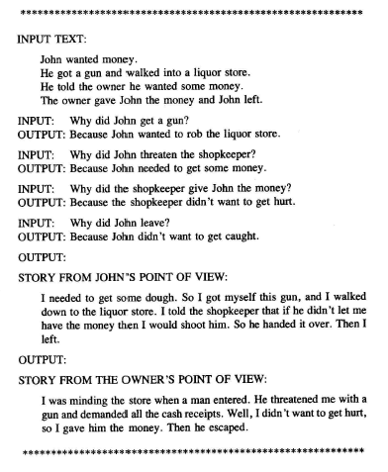
Sample PAM Trace

Slide 26
Explanation Based Learning of Narrative Schemas
My 1987 PhD thesis research used PAM-like plan-based understanding to produce explanations for novel stories.
It then generalized these explanations into new scripts using explanation-based learning.

Slide 27
GENESIS Trace Inititial Schema Learning
Fred is Mary's father and is a millionaire. John approached Mary and pointed a gun at her. She was wearing blue jeans. He told her if she did not get in his car then he would shoot her. He drove her to his hotel and locked her in his room. John called Fred and told him John was holding Mary captive. John told Fred if Fred gave him 250000 dollars at Trenos then John would release Mary. Fred paid him the ransom and the kidnapper released Mary. Valerie is Fred's wife and he told her that someone had kidnapped Mary.

Slide 28
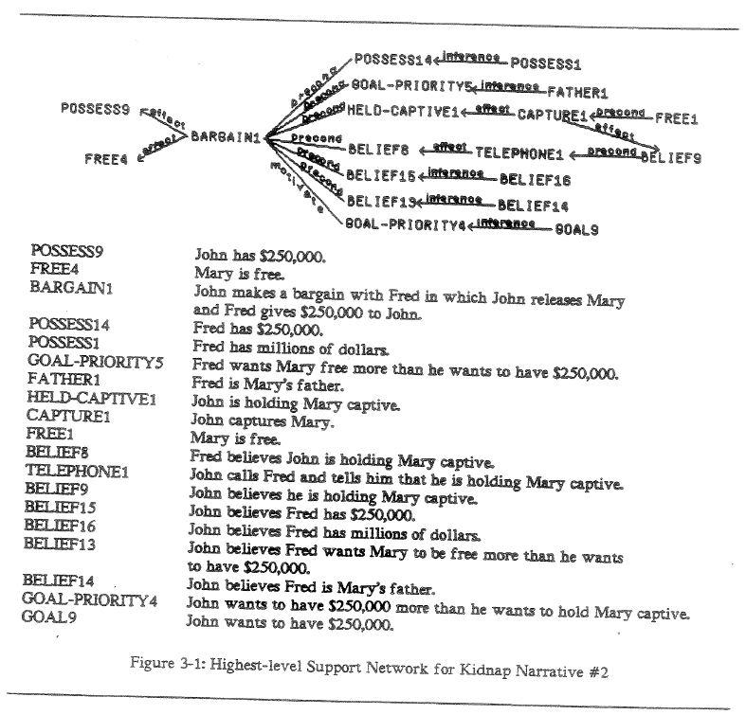
Explanation Graph of Story

Slide 29
GENESIS Trace Question Answering
>Why did John aim the gun at Mary?
So John could threaten to shoot Mary with the gun unless Mary went from John in to the car.
>Why did Mary get into the car?
Because Mary wanted not to be shot and because Mary believed that if Mary did not go from John into the car then John would shoot Mary with the gun.
>Why did Fred give John the money?
Because Fred believed that if Fred gave John the $250000 at Trenos then John would release Mary and because Fred wanted Mary to be free more than he wanted to have the $250000.
>

Slide 30
Modernizing Plan-Based Understanding
We need new statistical/neural learning and inference methods to make this process robust.
We have started work on this:
Use UW’s COMET (Commonsense Transformers for Automatic Knowledge Graph Construction, Bosselut, et al., ACL-2019) to generate robust predictions of “effects” and “needs” of NL sentences.
Use a BERT-based sentence similarity metric to match predicted “effects” of one sentence in a documents to predicted “needs” of another.
Construct a “causal chain” of events that better supports answering “why” questions.

Slide 31
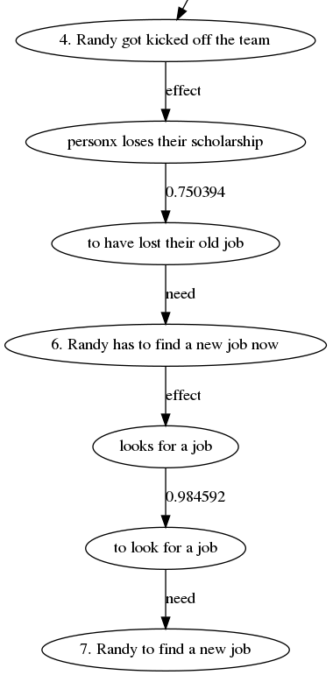
Sample Piece of Causal Graph Constructed using COMET
Short Story
from CATERS Data Set
Randy was a famous basketball player. Suddenly, people exposed him for having an affair. This caused a lot of problems. He got kicked off the team. He now has to find a new job.

Slide 32
Conclusions
Integrating logical and vector-space approaches is a promising approach to RCQA.
Modernizing and robustifying plan-based understanding is another promising approach to RCQA.

