Slide 1
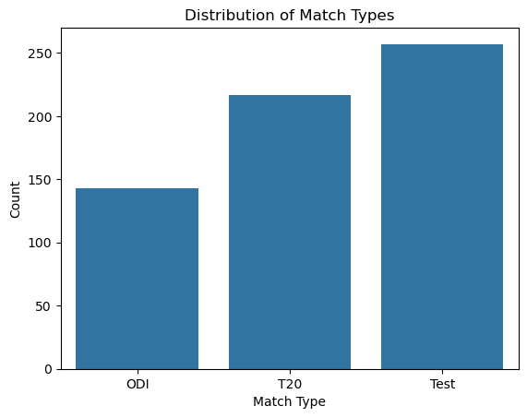
Match Types Distribution

Slide 2
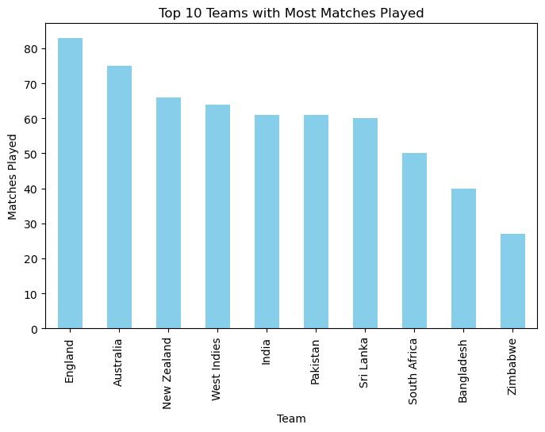
Top 10 Teams with Most Matches

Slide 3
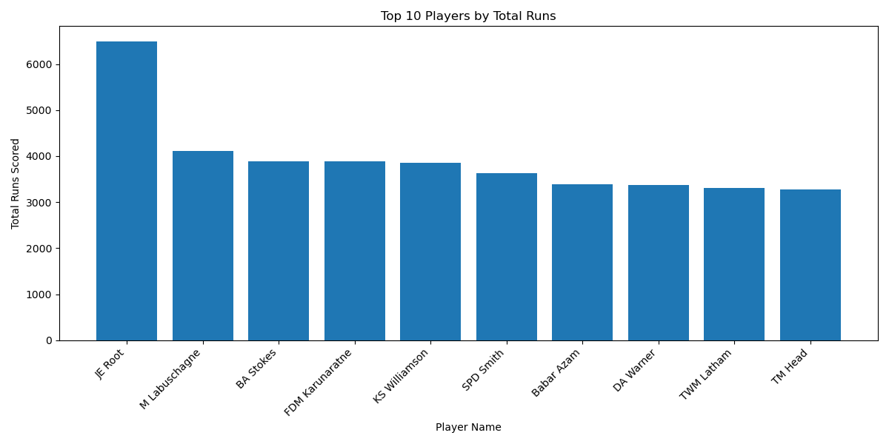
Top 10 Players by Runs

Slide 4
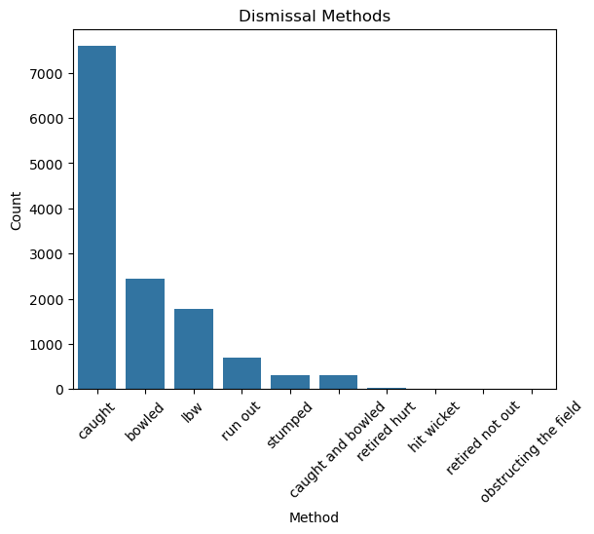
Dismissal Methods

Slide 5
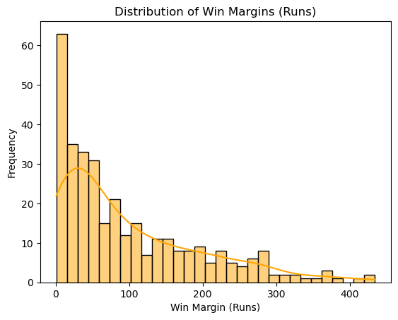
Win Margin Distribution

Slide 6
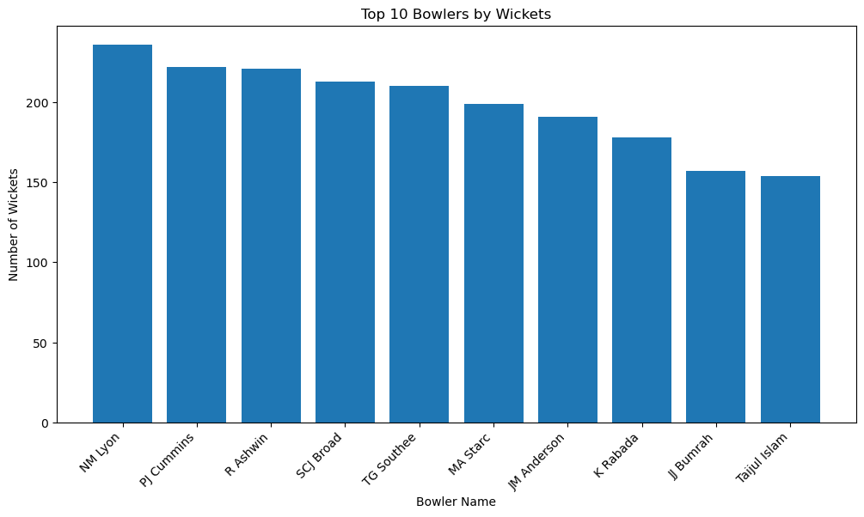
Top 10 Bowlers by Wickets

Slide 7
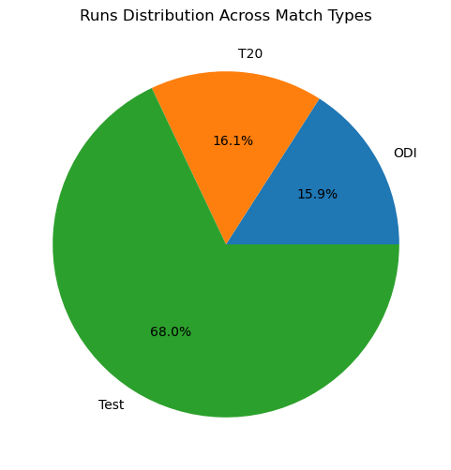
Runs Distribution Across Match Types

Slide 8
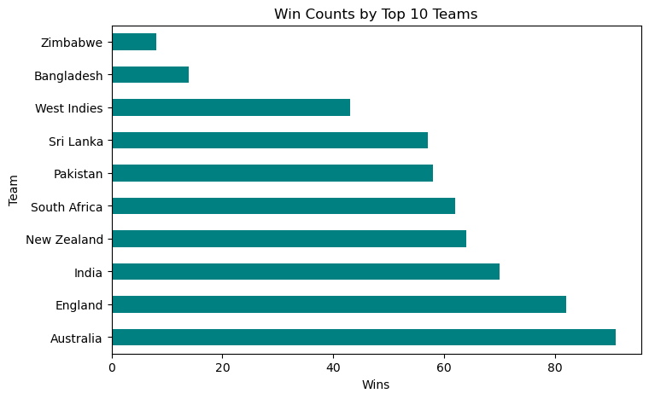
Win Counts by Top 10 Teams

Slide 9
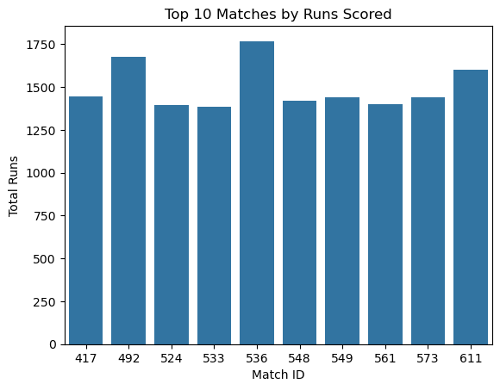
Top 10 Matches by Runs Scored

Slide 10
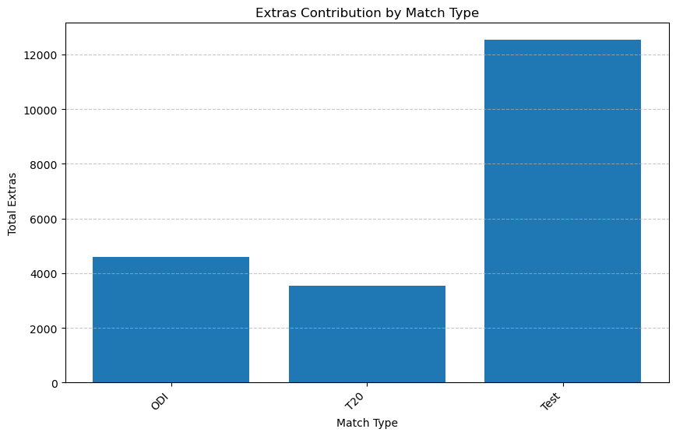
Extras Contribution by Match Type

