Slide 1
OnComPlex
Matching mutation prevalence in human cancer with protein-protein interactions
Remco Crefcoeur

Slide 2
OnComPlex - Aim

Slide 3
OnComPlex - Datafiles
BIOGRID_URL=https://downloads.thebiogrid.org/BioGRID/Release-Archive/BIOGRID-ALL-LATEST/BIOGRID-ALL-LATEST.tab2.zip
INTACT_URL=https://ftp.ebi.ac.uk/pub/databases/intact/current/psimitab/intact_psimitab.txt.gz
COSMIC: https://cancer.sanger.ac.uk/cosmic/download/cancer-mutation-census/v103/alldata-cmc#
The Cancer Mutation Census (CMC) project is an undertaking to classify coding mutations in COSMIC and identify variants driving different types of cancer. The CMC integrates all coding somatic mutations collected by COSMIC with biological and biochemical information from multiple sources, combining data obtained from manual curation and computational analyses. Metrics like ClinVar significance, dN/dS ratios, and variant frequencies in normal populations (gnomAD) have been integrated into this resource. They have been used alongside COSMIC data on mutations' prevalence across 1,500 forms of human cancer. This helps to predict candidates for driver mutations in the coding portion of the genome.
ICGC ARGO: https://docs.icgc-argo.org/docs/data-access/icgc-25k-data
International Cancer Genome Consortium - Accelerating Research in Genomic Oncology

Slide 4
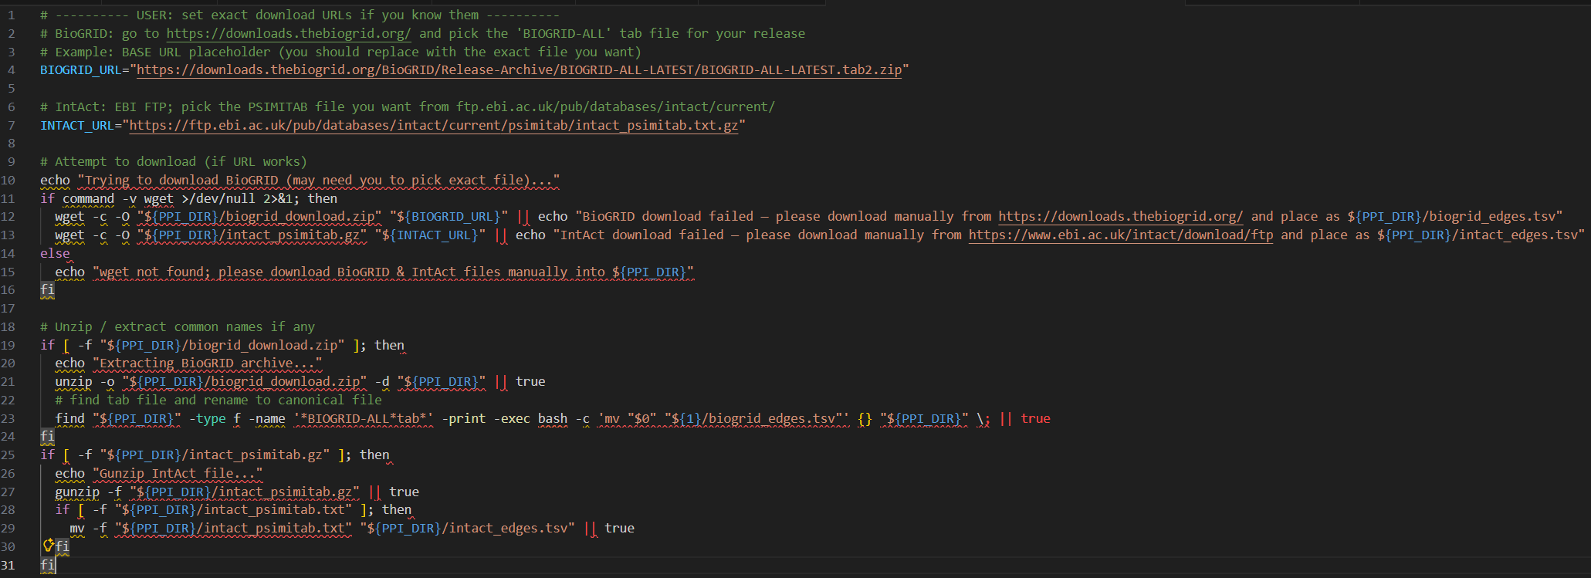
Download and extract interaction databases with script

Slide 5
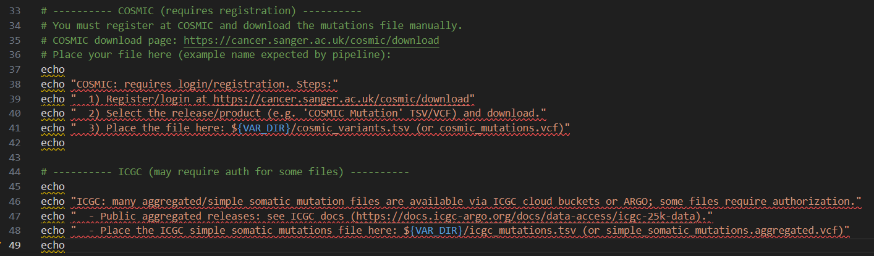
COSMIC and ICGC data require manual login

Slide 6
Raw Data overview
BioGRID Ensembl 24 columns, 2’815’791 entries
IntACT: Uniprot 42 columns, 1’726’476 entries
COSMIC 58 columns, 5’437’369 entries

Slide 7
Raw Data Processing, Filtering
Remove any non-human entries
Normalization: Split Ensembl1 | Ensembl2 | Ensembl3 | … into: Ensembl1 Ensembl2 Ensembl3 …
Remove entries lacking a matching uniport accession number
Remove columns that will not be used

Slide 8
Mapping all proteins / genes to Uniprot accession number

Slide 9
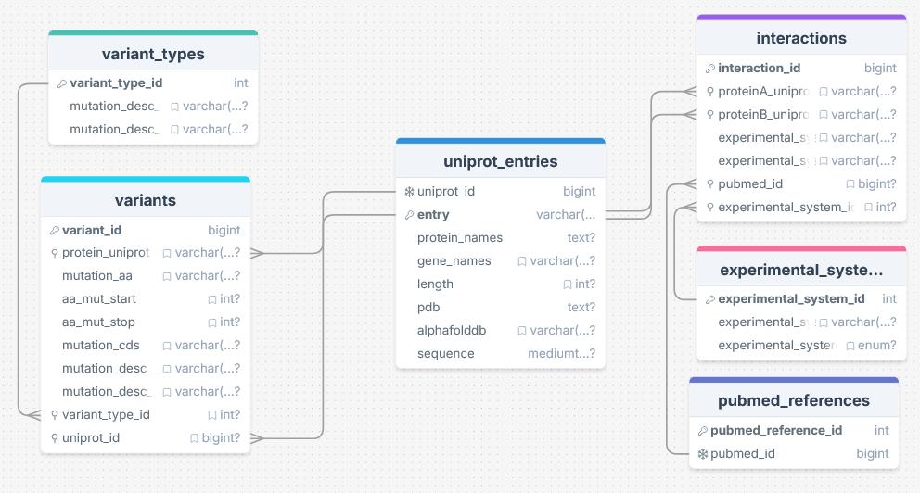
Mapping all proteins / genes to Uniprot accession number

