Slide 1
Eines Informàtiques:
Python
Ramon Crehuet
Curs 2020-2021

Slide 2
Overview
Why Python
Language basics
Functions and modules
Working with files
Classes and objects (bare minimum!)
Working with arrays: Numpy
Data visualization
Scientific modules. Scipy
Other scientfic modules: Pandas, sckikit-learn, biopython
Profiling and optimization
Beyond Python

Slide 3
Introduction

Slide 4
Overview
Why Python
Language basics
Functions and modules
Working with files
Classes and objects (bare minimum!)
Working with arrays: Numpy
Data visualization
Scientific modules. Scipy
Organizing data: pandas and xarray
Other scientfic modules: sckikit-learn, biopython
Profiling and optimization
Beyond Python

Slide 5
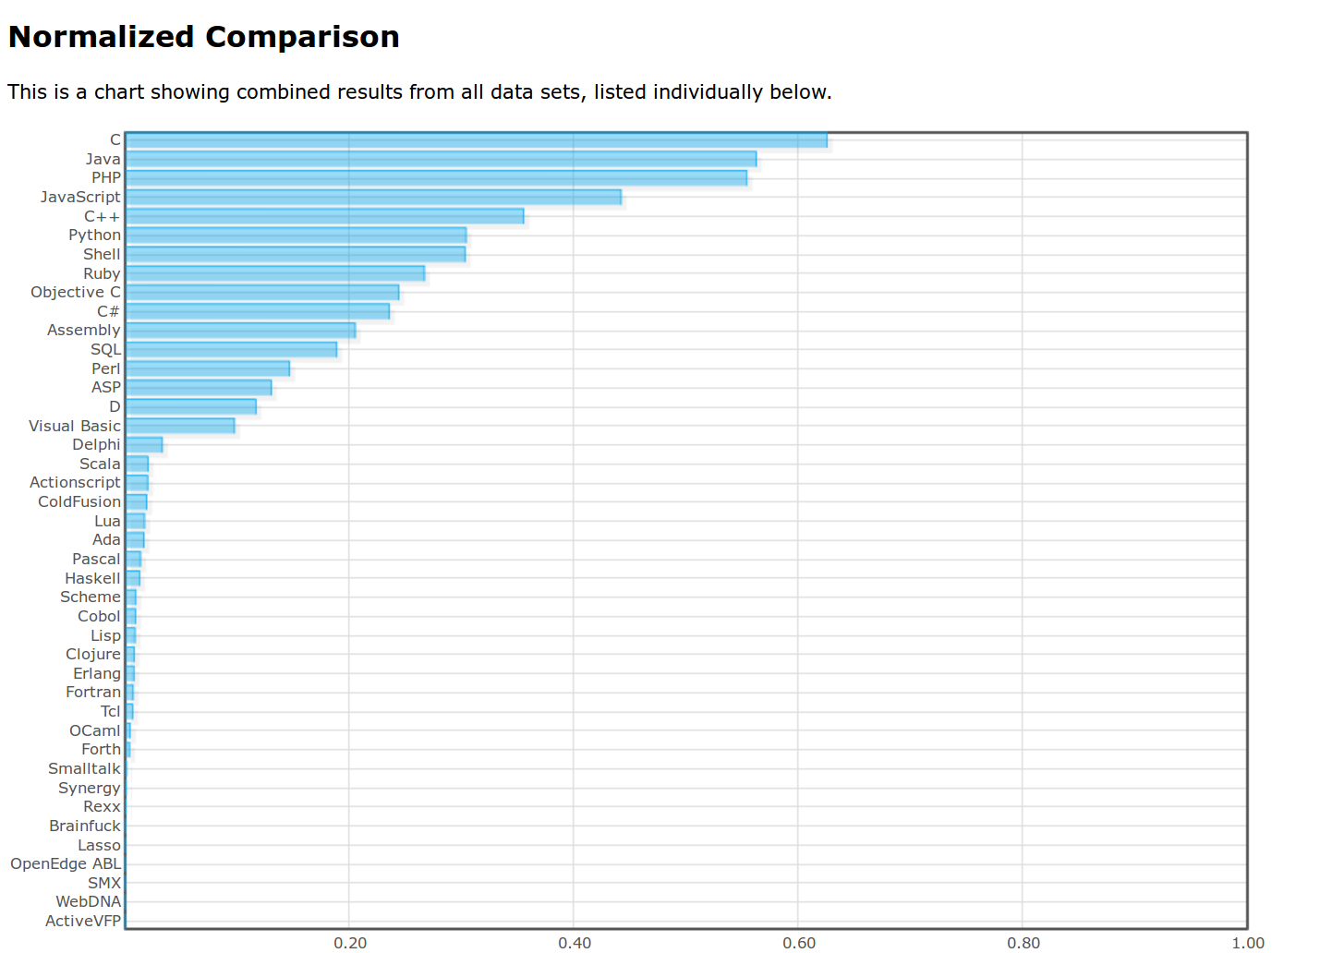
Language popularity
http://langpop.com/

Slide 6
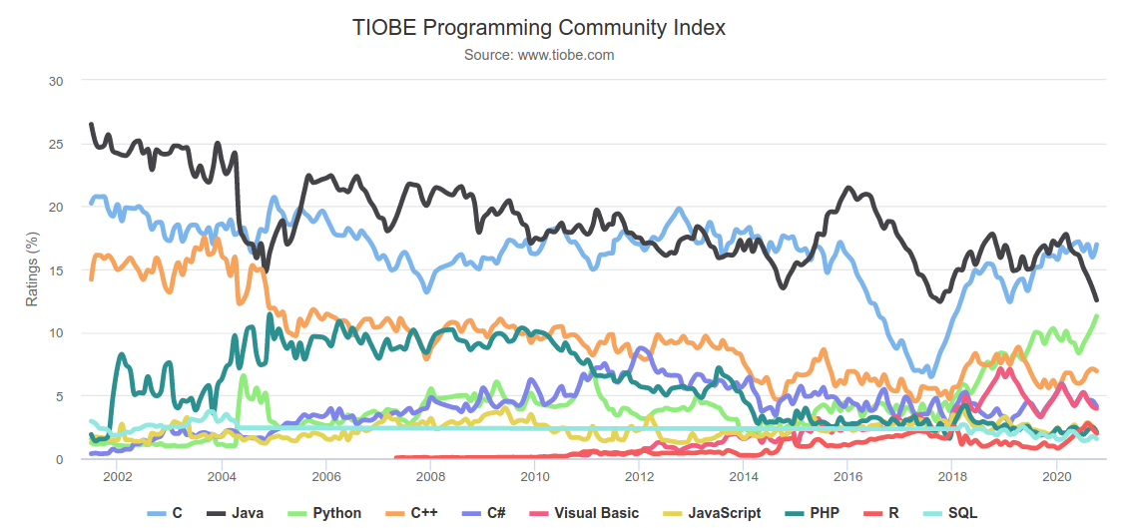
Language popularity
http://www.tiobe.com/index.php/content/paperinfo/tpci/index.html

Slide 7
Python for science
A high level language gives more time to more complex problems
  At the expense of hiding important details
Example:
  A reaction mechanism
  Optimisation of an energy function
    Steepest descent, conjugate gradients, quasi-Newton
  Implementation of BFGS quasi-Newton
    Memory issues, diagonalization, matrix inversion...
  Calculation of numerical gradients or hessians:
    machine precision, central differences, etc.

Slide 8
Python for science
Compiled languages
Fast
Difficult
non-interactive
Matlab, Mathematica, Octave
Slow
Rich libraries
Nice development environment
Restricted base language
Expensive (some)
Python
Rich libraries (less than matlab)
Other libraries
Free
Active community
Harder than Matlab

Slide 9
Matlab, Mathematica?
Scientific computing:
  ipython + scipy + matplotlib
Free
Open source
Extensible
Bioinformatics
  Biopython
Molecular Dynamics
  MMTK
Efficiency
  Numba, Cython, Cupy, Fortran, C
Server control
XML parser

Slide 10
Low level vs. high level
Python is a high level language
You can focus on:
  Low level issues
  Higher complexity of problems
Low level issues
  Variable types
  Machine precision
But also
  Extend
  Mantain
  Document code

Slide 11
Python vs. Fortran
Different time distribution to get a task done
Python
Execution time
Getting info
coding
Fortran
Execution time
Getting info
coding

Slide 12
Python Fortran
core
core
Extensions
Extensions
Program
Program

Slide 13
Python for science
The homogenization of scientific computing, or why Python is steadily eating other languages’ lunch http://www.talyarkoni.org/blog/2013/11/18/the-homogenization-of-scientific-computing-or-why-python-is-steadily-eating-other-languages-lunch/
10 Reasons Python Rocks for Research (And a Few Reasons it Doesn’t) http://www.stat.washington.edu/~hoytak/blog/whypython.html

Slide 14
Hello World program
print(“Hello World!”)
print(“Hello World!”)
$ python3 hello.py

Slide 15
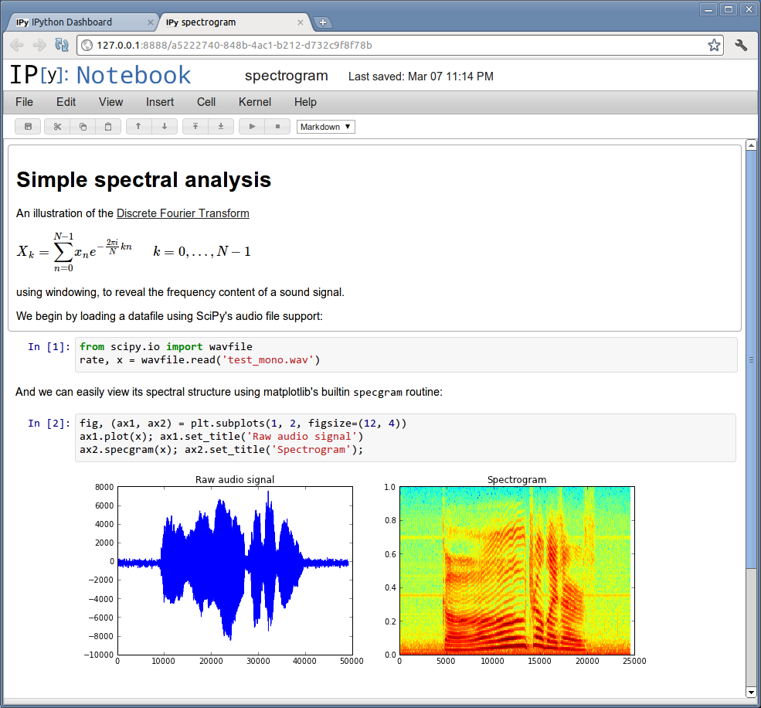
Interactive shells
python
IDLE
ipython
  shell
  notebook
spyder
visual studio code
PIDA
Sage

Slide 16
Dynamically typed
>>> a = 4
>>> type(a)
<class 'int'>
>>> b = 7.6
>>> type(b)
<class 'float'>
>>> type(a+b)
<class 'float'>
>>> c = 'Hola'
>>> c + ' Que tal?'
'Hola Que tal?'
>>> c + a
Traceback (most recent call last):
File "<stdin>", line 1, in <module>
TypeError: Can't convert 'int' object to str implicitly

Slide 17
Which python version?
Language is fast evolving
2 versions now coexist: 3.x and 2.x
These versions are not completely compatible
3.x is better and continued
2.x has some software still not ported
Both can safely coexisit
  Packages and shells are for a specific version
2to3 -w hello.py

Slide 18
Language elements

Slide 19
Numbers
Integers:
> i = 5
> j = i**i**i
Limited by amount of memory:
>>> i.bit_length()
3
>>> j = i**i**i
>>> j.bit_length()
7257
>>> 9 % 5 #modulo
4
Floating point:
>>> x = 5.
>>> y = x**x**x
Traceback (most recent call last):
File "<stdin>", line 1, in <module>
OverflowError: (34, 'Numerical result out of range')
Division vs integer division (Python 3):
>>> 3/2
1.5
>>> 3//2
1
>>> j/i #Returns a Float

Slide 20
Assignments
Explicit notation:
> i = i+1
> j = j / 10.
Short notation:
> i += 1
> j /= 10.
Floating point:
>>> x = 5.
>>> y = x**x**x
Traceback (most recent call last):
File "<stdin>", line 1, in <module>
OverflowError: (34, 'Numerical result out of range')

Slide 21
strings
Strings:
> str(6.7)
> c ='Hola'
Operations:
> s='numeric ' +'python'
> len(s)
> s[5]
'i'
> s.split()
['numeric', 'python']
> print('Result: %5.3f' % (11./3.))
3.667
Non mutable:
> s[6]
> s[6]='7'
Regular expressions
import re

Slide 22
Lists, sets and tuples
Fortran dimension:
much more flexible
> l=[6, 'a', [5,[9,8,7,6]], -6.5, (True, True)]
> [1,2]+[3,4]
> l.append(6)
sets:
s=set([4,3,2,3])
> 4 in s
True
> s
set([2, 3, 4])
Tuples are unmutable lists
t=(1,2,3)

Slide 23
Lists, sets and tuples
List indexing and methods:
> l = list(range(10))
> l[4] = 20
> l[4:]
> l[-4]
> l[:]
> l[::-1] #reverse
> l.reverse()
> l.pop()
> l.extend([3,4,5])
> l.sort()
Set methods:
> s1=set([1,2,3,4])
> s2=set([3,4,5,6,7])
> s1.union(s2)
> s1.intersection(s2)
> s1.difference(s2)
> s2.difference(s1)
> s1.intersection(s2) == s2 & s1
True
> s1 - s2 == s2 - s1
False
First index is 0

Slide 24
Uses of lists, sets and tuples
Calculate and keep all the primes < 1000
Given a coordinate file, calculate for each atom a list of all the atoms that are at less than 0.2nm.
Get the solutions of a quadratic equation (0,1,2) or (real vs. complex).
http://docs.python.org/3/tutorial/datastructures.html

Slide 25
Copying and looping over lists
lists are treated as pointers:
copying lists, makes a copy of the pointer.
> l=[1,2,3,4]
> l2=l
> l[2]=1000
l1
[1, 2 , 1000, 4]
Looping over lists:
Fortran/C style:
num=[2,3,2,3,4,5,5]
for i in range(len(num)):
print(num[i])
Pythonic style:
for item in num:
print(item)
This can be used for sets, dictionaries, and tuples.

Slide 26
Dictionaries
Setting elements:
> phone={}
> phone['Ramon']='1242'
> phone['Joan']='1323'
> phone['Quique']='1242'
> phone.keys()
['Quique', 'Joan', 'Ramon']
> d2 = dict(Ramon=1242, Joan=1323, Quique=1242)
Dictionaries are not ordered
Getting elements:
> for key in phone:
... print(key, phone[key])
Quique 1242
Joan 1323
Ramon 1242
Removing elements:
> del(phone['Ramon'])

Slide 27
The beauty of Python blocks
We are usually told to indent blocks for clarity.
Python makes this the syntax rule to identify blocks.
The code has to be nice!
Convention:
Use 4 spaces
Use spaces, not tabs.
while iter < maxIter:
x = f(x)
iter = iter + 1
if i>0:
print("i is positive")
elif i==0:
print("i is zero")
else:
print("i is negative")

Slide 28
Execution control: if
if... elif... else
if <condition>:
<block>
elif <condition>:
<block>
else:
<block>
4==4 #True
5!=4 #True
4>=5 #False
4 in [4,5] #True
result=True
if result: print('yes')

Slide 29
Execution control
Conditions can be combined with:
and or not ( )
Object identity:
> a=[1,2,3]
> b=a
> b is a
True
Any non-zero number or non-empty string is True:
> if []: print ('yes')
else: print('no')
no
> if 5 and 'result':
print('yes')
else:
print('no')
yes
> if 5 or 1/0: print('yes')
yes

Slide 30
for and while loops
For loops
> dict={4:'a',3:'b', 2:'c', 1:'d'}
> for i in dict:
print(i, dict[i])
While
while <condition>:
<block>
Break continue pass
> pass # does nothing
break: Fortran EXIT
if x>0:
pass
else:
break
cycle: Fortran CONTINUE

Slide 31
list comprehension and enumerate
simple way to create lists:
> l=[x**2 for x in range(8)]
[0, 1, 4, 9, 16, 25, 36, 49]
with conditionals:
l2= [(i, -2*i+3) for i in l if i % 3 == 0]
[(0, 3), (9, -15), (36, -69)
Nested lists:
> [(x, y) for x in [1,2,3] for y in [3,1,4] if x != y]
[(1, 3), (1, 4), (2, 3), (2, 1), (2, 4), (3, 1), (3, 4)]

Slide 32
list comprehension and enumerate
Enumerate indexes lists:
line='how do you do?'
line=line.split()
for i, word in enumerate(line):
print(i, word.upper())
0 HOW
1 DO
2 YOU
3 DO?
Enumerate returns an iterator
> enumerate(['a', 'b', 'c'])
<enumerate object at 0x1ebeaa50>

Slide 33
Be pythonic
Convert the negative elements of a list to positive
>>> x = [1, 2, -4, -5, 3, -5]
j = 0
while j < len(x):
x[j] = abs(x[j])
j += 1
for j in range(len(x)):
x[i] = abs(x[i])
Or with list comprehensions
x = [abs(j) for j in x]
Or with functional programming
x= map(abs, x) #returns an iterator
http://docs.python-guide.org/en/latest/writing/style/

Slide 34
More python functions
print(3,4,5, sep='o', end='<<<<\n')
zip([1,2,3], ['a', 'b', 'c', 'd'])
a = input('Write a number: ')
len([1,2,3])
list(range(5))
range(20,10,-1)
sorted([5,4,3,5])
sum([5,4,3,5])
http://docs.python.org/3.3/library/functions.html

Slide 35
Mutable and immutable
>>> a = 4
>>> id(a)
9157088
>>> a += 2
>>> id(a)
9157152
>>> s = 'Hola'
>>> id(s)
140165884365656
>>> s = s+ ' que tal?'
>>> id(s)
140165884365712
>>> ll = [3,4,5]
>>> id(ll)
140165884674416
>>> ll.append(6)
>>> id(ll)
140165884674416
Mutable objects can be mutated.
  Their identity remains the same
Immutable objects are “mutated” by creating a new object

Slide 36
Identity and equality
>>> a = 4
>>> b = a
>>> a is b
True
>>> id(a)
9157088
>>> id(b)
9157088
>>> l1 = [1,2,3,]
>>> l2 = l1
>>> l2 = l1[:]
>>> l2 is l1
False
>>> l2 == l1
True
>>> 1.0 is 1.0
True
>>> 1.0 == 1.0
True
>>> 1 == 1.0
True
>>> 1 is 1.0
False

Slide 37
Objects: everything
>>> a = 5
>>> isinstance(a, int)
True
>>> object
<class 'object'>
>>> int
<class 'int'>
>>> isinstance(a, object)
True
>>> issubclass(int, object)
True
Objects have variables:
> c = 4+5j
> c.real
Objects have methods:
> c.conjugate #the method
> c.conjugate() #its call
And we can apply functions to objects:
> abs(c)

Slide 38
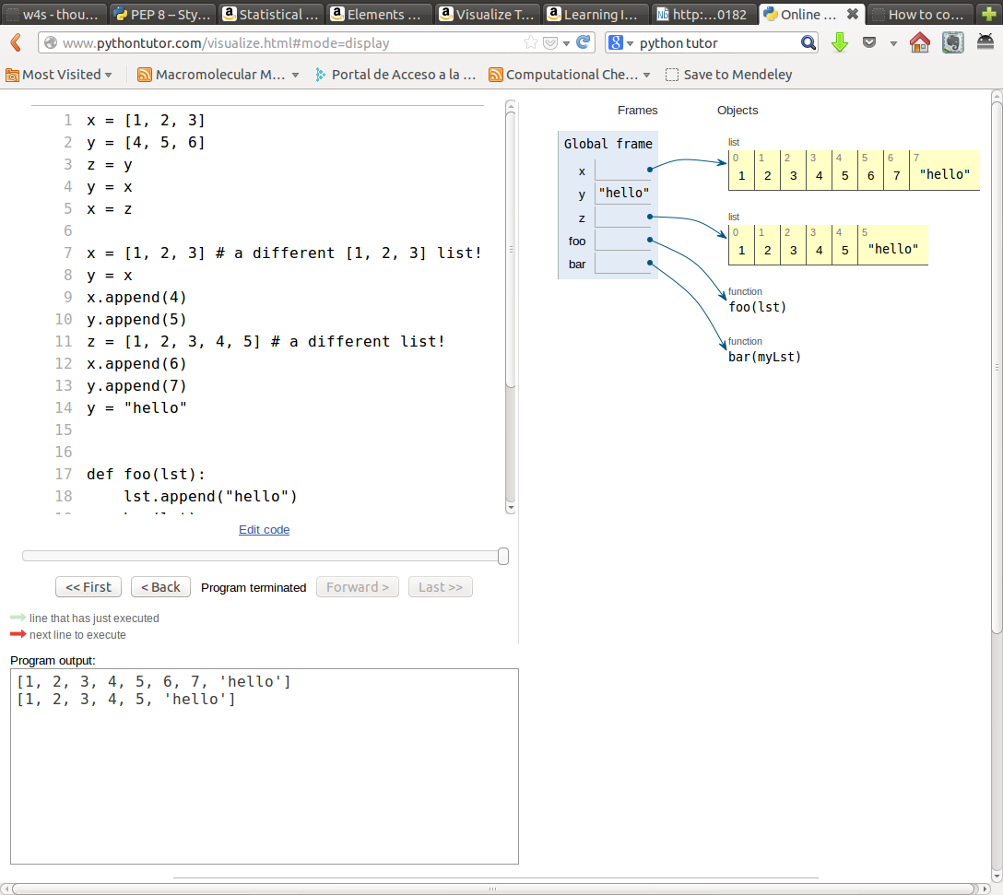
Python flow with pythontutor

Slide 39
try... except
“Look before you leap”:
def safe_divide_1(x, y):
if y==0:
print("Divide-by-0 attempt detected")
return None
else:
return x/y
“It's easier to ask forgiveness than permission”:
def safe_divide_2(x, y):
try:
return x/y
except ZeroDivisionError: print("Divide-by-0 attempt detected")
return None

Slide 40
Short notebook tutorial
But watch “I don’t like notebooks”:
http://ipython.org/ipython-doc/dev/interactive/tutorial.html

Slide 41
beyond python
TAB autocomplete:
functions
methods
files
…
reload command
cursor keys get history:
even previous sessions!
text + keys: previous match
?: intro to ipython
%quickref
Ctrl-r : previous commands
Without ipython:
python3 -u script.py enters interactive mode
>>> import rlcompleter, readline
>>> readline.parse_and_bind('tab:complete')

Slide 42
Magic functions
%timeit x=10 : time the 'x=10' statement with high precision.
%%timeit x=2**100
x*100 : time 'x*100' with a setup of 'x=2**100'; setup code is not
counted. This is an example of a cell magic.
%cpaste, %paste: Paste & execute a pre-formatted code block from clipboard.
%history
%load_ext
%run
%pdb: Control the automatic calling of the pdb interactive debugger.
%pylab
%timeit
%pwd
%cd
%%bash
http://ipython.org/ipython-doc/dev/interactive/tutorial.html

Slide 43
running scripts
%run script.py
import script.py
are not the same!
%run script.py is like python3 script.py

Slide 44
ipython notebook
Nice presentation
Allows parallel execution
Combines text and code
Executable or exportable to:
  html
  LaTeX
  python
Start with: ipython3 notebook
Examples: https://github.com/jrjohansson/scientific-python-lectures

Slide 45
Files

Slide 46
Files
Files can be text of binary files
Files can be opened for read, write or append
  'r', 'w', 'a+'
with open('name') as filein:
  Allows automatic file closure

Slide 47
Reading / Writing Files
file_in=open('indata.txt','r')
file_out=open('outdata.txt','w')
for line in file_in:
# Take some information (split() method is very useful!)
x = float(line.split()[0])
# Apply a given function (fact)
fx = fact(x)
# Write the result in an output file with a defined format
file_out.write('{%:010.3f}\n'.format(fx))
But for loading numerical data Numpy is more efficient...

Slide 48
File parsing
The basic:
  for line in filein:
  do something
Common things:
  if 'optimized' in line: do something
  line = line.split()
  if line.upper().startswith('GEOM'): …
  energy = float(line[2])

Slide 49
skipping lines
Lines can be skipped by calling next() to a file:
for line in filein:
if 'Optimized' in line:
next(filein); next(filein) #skip two lines
do something...

Slide 50
Formatting
There are several function:
  '12'.rjust(5), '12'.zfill(5)
But format is more general:
  print('{0:2d} {1:3d}'.format(x, x*x))
  print("{:10.3f} {:10.3f} {:10.3f}".format(x,y,z))
List of unkown length:
  vals = np.linspace(0,1,11)
  print((len(vals)*"{:10.2e} ").format(*vals))
http://docs.python.org/3/library/string.html#formatspec

Slide 51
Useful modules
Similar to ls:
  import glob
  files = glob.glob(pattern)
Working with shell-like commands:
  import os
  os.rename(src, dst)
  os.mkdir(path)
  os.chown(path, uid, gid)
  os.getenv(key)
  os.walk(directory)
http://docs.python.org/3/library/os.html

Slide 52
Useful modules
Reading Excel files:
  import xlrd
Working with image files:
  from PIL import Image
http://www.python-excel.org/
http://pillow.readthedocs.org/en/latest/

Slide 53
Numpy

Slide 54
Why Numpy / Scipy?
Python (alone) is not efficient for numerical calculations
Python (alone) is not practical for array manipulation
Numpy provides the data types and methods for arrays
Scipy provides more elaborate numerical methods
  Optimization
  Fast Fourier Transform
  Linear algebra, etc
  import numpy as np
  import scipy.optimization
  import scipy.stats as stats

Slide 55
numpy arrays
without numpy:
> a=[[1,2],[3,4]]
> b=[[10,20], [30,40]]
> a+b
[[1, 2], [3, 4], [10, 20], [30, 40]]
with numpy:
> a=np.array(a)
> b=np.array(b)
> a+b
array([[11, 22],[33, 44]])
Array creation
a=np.array([1,2,3,4]).reshape([2,2])
a=np.array([[1,2], [3,4]])
a=np.zeros([2,2], dtype=int)
a[0,0]=1.
a=np.ones((4,4))
a=np.arange(10)
a=np.diag([1,2,3,4])
a=np.tile(a, (10,2))
a=np.identity(3)
a=np.linspace(-5,5, 20)

Slide 56
Ufuncs
Unary:
a.min()
a.sum()
a.cumsum()
a.mean()
np.argmin(a)
np.exp(-a)
np.cov(a)
a.tolist()
Binary:
a + b
np.dot(a, b)
Applying to parts of an array:
> a=np.array([[1,2], [3,4]])
> a.min(axis=0)
array([1, 2])
a.sum(axis=1)
array([3, 7])
Python functions are less efficient than numpy functions:
a.sum() better than sum(a)
np.min(a) better than min(a)
many implemented as methods and functions

Slide 57
Accessing array elements
Slicing:
> a[2:5]
> b[:, ::5]
> a[1:4, ...]
Fancy indexing:
  Boolean arrays (masks):
> a = np.arange(10,15)
> indices = (a**2 > 115) & (a < 14)
> a[indices]
array([11, 12, 13])
  With lists:
> a = np.arange(10,15)
> y=a[[4,4,1]]
> y
array([14, 14, 11])
> a[[4,4,1]] = [-2, -4, 5]
> a
array([10, 5, 12, 13, -4])

Slide 58
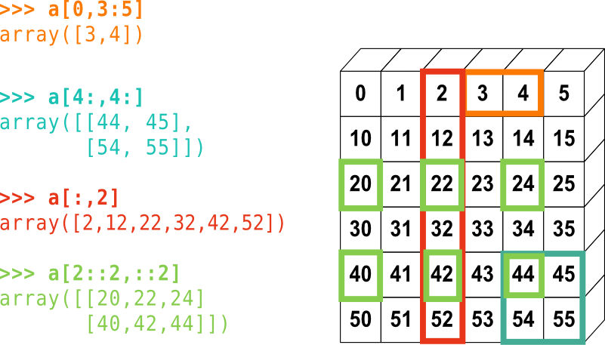
Accessing array elements
From: https://scipy-lectures.github.io/intro/numpy/array_object.html

Slide 59
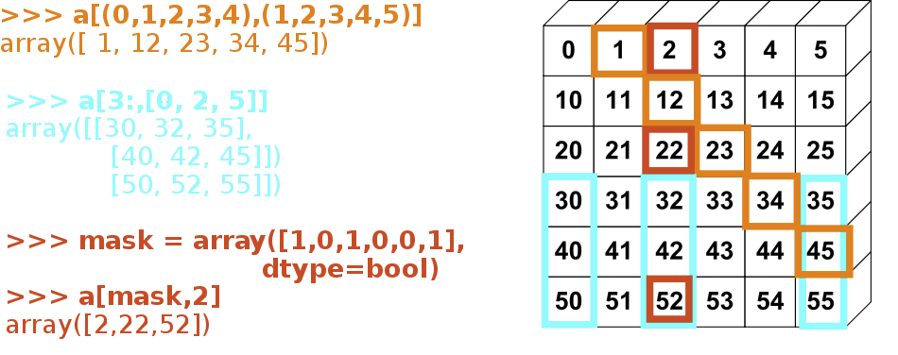
Accessing array elements
From: https://scipy-lectures.github.io/intro/numpy/array_object.html

Slide 60
Accessing array elements
Slices return views
> a = np.arange(5)
> y=a[2:5]
> y *= -1
> a
array([ 0, 1, -2, -3, -4])
> y.flags.owndata
False
np.where
> np.where((a>=2)&(a<4), a**2, -1)
Array([-1, -1, 4, 9, -1])
np.choose
  Powerful, but complex!
np.nonzero
Boolean arrays return copies
> a = np.arange(5)
> y = a[a>1-5]
> y *= -1
> a
array([0, 1, 2, 3, 4])
> y.flags.owndata
True
Fancy indexing returns copies:
> a = np.arange(5)
> y=a[[2,3,4]]
> y *= -1
> a
array([0, 1, 2, 3, 4])
> y.flags.owndata
True

Slide 61
Broadcasting
> a = 4.
> b = np.array([1,2,3])
> c = np.array([[1,2,3], [4,5,6]])
> b+a, c+a
(array([ 5., 6., 7.]), array([[ 5., 6., 7.],
[ 8., 9., 10.]]))
> b+c
array([[2, 4, 6],
[5, 7, 9]])
> c.dot(b)
> b.dot(c)
ValueError: objects are not aligned
> b[1:]*c
ValueError: operands could not be broadcast together with shapes (2) (2,3)
> b[1:]*c.T
Use matrix if you want more algebra-like behaviour

Slide 62
Broadcasting
The size of the trailing axes for both arrays in an operation must either be the same size or one of them must be one.
When operating on two arrays, NumPy compares their shapes element-wise. It starts with the trailing dimensions and works its way forward. Two dimensions are compatible when
  they are equal, or
  one of them is 1

Slide 63
array functions and methods
Array reduction and logical operations:
> a=np.arange(5)
> np.all(a>3)
False
> np.any(a>3)
True
> a > 3
array([False, False, False, False, True], dtype=bool)
> (a > 3) & (a < 5)
array([False, False, False, False, True], dtype=bool)
Some details of memory use:
a.iscontiguous()
Useful when interfacing with fortran / C:
a.is_c_array()
a.is_f_array()

Slide 64
Loading and saving data
Pickle is the usual way to save and restore data in Python
We often have data file in text format:
#Dist Energy
1.0 34.
1.2 38.
2.4 42.
> f=np.loadtxt(“energies.dat”)
> f
array([[ 1. , 34. ],
[ 1.2, 38. ],
[ 2.4, 42. ]])
Save single arrays with:
> np.save('result_y', y)
Save in text mode with:
> np.savetxt('result_y', y)
and multiple arrays with:
> np.savez('results', x, y)
Recover them with load:
> y=np.load('results_y.npy')
> npz=np.load('results.npz')

Slide 65
pandas and xarray

Slide 66
Beyond numpy
Pandas:
  Dataframes with named columns and rows
  Similar to a spreadsheet
  Great for data analysis
  https://pandas.pydata.org/
xarray
  labeled multidimensional arrays: n-dimensional pandas-like dataframes
  http://xarray.pydata.org/en/stable/

Slide 67
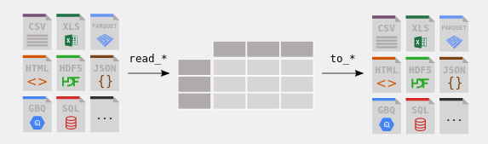
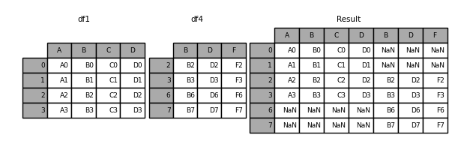
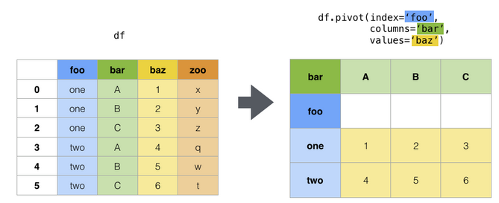
pandas
import pandas as pd
Creation of DataFrames:
  From files (many formats):
    read_table, read_csv, read_...
  From python dictionaries, arrays:
    pd.DataFRame(dict)
  From other dataframes:
    df1.append(df2), pd.concat([df1, df2]), pd.merge
Accessing elements:
  df.loc[], df.iloc[]
Reshaping:
  pd.pivot, pd.stack, pd.melt
See https://pandas.pydata.org/docs/getting_started/index.html

Slide 68
pandas
Compare:
  pd.DataFrame(np.random.random(size=(3,4))
  pd.DataFrame(np.random.random(size=(3,4)),
          columns=['A', 'B', 'C', 'D'])
  pd.DataFrame(np.random.random(size=(3,4)),
  columns=['A', 'B', 'C', 'D'],
  index=[300., 320., 350.])
  df= pd.DataFrame(np.random.random(size=(3,4)),
  columns=['A', 'B', 'C', 'D'],
  index=[300., 320., 350.])
  df.index.rename('Temperature', inplace=True)

Slide 69
seaborn: plotting dataframes
import pandas as pd
import seaborn as sns
Seaborn is a library for making statistical graphics in Python.
  https://seaborn.pydata.org/introduction.html
penguins = sns.load_dataset("penguins")
# Show the joint distribution using kernel density estimation
g = sns.jointplot(
data=penguins,
x="bill_length_mm", y="bill_depth_mm", hue="species",
kind="kde")

Slide 70
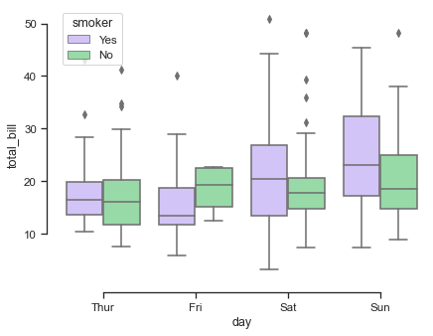
seaborn
sns.set_theme(style="ticks",
palette="pastel")
# Load the example tips dataset
tips = sns.load_dataset("tips")
# Draw a nested boxplot to show bills by day and time
sns.boxplot(x="day", y="total_bill",
hue="smoker", palette=["m", "g"],
data=tips)
sns.despine(offset=10, trim=True)

Slide 71
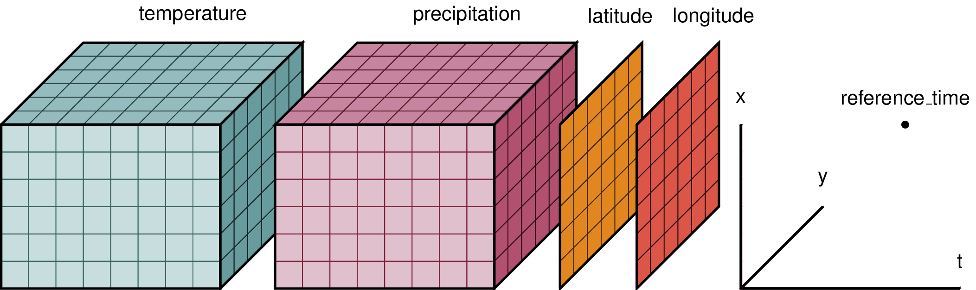
xarray
import xarray as xr
Multi-dimensional labelled arrays (N-D pandas datafrmes)
See http://xarray.pydata.org/en/stable/
ds = xr.Dataset({ "temperature": (["x", "y", "time"], temp),
"precipitation": (["x", "y", "time"], precip),},
coords={"lon": (["x", "y"], lon), "lat": (["x", "y"], lat),
"time": pd.date_range("2014-09-06", periods=3),
"reference_time": pd.Timestamp("2014-09-05")})

Slide 72
matplotlib

Slide 73
Matplotlib
A module for plotting 2D and 3D data
Combines well with numpy
Starts with
  import matplotlib.pyplot as plt
  %matplotlib inline
  import pylab or similar is deprecated.

Slide 74
Matplotlib
Simplest plots:
  > plt.plot([1,2,3], [1,4,9])
  > plt.plot(x, sin(x), '--') #where x is a numpy array
  > plt.figure() # creates new figure
  > plt.clf() # Clears current figure
  > plt.matshow(m) # m is a 2D array
  > plt.imshow(m) # m is a 2D array. Similar to matshow.
  > d = np.loadtxt('data.txt')
  > plt.plot(d[:,0], d[:,1], 's') #just slightly longer than gnuplot

Slide 75
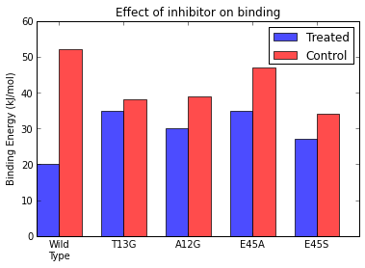
Matplotlib
Totally reproducible
figures
N = 5
treated = (20, 35, 30, 35, 27)
control = (52, 38, 39, 47, 34)
ind = np.arange(N) # the x locations for the groups
width = 0.35 # the width of the bars
fig, ax = plt.subplots()
rects1 = ax.bar(ind, treated, width, color='b', alpha=0.7, label='Treated')
rects2 = ax.bar(ind+width, control, width, color='r', alpha=0.7, label = 'Control')
# add some
ax.set_ylabel('Binding Energy (kJ/mol)')
ax.set_title('Effect of inhibitor on binding')
ax.set_xticks(ind+width)
ax.set_xticklabels( ('Wild\nType', 'T13G', 'A12G', 'E45A', 'E45S') )
ax.legend()

Slide 76
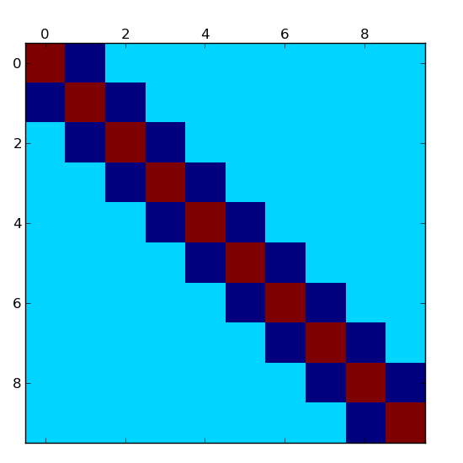
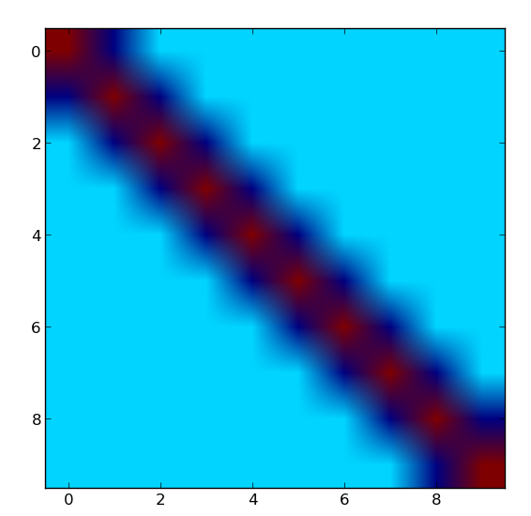
Plotting matrices
m=np.diag(2*np.ones(10))+np.diag(-1*np.ones(9),1)+np.diag(-1*np.ones(9), -1)
matshow(m)
imshow(m)

Slide 77
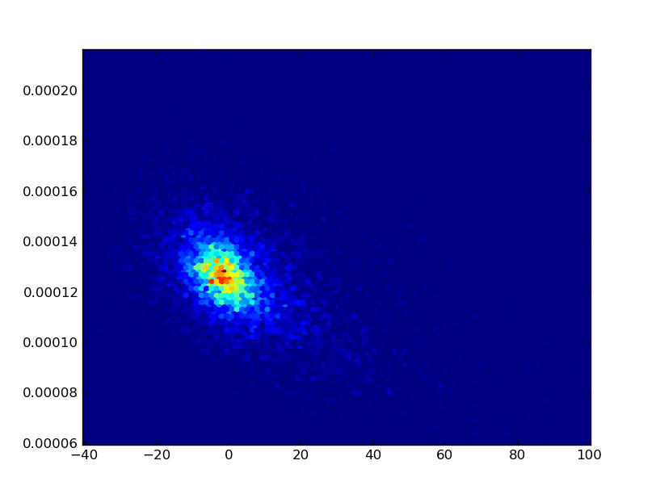
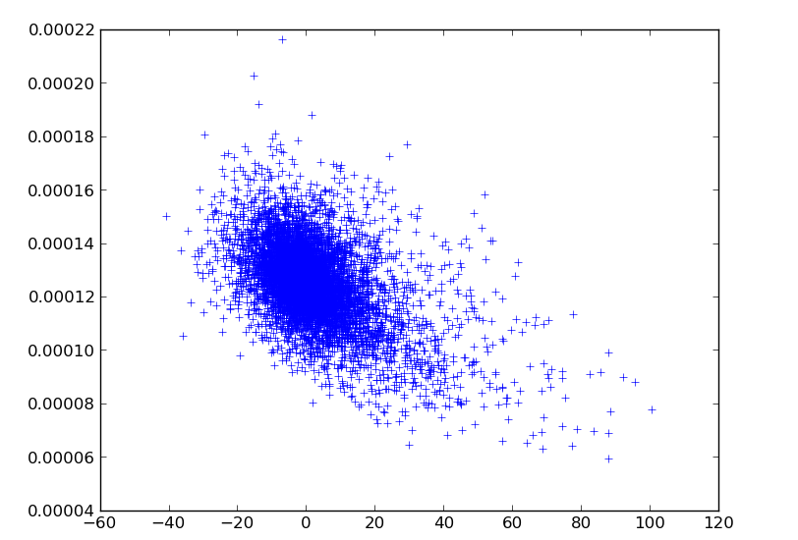
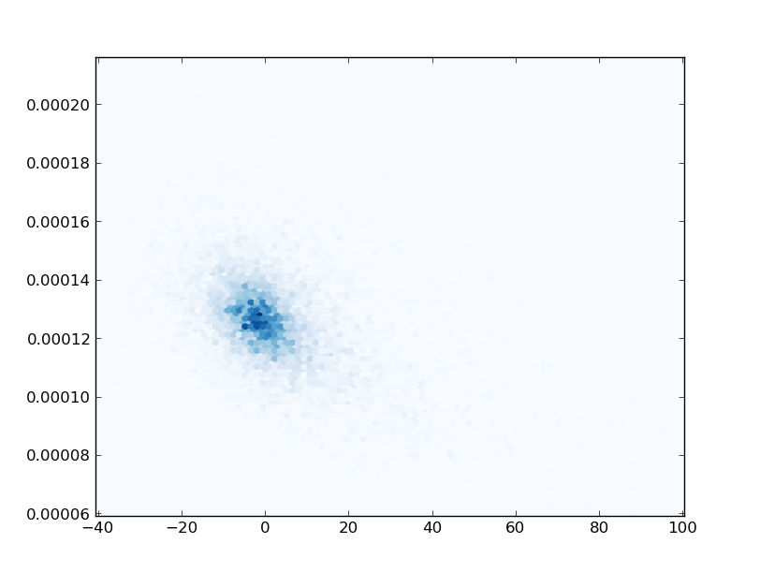
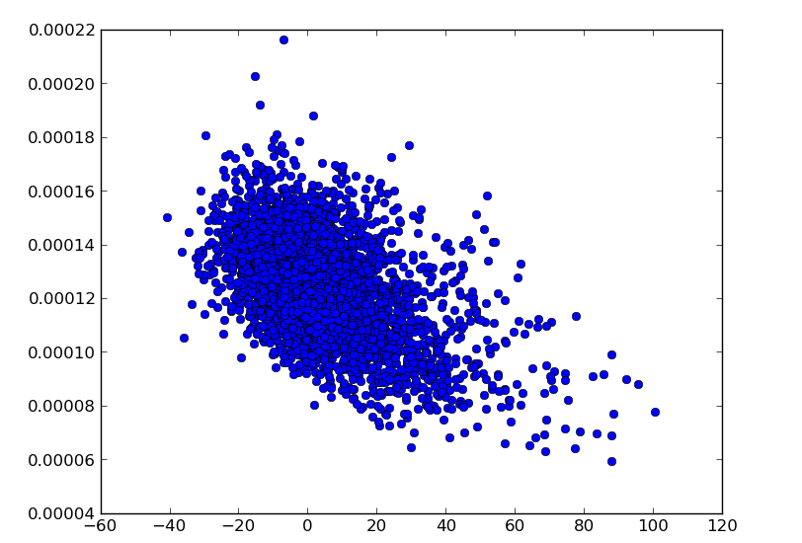
Plotting lots of points:hexbin
plt.hexbin(x, y)
plt.plot(x, y, '+')
plt.hexbin(x, y, cmap=pylab.cm.Blues)
plt.plot(x, y, 'o')

Slide 78
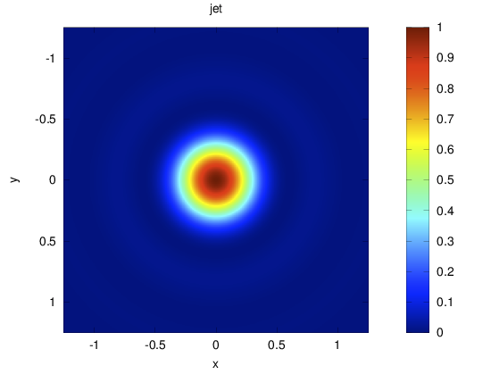
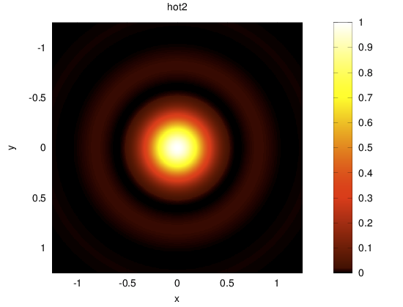
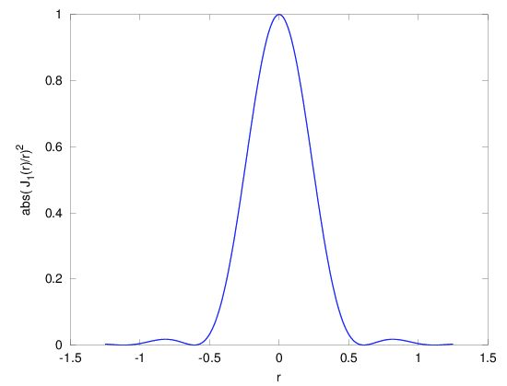
Jet is not a good colormap
http://cresspahl.blogspot.com.es/2012/03/expanded-control-of-octaves-colormap.html
https://jakevdp.github.io/blog/2014/10/16/how-bad-is-your-colormap/

Slide 79
Matplotlib
Do Lecture-4-Matplotlib.ipynb from http://jrjohansson.github.io/
  Other interesting material there...
Check matplotlib gallery
  http://matplotlib.org/gallery.html
Quick reference of symbols and colours:
  http://www.loria.fr/~rougier/teaching/matplotlib/#quick-references
  (part of a larger tutorial)
Some more tricks and examples:
  http://wiki.scipy.org/Cookbook/Matplotlib

Slide 80
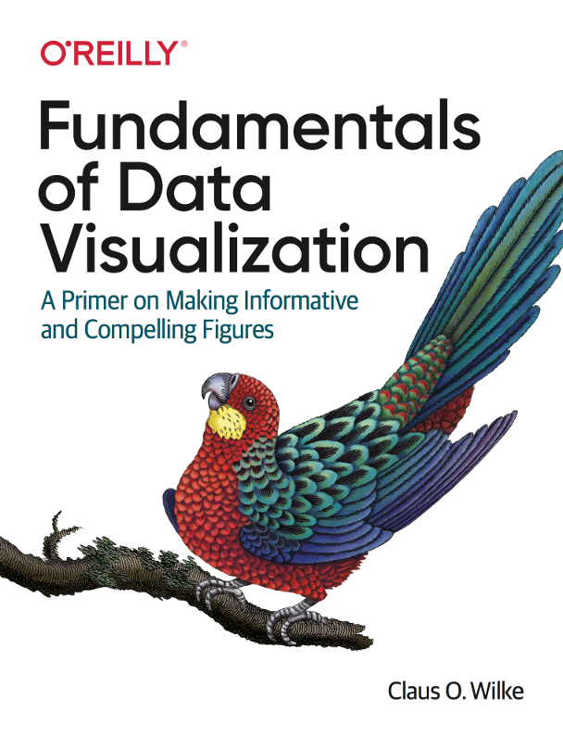
Making nice plots
https://clauswilke.com/dataviz/

Slide 81
Functions and modules

Slide 82
Exceptions and errors
Although the language is interpreted there are some syntax errors that prevent execution:
def safe_divide_1(x, y)
File"/home/ramon/python/prova.py", line 1
def safe_divide_1(x, y)
^
SyntaxError: invalid syntax
Exceptions leave a trace easy to follow.
Easy debugging with
%pdb
%debug

Slide 83
Functions
defined by def and a colon:
def add(x,y):
return x+y
Remember indentation!
Automatic (and recommended) documentation:
def add(x,y):
””” Returns the
sum of 2 numbers”””
return x+y
Functions can be seen as both fortran procedures and functions but...
Arguments are passed by reference
there is access to global variables:
> def x_val(): print(x)
> x=60
> x_val()
60

Slide 84
Functions II
Function variables are local :
> def x_val():
... x=40
... print(x)
> x=60
> x_val()
40
> x
60
to assign variables, use return
def x_val():
... x=40
... print(x)
... return x
> x = xval()
40
> x
40

Slide 85
Functions III
Mutable objects are passed by reference:
> def square_0(lst):
... lst[0]*=lst[0]
> a=[3,2,1]
> square_0(a)
> a
[9,2,1]
Copy variables that need to be preserved:
> a_copy=a[:]
> square_0(a)
> import copy
> import copy
> a_copy=copy.deepcopy(a)

Slide 86
Functions IV
Functions can have default arguments :
> def submit(job, priority=10, nprocs=1):
... pass
> submit('job1.sh')
Function arguments do not have explicit types.
> add('Python ', 'summerschool')
Python summerschool
Functions can be recursive
def fact(n):
if n == 1:
return 1
else:
return n * fact(n-1)

Slide 87
Argument unpacking
Starred arguments are tuples that collect positional arguments :
> def prod(*args): ...
> prod(2,3,4)
> x = (4, 5, 6)
> prod(*x)
In prod, args=(2,3,4)
Keword arguments can be passed as a dictionary:
> options = dict(paper='A4', color = True)
print_setup(options)
Unpacking can be a convenient way to print a list:
> vals = [1,2,3,4,5]
> print((4*'{:03d} ').format(*vals))
001 002 003 004

Slide 88
Lists or iterators?
Lists are iterable objects
Iterators generate objects on-the-fly
Iterators can be created with a generator function
  Uses yield satement
Relevant for efficiency
def rang_llista(n):
result = []
i = 0
while i<n:
result.append(i)
i += 1
return result
def rang_gen(n):
i = 0
while i<n:
yield i
i += 1

Slide 89
Modules
Modules allow packing libraries or extensions
There are built-in and external modules
When imported modules are executed
Modules can be written in C or Fortran!
> import math
> m = math
> import math as m
> from math import cos, sin
> from math import * #dangerous. All into the same namespace

Slide 90
Modules
Python checks if a module is already loaded.
  The interpreter does not reload a module already imported
  This can cause unexpected behaviour interactively
Ipython has a more versatile module loading
%load_ext autoreload
autoreload 2 #Will reload a module if it changes

Slide 91
Some useful modules
sys — System-specific parameters and functions
os — Miscellaneous operating system interfaces
os.path — Common pathname manipulations
glob — Unix style pathname pattern expansion
re — regular expressions
copy — Shallow and deep copy operations
argparse — Parser for command-line options, arguments and sub-commands
subprocess — Subprocess management
inspect — Inspect live objects

Slide 92
Some useful modules
if len(sys.argv!=3):
print('Error: Use two arguments.')
sys.exit()
method = sys.argv[1]
filelist = glob.glob('/home/ramon/*')
for fileName in filelist:
if os.path.isfile(fileName): print(fileName)

Slide 93
Modules: too many...
From the python documentation:
It is also possible to use a list as a queue, where the first element added is the first element retrieved (“first-in, first-out”); however, lists are not efficient for this purpose. While appends and pops from the end of list are fast, doing inserts or pops from the beginning of a list is slow (because all of the other elements have to be shifted by one).
To implement a queue, use collections.deque which was designed to have fast appends and pops from both ends.

Slide 94
Modules: too many...
>>> import math
>>> import cmath
>>> import numpy.lib.scimath as scimath
>>> math.sqrt(4)
2.0
>>> math.sqrt(-4)
Traceback (most recent call last):
File "<stdin>", line 1, in <module>
ValueError: math domain error
>>> cmath.sqrt(4)
(2+0j)
>>> cmath.sqrt(-4)
2j
>>> scimath.sqrt(4)
2.0
>>> scimath.sqrt(-4)
2j

Slide 95
Working with your modules
Import reads from local directory and from the directories in sys.path (import sys first)
Put your modules in a directory and add it to the environtment variable $PYTHONPATH.
Python will add the directories in $PYTHONPATH to sys.path
Document your modules and the functions therein.
Use if __name__=='__main__': to execute code only if Python is running the module, and not if it is imported.
  http://stackoverflow.com/questions/419163/what-does-if-name-main-do

Slide 96
Installing external Modules
Use conda distribution. Then `conda install module`
Many come as part of the linux distributions (usually older versions)
  ipython, numpy, biopython...
For modules in the PyPI repository(most of them) https://pypi.python.org/pypi
  Use pip-3 or pip3
Use:
  $ python setup.py build
  $ (sudo?) python setup.py install

Slide 97
Scipy

Slide 98
Linear algebra
Support for LAPACK, BLAS and ATLAS
  Can make Scipy compilation more involved
> A=matrix(random.rand(5,5))
> A.I
> linalg.det(A)
> linalg.eigvals(A)
> linalg.eig(A)
> linalg.svd(A)
> linalg.cholesky(A)
Solving linear systems:
  A.x=b
> b=matrix(random.rand(5)).reshape((5,1))
> linalg.solve(A,b)
LAPACK, BLAS wrappers
> from scipy.lib import lapack
> from scipy.lib import blas
blas.fblas.sdot?

Slide 99
Linear regression
There are different ways to perform linear regression (still surprised?)
See the notebook.

Slide 100
Optimization
There are different optimization methods:
> import scipy.optimize as so
Some only need the function value:
> fmin, fmin_powell
Some need the gradient or the hessian:
> fmin_cg, fmin_bfgs, fmin_ncg
Some look for global minima:
> anneal
Remember:
> scipy.info('optimize')
Pedagogical documentation:
http://docs.scipy.org/doc/scipy/reference/tutorial/optimize.html
http://docs.scipy.org/doc/scipy/reference/optimize.html

Slide 101
f2py
Many things are fast with Numpy
Iterative algorithms over array values are slow
You can import Fortran functions and subroutines with f2py
You could also call external fortran programs with
> subprocess.call(<program>, shell=True)
  but data exchange has to be through files (slower)
f2py finds your fortran compiler. Works with gfortran, ifort,...
f2py creates a module you can import in python
As simple as:
$ f2py -c <file> -m <module>
  Tip: first compile it to check it works

Slide 102
f2py II
module funcs
implicit none
contains
function f1(x,y)
real,intent(in):: x,y
real:: f1
f1=x+y**2
end function f1
function f2(x,y)
real,intent(in):: x,y
real, dimension(3):: f2
f2(1)=x+y**2
f2(2)=sin(x*y)
f2(3)=2*x-y
end function f2
end module
$ f2py -c test.f90 -m test
go to ipython:
> import test
> test.funcs.f1(1,2)
5.0
> test.funcs.f2(1,2)
array([ 5., 0.90929741, 0.], dtype=float32)

Slide 103
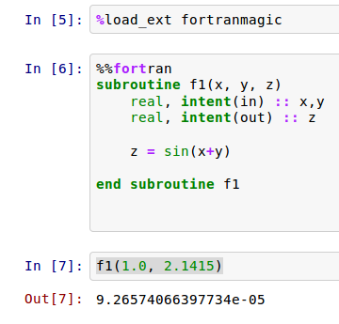
f2py III
Using ipython magicfunctions:
sudo pip3 install -U fortran-magic
Useful for performing long array operations

Slide 104
Big data, big memory
Numpy arrays are meant to live in memory
If that is not possible:
  Use op= operations (they use half the memory):
    p *=alpha is better than p = p*alpha
  Use scipy.sparse matrices
  Use PyTable to store (compressed) matrices on disk
  Modify your algorithm to work with submatrices

Slide 105
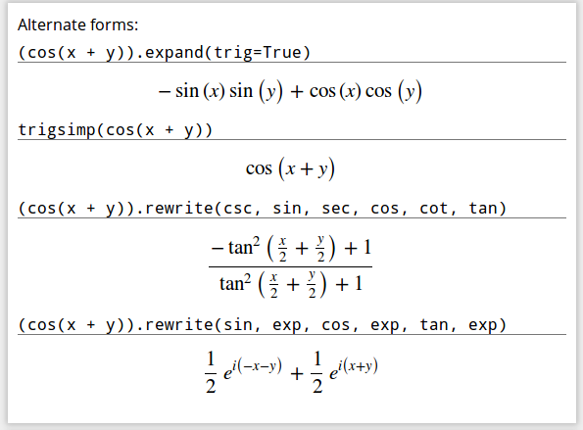
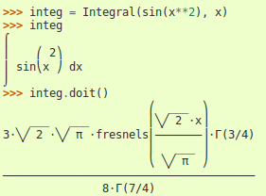
Sympy: Symbolic math
Symbolic algebra
Analytic solution of equations
Integration, derivation
Polynomials
Limis
http://sympy.org/en/index.htm l

Slide 106
Classes

Slide 107
Classes and objects
Most simple examples are quite stupid...
Everything is an object with python.
Objects have methods
sort is a method of list objects
They have to be called with ()
Objects have attributes
c.real is an attribute
Example: you have a set of sensors
Sensors have position
Sensors have a value
Sensors can be reset

Slide 108
Classes and objects II
Sensor is an object
Each object has methods (and attributes)
sensor[i].position
sensor[i].value
sensor[i].reset(0.0)
Fortran / C:
Generate arrays for each property:
position[i]
value[i]
subroutine reset(i, val)

Slide 109
Classes and objects III
Better Fortran / C:
use struct (in C)
use type (in Fortran)
type sensor
real, dimension(3) :: position
real :: value
end type sensor
sensor[i]%position
sensor[i]%value
reset ?
But now you also have clocks:
clocks have values
clocks can be reset
What does value refer to?
What is the argument of reset?

Slide 110
Objects and inheritance
New classes are defined as:
class Point:
def __init__(self,x,y):
self.x=x
self.y=y
Classes allow the definition of elaborate personal objects
class Num_List(list):
def __init__(self, lst=None)
list.__init__(self,lst)
def square(self):
for i in range(len(self)):
self[i]=self[i]**2
> a=num_list([1,2,3])
> a.square()
> a
[1, 4, 9]

Slide 111
A periodic table of objects
Each chemical element can be defined as a object.
Attributes such as:
Name
atomic symbol
atomic weight
Exercice: generate element objects and iterate over them to print:
The atomic number of hydrogen is 1
The atomic number of lithium is 3
The atomic number of helium is 2
https://ramoncrehuet.wordpress.com/2014/11/12/a-periodic-table-of-objects/

Slide 112
A practical application
Line search in one dimension:
f(x) becomes f(x₀+s d)
Implicitly depends on x₀ and d.
How can we use our line_search algorithm?
def f1(x):
return x[0]**2+2*x[1]**2+4*\
x[0]*x[1]-3*x[1]+2*x[1]
x0 = np.asarray([3,-1.])
r=cg(f1, x0)
print(r)
import numpy as np
import scipy.optimize as so
def cg(func, x0):
"Conjugate Gradient"
class Scalar:
'A class to hold scalar functions'
def __init__(self, func, x0, d):
self.func = func
self.x0 = x0
self.d = d
def value(self,s):
'function evaluation'
return self.func(x0+s*d)
d = # from conjugate gradient algorithm
f=Scalar(func, x0, d)
result = so.minimize_scalar(f.value)
return result

Slide 113
A practical application
As usual, there are already solutions for this common task:
scipy.optimize.fmin(func, x0, args=())
Parameters
----------
func : callable func(x,*args)
The objective function to be minimized.
x0 : ndarray
Initial guess.
args : tuple, optional
Extra arguments passed to func, i.e. ``f(x,*args)``.
Or use (needs gradient):
scipy.optimize.line_search

Slide 114
Add ons: itertools
> import itertools
> perms = itertools.permutations('ABC', 3)
> list(perms)
[('A', 'B', 'C'),
('A', 'C', 'B'),
('B', 'A', 'C'),
('B', 'C', 'A'),
('C', 'A', 'B'),
('C', 'B', 'A')]
> list(itertools.combinations('ABC',2))
[('A', 'B'), ('A', 'C'), ('B', 'C')]

Slide 115
Resources

Slide 116
Resources
On-line Official documentation (contains Tutorial in PDF or HTML):
http://www.python.org/doc
General introductory books (also in paper):
http://diveintopython.org/ (This one is simpler!)
http://www.greenteapress.com/thinkpython/thinkpython.html
Comparison of codes in different languages:
http://rosetacode.org
http://www.codecodex.com
Python package index: where to find modules
http://pypi.python.org/pypi

Slide 117
Resources
A Crash Course in Python for Scientists (with applications in Quantum chemistry)
  http://nbviewer.ipython.org/5920182
  Written in an ipython notebook
Python Scientific Lectures
  http://scipy-lectures.org/
Python flow with Pythontutor
  http://www.pythontutor.com

Slide 118
Resources
Videos from the Scipy conference:
  https://www.youtube.com/watch?v=V0D2mhVt7NE&t=0s&list=PLYx7XA2nY5Gd-tNhm79CNMe_qvi35PgUR&index=15
  https://www.youtube.com/watch?v=Gzun8PpyBCo&t=0s&list=PLYx7XA2nY5Gd-tNhm79CNMe_qvi35PgUR&index=93

Slide 119
Resources: Books
Langtangen, A Premier on Scientific Programming with Python.
  Good for learning scientific programming. Starts from scratch. Unfortunately does not use ipython nor numpy. Python 2.
Langtangen, Python Scripting for Computational Science.
  Good book for programmers. Advanced level. Explains how to interface with C and Fortran and how to optimize code. Python 2.
Rossant, C, Learning Ipython for Interactive Computing and Data Visualization.
  Basic level. Covers several subjects, includng matplotlib and parallelism.

Slide 120
Resources: Teaching
On teaching programming with Python 3
http://www.comp.leeds.ac.uk/nde/papers/teachpy3.html
Online Syntax Highlighting
http://tohtml.com/python/
Style Guide for Python Code:
www.python.org/dev/peps/pep-0008/

Slide 121
K. Hinsen views
NumPy has introduced incompatible changes with almost every new version over the last years
iven the importance of NumPy in the scientific Python ecosystem, I consider its lack of stability alarming.
What makes me hesitate to recommend not using Python is that there is no better alternative.
https://khinsen.wordpress.com/2014/09/12/the-state-of-numpy/

Slide 122
Software in python
Molecular visualization:
  VMD: http://www.ks.uiuc.edu/Research/vmd/
  pymol: http://www.pymol.org/
Molecular Dynamics
  Espresso http://espressomd.org/wordpress/
  HOOMD-Blue http://glotzerlab.engin.umich.edu/hoomd-blue/
  QM/MM with pDynamo: http://www.pdynamo.org
QM calculation with
  pyQuante: http://pyquante.sourceforge.net/
  NWChem: http://www.nwchem-sw.org/index.php/Python
Protein structure with pyRosetta: http://pyrosetta.org/
Bioinformatics with BioPython: http://biopython.org/

