Slide 1
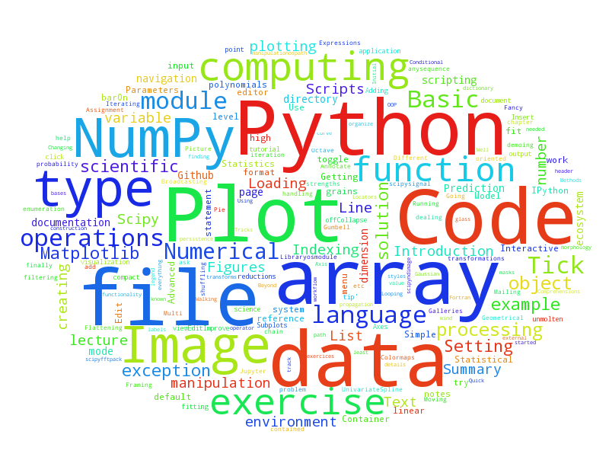
Python for Scientists
Welcome!
ramon.crehuet@iqac.csic.es
fermin.huarte@ub.edu

Slide 2
Outline of the Course
General Features of the Python language.
Python basic elements
Interactive scientific coding with the Jupyter Notebook
Functions
Modules
Working with files
Creating your Python Environment

Slide 3
Outline of the Course
Numpy
Data Visualitzation with Matplotlib and other libraries
Scipy
Data Analysis with Python: Pandas
Debugging and code optimization
Other modules useful in science
Beyond Python

Slide 4
Outline of the Course
Monday | Tuesday | Wednesday | Thursday | Friday
Basic Python | Numerical Python | Data Analysis & Visualization | Graphics | Beyond Python

Slide 5
Daily Schedule
9:30 – 11:00h | Theory and Practice
11:00 – 11:30h | Coffee Break
11:30 – 13:30h | Hands-on
13:30 – 15:00h | Lunch
15:00 – 17:30 | Theory and Practice / Hands on

Slide 6
Course Material
Github https://github.com/rcrehuet/Python_for_Scientists_2017

