Slide 1
Python for Scientists
Ramon Crehuet & Fermín Huarte
ramon.crehuet@iqac.csic.es
fermin.huarte@ub.edu
Barcelona, june 2017

Slide 2
Me
Researcher at the CSIC
Computational biochemistry and biophysics
Started with Fortran. Learnt some Perl, R, Mathematica.
  But now mainly use Python
Analysis of simulations
Developing new methods

Slide 3
You?
Research institute?
Research field?
Known languages?
Kind of data?
Expectations?

Slide 4
Overview
Why Python
Language basics
Working with files
Working with arrays: Numpy
Data visualization: matplotlib
Functions and modules
Scientific modules. Scipy
Classes and objects (bare minimum!)
Other scientific modules: sckikit-learn, biopython...
Profiling and optimization and beyond Python

Slide 5
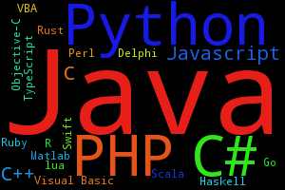
Language popularity
http://pypl.github.io/PYPL.html

Slide 6
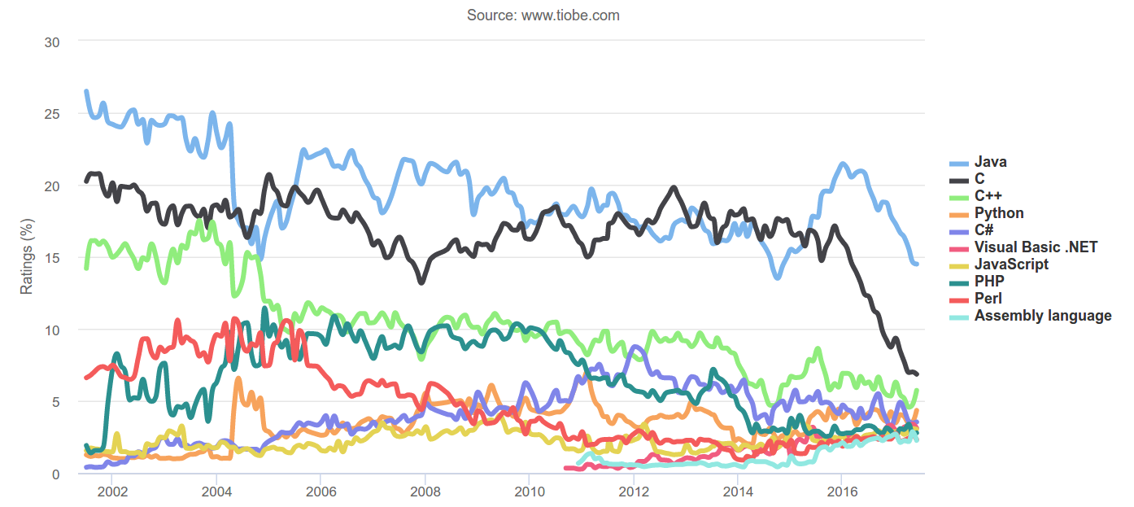
Language popularity
http://www.tiobe.com/index.php/content/paperinfo/tpci/index.html

Slide 7
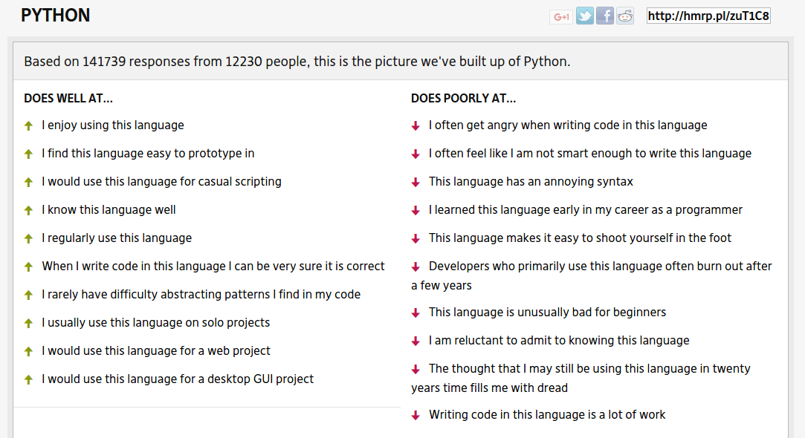
Hammerprinciple.com

Slide 8
Python for science
A high level language gives more time to more complex problems
  At the expense of hiding important details
Example:
  A reaction mechanism
  Optimisation of an energy function
    Steepest descent, conjugate gradients, quasi-Newton
  Implementation of BFGS quasi-Newton
    Memory issues, diagonalization, matrix inversion...
  Calculation of numerical gradients or hessians:
    machine precision, central differences, etc.
http://fperez.org/py4science/why_python.html

Slide 9
Python for science
“We then generated 1000 random sequences with randomly specified〈H〉 and〈Q〉values, and conducted molecular-dynamics simulations to calculate the〈Rg〉for each chain. The obtained〈Rg〉values were combined with the two-state formalism to determine whether the chain was ordered (globule) or disordered (coil)”
Biophysical Journal, 104, 2013, 488–495
OS calls
Numerical analysis
File parsing
Data visualization

Slide 10
Python for science
Compiled languages
Fast
Difficult
non-interactive
Matlab, Mathematica, Octave
Slow
Rich libraries
Nice development environment
Restricted base language
Expensive (some)
Python
Rich libraries (less than matlab)
Other libraries
Free
Active community
Harder than Matlab

Slide 11
Matlab, Mathematica?
Scientific computing:
  ipython + scipy + matplotlib
Free
Open source
Extensible
Bioinformatics
  Biopython
Molecular Dynamics
  MMTK
Efficiency
  Numba, Cython, Fortran, C
Server control
XML parser

Slide 12
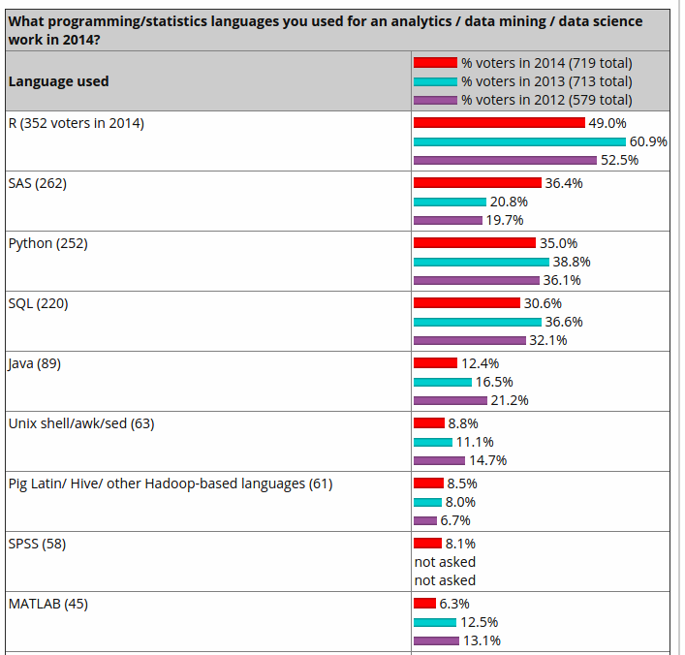
Python for data science
http://www.kdnuggets.com/2014/08/four-main-languages-analytics-data-mining-data-science.html

Slide 13
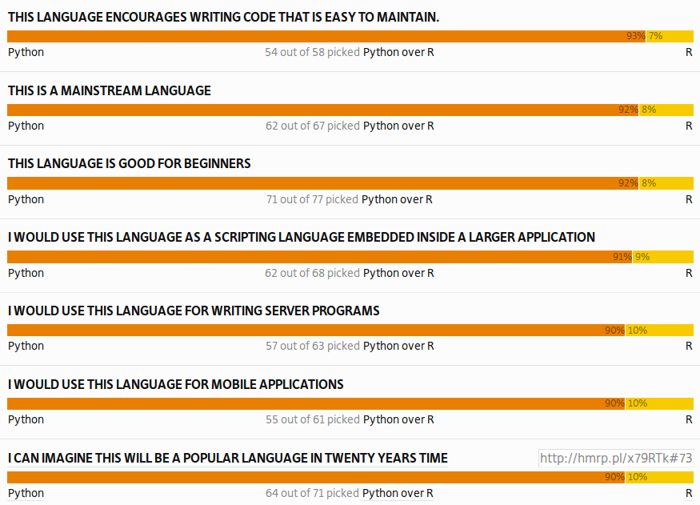
Hammerprinciple.com

Slide 14
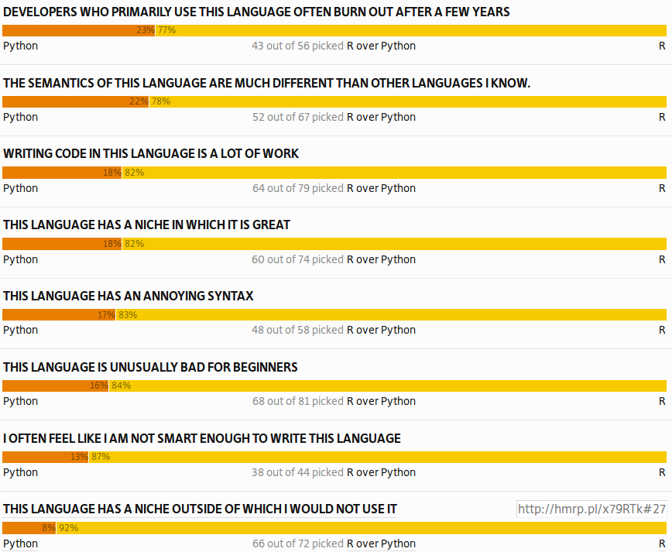
Hammerprinciple.com

Slide 15
Python for data science
Which is better for data analysis: R or Python? http://www.quora.com/Which-is-better-for-data-analysis-R-or-Python
SAS vs. R (vs. Python) – which tool should I learn? http://www.analyticsvidhya.com/blog/2014/03/sas-vs-vs-python-tool-learn/
Python Vs R Machine learninghttp://datascience.stackexchange.com/questions/326/python-vs-r-machine-learning
How to Choose Between Learning Python or R First http://blog.udacity.com/2015/01/python-vs-r-learn-first.html
Python, Machine Learning, and Language Wars http://sebastianraschka.com/blog/2015/why-python.html

Slide 16
Low level vs. high level
Python is a high level language
You can focus on:
  Low level issues
  Higher complexity of problems
Low level issues
  Variable types
  Machine precision
But also
  Extend
  Mantain
  Document code

Slide 17
Python vs. Fortran/C
Different time distribution to get a task done
Python
Execution time
Getting info
coding
Fortran / C
Execution time
Getting info
coding

Slide 18
Python Fortran/C
core
core
Extensions
Extensions
Program
Program

Slide 19
Python for science
The homogenization of scientific computing, or why Python is steadily eating other languages’ lunch http://www.talyarkoni.org/blog/2013/11/18/the-homogenization-of-scientific-computing-or-why-python-is-steadily-eating-other-languages-lunch/
10 Reasons Python Rocks for Research (And a Few Reasons it Doesn’t) http://www.stat.washington.edu/~hoytak/blog/whypython.html

Slide 20
Hello World program
print(“Hello World!”)
print(“Hello World!”)
$ python3 hello.py

Slide 21
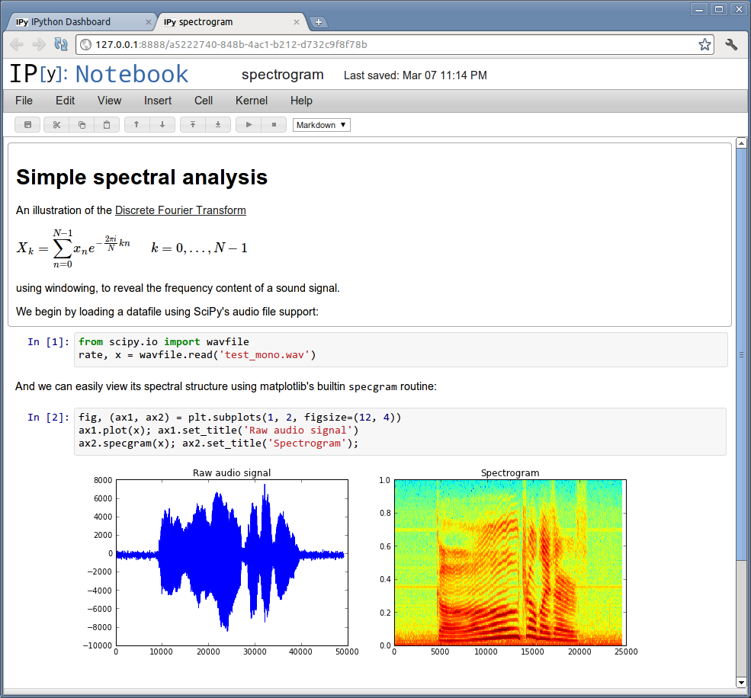
Interactive shells
python
IDLE
Jupyter (previously called ipython)
  shell
  notebook
spyder
eric
PIDA
Sage

Slide 22
Python distributions
Anaconda
  https://www.continuum.io/downloads
Enthought Canopy
  https://www.enthought.com/products/canopy/

Slide 23
Dynamically typed
>>> a = 4
>>> type(a)
<class 'int'>
>>> b = 7.6
>>> type(b)
<class 'float'>
>>> type(a+b)
<class 'float'>
>>> c = 'Hola'
>>> c + ' Que tal?'
'Hola Que tal?'
>>> c + a
Traceback (most recent call last):
File "<stdin>", line 1, in <module>
TypeError: Can't convert 'int' object to str implicitly

Slide 24
Which python version?
Language is fast evolving
2 versions now coexist: 3.x and 2.x
These versions are not completely compatible
3.x is better and continued
2.x has some software still not ported
Both can safely coexisit
  Packages and shells are for a specific version
2to3 -w hello.py

Slide 25
Language elements

Slide 26
Numbers
Integers:
> i = 5
> j = i**i**i
Limited by amount of memory:
>>> i.bit_length()
3
>>> j = i**i**i
>>> j.bit_length()
7257
>>> 9 % 5 #modulo
4
Floating point:
>>> x = 5.
>>> y = x**x**x
Traceback (most recent call last):
File "<stdin>", line 1, in <module>
OverflowError: (34, 'Numerical result out of range')
Division vs integer division (Python 3):
>>> 3/2
1.5
>>> 3//2
1
>>> j/i #Returns a Float

Slide 27
Assignments
Explicit notation:
> i = i+1
> j = j / 10.
Short notation:
> i += 1
> j /= 10.
Floating point:
>>> x = 5.
>>> y = x**x**x
Traceback (most recent call last):
File "<stdin>", line 1, in <module>
OverflowError: (34, 'Numerical result out of range')

Slide 28
strings
Strings:
> str(6.7)
> c ='Hola'
Operations:
> s='numeric ' +'python'
> len(s)
> s[5]
'i'
> s.split()
['numeric', 'python']
> print('Result: %5.3f' % (11./3.))
3.667
Non mutable:
> s[6]
> s[6]='7' #Error!
Regular expressions
import re

Slide 29
Lists, sets and tuples
Heterogeneous containers:
> l=[6, 'a', [5,[9,8,7,6]], -6.5, (True, True)]
> [1,2]+[3,4]
> l.append(6)
sets:
s=set([4,3,2,3])
> 4 in s
True
> s
set([2, 3, 4])
Tuples are unmutable lists
t=(1,2,3)

Slide 30
Lists, sets and tuples
List indexing and methods:
> l = list(range(10))
> l[4] = 20
> l[4:]
> l[-4]
> l[:]
> l[::-1] #reverse
> l.reverse()
> l.pop()
> l.extend([3,4,5])
> l.sort()
Set methods:
> s1=set([1,2,3,4])
> s2=set([3,4,5,6,7])
> s1.union(s2)
> s1.intersection(s2)
> s1.difference(s2)
> s2.difference(s1)
> s1.intersection(s2) == s2 & s1
True
> s1 - s2 == s2 - s1
False
First index is 0

Slide 31
Uses of lists, sets and tuples
Calculate and keep all the primes < 1000
Given a coordinate file, calculate for each atom a list of all the atoms that are at less than 0.2nm.
Get the solutions of a quadratic equation (0,1,2) or (real vs. complex).
http://docs.python.org/3/tutorial/datastructures.html

Slide 32
Copying and looping over lists
lists are treated as pointers:
copying lists, makes a copy of the pointer.
> l=[1,2,3,4]
> l2=l
> l[2]=1000
l1
[1, 2 , 1000, 4]
Looping over lists:
Fortran/C style:
num=[2,3,2,3,4,5,5]
for i in range(len(num)):
print(num[i])
Pythonic style:
for item in num:
print(item)
This can be used for sets, dictionaries, and tuples.

Slide 33
Dictionaries
Setting elements:
> phone={}
> phone['Ramon']='1242'
> phone['Joan']='1323'
> phone['Quique']='1242'
> phone.keys()
['Quique', 'Joan', 'Ramon']
> d2 = dict(Ramon=1242, Joan=1323, Quique=1242)
Dictionaries are not ordered
Getting elements:
> for key in phone:
... print(key, phone[key])
Quique 1242
Joan 1323
Ramon 1242
Removing elements:
> del(phone['Ramon'])

Slide 34
The beauty of Python blocks
We are usually told to indent blocks for clarity.
Python makes this the syntax rule to identify blocks.
The code has to be nice!
Convention:
Use 4 spaces
Use spaces, not tabs.
while iter < maxIter:
x = f(x)
iter = iter + 1
if i>0:
print("i is positive")
elif i==0:
print("i is zero")
else:
print("i is negative")

Slide 35
Execution control: if
if... elif... else
if <condition>:
<block>
elif <condition>:
<block>
else:
<block>
4==4 #True
5!=4 #True
4>=5 #False
4 in [4,5] #True
result=True
if result: print('yes')

Slide 36
Execution control
Conditions can be combined with:
and or not ( )
Object identity:
> a=[1,2,3]
> b=a
> b is a
True
Any non-zero number or non-empty string is True:
> if []: print ('yes')
else: print('no')
no
> if 5 and 'result':
print('yes')
else:
print('no')
yes
> if 5 or 1/0: print('yes')
yes

Slide 37
for and while loops
For loops
> dict={4:'a',3:'b', 2:'c', 1:'d'}
> for i in dict:
print(i, dict[i])
While
while <condition>:
<block>
Break continue pass
> pass # does nothing
break: Exit loop
if x>0:
pass
else:
break
cycle: Continue with the next iteration

Slide 38
list comprehension and enumerate
simple way to create lists:
> l=[x**2 for x in range(8)]
[0, 1, 4, 9, 16, 25, 36, 49]
with conditionals:
l2= [(i, -2*i+3) for i in l if i % 3 == 0]
[(0, 3), (9, -15), (36, -69)
Nested lists:
> [(x, y) for x in [1,2,3] for y in [3,1,4] if x != y]
[(1, 3), (1, 4), (2, 3), (2, 1), (2, 4), (3, 1), (3, 4)]

Slide 39
list comprehension and enumerate
Enumerate indexes lists:
line='how do you do?'
line=line.split()
for i, word in enumerate(line):
print(i, word.upper())
0 HOW
1 DO
2 YOU
3 DO?
Enumerate returns an iterator
> enumerate(['a', 'b', 'c'])
<enumerate object at 0x1ebeaa50>

Slide 40
Be pythonic
Convert the negative elements of a list to positive
>>> x = [1, 2, -4, -5, 3, -5]
j = 0
while j < len(x):
x[j] = abs(x[j])
j += 1
for j in range(len(x)):
x[i] = abs(x[i])
Or with list comprehensions
x = [abs(j) for j in x]
Or with functional programming
x= map(abs, x) #returns an iterator
http://docs.python-guide.org/en/latest/writing/style/

Slide 41
More python functions
print(3,4,5, sep='o', end='<<<<\n')
zip([1,2,3], ['a', 'b', 'c', 'd'])
a = input('Write a number: ')
len([1,2,3])
list(range(5))
range(20,10,-1)
sorted([5,4,3,5])
sum([5,4,3,5])
http://docs.python.org/3.3/library/functions.html

Slide 42
Mutable and immutable
>>> a = 4
>>> id(a)
9157088
>>> a += 2
>>> id(a)
9157152
>>> s = 'Hola'
>>> id(s)
140165884365656
>>> s = s+ ' que tal?'
>>> id(s)
140165884365712
>>> ll = [3,4,5]
>>> id(ll)
140165884674416
>>> ll.append(6)
>>> id(ll)
140165884674416
Mutable objects can be mutated.
  Their identity remains the same
Immutable objects are “mutated” by creating a new object

Slide 43
Identity and equality
>>> a = 4
>>> b = a
>>> a is b
True
>>> id(a)
9157088
>>> id(b)
9157088
>>> l1 = [1,2,3,]
>>> l2 = l1
>>> l2 = l1[:]
>>> l2 is l1
False
>>> l2 == l1
True
>>> 1.0 is 1.0
True
>>> 1.0 == 1.0
True
>>> 1 == 1.0
True
>>> 1 is 1.0
False

Slide 44
Objects: everything
>>> a = 5
>>> isinstance(a, int)
True
>>> object
<class 'object'>
>>> int
<class 'int'>
>>> isinstance(a, object)
True
>>> issubclass(int, object)
True
Objects have variables:
> c = 4+5j
> c.real
Objects have methods:
> c.conjugate #the method
> c.conjugate() #its call
And we can apply functions to objects:
> abs(c)

Slide 45
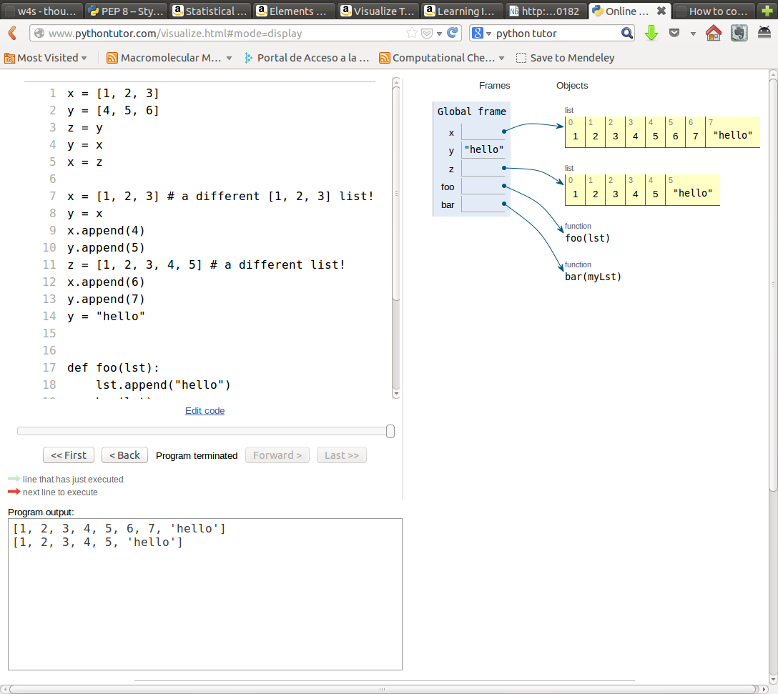
Python flow with pythontutor

Slide 46
try... except
“Look before you leap”:
def safe_divide_1(x, y):
if y==0:
print("Divide-by-0 attempt detected")
return None
else:
return x/y
“It's easier to ask forgiveness than permission”:
def safe_divide_2(x, y):
try:
return x/y
except ZeroDivisionError: print("Divide-by-0 attempt detected")
return None

Slide 47
Short ipython tutorial

Slide 48
beyond python
TAB autocomplete:
functions
methods
files
…
reload command
cursor keys get history (for console only):
even previous sessions!
text + keys: previous match
?: help
%quickref
Ctrl-r : previous commands
Without ipython:
python3 -u script.py enters interactive mode

Slide 49
Magic functions
%timeit x=10 : time the 'x=10' statement with high precision.
%%timeit x=2**100
x*100 : time 'x*100' with a setup of 'x=2**100'; setup code is not
counted. This is an example of a cell magic.
%cpaste, %paste: Paste & execute a pre-formatted code block from clipboard.
%history
%load_ext
%run
%pdb: Control the automatic calling of the pdb interactive debugger.
%pylab
%timeit
%pwd
%cd
%%bash
http://ipython.org/ipython-doc/dev/interactive/tutorial.html

Slide 50
running scripts
%run script.py
import script.py
are not the same!
%run script.py is like python3 script.py
Imports are only “impoted” once in a session (see later %autoreload magic function)

Slide 51
jupyter notebook
Nice presentation
Allows parallel execution
Combines text and code
Executable or exportable to:
  html
  LaTeX
  python
Start with: ipython3 notebook
Examples:
https://github.com/jrjohansson/scientific-python-lectures

Slide 52
Files

Slide 53
Files
Files can be text or binary
Files can be opened for read, write or append
  'r', 'w', 'a+'
with open('name') as filein:
  Allows automatic file closure
  Explanation of the with statement: http://effbot.org/zone/python-with-statement.htm

Slide 54
Reading / Writing Files
file_in=open('indata.txt','r')
file_out=open('outdata.txt','w')
for line in file_in:
# Take some information (split() method is very useful!)
x = float(line.split()[0])
# Apply a given function (fact)
fx = fact(x)
# Write the result in an output file with a defined format
file_out.write('{:010.3f}\n'.format(fx))
But for loading numerical data Numpy is more efficient. And pandas even more.

Slide 55
File parsing
The basic:
  for line in filein:
  do something
Common things:
  if 'optimized' in line:
  do something
  line = line.split()
  if line.upper().startswith('GEOM'): …
  energy = float(line[2])

Slide 56
skipping lines
Lines can be skipped by calling next() to a file:
for line in filein:
if 'Optimized' in line:
next(filein); next(filein) #skip two lines
do something...

Slide 57
Formatting
There are several function:
  '12'.rjust(5), '12'.zfill(5)
But format is more general:
  print('{0:2d} {1:3d}'.format(x, x*x))
  print("{:10.3f} {:10.3f} {:10.3f}".format(x,y,z))
List of unkown length (use argument unpacking):
  vals = np.linspace(0,1,11)
  print((len(vals)*"{:10.2e} ").format(*vals))
http://docs.python.org/3/library/string.html#formatspec

Slide 58
Useful modules
Similar to ls:
  import glob
  files = glob.glob(pattern)
Working with shell-like commands:
  import os
  os.rename(src, dst)
  os.mkdir(path)
  os.chown(path, uid, gid)
  os.getenv(key)
  os.walk(directory)
http://docs.python.org/3/library/os.html

Slide 59
Useful modules
Reading Excel files http://www.python-excel.org/:
  import xlrd
  Pandas uses this library
Working with image files
  http://scikit-image.org/
  http://pillow.readthedocs.io/en/latest/

Slide 60
Numpy

Slide 61
Why Numpy / Scipy?
Python (alone) is not efficient for numerical calculations
Python (alone) is not practical for array manipulation
Numpy provides the data types and methods for arrays
Scipy provides more elaborate numerical methods
  Optimization
  Fast Fourier Transform
  Linear algebra, etc
  import numpy as np
  import scipy.optimization
  import scipy.stats as stats

Slide 62
numpy arrays
without numpy:
> a=[[1,2],[3,4]]
> b=[[10,20], [30,40]]
> a+b
[[1, 2], [3, 4], [10, 20], [30, 40]]
with numpy:
> a=np.array(a)
> b=np.array(b)
> a+b
array([[11, 22],[33, 44]])
Array creation
a=np.array([1,2,3,4]).reshape([2,2])
a=np.array([[1,2], [3,4]])
a=np.zeros([2,2], dtype=int)
a[0,0]=1.
a=np.ones((4,4))
a=np.arange(10)
a=np.diag([1,2,3,4])
a=np.tile(a, (10,2))
a=np.identity(3)
a=np.linspace(-5,5, 20)

Slide 63
Ufuncs
Unary:
a.min()
a.sum()
a.cumsum()
a.mean()
np.argmin(a)
np.exp(-a)
np.cov(a)
a.tolist()
Binary:
a + b
np.dot(a, b) same as a@b
Applying to parts of an array:
> a=np.array([[1,2], [3,4]])
> a.min(axis=0)
array([1, 2])
a.sum(axis=1)
array([3, 7])
Python functions are less efficient than numpy functions:
a.sum() faster than sum(a)
np.min(a) faster than min(a)
many implemented as methods and functions

Slide 64
Accessing array elements
Slicing:
> a[2:5]
> b[:, ::5]
> a[1:4, ...]
Fancy indexing:
  Boolean arrays (masks):
> a = np.arange(10,15)
> indices = (a**2 > 115) & (a < 14)
> a[indices]
array([11, 12, 13])
  With lists:
> a = np.arange(10,15)
> y=a[[4,4,1]]
> y
array([14, 14, 11])
> a[[4,4,1]] = [-2, -4, 5]
> a
array([10, 5, 12, 13, -4])

Slide 65
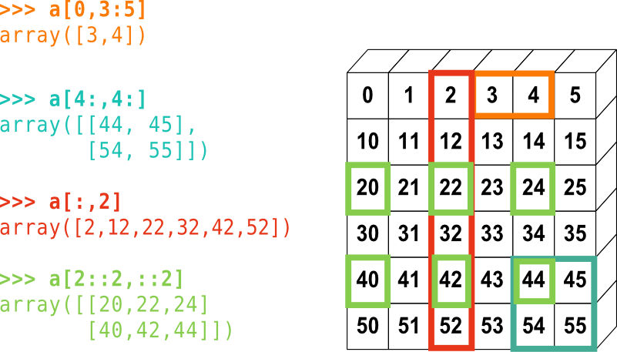
Accessing array elements
From: https://scipy-lectures.github.io/intro/numpy/array_object.html

Slide 66
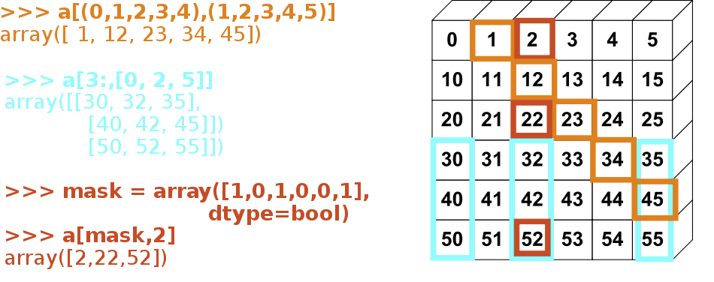
Accessing array elements
From: https://scipy-lectures.github.io/intro/numpy/array_object.html

Slide 67
Accessing array elements
Slices return views
> a = np.arange(5)
> y=a[2:5]
> y *= -1
> a
array([ 0, 1, -2, -3, -4])
> y.flags.owndata
False
np.where
> np.where((a>=2)&(a<4), a**2, -1)
Array([-1, -1, 4, 9, -1])
np.choose
  Powerful, but complex!
np.nonzero
Boolean arrays return copies
> a = np.arange(5)
> y = a[a>1]
> y *= -1
> a
array([0, 1, 2, 3, 4])
> y.flags.owndata
True
Fancy indexing returns copies:
> a = np.arange(5)
> y=a[[2,3,4]]
> y *= -1
> a
array([0, 1, 2, 3, 4])
> y.flags.owndata
True

Slide 68
Broadcasting
> a = 4.
> b = np.array([1,2,3])
> c = np.array([[1,2,3], [4,5,6]])
> b+a, c+a
(array([ 5., 6., 7.]), array([[ 5., 6., 7.],
[ 8., 9., 10.]]))
> b+c
array([[2, 4, 6],
[5, 7, 9]])
> c.dot(b)
> b.dot(c)
ValueError: objects are not aligned
> b[1:]*c
ValueError: operands could not be broadcast together with shapes (2) (2,3)
> b[1:]*c.T
Use matrix if you want more algebra-like behaviour
Python 3.5 introduces

Slide 69
Broadcasting
Change the shape to allow for broadcasting:
> c = np.array([[1,2,3], [4,5,6]])
> b = c.mean(axis=1)
> c+b[:,np.newaxis] #or c+b[:,None]
> c+b.reshape((-1,1))
Or keep the shape:
> b = c.mean(axis=1, keepdims=True)
> c+b
See also:
  np.atleast_2d, np.atleast_1d and np.atleast_3d

Slide 70
np.einsum
Complex but powerful function to avoid the use of loops
  Dot product, outer product, and others can be written as einsum
> c = np.array([[1,2,3], [4,5,6]])
> np.allclose(c.dot(c.T), np.einsum('ij, kj->ik',c,c))
True
See numpy documentation and the following blog entry:
  http://docs.scipy.org/doc/numpy-1.10.0/reference/generated/numpy.einsum.html
  http://ajcr.net/Basic-guide-to-einsum/

Slide 71
array functions and methods
Array reduction and logical operations:
> a=np.arange(5)
> np.all(a>3)
False
> np.any(a>3)
True
> a > 3
array([False, False, False, False, True], dtype=bool)
> (a > 3) & (a < 5)
array([False, False, False, False, True], dtype=bool)
Some details of memory use:
> a.flags
C_CONTIGUOUS : True
F_CONTIGUOUS : True
OWNDATA : True
WRITEABLE : True
ALIGNED : True
UPDATEIFCOPY : False

Slide 72
Loading and saving data
Pickle is the usual way to save and restore data in Python
We often have data file in text format:
#Dist Energy
1.0 34.
1.2 38.
2.4 42.
> f=np.loadtxt(“energies.dat”)
> f
array([[ 1. , 34. ],
[ 1.2, 38. ],
[ 2.4, 42. ]])
Pandas adds more flexibility
Save single arrays with:
> np.save('result_y', y)
Save in text mode with:
> np.savetxt('result_y', y)
and multiple arrays with (saves a dictionary):
> np.savez('results', x, y)
Recover them with load:
> y=np.load('results_y.npy')
> npz=np.load('results.npz')

Slide 73
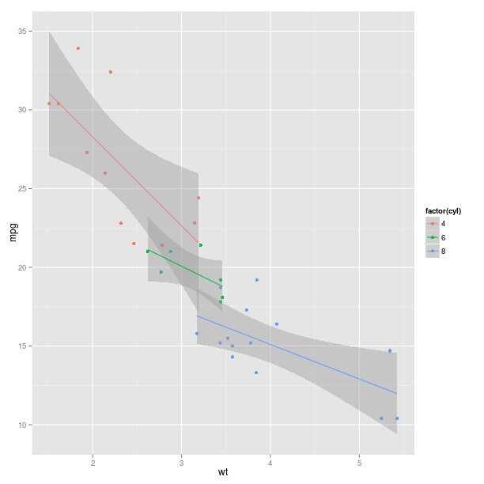
Acess R from python
Use the rpy2 module.
From the documentation:
import math, datetime
import rpy2.robjects.lib.ggplot2 as ggplot2
import rpy2.robjects as ro
from rpy2.robjects.packages import importr
base = importr('base')
datasets = importr('datasets')
mtcars = datasets.data.fetch('mtcars')['mtcars']
pp = ggplot2.ggplot(mtcars) + \
ggplot2.aes_string(x='wt', y='mpg', col='factor(cyl)') + \
ggplot2.geom_point() + \
ggplot2.geom_smooth(ggplot2.aes_string(group = 'cyl'),
method = 'lm')
pp.plot()

Slide 74
Other tutorials
Take a look at these tutorials:
  http://wiki.scipy.org/Tentative_NumPy_Tutorial
  From: http://jrjohansson.github.io/
    Lecture-2-Numpy.ipynb
    Lecture-3-Scipy.ipynb

Slide 75
matplotlib

Slide 76
Matplotlib
A module for plotting 2D and 3D data
Combines well with numpy
Starts with
  import matplotlib.pyplot as plt
  %matplotlib inline
  import pylab or similar is deprecated.

Slide 77
Matplotlib
Simplest plots:
  > plt.plot([1,2,3], [1,4,9])
  > plt.plot(x, sin(x), '--') #where x is a numpy array
  > plt.figure() # creates new figure
  > plt.clf() # Clears current figure
  > plt.matshow(m) # m is a 2D array
  > plt.imshow(m) # m is a 2D array. Similar to matshow.
  > d = np.loadtxt('data.txt')
  > plt.plot(d[:,0], d[:,1], 's') #just slightly longer than gnuplot

Slide 78
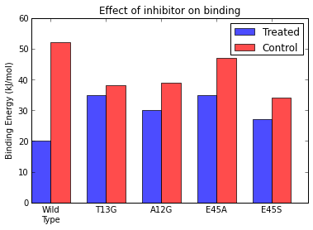
Matplotlib
Totally reproducible
figures
N = 5
treated = (20, 35, 30, 35, 27)
control = (52, 38, 39, 47, 34)
ind = np.arange(N) # the x locations for the groups
width = 0.35 # the width of the bars
fig, ax = plt.subplots()
rects1 = ax.bar(ind, treated, width, color='b', alpha=0.7, label='Treated')
rects2 = ax.bar(ind+width, control, width, color='r', alpha=0.7, label = 'Control')
# add some
ax.set_ylabel('Binding Energy (kJ/mol)')
ax.set_title('Effect of inhibitor on binding')
ax.set_xticks(ind+width)
ax.set_xticklabels( ('Wild\nType', 'T13G', 'A12G', 'E45A', 'E45S') )
ax.legend()

Slide 79
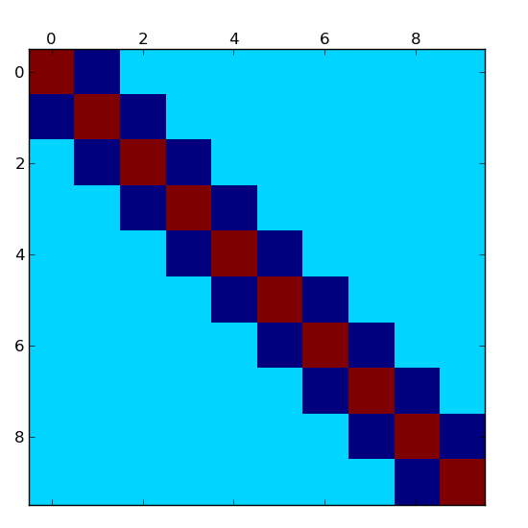
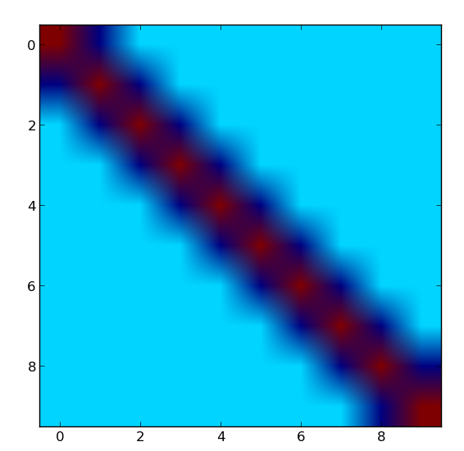
Plotting matrices
m=np.diag(2*np.ones(10))+np.diag(-1*np.ones(9),1)+np.diag(-1*np.ones(9), -1)
matshow(m)
imshow(m)

Slide 80
Matplotlib styles
Since version 1.5 several default styles.
Try the following code
x= np.linspace(0, np.pi, 100)
for s in plt.style.available:
with plt.style.context(s):
plt.figure()
plt.title(s)
plt.plot(x,np.sin(x)*np.cos(x**2), label='A')
plt.plot(x,np.sin(x)*np.cos(x**2)*np.cos(x), label='B')
plt.plot(x,np.sin(x)-np.cos(x)*np.sin(x), label='C')
plt.legend(loc='best')

Slide 81
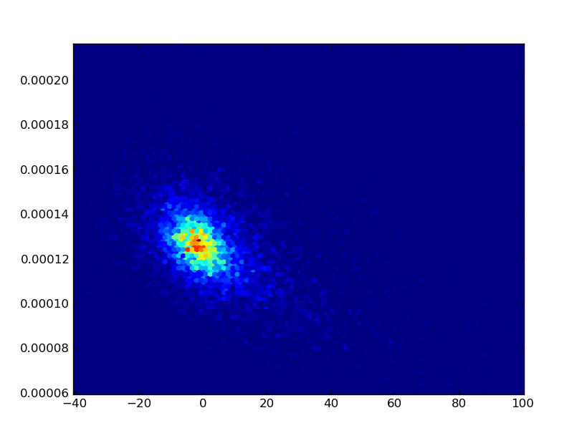
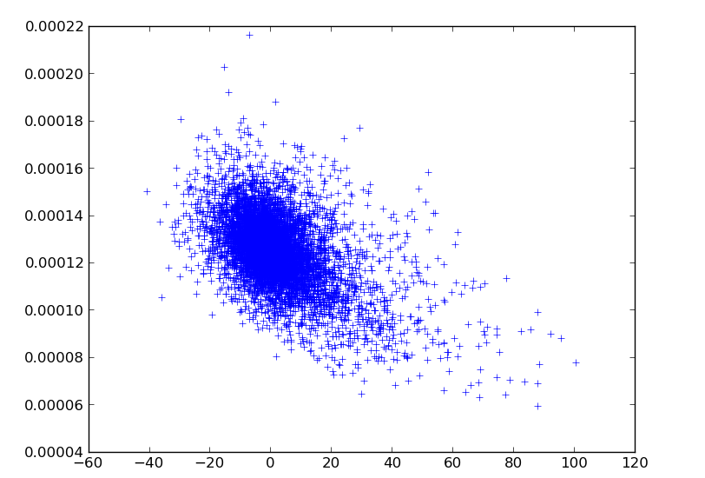
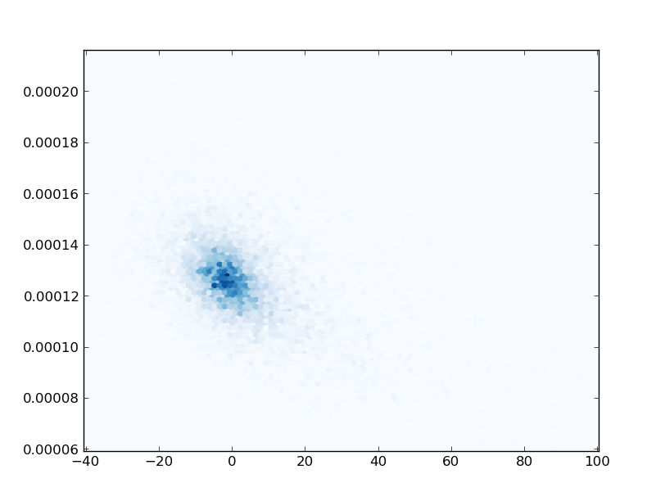
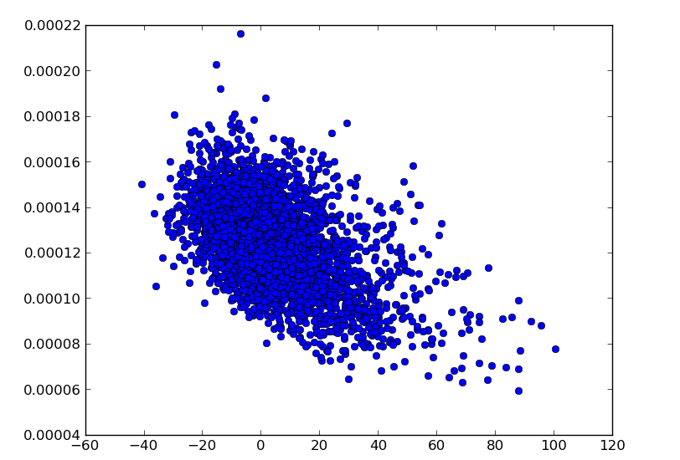
Plotting lots of points:hexbin
plt.hexbin(x, y)
plt.plot(x, y, '+')
plt.hexbin(x, y, cmap=pylab.cm.Blues)
plt.plot(x, y, 'o')

Slide 82
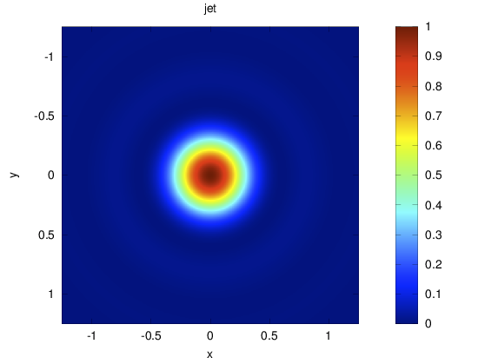
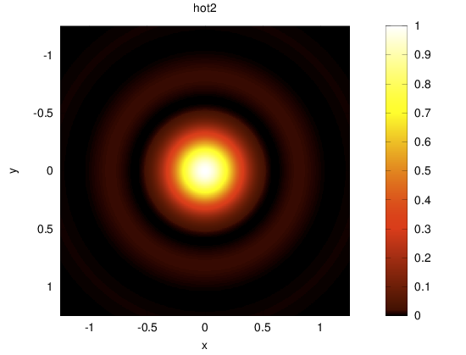
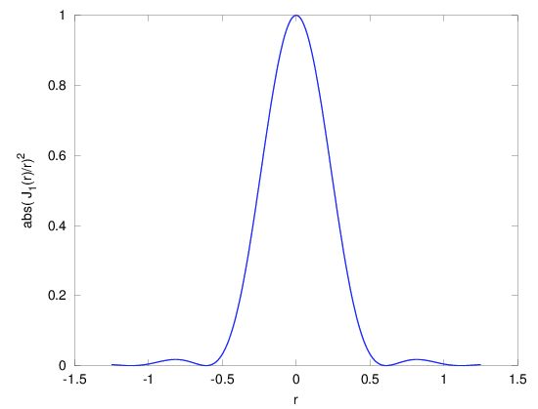
Jet is not a good colormap
http://cresspahl.blogspot.com.es/2012/03/expanded-control-of-octaves-colormap.html
https://jakevdp.github.io/blog/2014/10/16/how-bad-is-your-colormap/

Slide 83
Matplotlib
Do Lecture-4-Matplotlib.ipynb from http://jrjohansson.github.io/
  Other interesting material there...
Check matplotlib gallery
  http://matplotlib.org/gallery.html
Quick reference of symbols and colours:
  http://www.loria.fr/~rougier/teaching/matplotlib/#quick-references
  (part of a larger tutorial)
Some more tricks and examples:
  http://wiki.scipy.org/Cookbook/Matplotlib

Slide 84
Extensions
Seaborn
  Data visualization
  Nice color palettes from http://colorbrewer2.org/
  https://stanford.edu/~mwaskom/software/seaborn/
Bokeh:
  http://bokeh.pydata.org/en/latest/
Plotly:
  https://plot.ly/
http://pbpython.com/visualization-tools-1.html

Slide 85
Pandas

Slide 86
Pandas
library providing high-performance, easy-to-use data structures and data analysis tools for Python
Follow this notebook
  As an example of what can be found out there...
Watch the video:
  https://www.youtube.com/watch?v=0CFFTJUZ2dc
Download the notebook and the data:
  https://github.com/jonathanrocher/pandas_tutorial﻿

Slide 87
Functions and modules

Slide 88
Functions
defined by def and a colon:
def add(x,y):
return x+y
Remember indentation!
Automatic (and recommended) documentation:
def add(x,y):
””” Returns the
sum of 2 numbers”””
return x+y
Functions can be seen as both fortran procedures and functions but...
Arguments are passed by reference
there is access to global variables:
> def x_val(): print(x)
> x=60
> x_val()
60

Slide 89
Functions II
Function variables are local :
> def x_val():
... x=40
... print(x)
> x=60
> x_val()
40
> x
60
to assign variables, use return
def x_val():
... x=40
... print(x)
... return x
> x = xval()
40
> x
40

Slide 90
Functions III
Mutable objects are passed by reference:
> def square_0(lst):
... lst[0]*=lst[0]
> a=[3,2,1]
> square_0(a)
> a
[9,2,1]
Copy variables that need to be preserved:
> a_copy=a[:]
> square_0(a)
> import copy
> import copy
> a_copy=copy.deepcopy(a)

Slide 91
Functions IV
Functions can have default arguments :
> def submit(job, priority=10, nprocs=1):
... pass
> submit('job1.sh')
Function arguments do not have explicit types.
> add('Python ', 'summerschool')
Python summerschool
Functions can be recursive
def fact(n):
if n == 1:
return 1
else:
return n * fact(n-1)

Slide 92
Argument unpacking
Starred arguments are tuples that collect positional arguments :
> def prod(*args): ...
> prod(2,3,4)
> x = (4, 5, 6)
> prod(*x)
In prod, args=(2,3,4)
https://docs.python.org/3/tutorial/controlflow.html#unpacking-argument-lists
Keword arguments can be passed as a dictionary:
> options = dict(paper='A4', color = True)
print_setup(options)
Unpacking can be a convenient way to print a list:
> vals = [1,2,3,4,5]
> print((4*'{:03d} ').format(*vals))
001 002 003 004

Slide 93
Lists or iterators?
Lists are iterable objects
Iterators generate objects on-the-fly
Iterators can be created with a generator function
  Uses yield satement
Relevant for efficiency
def rang_llista(n):
result = []
i = 0
while i<n:
result.append(i)
i += 1
return result
def rang_gen(n):
i = 0
while i<n:
yield i
i += 1

Slide 94
Modules
Modules allow packing libraries or extensions
There are built-in and external modules
When imported modules are executed
Modules can be written in C or Fortran!
> import math
> m = math
> import math as m
> from math import cos, sin
> from math import * #dangerous. All into the same namespace

Slide 95
Modules
Python checks if a module is already loaded.
  The interpreter does not reload a module already imported
  This can cause unexpected behaviour interactively
Ipython has a more versatile module loading
%load_ext autoreload
autoreload 2 #Will reload a module if it changes

Slide 96
Some useful modules
sys — System-specific parameters and functions
os — Miscellaneous operating system interfaces
os.path — Common pathname manipulations
glob — Unix style pathname pattern expansion
re — regular expressions
copy — Shallow and deep copy operations
argparse — Parser for command-line options, arguments and sub-commands
subprocess — Subprocess management
inspect — Inspect live objects

Slide 97
Some useful modules
if len(sys.argv!=3):
print('Error: Use two arguments.')
sys.exit()
method = sys.argv[1]
filelist = glob.glob('/home/ramon/*')
for fileName in filelist:
if os.path.isfile(fileName): print(fileName)

Slide 98
Modules: too many...
From the python documentation:
It is also possible to use a list as a queue, where the first element added is the first element retrieved (“first-in, first-out”); however, lists are not efficient for this purpose. While appends and pops from the end of list are fast, doing inserts or pops from the beginning of a list is slow (because all of the other elements have to be shifted by one).
To implement a queue, use collections.deque which was designed to have fast appends and pops from both ends.

Slide 99
Modules: too many...
>>> import math
>>> import cmath
>>> import numpy.lib.scimath as scimath
>>> math.sqrt(4)
2.0
>>> math.sqrt(-4)
Traceback (most recent call last):
File "<stdin>", line 1, in <module>
ValueError: math domain error
>>> cmath.sqrt(4)
(2+0j)
>>> cmath.sqrt(-4)
2j
>>> scimath.sqrt(4)
2.0
>>> scimath.sqrt(-4)
2j

Slide 100
Working with your modules
Import reads from local directory and from the directories in sys.path (import sys first)
Put your modules in a directory and add it to the environtment variable $PYTHONPATH.
Python will add the directories in $PYTHONPATH to sys.path
Document your modules and the functions therein.
Use if __name__=='__main__': to execute code only if Python is running the module, and not if it is imported.
  http://stackoverflow.com/questions/419163/what-does-if-name-main-do

Slide 101
Installing external Modules
Use conda distribution. Then $ conda install module
Many come as part of the linux distributions (usually older versions that those in conda or PyPI)
  ipython, numpy, biopython...
For modules in the PyPI repository(most of them) https://pypi.python.org/pypi
  (sudo) pip3 install module
Manual installation (dependencies have to be also manually installed):
  $ python setup.py build
  $ (sudo) python setup.py install

Slide 102
Updating external Modules
With conda $ conda update module
For modules in the PyPI repository(most of them) https://pypi.python.org/pypi
  pip3 install -U module
pip can also be used in the conda installation.
Remeber that modules are installed for a given version of python. If you have python 2.x and 3.x you need to check for which version you are installing. For example using pip3 or
  $ which pip

Slide 103
Scipy

Slide 104
Linear algebra
Support for LAPACK, BLAS and ATLAS
  Can make Scipy compilation more involved
> A=matrix(random.rand(5,5))
> A.I
> linalg.det(A)
> linalg.eigvals(A)
> linalg.eig(A)
> linalg.svd(A)
> linalg.cholesky(A)
Solving linear systems:
  A.x=b
> b=matrix(random.rand(5)).reshape((5,1))
> linalg.solve(A,b)
LAPACK, BLAS wrappers
> from scipy.lib import lapack
> from scipy.lib import blas
blas.fblas.sdot?

Slide 105
Optimization
There are different optimization methods:
> import scipy.optimize as so
Some only need the function value:
> fmin, fmin_powell
Some need the gradient or the hessian:
> fmin_cg, fmin_bfgs, fmin_ncg
Some look for global minima:
> anneal
Remember:
> scipy.info('optimize')
Pedagogical documentation:
http://docs.scipy.org/doc/scipy/reference/tutorial/optimize.html
http://docs.scipy.org/doc/scipy/reference/optimize.html

Slide 106
f2py
Many things are fast with Numpy
Iterative algorithms over array values are slow
You can import Fortran functions and subroutines with f2py
You could also call external fortran programs with
> subprocess.call(<program>, shell=True)
  but data exchange has to be through files (slower)
f2py finds your fortran compiler. Works with gfortran, ifort,...
f2py creates a module you can import in python
As simple as:
$ f2py -c <file> -m <module>
  Tip: first compile it to check it works

Slide 107
f2py II
module funcs
implicit none
contains
function f1(x,y)
real,intent(in):: x,y
real:: f1
f1=x+y**2
end function f1
function f2(x,y)
real,intent(in):: x,y
real, dimension(3):: f2
f2(1)=x+y**2
f2(2)=sin(x*y)
f2(3)=2*x-y
end function f2
end module
$ f2py -c test.f90 -m test
go to ipython:
> import test
> test.funcs.f1(1,2)
5.0
> test.funcs.f2(1,2)
array([ 5., 0.90929741, 0.], dtype=float32)

Slide 108
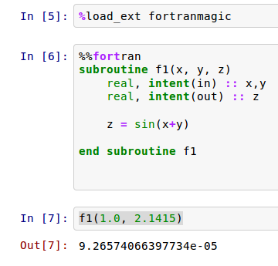
f2py III
Using ipython magicfunctions:
sudo pip3 install -U fortran-magic
Useful for performing long array operations

Slide 109
Big data, big memory
Numpy arrays are meant to live in memory
If that is not possible:
  Use op= operations (they use half the memory):
    p *=alpha is better than p = p*alpha
  Use scipy.sparse matrices
    http://docs.scipy.org/doc/scipy/reference/sparse.html
  Use PyTable to store (compressed) matrices on disk
    http://www.pytables.org/
  Modify your algorithm to work with submatrices

Slide 110
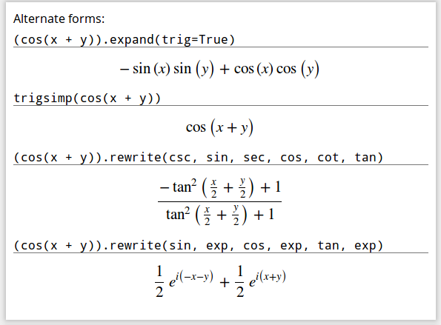
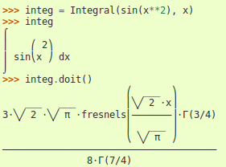
Sympy: Symbolic math
Symbolic algebra
Analytic solution of equations
Integration, derivation
Polynomials
Limits
http://sympy.org/en/index.htm l

Slide 111
Add-ons

Slide 112
Add ons: Biopython
Biopython
from Bio.PDB import *
p=PDBParser(PERMISSIVE=1)
s=p.get_structure('1OJR', filename)
Print out the coordinates of all CA atoms with B factor > 50:
for model in s.get_list():
for chain in model.get_list():
for residue in chain.get_list():
if residue.has_id("CA"):
ca=residue["CA"]
if ca.get_bfactor()>50.0:
print ca.get_coord()
http://biopython.org

Slide 113
Add ons: Machine learning and statistics
Basic statistics in scipy.stats
  Tutorial: http://docs.scipy.org/doc/scipy/reference/tutorial/stats.html
  Reference: http://docs.scipy.org/doc/scipy/reference/stats.html
Machine learning with sklearn
  http://scikit-learn.org/stable/
  Choosing the method: http://scikit-learn.org/stable/tutorial/machine_learning_map/
More algorithms (and a textbook) with AstroML
  http://www.astroml.org/

Slide 114
Add ons: cclib
cclib
> import cclib
> data=cclib.parser.ccopen('http://cclib.sourceforge.net/\data/Gaussian/Gaussian03/neoprene.zip').parse()
> data.scfenergies
array([-16052.64196043])
http://cclib.sourceforge.net

Slide 115
Add ons: itertools
> import itertools
> perms = itertools.permutations('ABC', 3)
> list(perms)
[('A', 'B', 'C'),
('A', 'C', 'B'),
('B', 'A', 'C'),
('B', 'C', 'A'),
('C', 'A', 'B'),
('C', 'B', 'A')]
> list(itertools.combinations('ABC',2))
[('A', 'B'), ('A', 'C'), ('B', 'C')]

Slide 116
Add ons: active papers
ActivePapers is a framework for doing and publishing reproducible research. An ActivePaper is a file that contains code (Python modules and scripts) and data (HDF5 datasets), plus the dependency information between all these pieces. You can change a script and re-run all the computations that depend on it, for example. Once your project is finished, you can publish the ActivePaper as supplementary material to your standard paper.
http://khinsen.wordpress.com/2013/09/27/activepapers-for-python/

Slide 117
Optimization and debugging

Slide 118
Optimization
“Premature optimization is the root of all evil” Knuth
%timeit a=np.random.random(100000)
a=np.random.random(100000)
n_dim=3
%%timeit
x=np.zeros(shape=(100000,n_dim),order='F')
for j in range(0,n_dim):
x[:,j]=a*j
Evaluated in a separate enviroment

Slide 119
Profiling
“Premature optimization is the root of all evil” Knuth
%timeit a=np.random.random(100000)
a=np.random.random(100000)
n_dim=3
%%timeit
x=np.zeros(shape=(100000,n_dim),order='F')
for j in range(0,n_dim):
x[:,j]=a*j
Evaluated in a separate enviroment

Slide 120
Exceptions and errors
Although the language is interpreted there are some syntax errors that prevent execution:
def safe_divide_1(x, y)
File"/home/ramon/python/prova.py", line 1
def safe_divide_1(x, y)
^
SyntaxError: invalid syntax
Exceptions leave a trace easy to follow.
Easy debugging with
%pdb
%debug

Slide 121
pdb: python debugger
In [1]: pdb
Automatic pdb calling has been turned ON
In [4]: run foo.py
NameError: name 'b' is not defined
> /home/ramon/python/foo.py(2)<module>()
1 a = 3
----> 2 print(b)
ipdb> ?

Slide 122
pdb: python debugger
In [9]: run foo.py
---------------------------------------------------------------------------
NameError Traceback (most recent call last)
/home/ramon/python/foo.py in <module>()
1 a = 3
----> 2 print(b)
NameError: name 'b' is not defined
In [10]: %debug
> /home/ramon/python/foo.py(2)<module>()
1 a = 3
----> 2 print(b)
ipdb>

Slide 123
Numba
Numba compiles in a virtual machine.
Developped by Continuum analytics, so easiest install from conda.
$ conda install numba

Slide 124
Cython
An extension to python that generates C code that can be compiled
Available in most linux distributions
Fortran programmers can use f2py, available in scipy.
See also:
https://jakevdp.github.io/blog/2013/06/15/numba-vs-cython-take-2/

Slide 125
Other alternatives
Use Julia
  A different language
  Close in syntax to Python
Theano: “define, optimize, and evaluate mathematical expressions involving multi-dimensional arrays efficiently”
  https://theano.readthedocs.org/en/latest/
Parakeet: a runtime compiler for scientific computing in Python
  http://www.parakeetpython.com/http://www.parakeetpython.com/
Just-in-time compilers for number crunching in Python
  http://www.phi-node.com/2013/01/just-in-time-compilers-for-number.html
See also the notebooks here:
  http://nbviewer.jupyter.org/github/rasbt/One-Python-benchmark-per-day/tree/master/ipython_nbs/

Slide 126
Resources

Slide 127
Resources
On-line Official documentation (contains Tutorial in PDF or HTML):
http://www.python.org/doc
General introductory books (also in paper):
http://diveintopython.org/ (This one is simpler!)
http://www.greenteapress.com/thinkpython/thinkpython.html
Comparison of codes in different languages:
http://rosetacode.org
http://www.codecodex.com
Python package index: where to find modules
http://pypi.python.org/pypi

Slide 128
Resources
Interactive tutorial
  http://pythonmonk.com/
A Crash Course in Python for Scientists (with applications in Quantum chemistry)
  http://nbviewer.ipython.org/5920182
  Written in an ipython notebook
Python Scientific Lecture notes
  http://scipy-lectures.github.io/
Python flow with Pythontutor
  http://www.pythontutor.com

Slide 129
Resources: Books
Rossant, C, Learning Ipython for Interactive Computing and Data Visualization.
  Basic level. Covers several subjects, includng matplotlib and parallelism. Recipes book.
Stewart, J.M., Python for Scientists
  Basic level. Unfortunately in Python 2. Covers a lot on differential equations.
DeCaria A. J. Python Programming and Visualization for Scientists
  DeCaria teaches Python programming and visualization for meteorology and ocean sciences majors.
Packt Publishing. Wide variety, lots on GIS and Python.
https://wiki.python.org/moin/AdvancedBooks

Slide 130
Resources: Video Tutorials
Check: https://www.youtube.com/user/EnthoughtMedia
Check: http://www.pyvideo.org/
  Will close down in 2016... :-(
Check Scipy Conference and Euroscipy:
  http://conference.scipy.org/proceedings/scipy2015/

Slide 131
Resources: MOOCs
General Python programming:
  https://www.coursera.org/course/programming1
  https://www.coursera.org/course/programming2
Advanced scientific programming with Fortran, Python, OMP, OpenMPI...
  https://www.coursera.org/course/scicomp

Slide 132
Resources: Teaching
On teaching programming with Python 3
http://www.comp.leeds.ac.uk/nde/papers/teachpy3.html
Online Syntax Highlighting
http://tohtml.com/python/
Style Guide for Python Code:
www.python.org/dev/peps/pep-0008/

Slide 133
K. Hinsen views
“NumPy has introduced incompatible changes with almost every new version over the last years”
“Given the importance of NumPy in the scientific Python ecosystem, I consider its lack of stability alarming”.
“What makes me hesitate to recommend not using Python is that there is no better alternative”.
https://khinsen.wordpress.com/2014/09/12/the-state-of-numpy/

Slide 134
Jake VanderPlas
Great blog about python with applications in
  Science
  Statistics
  Cycling...
  All entries are jupyter notebooks.
  https://jakevdp.github.io/
  See also his book and library on machine learning:
  http://www.astroml.org/
  http://press.princeton.edu/titles/10159.html

Slide 135
Software in python
QM/MM with pDynamo: http://www.pdynamo.org
MM with MMTK: http://dirac.cnrs-orleans.fr/MMTK/
Molecular visualization:
  VMD: http://www.ks.uiuc.edu/Research/vmd/
  pymol: http://www.pymol.org/
QM calculation with
  pyQuante: http://pyquante.sourceforge.net/
  NWChem: http://www.nwchem-sw.org/index.php/Python
Protein structure with pyRosetta: http://pyrosetta.org/
Bioinformatics with BioPython: http://biopython.org/

Slide 136
Python for modelling
cclib: http://cclib.github.io/
ORBKIT: http://orbkit.github.io/
Nglview, chemical structures in juptyer: https://github.com/arose/nglview
Trajectory analysis:
  MDtraj : http://mdtraj.org
  MDAnalysis: http://www.mdanalysis.org/
  Pytraj: https://github.com/Amber-MD/pytraj

