Slide 1
Enterprise Web Development
App: MediaLibrary
Richard Crinion
20060669

Slide 2
Overview
MediaLibrary is an application aimed at the home user as both an inventory tool, and a library control system.
Primary purpose is to allow searching and display of items already in the library, with location.
Also provides mechanism to search/view brief summary of items.

Slide 3
Main features
Login using Firebase as Authentication
4 Main views, with detail view for each media type
Ability to add items, and add detailed information/track listing to an item.
Search on all screens for title

Slide 4
Development environment
Scaffolded using Yeoman and Angular-fullstack
7 Client routes
2 Server End-points
1 Factory service

Slide 5
Client side development
AngularJS
Makes use of
  Firebase – Application authentication
  AngularFire – Angular for working with Firebase

Slide 6
Server side development
NodeJS, Express
Makes use of
  Multer – middleware, handles file upload
  MongoDB / Mongoose – Database support code

Slide 7
MediaLibrary
Data Model and Design

Slide 8
Data model
Uses a single data model
  Contains variable object
    Detail - for Books
    Detail - for films
    Tracks array - for Music
  Simplifies database handling
  Reduced coding effort – single set of tasks for
    Create new item
    Update an item
    Find all items

Slide 9
Web API
Endpoints for Web Application

Slide 10
API Description
/api/medialib
  Main endpoint for library items
    Add new
    Search for all/single items
    Update an item
    Delete is available (not in Web Application)
/api/images
  Endpoint for handling file upload of images
    Single operation (post) to upload files.
    Uses Multer to achieve file upload and copy/rename

Slide 11
Screenshots
Screens from application

Slide 12
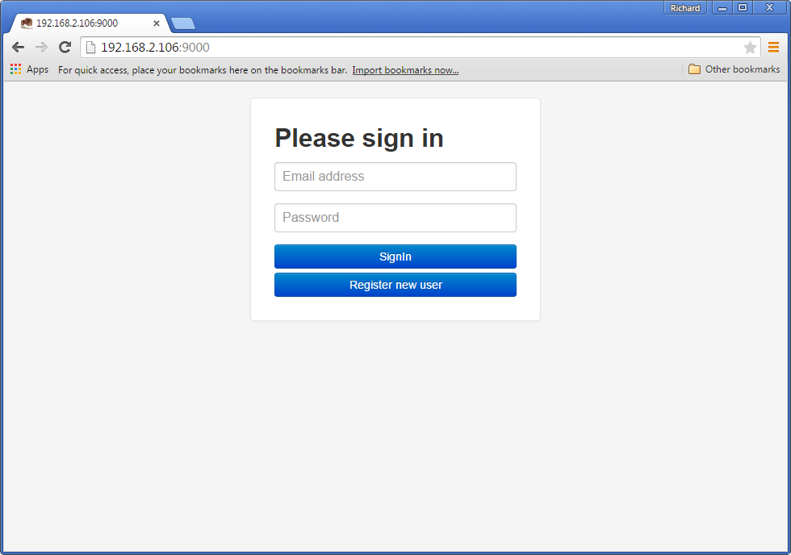
Authentication

Slide 13
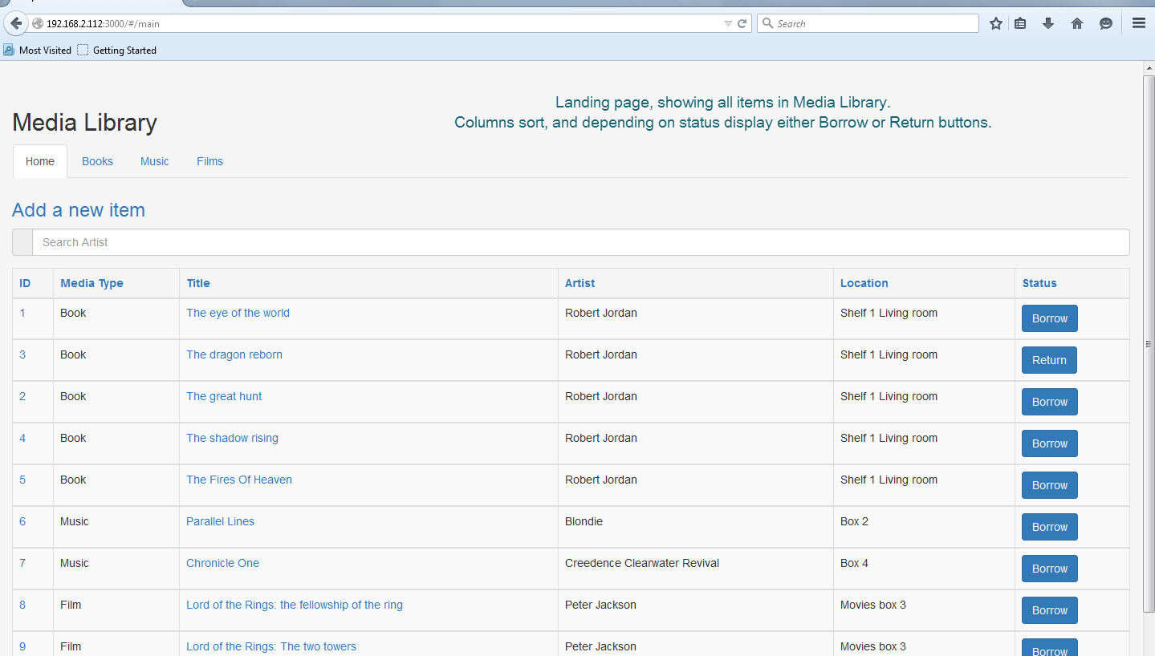
Main page

Slide 14
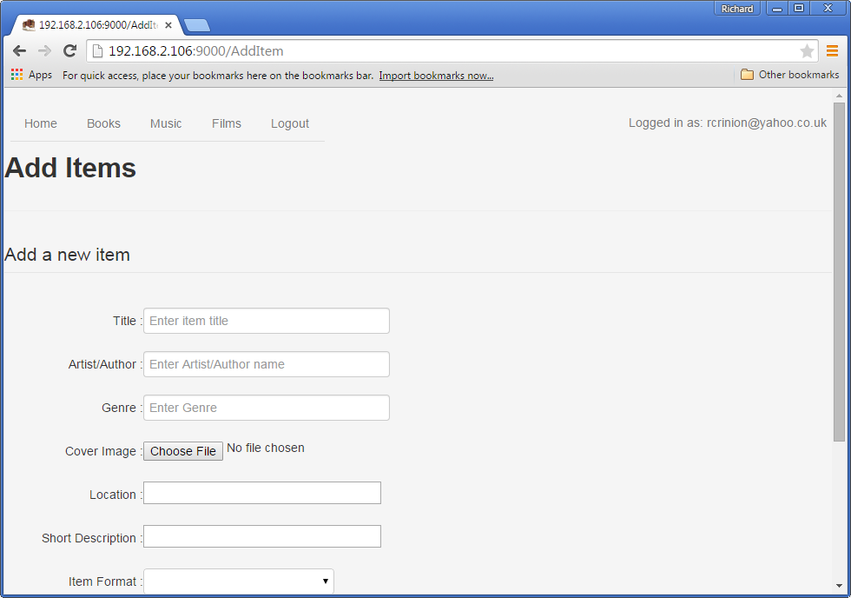
Add new item

Slide 15
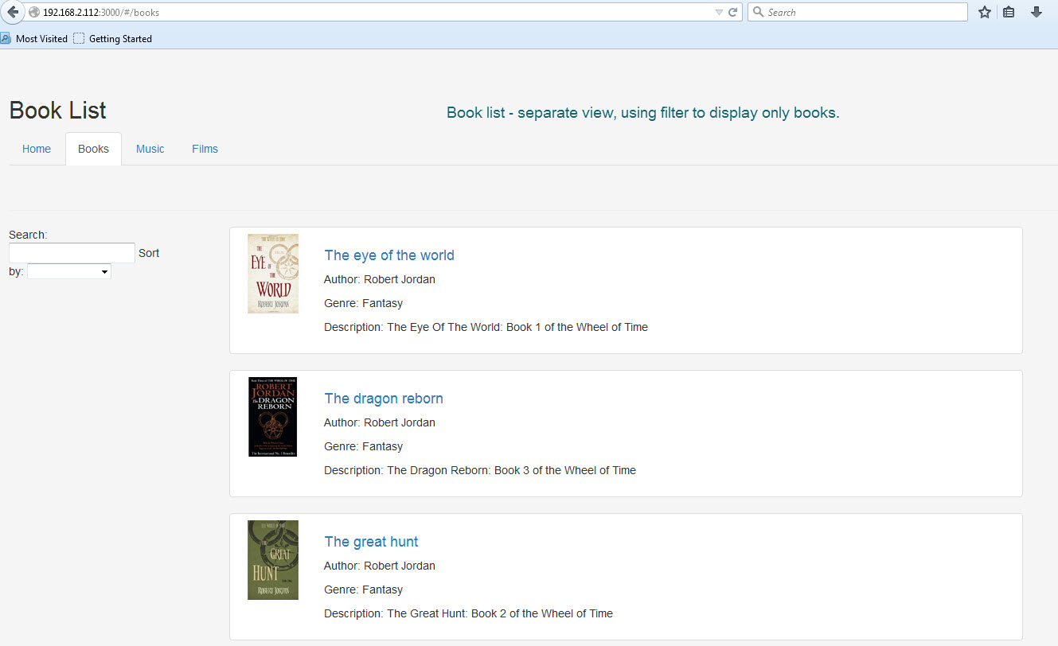
Books view

Slide 16
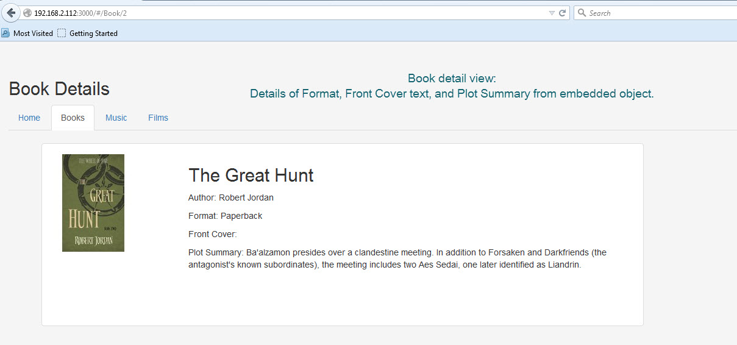
Books – Detail screen

Slide 17
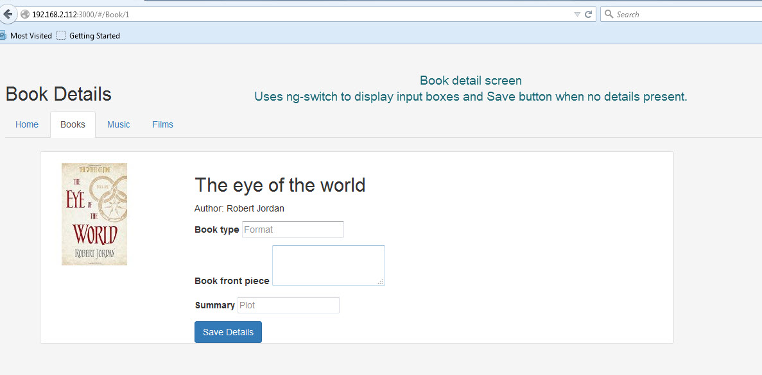
Books – Detail (add details)

Slide 18
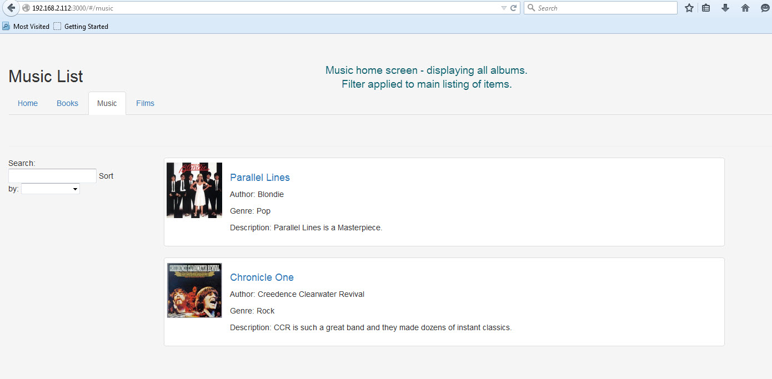
Music View

Slide 19
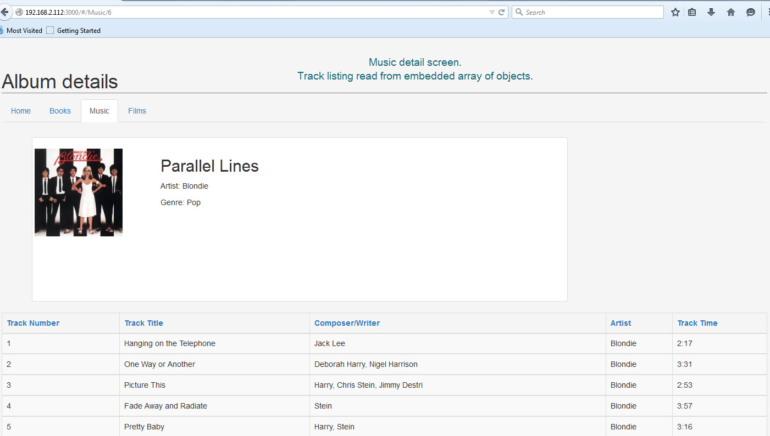
Music detail view

Slide 20
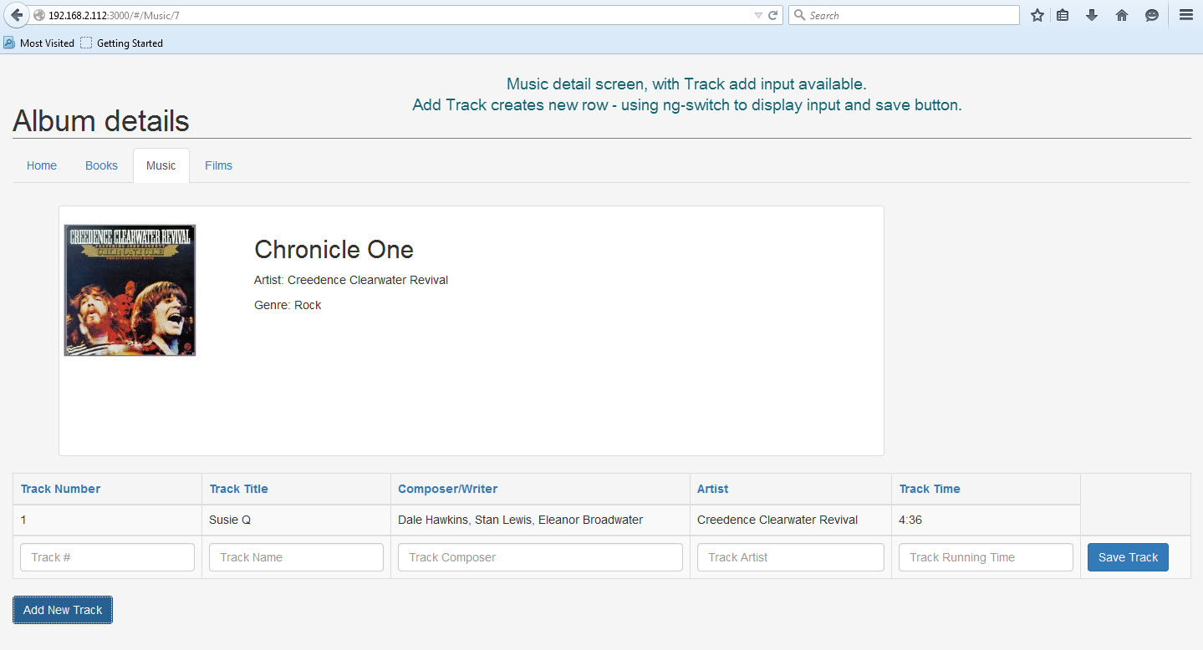
Music detail – Add track

Slide 21
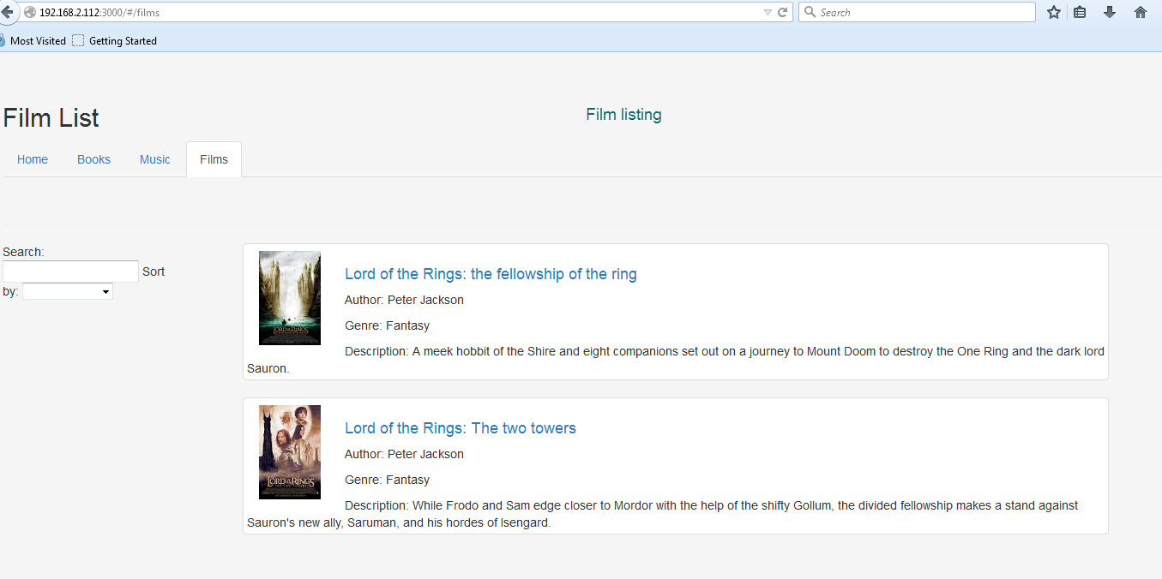
Films View

Slide 22
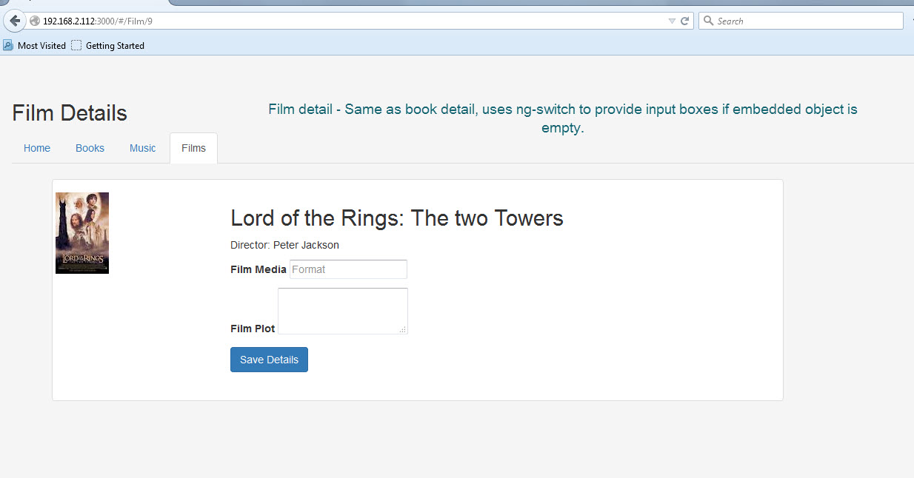
Film detail view

Slide 23
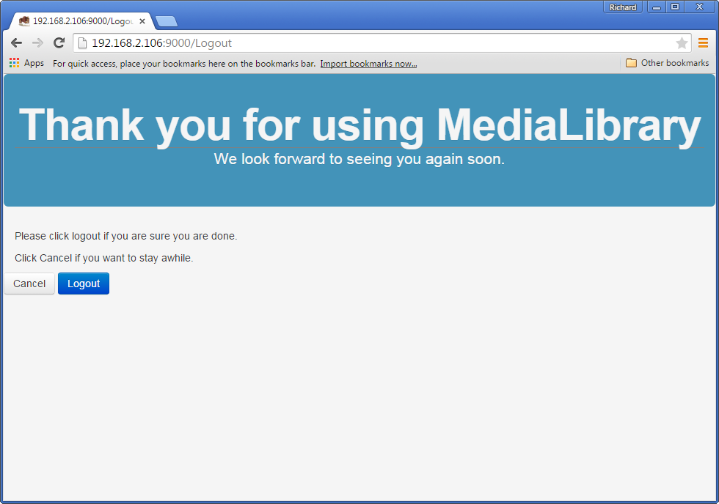
Logout screen

