Slide 1
Rectangle Shape
fill color = red
(x1, y1)
Border (outline) color = black
Border (outline) width = 1 px
(x2, y2)
Width = x2 – x1
Height = y2 – y1

Slide 2
Rectangle Decorators
Resize Selector: s1
Line Connector: c1
Click resize selector and drag to resize shape
Four (4) selectors: s1 to s4
Drag line end onto shape line connector to
“snap-to-shape”
Five (5) connectors: c1 to c4
Line will resize if connected shape moves or
resizes

Slide 3

ctk.TOP
ctk.LEFT
ctk.CENTER
ctk.RIGHT
ctk.BOTTOM

Slide 4
Line Types

Slide 5
Line Types
Straight Line
Elbow Line
Segmented Line

Slide 6
Triangle Shape
fill color = red
(x1, y1)
Border (outline) color = black
Border (outline) width = 3 px
(x3, y3)
(x2, y2)
Width = x2 – x1
Height = y2 – y1
(x1, y1) = (x1, y1)
(x2, y2) = (x1 + w, y2)
(x3, y3) = (x1, y2)

Slide 7
Triangle Decorators
Resize Selector: s1
Line Connector: c1
Click resize selector and drag to resize shape
Four (4) selectors: s1 to s4
Drag line end onto shape line connector to
“snap-to-shape”
Five (5) connectors: c1 to c5
Line will resize if connected shape moves or
resizes

Slide 8
Triangle Rotation (ccw rotation)
Angle = 0°
Angle = 90°
Angle = 180°
Angle = 270°
(x1, y1)
p1
(x1, y1)
p2
p2=(x1, y1)
p3
p3=(x1, y1)
p1
p1
p3=(x3, y3)
p2=(x2, y2)
(x3, y3)
p3 =(x2, y2)
(x3, y3)
p1
(x2, y2)
p2=(x3, y3)
(x2, y2)
Width = x2 – x1
Height = y2 – y1
p1 = (x1 + w/2, y1)
p2 = (x2, y2)
p3 = (x1, y2)
p1 = (x1, y1 + h/2)
p2 = (x2, y1)
p3 = (x2, y2)
p1 = (x1 + w/2, y2)
p2 = (x1, y1)
p3 = (x2, y1)
p1 = (x2, y1 + h/2)
p2 = (x1, y2)
p3 = (x1, y1)

Slide 9
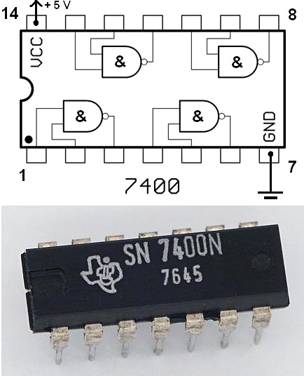
Integrated Circuits
Lets examine a digital integrated circuit: Texas Instruments SN7400N made in 1976.
The SN7400N chip contains four two-input NAND gates.
The SN prefix indicates it was manufactured by Texas Instruments[1]
The N suffix is a vendor-specific code indicating plastic DIP packaging.
The second line of numbers (7645) is a date code; this chip was manufactured in the 45th week of 1976.
The IC has 14 pins with Gnd on pin7 and Vcc on pin 14.
pin1 = in1 NAND1
pin2 = in2 NAND1
pin3 = out NAND1
pin4 = in1 NAND2
pin5 = in2 NAND2
pin6 = out NAND2
pin8 = out NAND3
pin9 = in2 NAND3
pin10 = in1 NAND3
pin11 = out NAND4
pin12 = in2 NAND4
pin13 = in1t NAND4
How can we model this integrated circuit, perhaps as a superset of our Nand Gate Class or do we need a subcircuit. Although, many
of the early IC’s were groups of logic gates such as And Gates, Or Gates, Not Gates, etc. later IC’s were subcircuits with higher-level functions
such as counters, flip-flops, and registers. It is probably best to create the IC as a subcircuit.

Slide 10
IC 7400
Quad NAND

Slide 11
Wire Busses
4-wire buss

Slide 12



Subcircuit
Sub Ckt 1
Main Ckt
In1
In2
In1
In2
Sub Ckt 1
In3
Out
In4
In3
Out
In4

Slide 13
Top Frame
Left Frame
Canvas
Bottom Frame

Slide 14
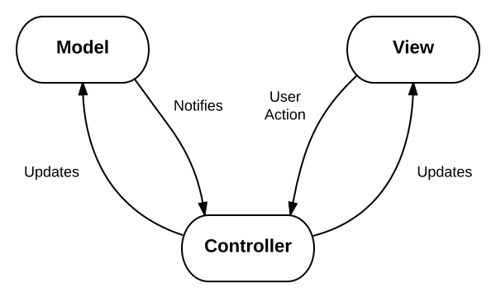
Courtesy: educative.io

Slide 15

Not Gate Decorators
Unselected
Selector
Connectors

Slide 16
9-LOAD
1-CLR
15-RCO
2-CLK
11-Qd
7-ENP
12-Qc
74LS161
10-ENT
13-Qb
3-A
14-Qa
4-B
8-GND
5-C
16-VCC
6-D

Slide 17
1-CLR
20-VCC
3-1D
2-1Q
4-2D
5-2Q
7-3D
6-3Q
8-4D
74LS273
9-4Q
13-5D
12-5Q
14-6D
15-6Q
17-7D
16-7Q
18-8D
19-8Q
10-GND
11-CLK

Slide 18
8-A0
24-VCC
7-A1
9-IO 0
6-A2
10-IO 1
5-A3
11-IO 2
4-A4
13-IO 3
3-A5
28C16
14-IO 4
2-A6
15-IO 5
1-A7
16-IO 6
23-A8
17-IO 7
22-A9
18-CE
19-A10
20-OE
12-GND
21-WE

