Slide 1
Python Decorators: From Basics to Advanced
Enhance functions with flexible and reusable coding techniques
Notes:
AI-generated content may be incorrect. ---

Slide 2
Introduction to Python Decorators
Notes:
Understanding Decorators

Slide 3
Understanding Decorators
Decorator Concept
Decorators are functions that modify other functions without changing their code, enhancing functionality.
Use Cases
Common uses for decorators include logging, authentication, and performance monitoring to simplify code.
Code Reusability
Decorators promote code reusability and separation of concerns, making programs cleaner and maintainable.
Framework Foundations
Many frameworks like Flask and Django rely on decorators for routing and middleware functionality.
Notes:
Python decorators are a powerful feature that allows developers to modify or enhance the behavior of functions or methods without changing their actual code. They are essentially functions that take another function as an argument and return a new function with added functionality. This concept promotes code reusability and separation of concerns, making programs cleaner and easier to maintain. Decorators are widely used in scenarios such as logging, authentication, and performance monitoring. For example, instead of adding repetitive logging statements inside multiple functions, a decorator can be applied to handle logging uniformly. This approach simplifies debugging and ensures consistency across the application. Understanding decorators is crucial for writing efficient and scalable Python applications, as they enable developers to implement cross-cutting concerns elegantly. They also form the foundation for many frameworks and libraries, such as Flask and Django, which use decorators extensively for routing and middleware functionalities.

Slide 4
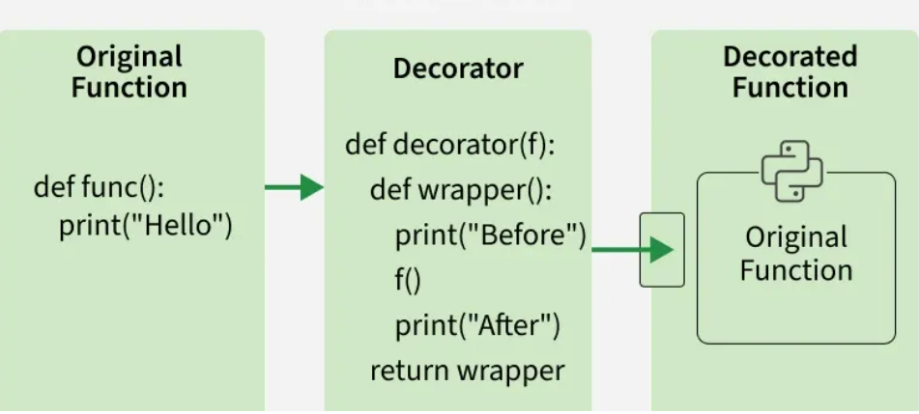
What are Decorators?
In Python, decorators are flexible way to modify or extend behavior of functions or methods, without changing their actual code.
A decorator is essentially a function that takes another function as an argument and returns a new function with enhanced functionality.
Decorators are often used in scenarios such as logging, authentication and memorization, allowing us to add additional functionality to existing functions or methods in a clean, reusable way.

Slide 5
example
def decorator(func):
def wrapper():
print("Before calling the function.")
func()
print("After calling the function.")
return wrapper
@decorator # Applying the decorator to a function
def greet():
print("Hello, World!")
greet()

Slide 6
Explanation:
decorator takes the greet function as an argument.
It returns a new function (wrapper) that first prints a message, calls greet() and then prints another message.
@decorator syntax is a shorthand for greet = decorator(greet).

Slide 7
How Decorators Work
Notes:
Core Concepts Behind Decorators

Slide 8
Core Concepts Behind Decorators
Functions as First-Class Citizens
Python functions can be passed, returned, and assigned like any other object, enabling flexible programming patterns.
Concept of Closures
Closures allow inner functions to remember variables from their enclosing scope after execution completes.
Decorator Wrapper Function
Decorators use inner wrapper functions to add behavior before or after the original function executes.
Notes:
To understand decorators, it is essential to grasp two fundamental concepts in Python: functions as first-class citizens and closures. In Python, functions can be passed as arguments, returned from other functions, and assigned to variables, which makes them first-class citizens. This property allows decorators to accept a function and return a modified version of it. Closures, on the other hand, enable inner functions to capture and remember variables from their enclosing scope even after the outer function has finished executing. A decorator typically defines an inner function (often called a wrapper) that adds extra behavior before or after calling the original function. For example, a simple decorator might print messages before and after executing a function, providing hooks for logging or debugging. This mechanism is the basis for creating more advanced decorators that handle arguments, manage state, or even apply multiple layers of functionality through chaining.

Slide 9
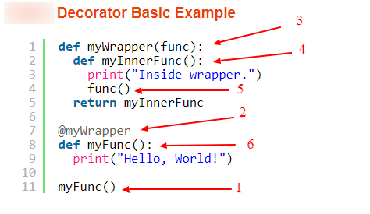

Slide 10
Basic Examples of Decorators
Notes:
Simple Decorator Implementation

Slide 11
Simple Decorator Implementation
Decorator Concept
A decorator adds behavior to a function without changing its original code, enhancing modularity.
Wrapper Function Role
The wrapper function executes additional logic before and after the original function call.
Debugging Usage
Simple decorators are commonly used to trace function calls and monitor execution flow for debugging.
Foundation for Complexity
Understanding simple decorators prepares developers for more advanced use cases like arguments and chaining.
Notes:
A basic decorator demonstrates how additional behavior can be injected into a function without altering its core logic. For instance, consider a decorator that prints messages before and after a function call. This decorator defines a wrapper function inside it, which first executes the pre-processing logic, then calls the original function, and finally performs post-processing. Applying this decorator is straightforward using the @decorator syntax above the function definition. This syntactic sugar simplifies readability and makes the code more expressive. Such simple decorators are often used for debugging purposes, where developers need to trace function calls or monitor execution flow. They also serve as a foundation for understanding more complex decorators, as the same principles apply when adding arguments or chaining multiple decorators together. Practicing with basic examples helps solidify the concept and prepares developers for advanced use cases.

Slide 12
Advanced Decorator Concepts
Notes:
Decorators with Arguments and Chaining

Slide 13
Decorators with Arguments and Chaining
Decorators with Arguments
Decorators can accept arguments through an outer function enabling dynamic behavior based on input parameters.
Class-Based Decorators
Class-based decorators implement __call__ to maintain state across calls, useful for counting or caching.
Chaining Multiple Decorators
Applying multiple decorators layers functionalities like authentication and logging on a single function.
Notes:
Advanced decorators extend the basic concept by accepting arguments, enabling dynamic behavior based on input parameters. For example, a decorator might accept an integer argument to repeat the execution of a function multiple times. This requires an additional layer of function nesting: the outer function receives the argument, returns the actual decorator, which then returns the wrapper. Class-based decorators are another advanced concept, where a class implements the __call__ method to behave like a function. This approach is useful when maintaining state across multiple function calls, such as counting executions or caching results. Chaining decorators is also common, where multiple decorators are applied to a single function, each adding its own layer of functionality. For instance, one decorator might handle authentication, while another logs execution time. Understanding these advanced patterns is essential for building robust and flexible Python applications.

Slide 14
Decorator with Parameters
Notes:
Decorators with Arguments and Chaining

Slide 15
Decorators often need to work with functions that have arguments. We use *args and **kwargs so our wrapper can accept any number of arguments.
Example: Let's see an example of a decorator that adds functionality before and after a function call.
def decorator_name(func):
def wrapper(*args, **kwargs):
print("Before execution")
result = func(*args, **kwargs)
print("After execution")
return result
return wrapper
@decorator_name
def add(a, b):
return a + b
print(add(5, 3))

Slide 16
decorator_name(func): This is the decorator function. It takes another function (func) as input.
**wrapper(*args, kwargs): A nested function that wraps func. *args collects positional arguments, **kwargs collects keyword arguments, so wrapper works with any function.
@decorator_name: Syntax sugar for add = decorator_name(add).

Slide 17
Functions as First-Class Objects
allows functions to be assigned to variables, passed as arguments, returned from other functions and stored in data structures enabling flexible programming patterns, including decorators.
Notes:
Decorators with Arguments and Chaining

Slide 18
# Assigning a function to a variable def greet(n): return f"Hello, {n}!" say_hi = greet # Assign the greet function to say_hi print(say_hi("Alice")) # Passing a function as an argument def apply(f, v): return f(v) res = apply(say_hi, "Bob") print(res) # Returning a function from another function def make_mult(f): def mult(x): return x * f return mult dbl = make_mult(2) print(dbl(5))

Slide 19
Explanation: greet() is assigned to say_hi variable, which is used to print a greeting for "Alice". apply() takes a function and a value as arguments, applies function to value and returns the result. apply is demonstrated by passing say_hi and "Bob", printing a greeting for "Bob". make_mult() creates a multiplier function based on a given factor.

Slide 20
Types of Decorators
Notes:
Practical Applications in Real Projects

Slide 21
1. Function Decorators Example: In this Example, a decorator prints a message before and after executing wrapped function. def simple_decorator(func): def wrapper(): print(">>> Starting function") func() print(">>> Function finished") return wrapper @simple_decorator def greet(): print("Hello, World!") greet()

Slide 22
2. Method Decorators Special decorators used for methods inside a class. They work like function decorators but handle the self parameter for instance methods.. def method_decorator(func): def wrapper(self, *args, **kwargs): print("Before method execution") res = func(self, *args, **kwargs) print("After method execution") return res return wrapper class MyClass: @method_decorator def say_hello(self): print("Hello!") obj = MyClass() obj.say_hello()

Slide 23
Chaining Multiple Decorators def decor1(func): def inner(): x = func() return x * x return inner def decor(func): def inner(): x = func() return 2 * x return inner @decor1 @decor def num(): return 10 @decor @decor1 def num2(): return 10 print(num()) print(num2())

Slide 24
Industry Use Cases
Notes:
Practical Applications in Real Projects

Slide 25
Practical Applications in Real Projects
Logging with Decorators
Decorators automate logging of function calls, arguments, and execution time without cluttering core logic.
Authentication and Authorization
Decorators validate user permissions in web frameworks to secure sensitive operations effectively.
Caching for Performance
Caching decorators save results of expensive computations to speed up repeated operations.
API Management
Decorators handle rate limiting, input validation, and error handling in API development.
Notes:
Decorators are widely used in industry to implement cross-cutting concerns efficiently. One common use case is logging, where decorators automatically log function calls, arguments, and execution time without cluttering the core logic. Authentication and authorization are another critical application, especially in web frameworks like Flask and Django, where decorators validate user permissions before executing sensitive operations. Caching is also a popular use case, where decorators store results of expensive computations to improve performance. For example, a machine learning model might use a caching decorator to avoid recomputing predictions for the same input. Decorators also play a vital role in API development, where they manage rate limiting, input validation, and error handling. These examples highlight how decorators simplify complex tasks and enhance maintainability, making them indispensable in modern software development.

Slide 26
Practical Problems and Solutions
Notes:
Common Challenges and Implementations

Slide 27
Common Challenges and Implementations
Performance Measurement
Timer decorators measure function execution time to help optimize performance effectively.
Authentication Enforcement
Decorators enforce authentication by validating user credentials before executing sensitive operations.
Retry Mechanism
Retry decorators improve resilience by retrying functions interacting with unreliable external services.
Notes:
In real-world scenarios, developers often face challenges that decorators can solve elegantly. For instance, measuring the execution time of functions is a frequent requirement in performance optimization. A timer decorator can wrap the target function, record the start and end times, and print or log the duration. Another common problem is enforcing authentication checks before executing sensitive operations. A decorator can validate user credentials and permissions, raising exceptions if the user is unauthorized. Similarly, decorators can handle retries for functions that interact with unreliable external services, improving resilience. These practical implementations demonstrate the versatility of decorators in addressing recurring problems without duplicating code. By centralizing such logic in decorators, developers achieve cleaner, more maintainable, and scalable applications.

