Slide 1

Caravel Custodial RWA Lending Platform on Stellar
Here for advice, not money.
not connected?
Borrow
SAFO
?
Earn
unusable?
Does anyone actually use SAFO to borrow or earn? Is there a gap?
OUR BACKTEST · DAILY ENTRIES IN PROFIT
EUR carry
99–100%
7–9.5%/yr on equity
USD carry
0–2.5%
86–100% only if subsidised
Backtest, small size: daily entries Jun 2024–Oct 2026. EUR: Morpho live market, equity at 88% LTV (Caravel 70%: ~4.9%). USD: market rates; subsidy 3.33%.
01 / 04

Slide 2
One whitelisted contract bridges crypto and RWA
CRYPTO · OPEN
RWA · WHITELISTED
whitelists
Issuer
USDC
USDC
USDC lenders
Borrower
Caravel
SHARES
never hold shares
contract
ON DEFAULT
WHITELISTED
USDC
Liquidator
SHARES
or Spiko itself
Is a whitelist-crossing structure possible? Would issuers approve it?
Sources: Caravel README (How it works); kyc-assets report, 25 Oct 2026. Shares = fund shares, e.g. Spiko SAFO.
02 / 04

Slide 3
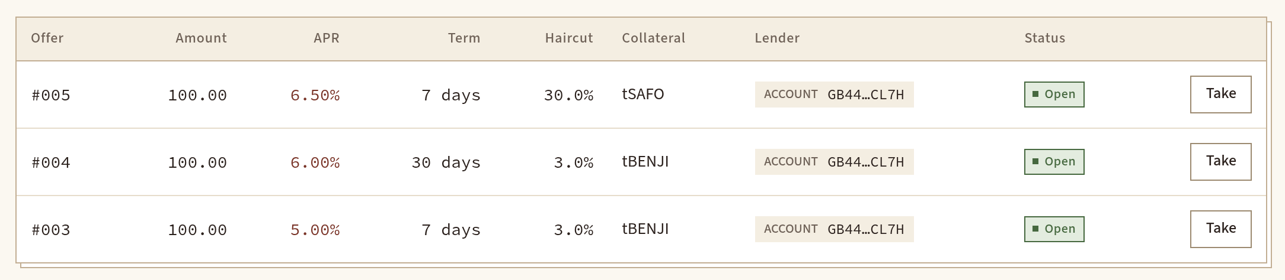
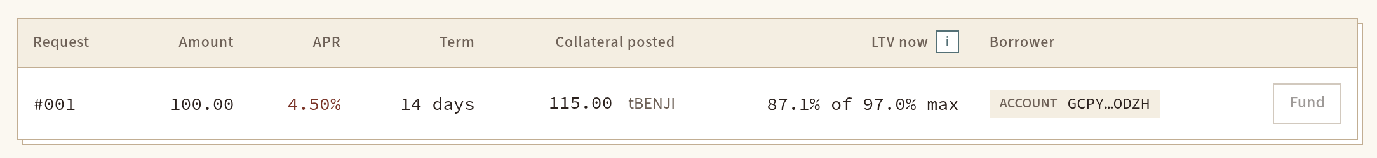
Rates, traded like a Bitcoin order book
APR %
USDC
TOTAL
ALSO IN THE BOOK
6.50
100
300
Liquidator
Issuer
Lenders
6.00
100
200
WHO ELSE?
5.00
100
100
EUR carry traders
USDY holders
Treasuries
Market makers
spread 0.50
SPARK?
LIVE TESTNET APP
4.50
100
100
Borrowers
Few interested. Not validated.
Who in the market would use this? What would be the spark?
Live testnet book, caravel-repo.pages.dev/app, 27 Oct 2026, no wallet. Depth = cumulative USDC. Who else: backtest scenarios S1–S4, untested.
03 / 04

Slide 4
Next few days: a pivot at every failure
NOW
NEXT FEW DAYS
[confirm]
[confirm]
[confirm]
[confirm]
Advice round
Spiko whitelists
Liquidator
EURC lenders
First mainnet
contract
signs on
commit
loan
NO GAP
NO
NO
NO
[confirm]
[confirm]
Rethink
Different
Spiko
Subsidised
use case
asset
liquidates
USD carry
Which step fails first? Is that the right pivot?
Sources: brief (MB, 27 Oct); kyc-assets report; backtest report; Caravel TASKS.md. [confirm] = drafted, not yet confirmed by MB.
04 / 04

