Slide 1


Slide 2
THE TEAM
Hello, we are team VENU
Richard Chen
Samir Mathur
Denny Tang
Justin Wright
Rachel Cusing
Notes:
We introduce ourselves

Slide 3

Notes:
Justin: explain what to do here.
-map: what’s on here
-button: what does it do
-side menu: links and stuff, transitions

Slide 4

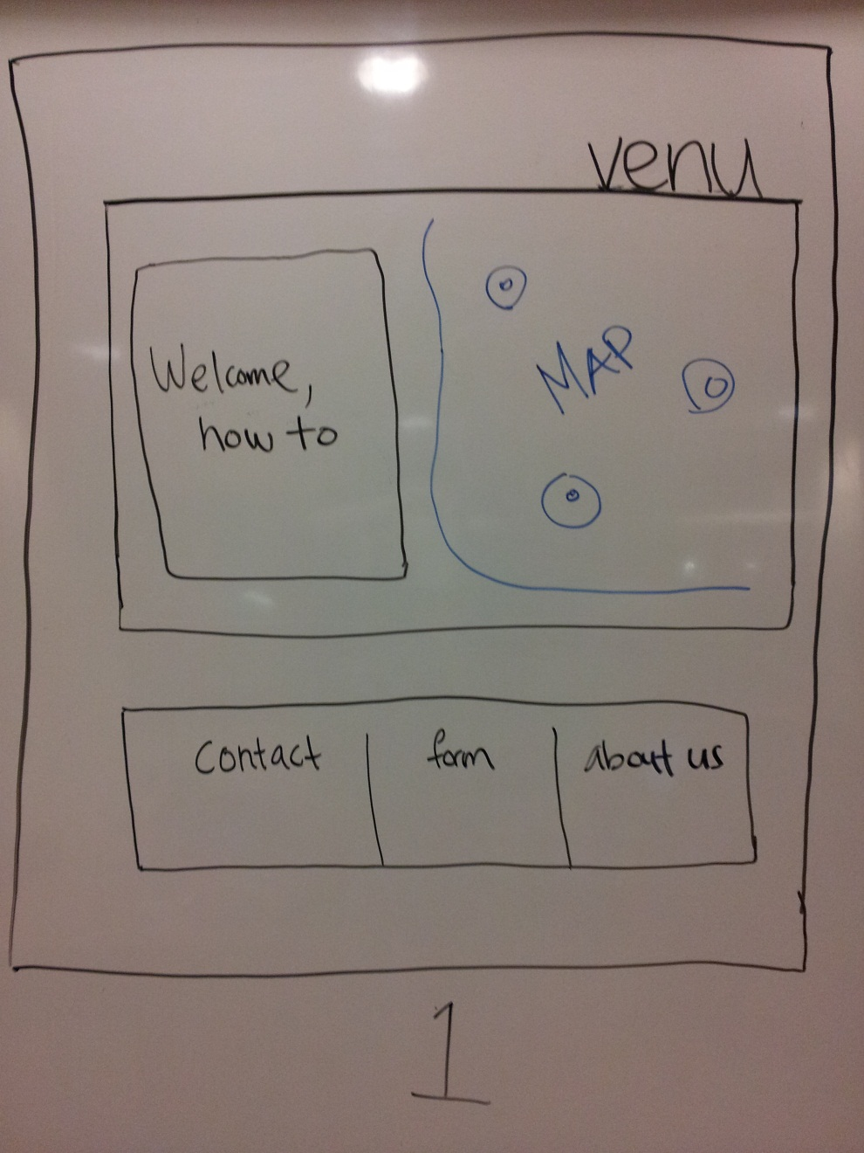

Slide 5
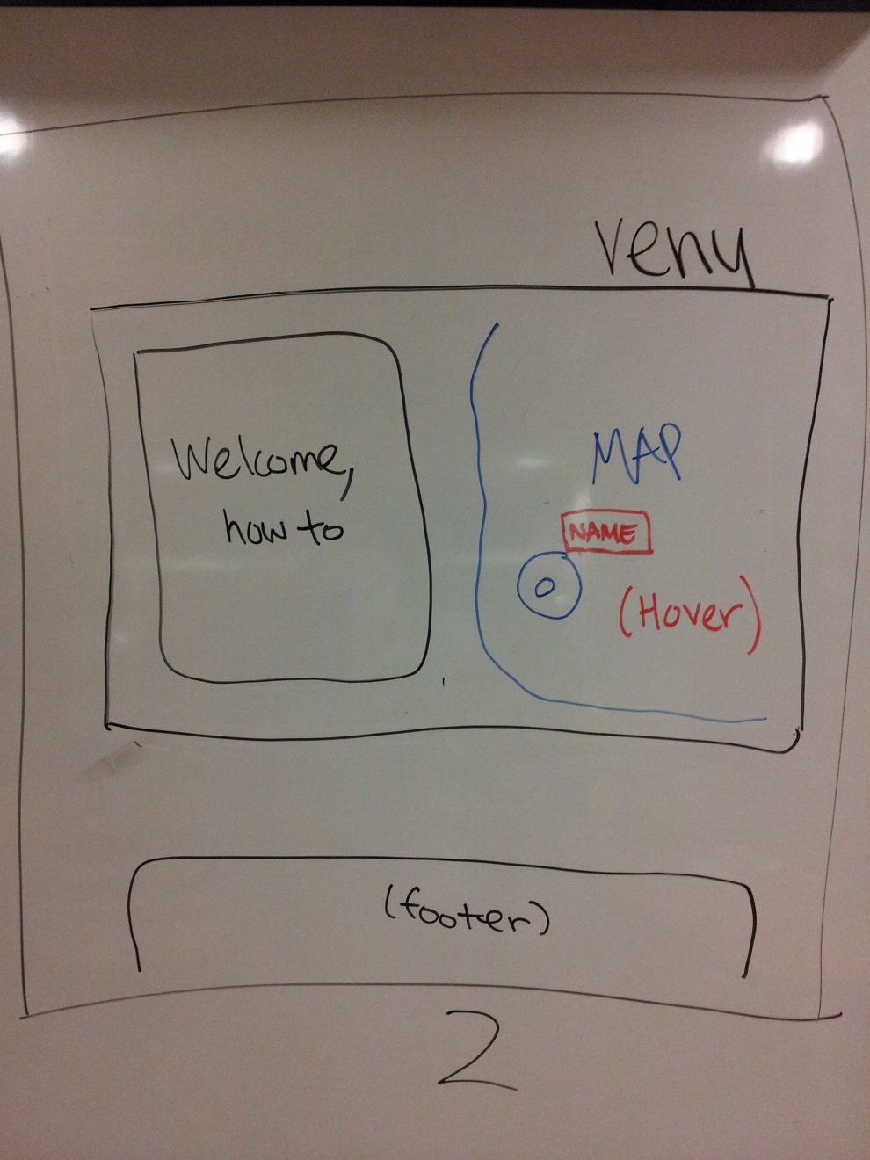
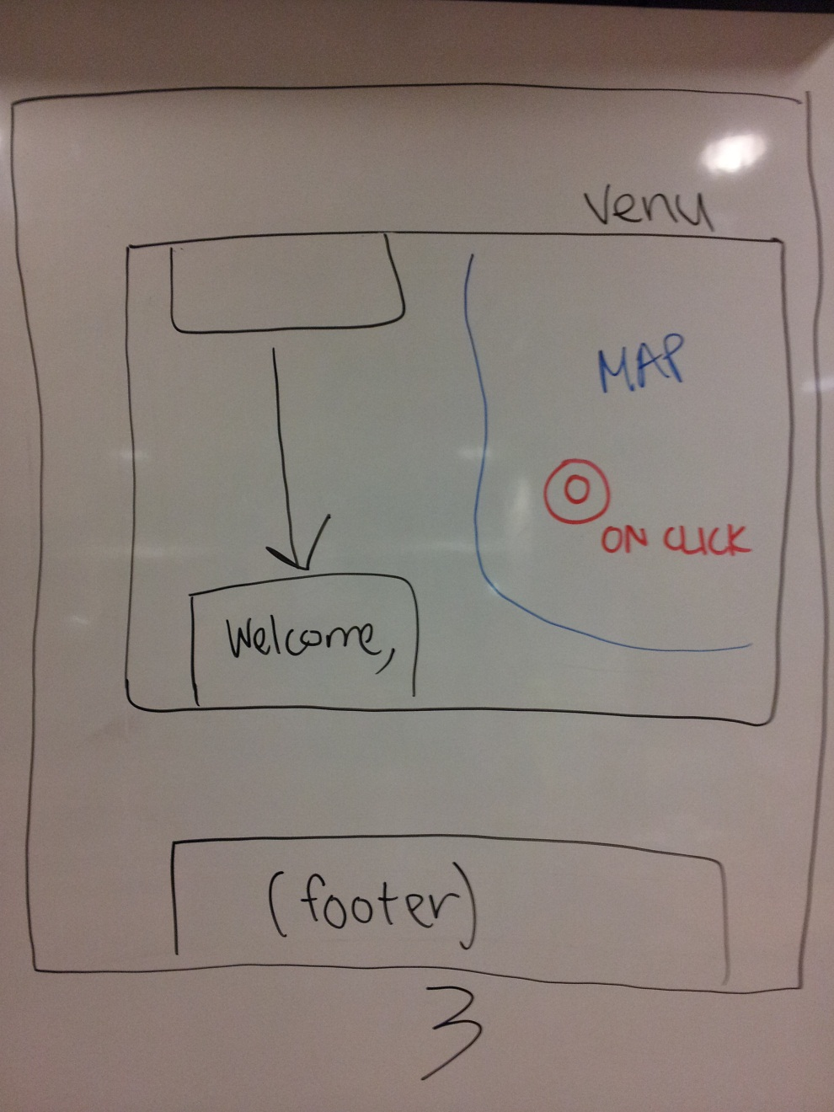
HOVER CLICK

Slide 6
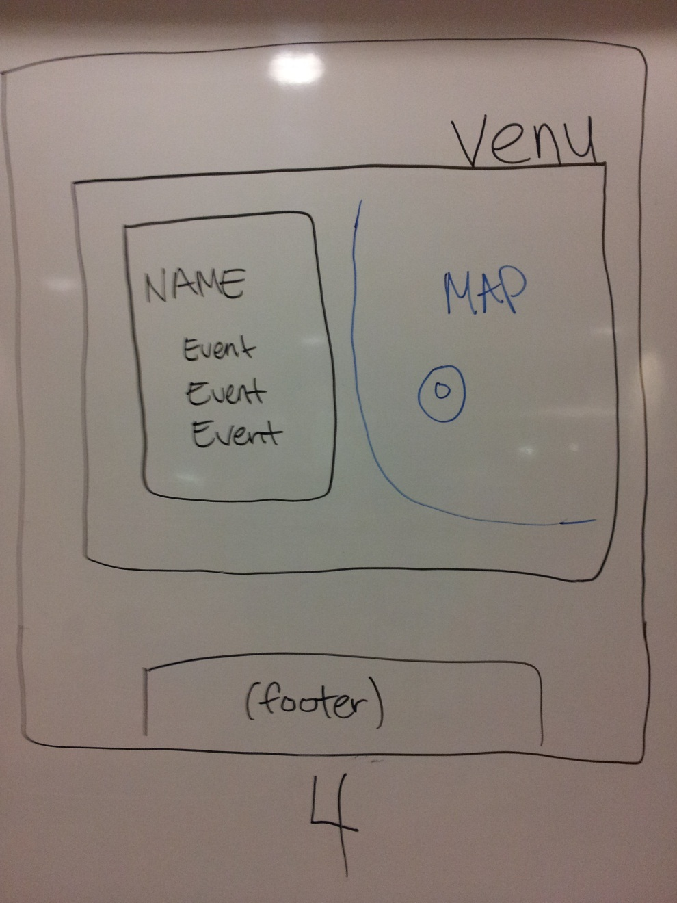
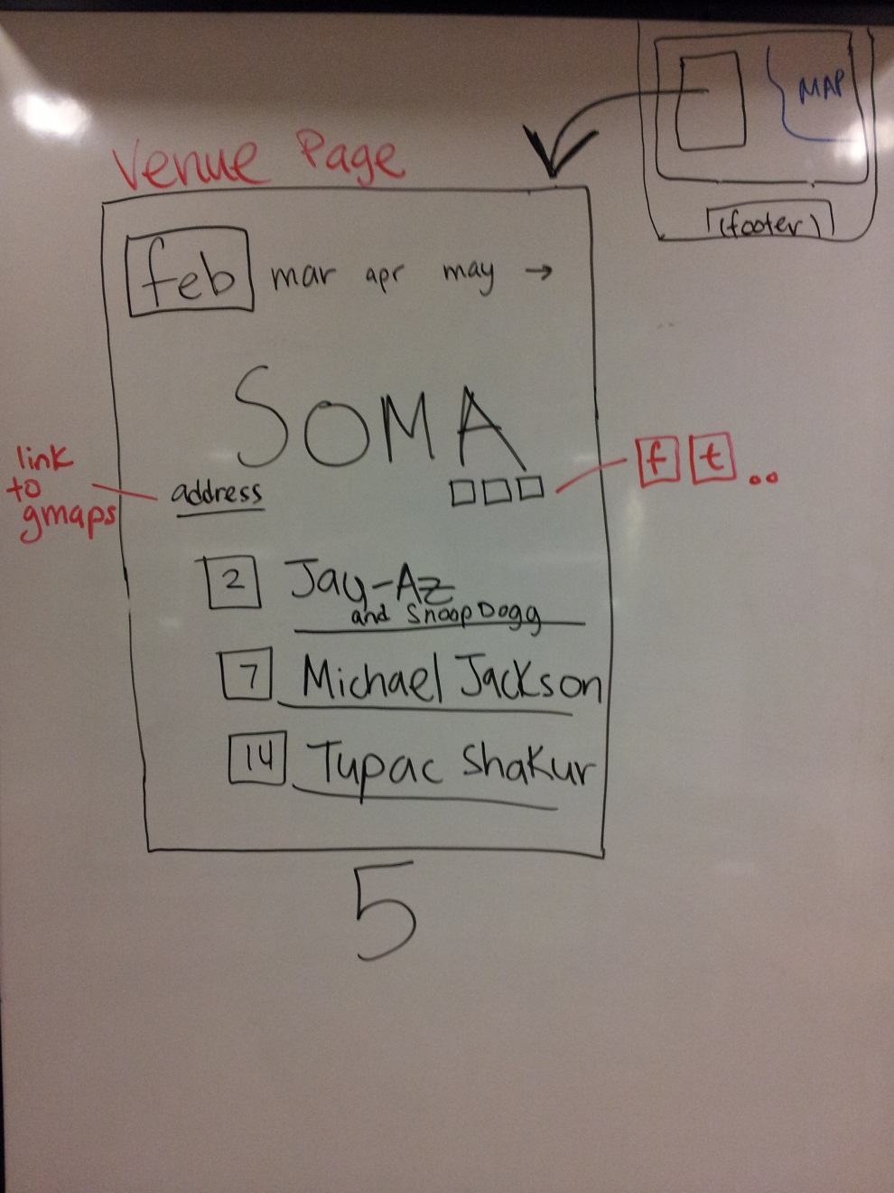
VENUE PAGE

Slide 7
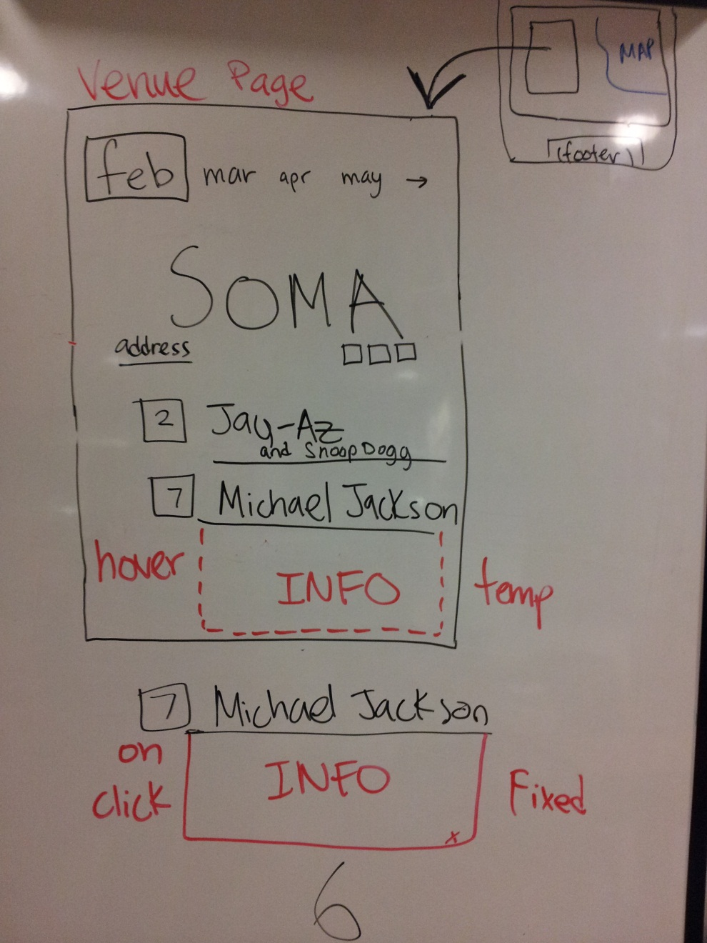
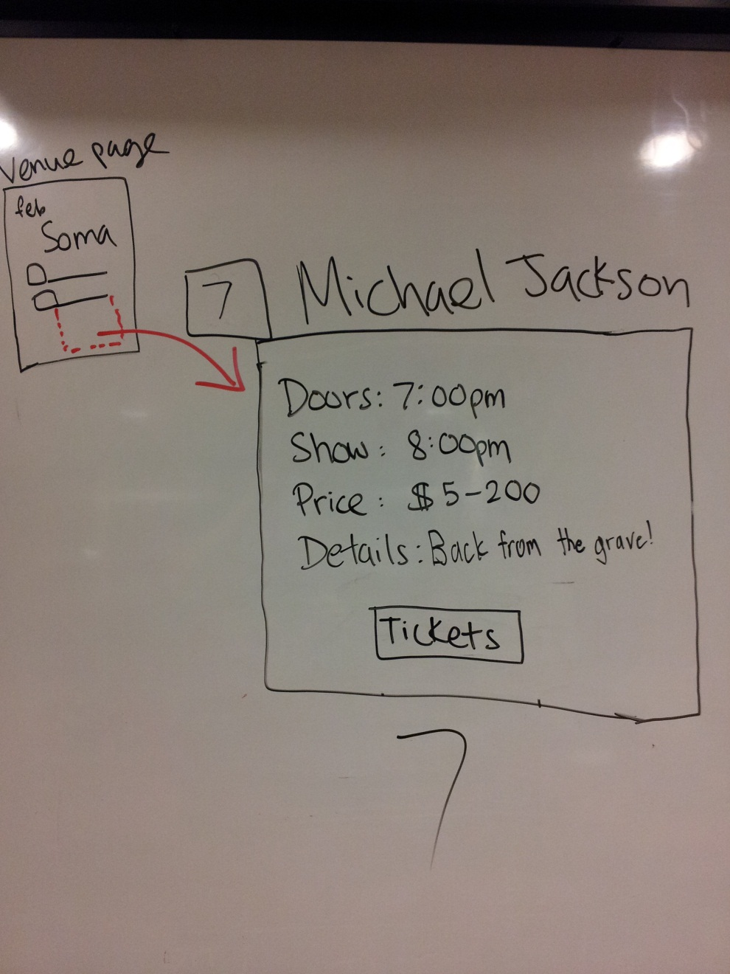
VIEW EVENT DETAILS

Slide 8
TECHNOLOGIES
TECHNOLOGY | GOALS
HTML 5 | -site structure and forms -familiarize ourselves with the new standard
CSS 3 | -STYLE ALL THE THINGS -simple events: rollover, hover, onclick …
Javascript | -pseudo back-end engineering -dynamic content
Git/github | -streamline collaboration -learn how to use this nifty tool

Slide 9
TIMELINE
WEEK | PROJECT MILESTONE
5 | -create storyboard -review tutorials with project in mind
6
7
8
9
10

