Slide 1


Slide 2
THE TEAM
Hello, we are team VENU
Richard Chen
Samir Mathur
Denny Tang
Justin Wright
Rachel Cusing
Notes:
We introduce ourselves

Slide 3

Notes:
concept

Slide 4
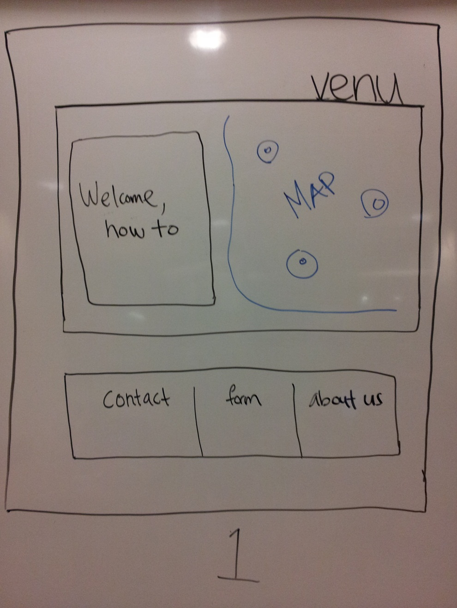

USER EXPERIENCE/STORYBOARD
Notes:
Footer is below the fold

Slide 5
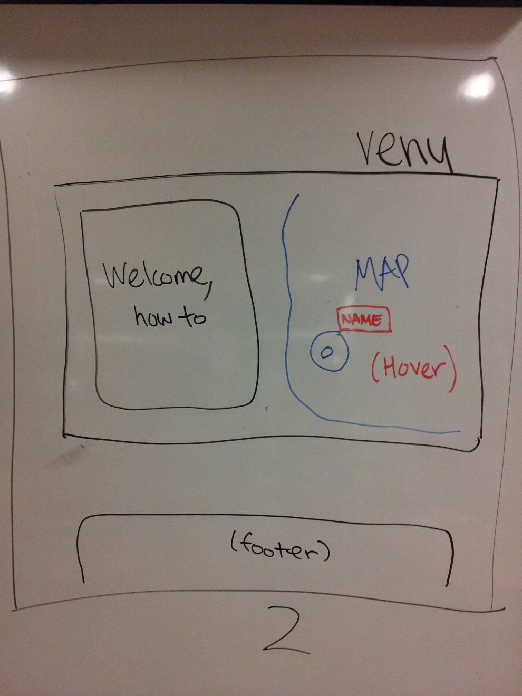
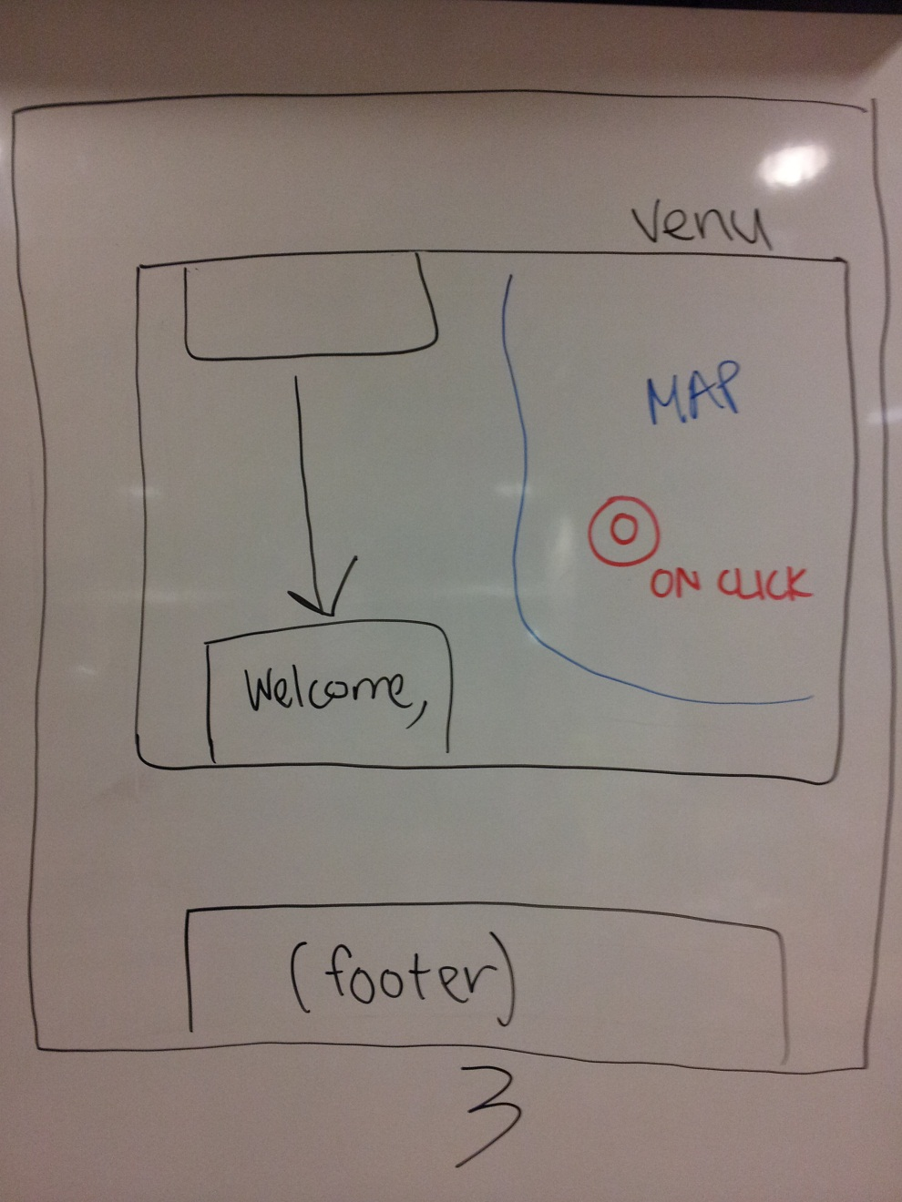
HOVER CLICK

Slide 6
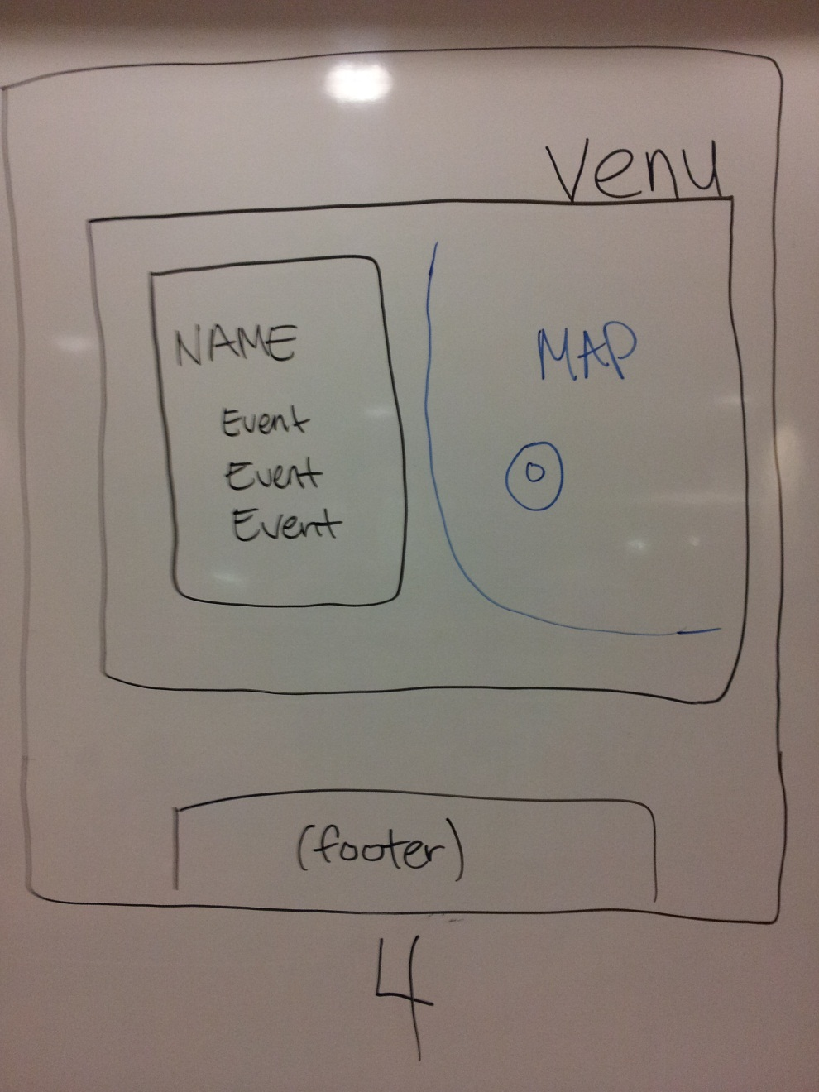
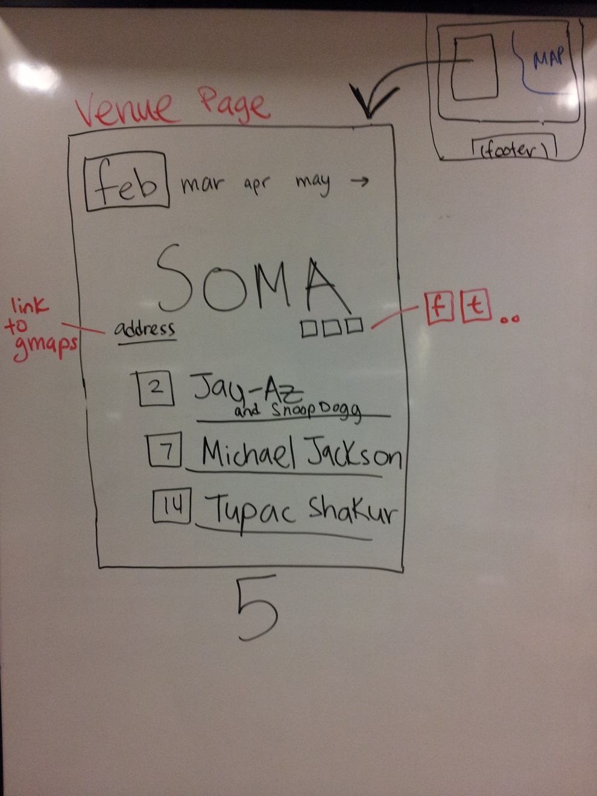
VENUE PAGE

Slide 7
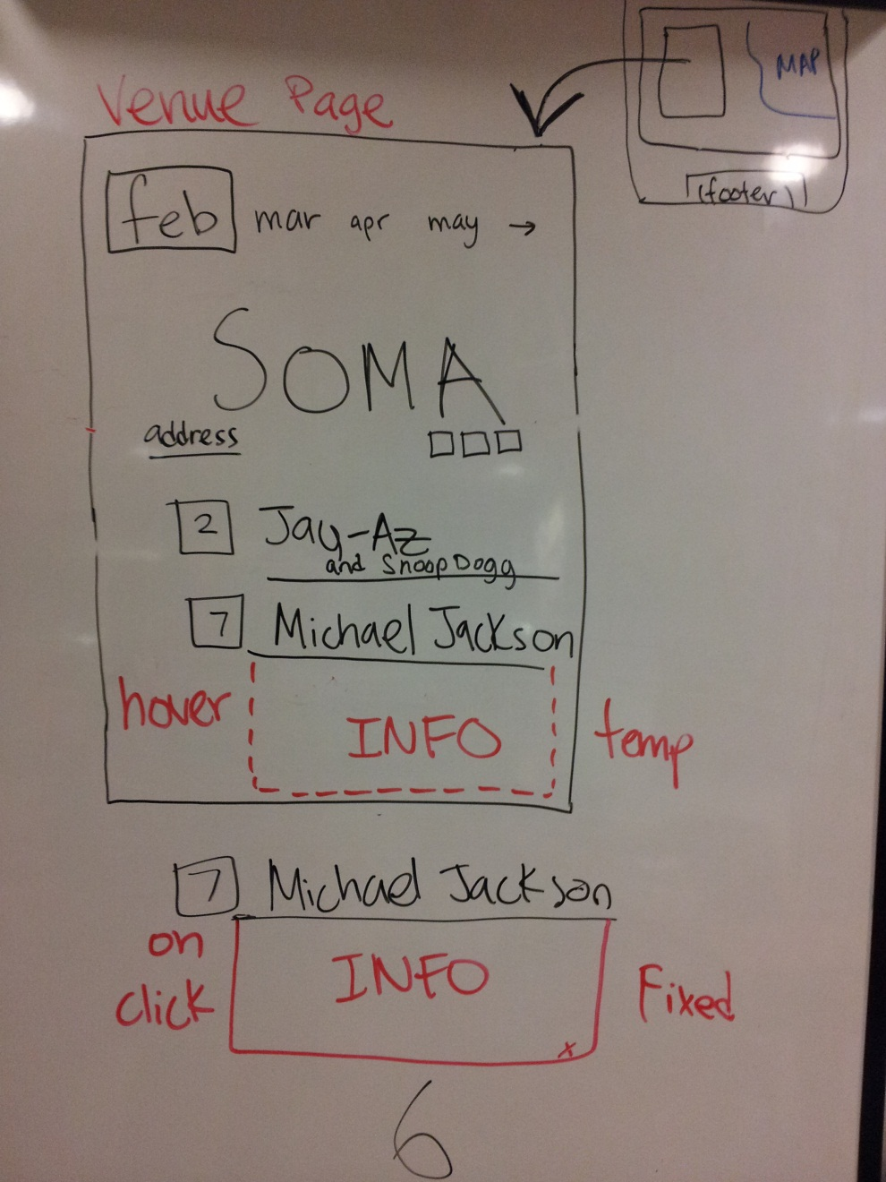
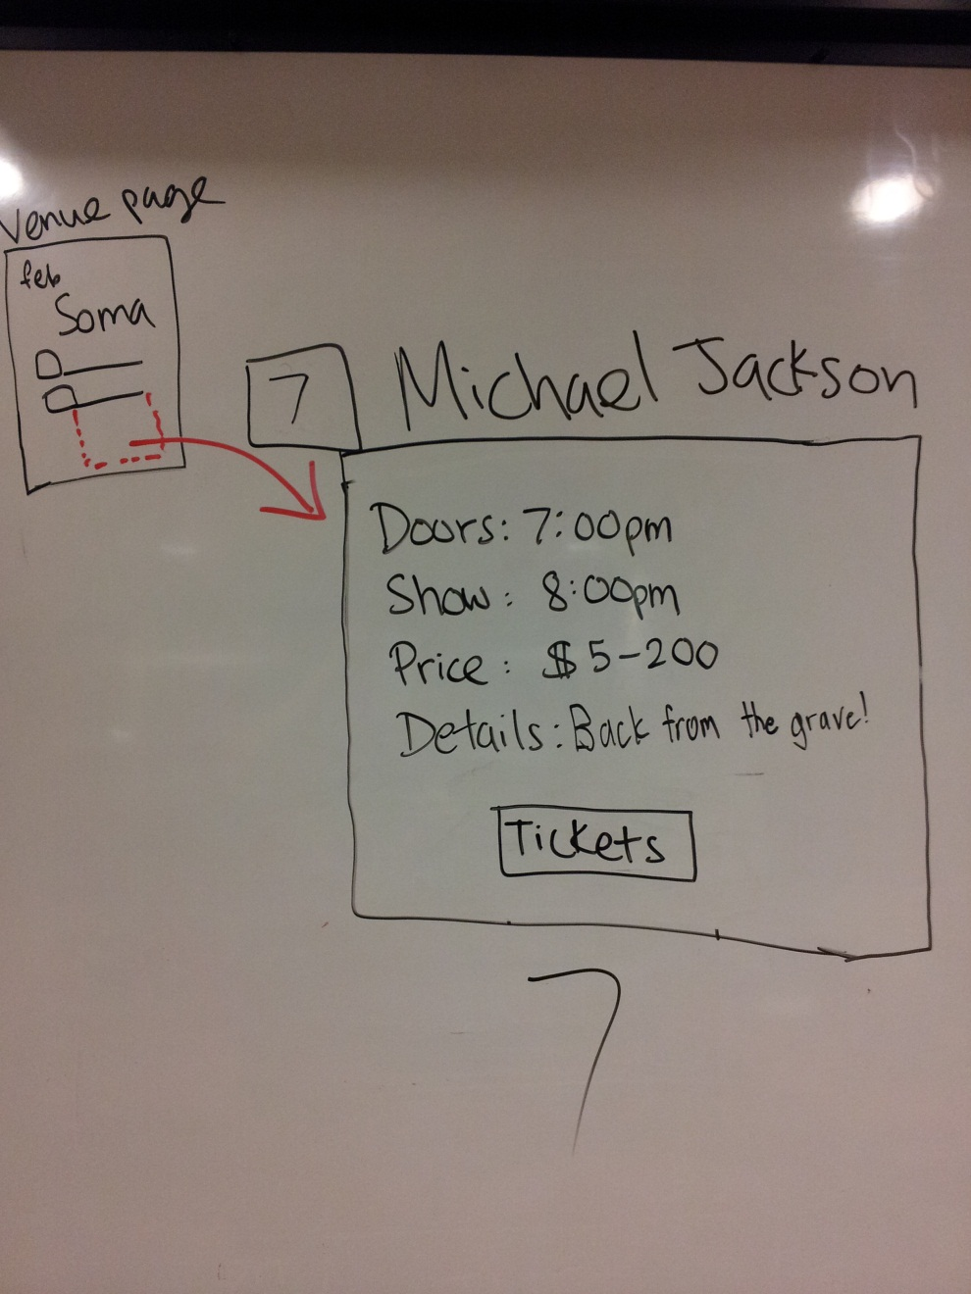
VIEW EVENT DETAILS
X

Slide 8
TECHNOLOGIES
TECHNOLOGY | GOALS
HTML 5 | -site structure and forms -familiarize ourselves with the new standard
CSS 3 | -STYLE ALL THE THINGS -simple events: rollover, hover, onclick …
Javascript | -pseudo back-end engineering -dynamic content
Git/github | -streamline collaboration -learn how to use this nifty tool

Slide 9
OUR SETLIST (A.K.A. TIMELINE)
WEEK | PROJECT MILESTONE
5 | -create storyboard -review tutorials with project in mind -Sat: divide up HTML/CSS
6 | -work on HTML and CSS
7 | -Mon: HTML/CSS completed -begin Javascript
8 | -Javascript
9 | -Mon: Javascript completed -put it all together and work out any issues
10 | -prepare presentation

