Slide 1
Molecular Subtyping of AML
BeatAML Multi-Omics Integration Project
October 2025

Slide 2
Project Overview
Objective: Identify molecular subtypes of AML and characterize their clinical implications
Approach:
• Multi-omics integration (expression, mutations, clinical, drug response)
• Consensus clustering with 1,000 bootstrap iterations
• Pathway enrichment analysis (50 Hallmark pathways)
• Survival analysis and drug response integration
Sample size: 478 patients with complete multi-omics profiles

Slide 3
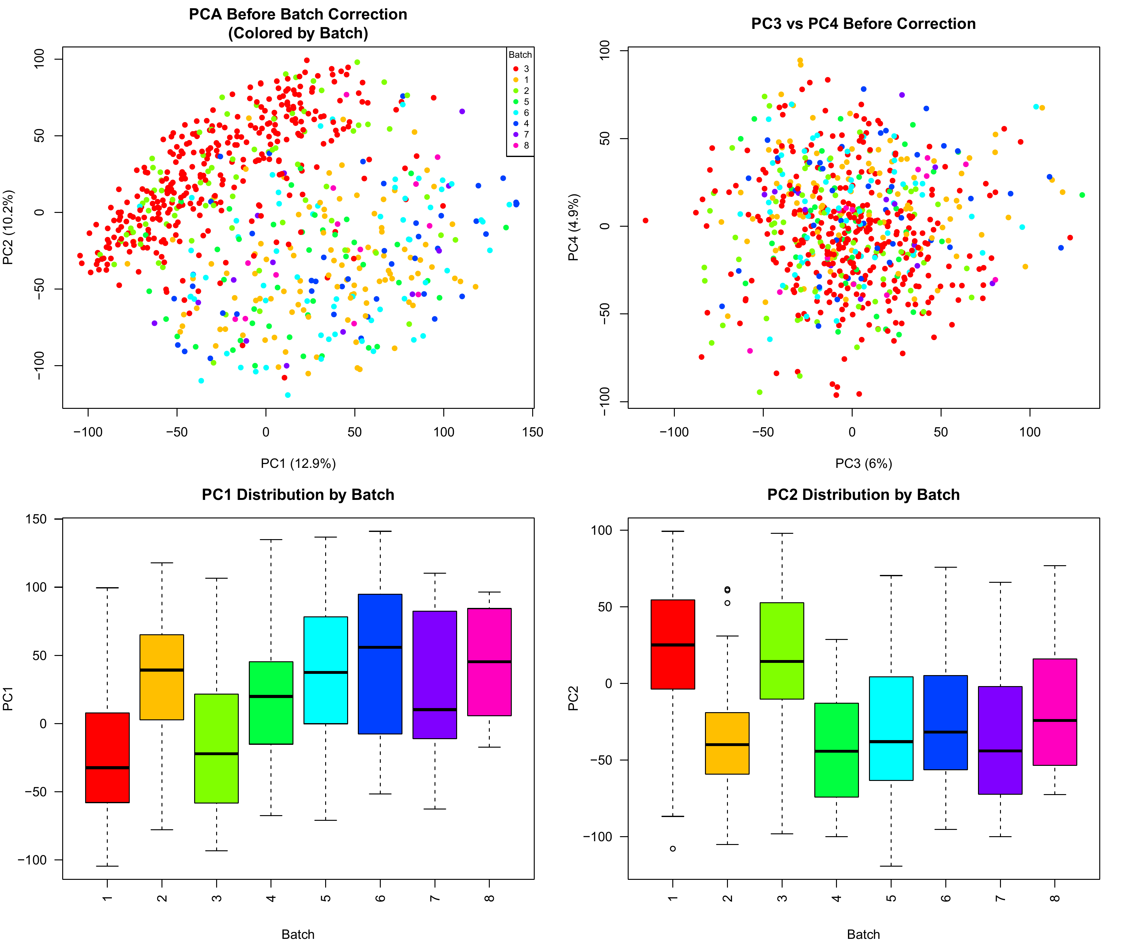
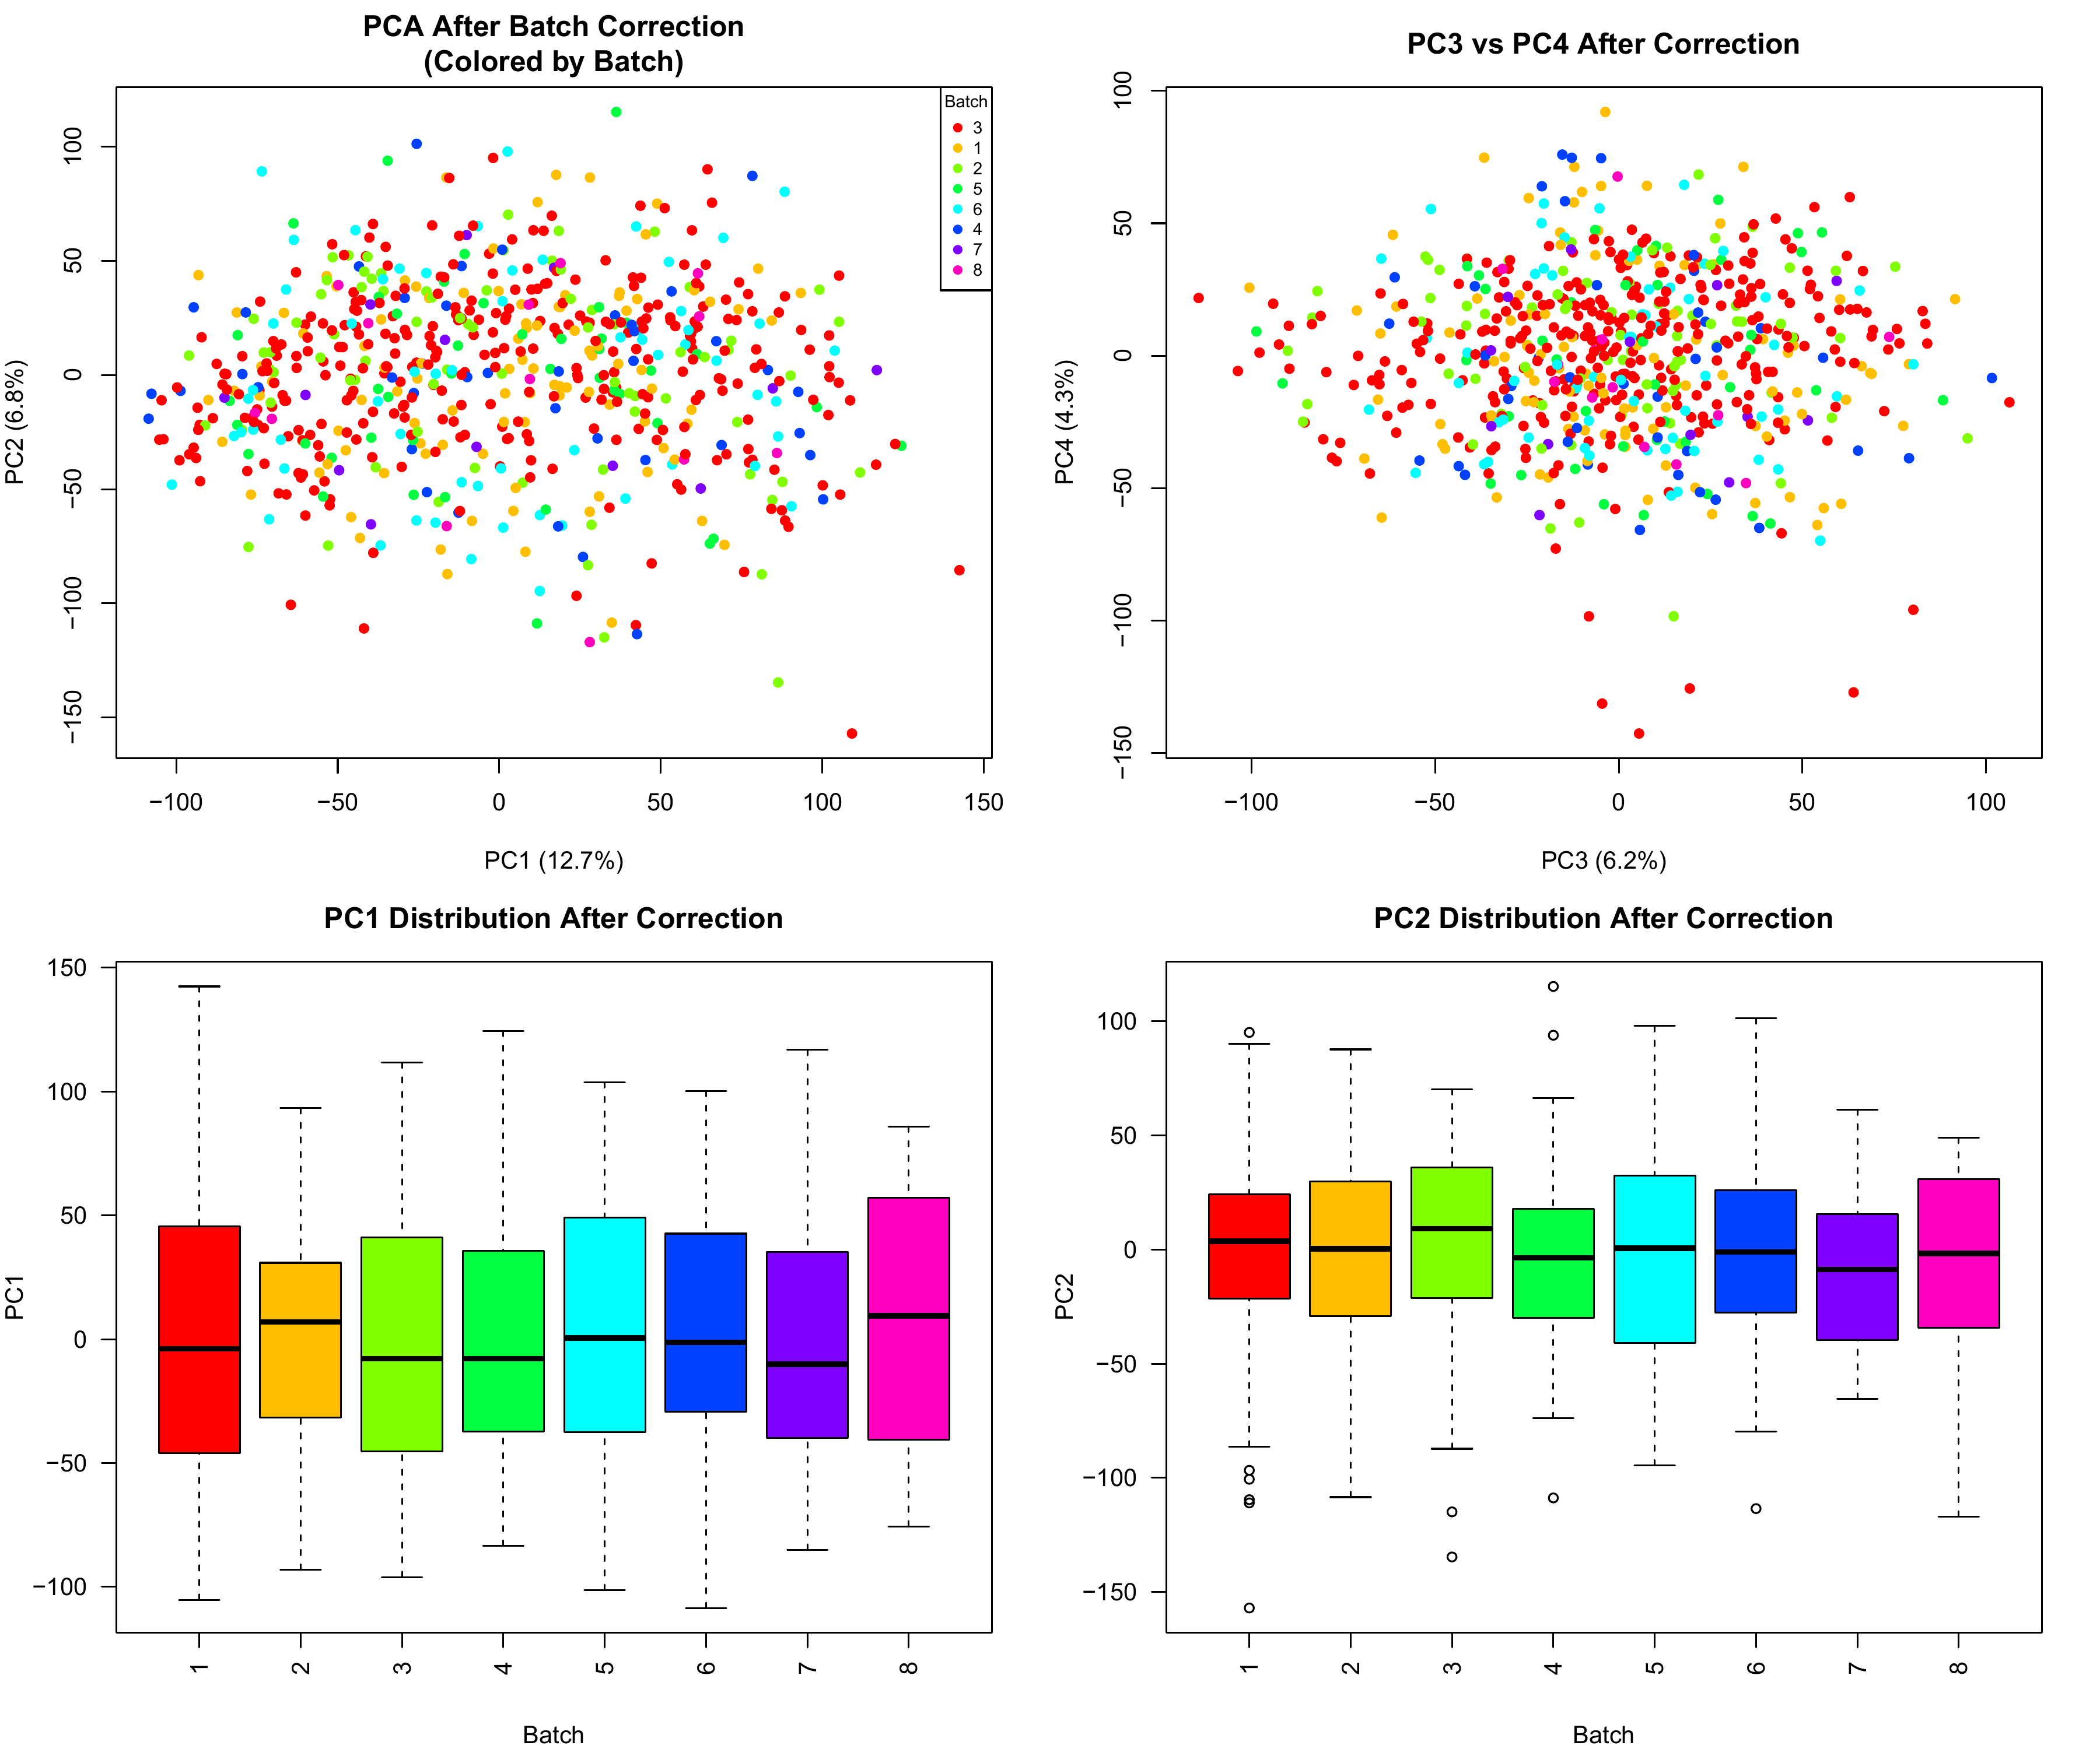
Quality Control: Batch Effect Correction

Slide 4
Key Finding 1: Two Robust Molecular Subtypes
Discovery:
• Consensus clustering identified k=2 as optimal
• Cluster 1: 320 patients (45.3%) - Proliferative subtype
• Cluster 2: 387 patients (54.7%) - Immune-Inflammatory subtype
• High consensus score (0.797) = robust classification
Evidence:
• 1,000 bootstrap iterations with 80% subsampling
• Silhouette analysis confirmed optimal k=2
• Hierarchical clustering with Pearson correlation

Slide 5
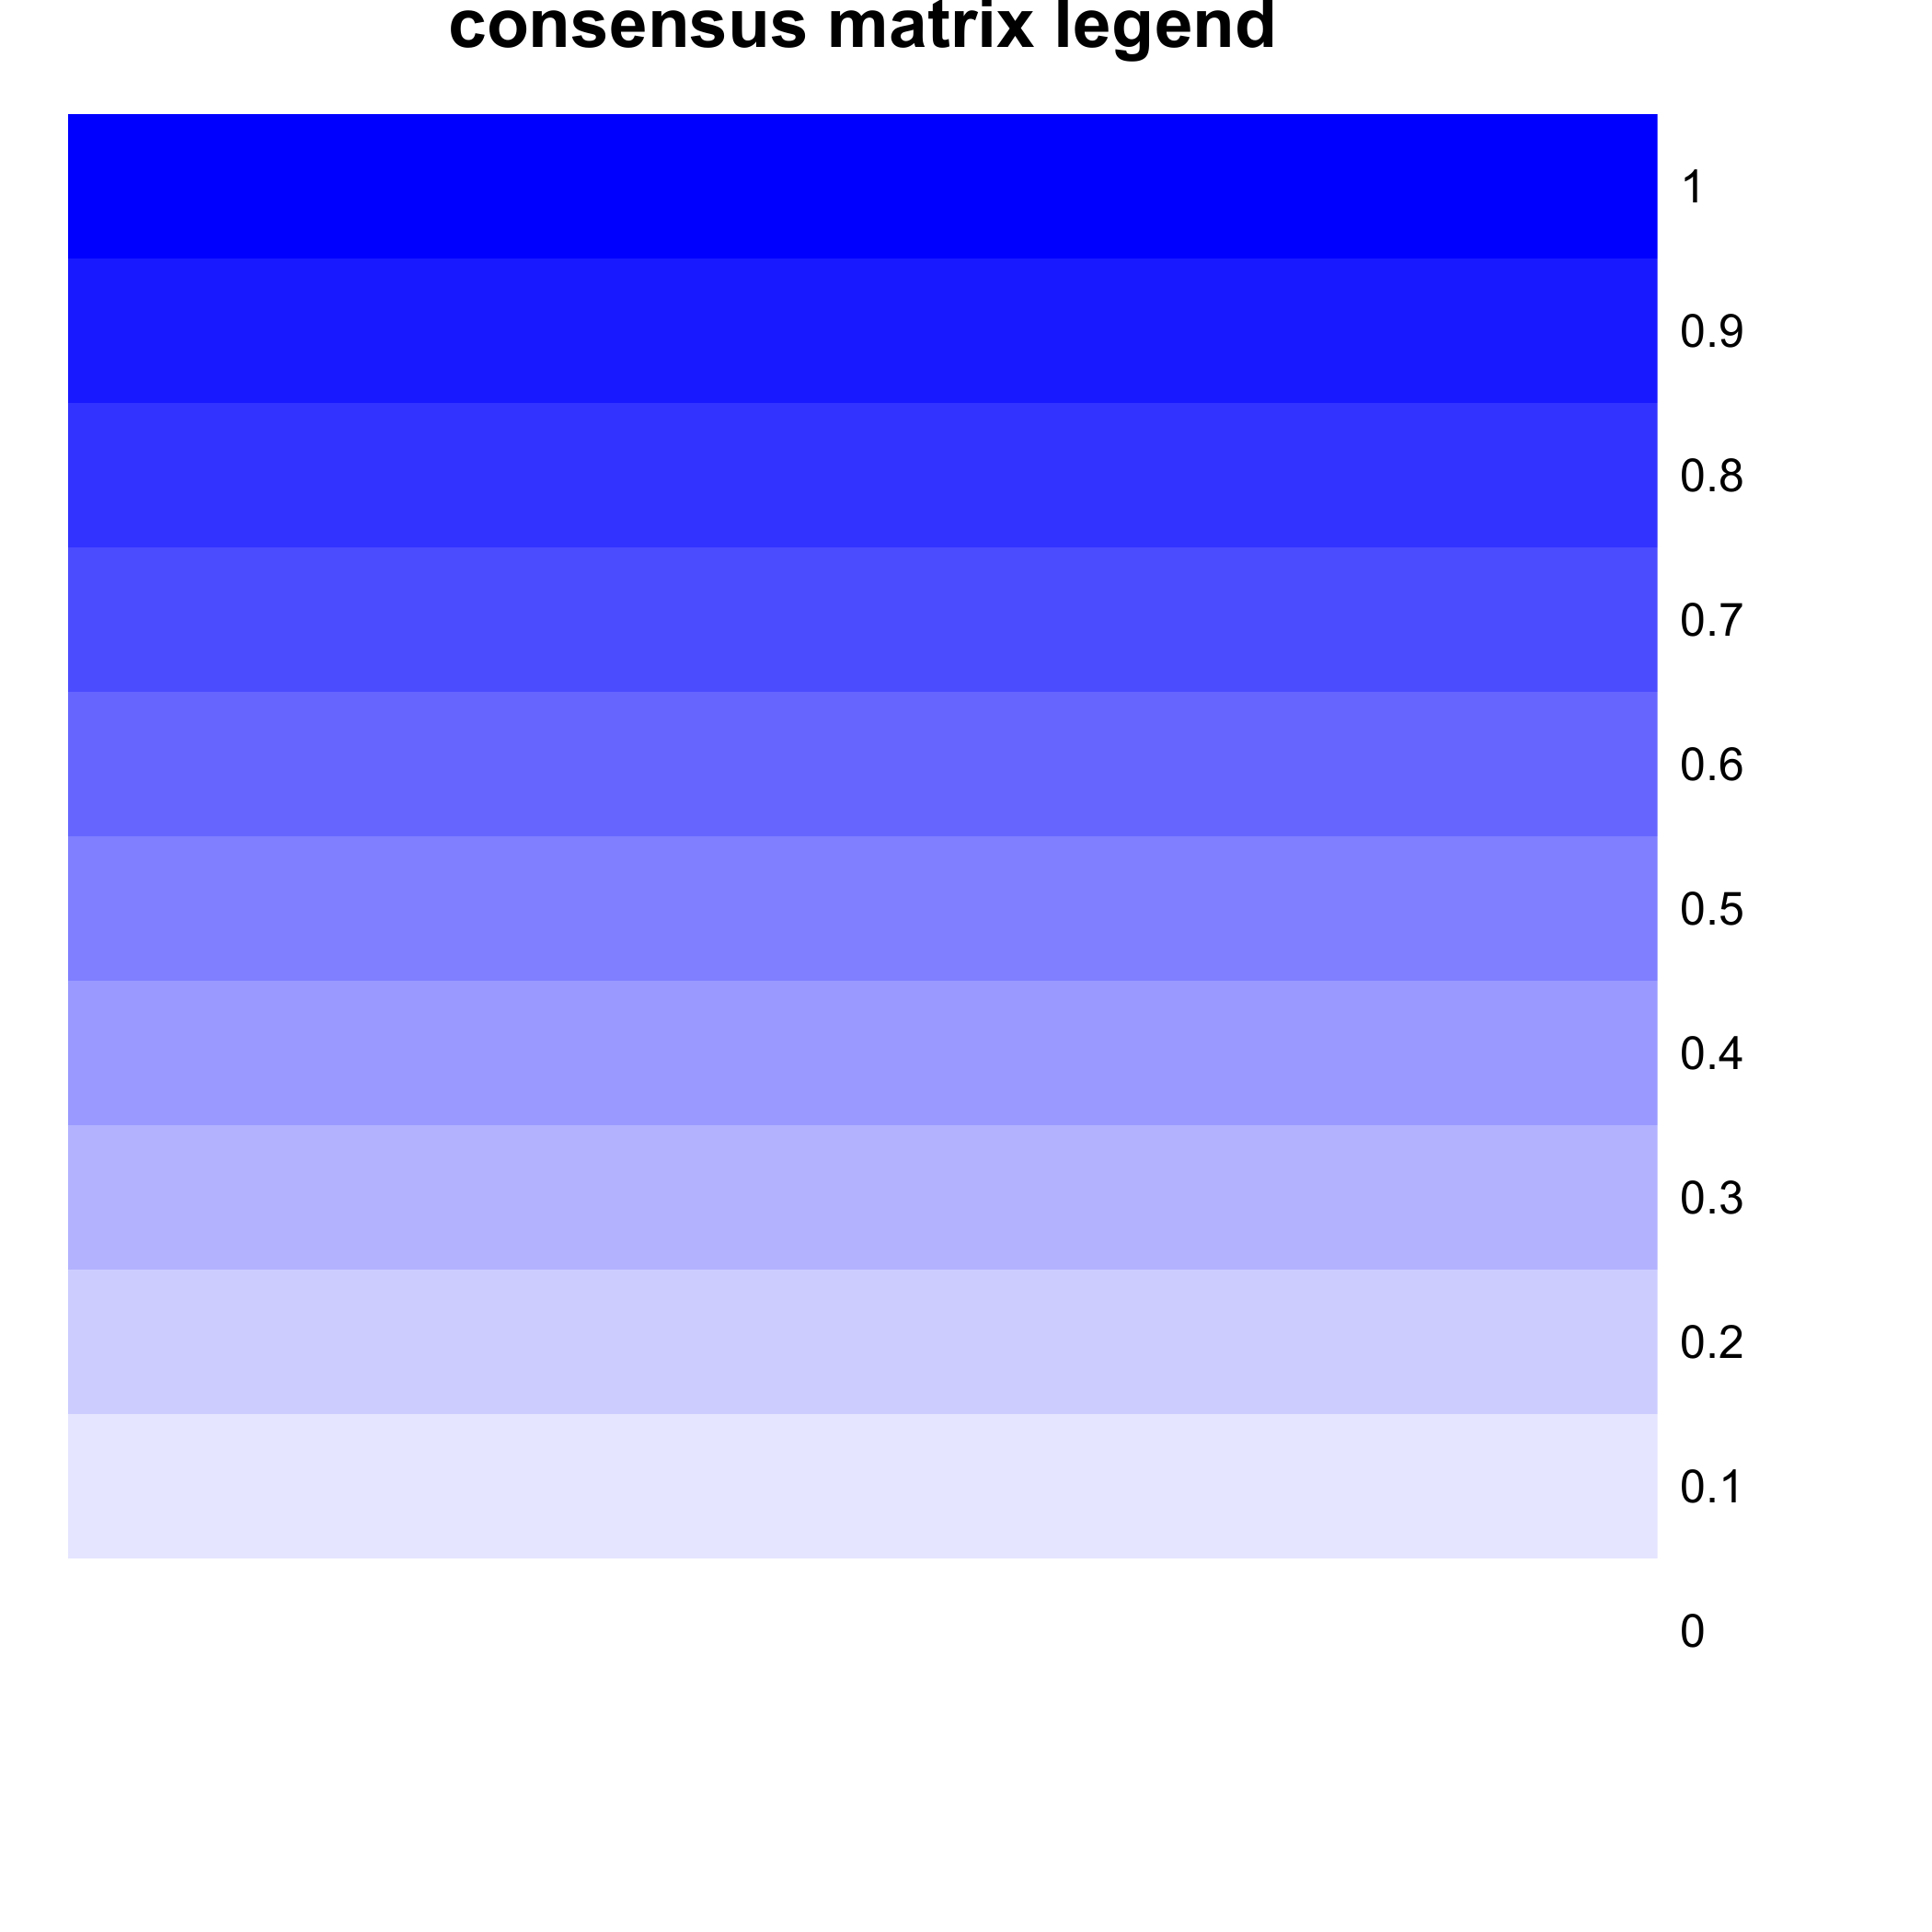
Consensus Clustering Results

Slide 6
Key Finding 2: Distinct Biological Mechanisms
Proliferative Subtype
(Cluster 1):
↑ MYC_TARGETS
↑ E2F_TARGETS
(cell cycle)
↑ DNA_REPAIR
↑ G2M_CHECKPOINT
↓ INFLAMMATORY
_RESPONSE
↓ COMPLEMENT
Immune-Inflammatory
Subtype (Cluster 2):
↑ INFLAMMATORY
_RESPONSE
↑ COMPLEMENT
↑ PI3K_AKT_MTOR
↑ TNFA_SIGNALING
↓ MYC_TARGETS
↓ DNA_REPAIR

Slide 7
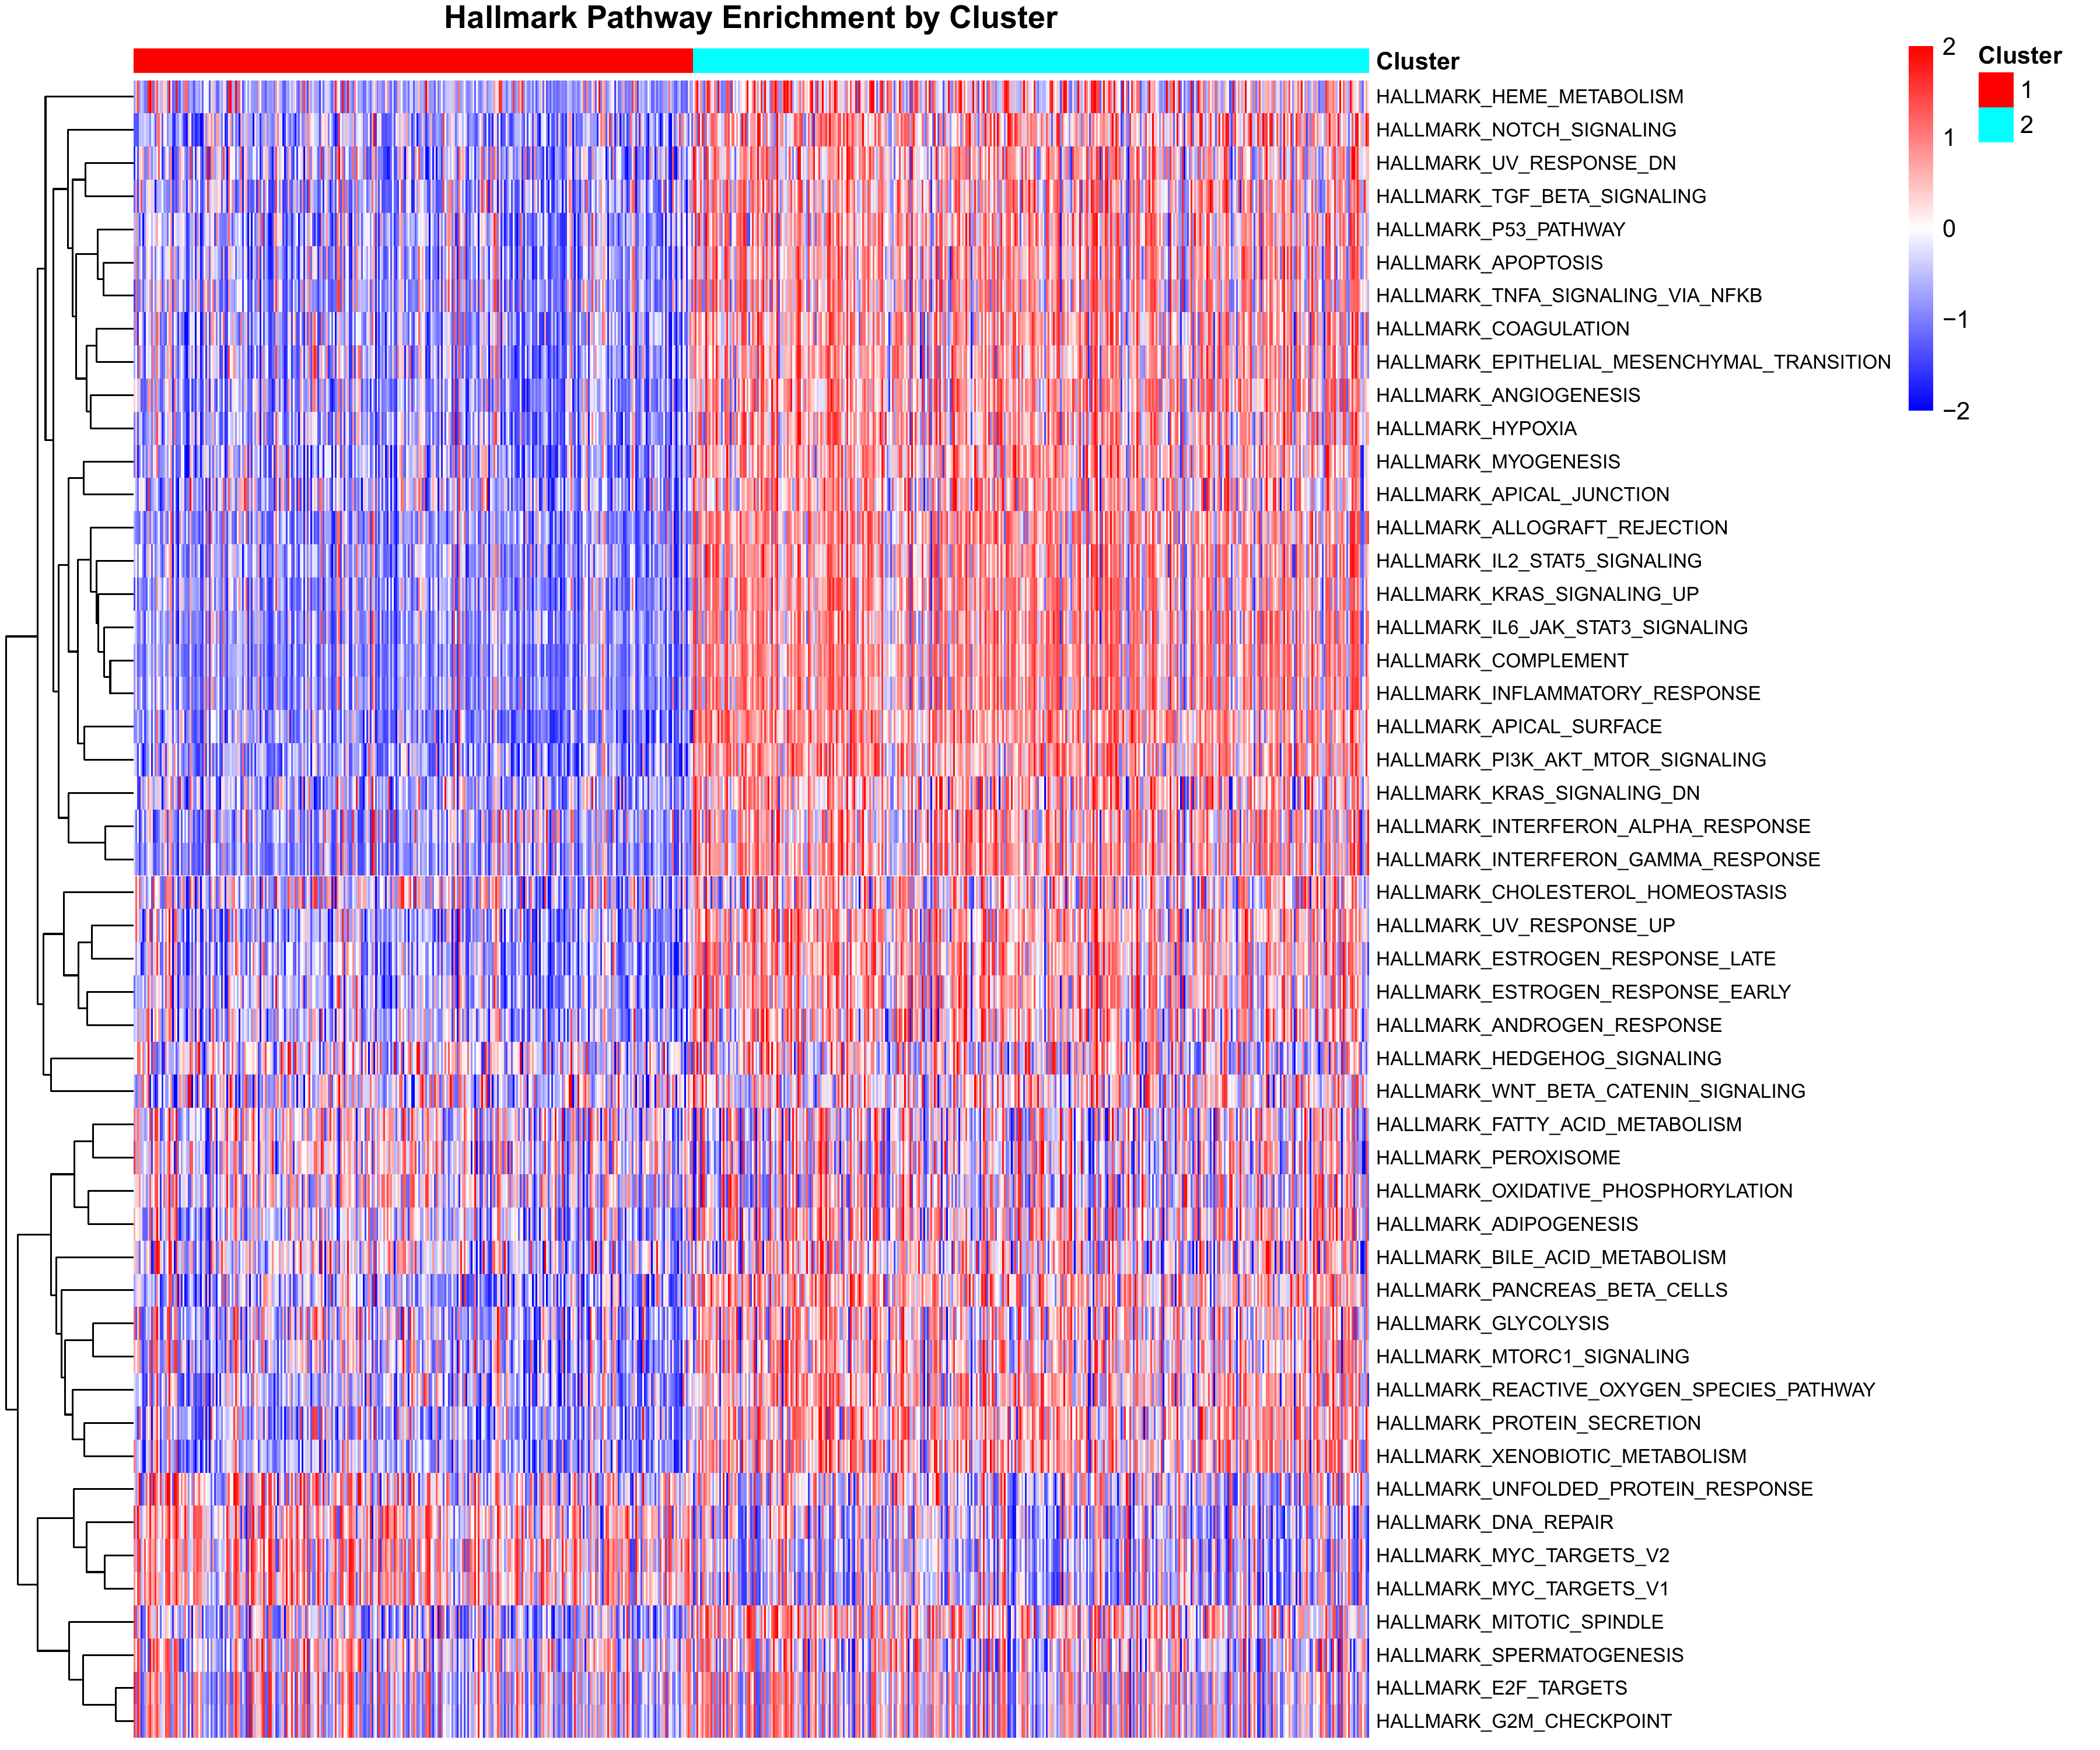
Pathway Enrichment by Molecular Subtype

Slide 8
Key Finding 3: Significant Survival Differences
Survival Outcomes:
Proliferative (Cluster 1): 19.1 months median survival
Immune-Inflammatory (Cluster 2): 11.8 months median survival
Difference: +7.3 months (62% improvement)
Statistical Significance:
• Log-rank test: p = 0.00155 (highly significant)
• Cox regression: HR = 1.38 (95% CI: 1.13-1.68)
• C-index: 0.58 (predictive value)
Clinical Interpretation:
Immune-Inflammatory subtype has 38% higher risk of death

Slide 9
Survival Analysis by Molecular Subtype
[Figure: Kaplan-Meier survival curves, p=0.00155]

Slide 10
Key Finding 4: Subtype-Specific Drug Sensitivities
Key Drug Discoveries:
Venetoclax (BCL-2 inhibitor):
• Highly sensitive in Proliferative subtype (p < 10⁻²²)
Panobinostat (HDAC inhibitor):
• Highly sensitive in Immune-Inflammatory subtype (p < 10⁻¹⁸)
Overall Statistics:
• 82 drugs show subtype-specific responses (FDR < 0.10)
• 160+ drugs tested across subtypes
Clinical Impact: Precision medicine opportunity
→ Match drug to subtype for optimal outcomes

Slide 11
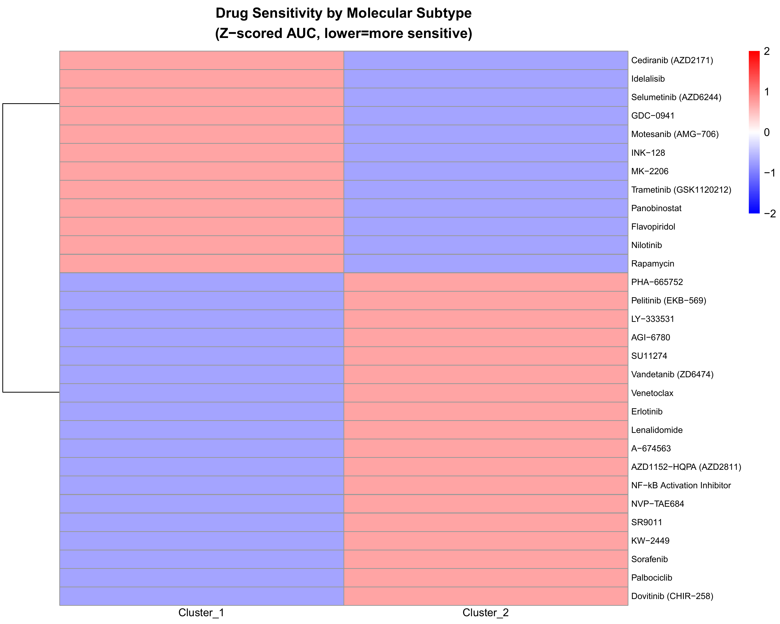
Drug Sensitivity by Molecular Subtype

Slide 12
Clinical Implications
Treatment Recommendations:
For Proliferative Subtype (Cluster 1):
✓ Venetoclax-based combinations
✓ MEK inhibitors (Trametinib)
⚠ Avoid: HDAC inhibitors (less effective)
For Immune-Inflammatory Subtype (Cluster 2):
✓ HDAC inhibitors (Panobinostat, Vorinostat)
✓ mTOR inhibitors (Everolimus)
⚠ Avoid: Venetoclax (less effective)
Applications:
• Risk stratification at diagnosis
• Personalized treatment planning
• Clinical trial stratification

Slide 13
Summary
We discovered two molecular subtypes of AML with:
✓ Distinct biological mechanisms
(proliferative vs immune-inflammatory)
✓ Major survival differences
(7.3 months, 62% improvement, p=0.00155)
✓ Different drug sensitivities
(82 drugs, precision medicine opportunity)
✓ Robust statistical evidence
(1,000 bootstraps, FDR-corrected)
✓ Clinical actionability
(ready for validation and biomarker development)

Slide 14
Next Steps
Short-term (1-3 months):
• External validation in TCGA-LAML cohort
• Develop minimal gene signature (50-200 genes)
• Manuscript preparation
Medium-term (3-12 months):
• Clinical assay development (RT-qPCR/NanoString)
• Functional validation in cell lines
• Design subtype-stratified clinical trial
Long-term (1-2 years):
• Clinical workflow integration
• Real-world evidence collection
• Single-cell RNA-seq studies

Slide 15
Acknowledgments
Data Source:
• BeatAML Consortium (dbGaP: phs001657)
Sample Size:
• 478 patients with complete multi-omics profiles
Statistical Power:
• >80% power for all analyses
• 1,000 bootstrap iterations
• FDR-corrected multiple testing
For more information:
See RESULTS_SUMMARY.md and FIGURE_GUIDE.md

