Slide 1
DSE5002 Project 1 Ryan Waterman

Slide 2
Contents
Understanding the Data
Analyzing US Salaries by Experience and Company Size
Predicting Expert Salaries for Small US Companies
Analyzing US Salaries for Remote Workers
Conclusion

Slide 3
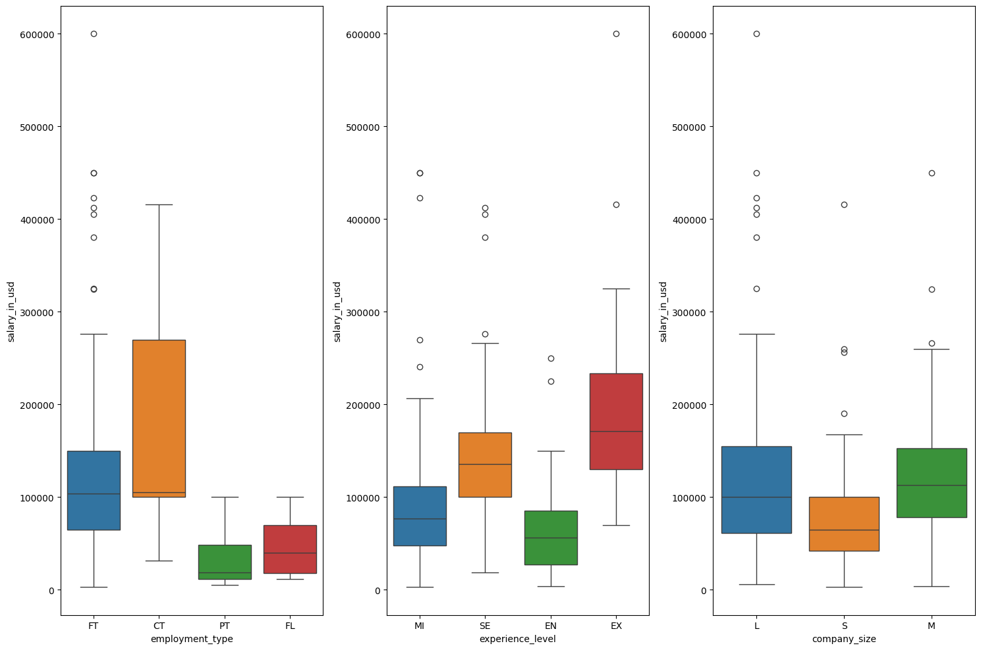
Understanding The Data
Part 1: Identifying confounding Variables
Initial critical variables for Salary in USD:
Employment type
Experience level
Company Size
The box plots for these variables showed the expected trends when analyzed individually
Requires a better understanding of how the variables influence each other

Slide 4
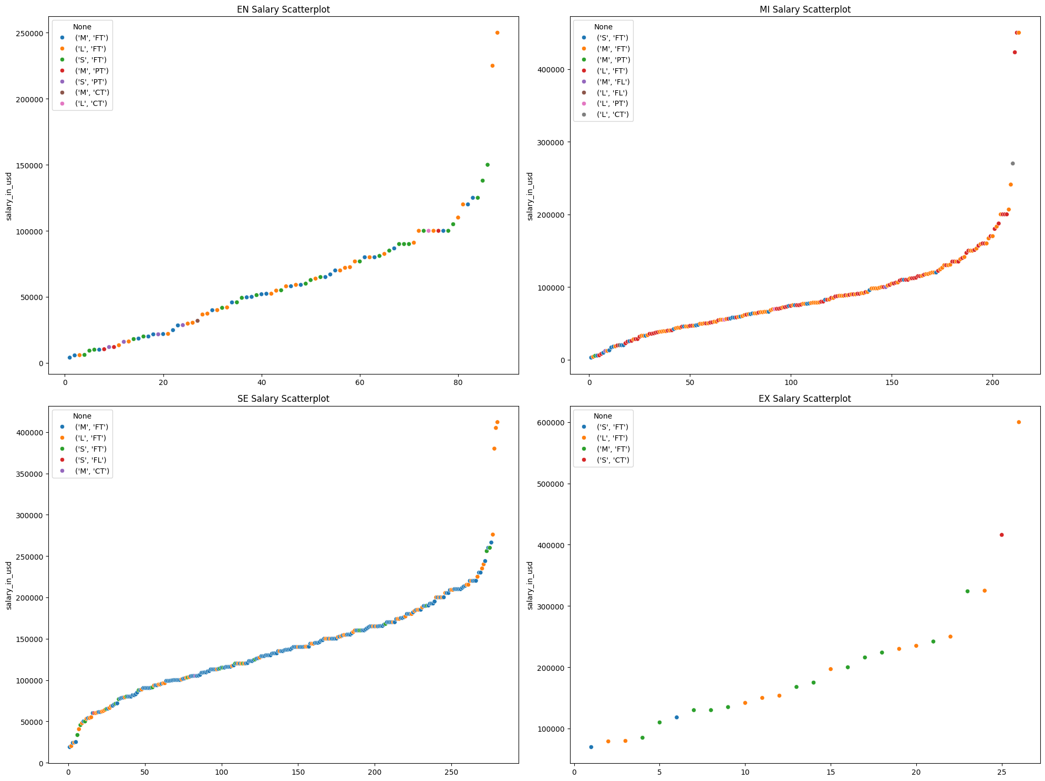
Understanding The Data
Part 1: Identifying confounding Variables (continued)
Scatter plots of Experience Level by Salary in USD were generated to understand the shape of the data.
Color coded by company size and employment type
Company size and employment type have an impact on the expected salary for a given experience level.
As indicated in the previous slide

Slide 5
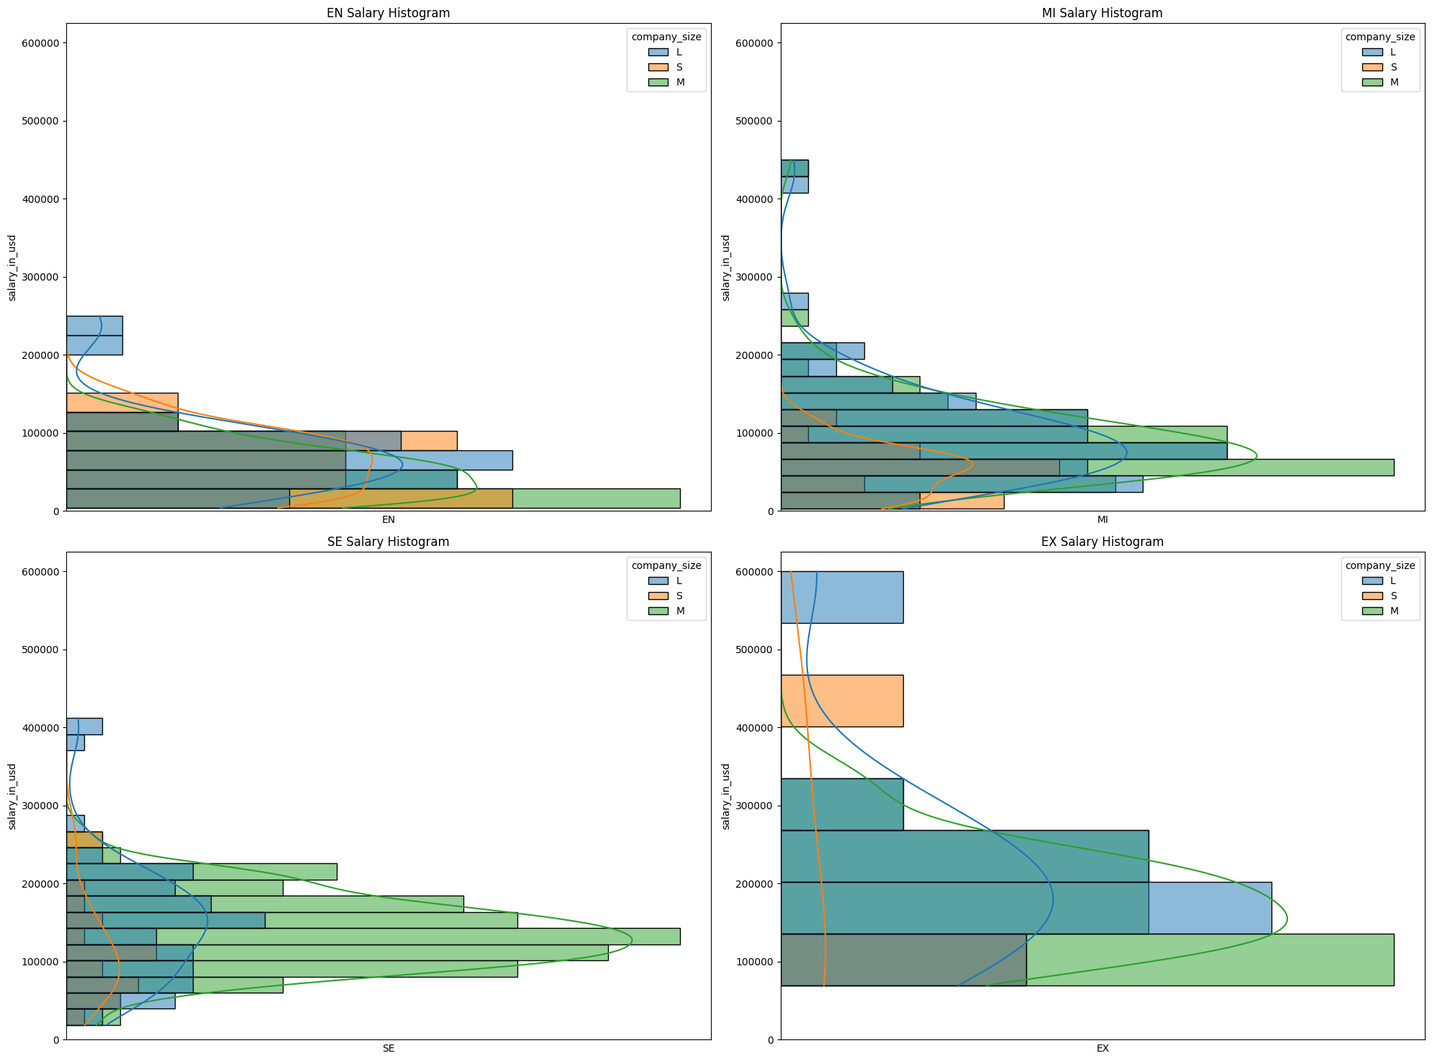
Understanding The Data
Part 2: Identifying Trends
Consistent, relatively normal distribution of salary ranges for each company size and experience level.
This is a critical insight for salary range recommendations

Slide 6
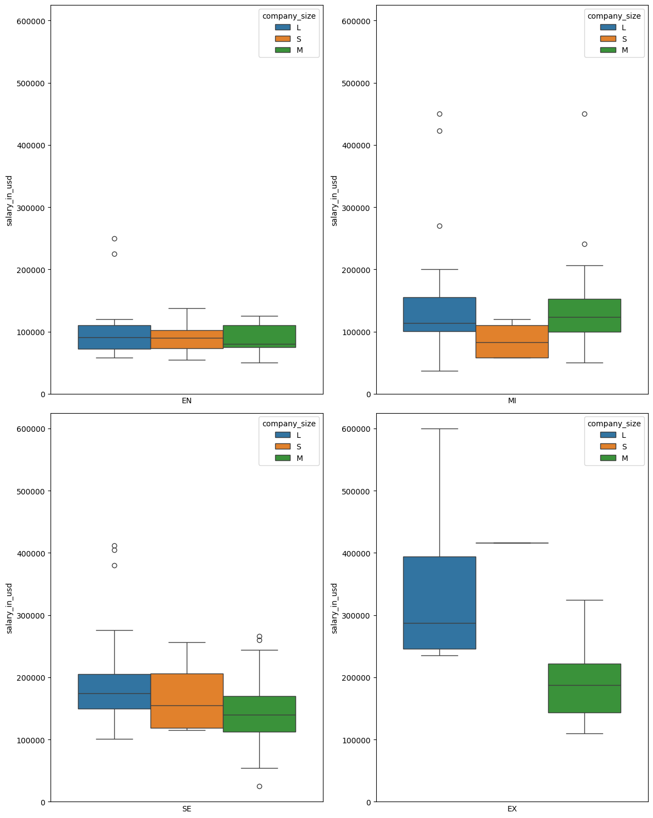
Analysis of US companies (part 1)
US Companies are a more representative group
Company size affects salary ranges across experience level
Consistent with all companies around the world
For now, the primary interest is US residents working for US companies. Non-US residents will be explored later.

Slide 7
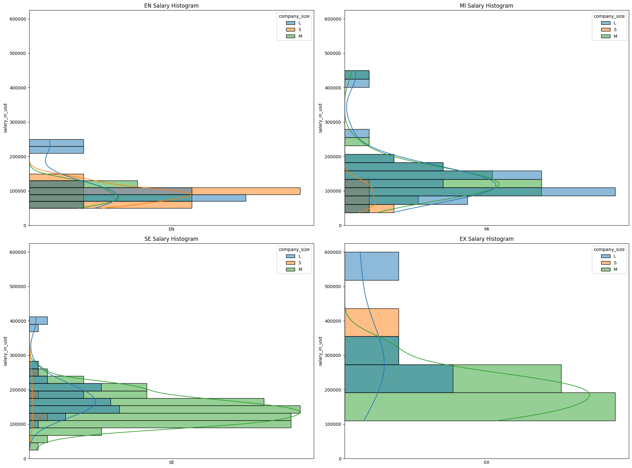
Analysis of US companies (part 2)
Salary distributions by company size and experience are more normal than global dataset
Senior positions have large variances in pay for small companies
Senior and expert positions are of interest

Slide 8
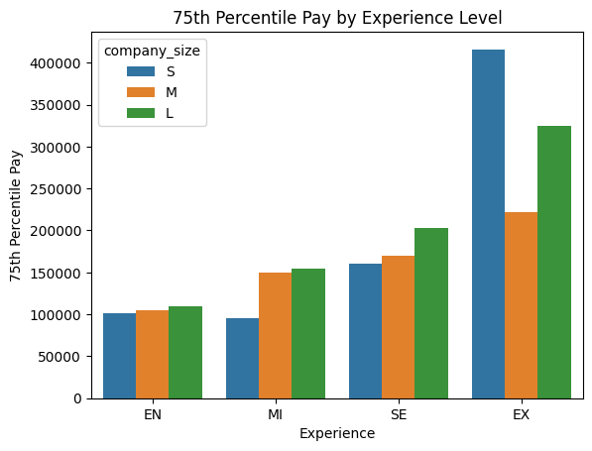
Analysis of US companies (part 3)
An attractive pay range would be around the 75th percentile.
Expert level pay for small companies is an outlier, with only one data point.
This is an ideal candidate
The pay for this candidate can be predicted based on trends in the data set

Slide 9
Predicting Expert Salaries for Small US Companies
There is only one salary present for Expert Data Scientists at small companies, and it appears to be an outlier. Two methods were used to predict a more reasonable salary for this position at a small company:
METHOD 1: Ordinary Least Squares Regression
METHOD 2: Linear Regression
Data included US company sizes, experience levels, and salaries.
Salaries for experts at small companies were excluded to avoid overfitting to the outlier.
Prediction for expert level salary at a small company:
~$227,900
Data included US company sizes, experience levels, and salaries.
Salaries for experts at small companies were excluded to avoid overfitting to the outlier.
Prediction for expert level salary at a small company:
~$227,900
Results:
Both models predicted the same salary for the position.
This output is reasonable for a 75th percentile salary when compared to the rest of the data set.

Slide 10
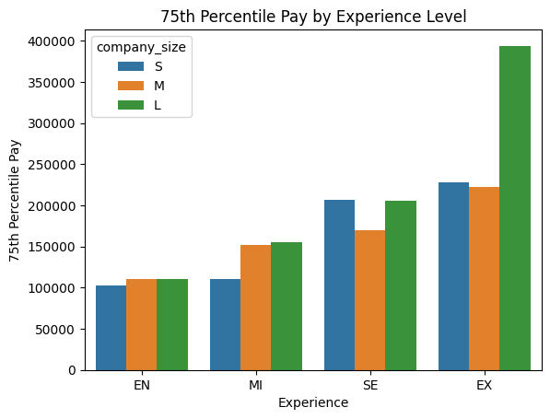
Predicting Expert Salaries for Small US Companies
The expert level, small company salary has been corrected to fit the trends within the data set.

Slide 11
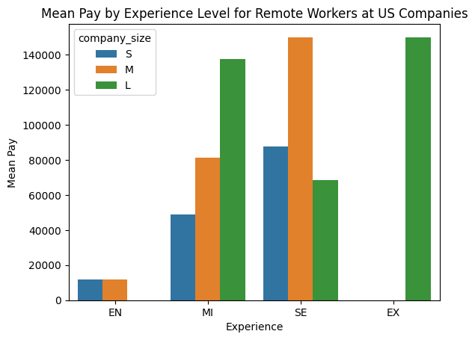
Analysis of Mean pay for Remote workers
Senior Level mean pay is about $90,000 USD.
Remote work is likely not ideal, depending on the infrastructure at the company
No data on expert level positions
Data set is too small to attempt predictive modeling

Slide 12
Conclusion
Based on the existing salaries for Data Scientists (or similar) by experience level and company size in the US, the salary ranges, below, are suggested.
Note: Maximum salary is the 80th percentile salary and minimum is 65th percentile salary for the respective position. These ranges are for US residents working for US companies.
EXPERIENCE LEVEL | MAXIMUM SALARY | MINIMUM SALARY
Entry | $105,000 | $95,000
Middle | $112,000 | $99,000
Senior | $216,400 | $186,500
Expert | $232,500 | $220,100
Remote positions with non-resident employees are not recommended, given the nature of a company our size. Infrastructure will need to be expanded as the company grows, and this will likely require periodic visits on-site, even for fully remote positions. This is not feasible for non-resident candidates.

