Slide 1
Robotic Arm Simulator
Bryant Pong

Slide 2
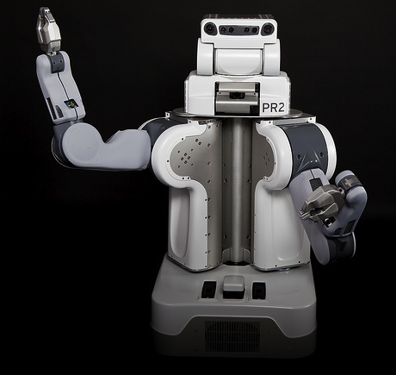
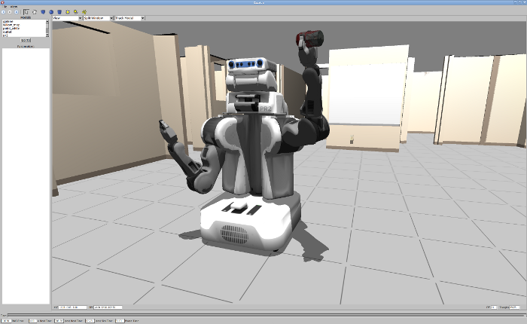
Why a Robot Simulator?
Interest in Robotics Increasing (Google/Facebook)
Two Problems for Interested Roboticists:
Robots are Expensive! (several $1000s)
Robot Simulators are Complex for New Roboticists

Slide 3
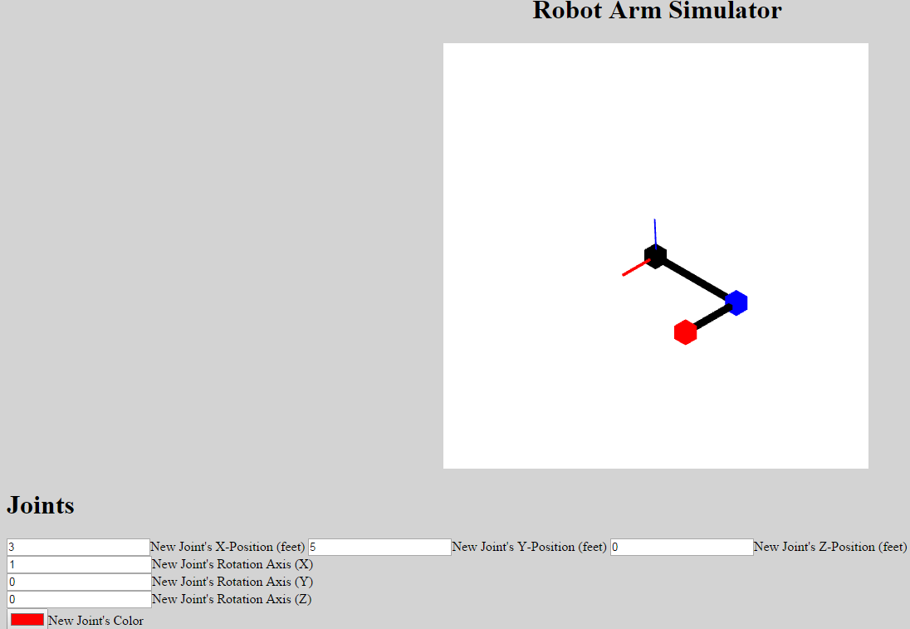
Simulator Requirements
Dynamically Add and Control Joints
Automatically Render Links between Joints
Render Reference Coordinate Frame
Calculate and Display Arm’s Forward Kinematics

Slide 4
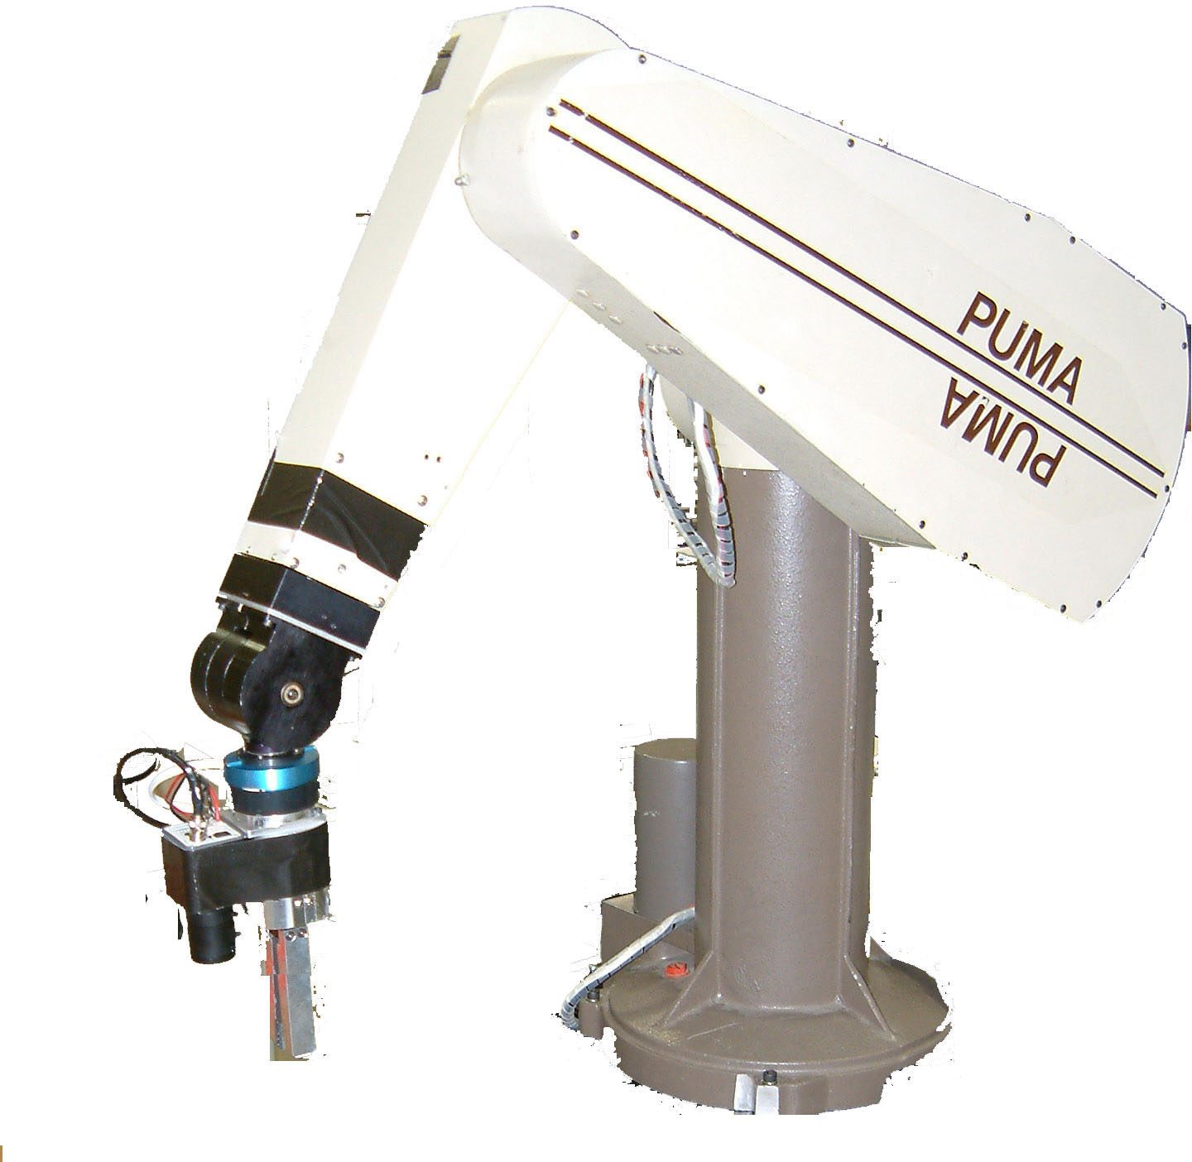
Demo: Simulating PUMA 560 Arm

Slide 5
Largest Challenge
Originally Send all Rotation Matrices to Vertex Shader
Memory Inefficient
Complex Code
Hard to Debug (GLSL debugger)
Hierarchical Modeling
Removed 400 Lines of Code!
Reduced Number of Vertices to Render

