Slide 1
WPI Sample Return Robot Challenge - 2015

Slide 2
What is the WPI Challenge?
Hosted by NASA (Centennial Challenge)
Task: Collect different samples in an open environment under a certain time limit and return back to base.
2 Parts: Phase 1 + Phase 2

Slide 3
Phase 1
1 Sample
30 minutes per team
1 – 2 attempts (time permitting)
Reward: $500 for picking up the sample; additional $5000 for returning sample to base

Slide 4
Phase 2
10 samples (need to only accumulate 15 points)
2 hours per team
Reward: varies, but if 15 points accumulated, $1.5 million

Slide 5
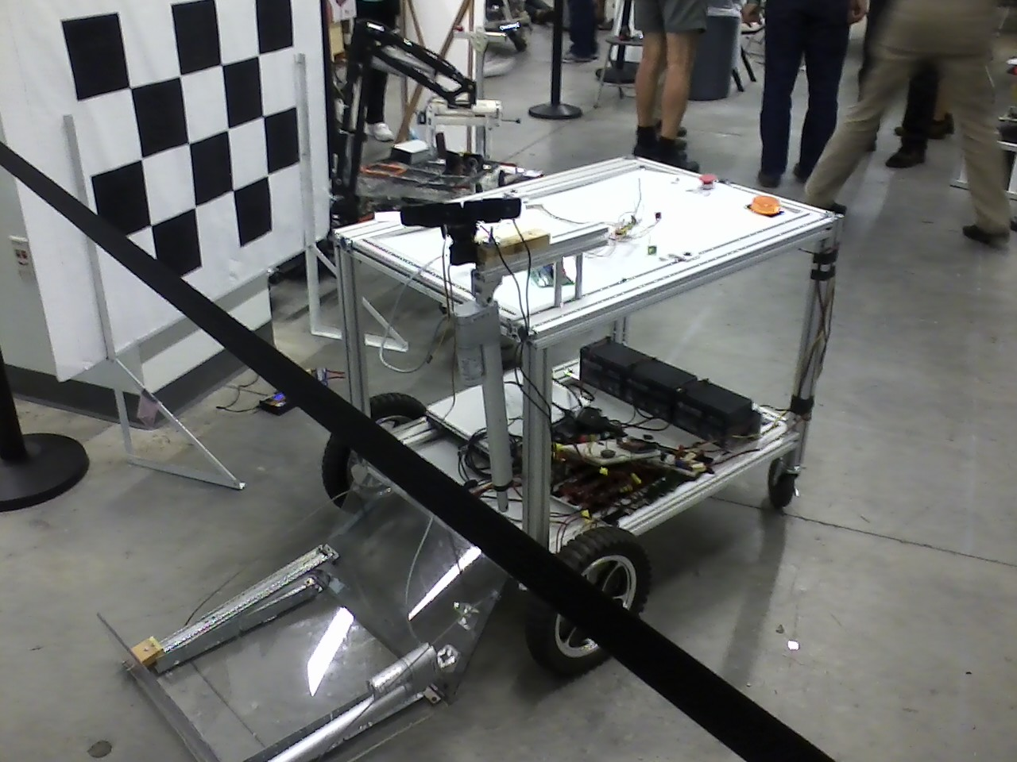

Slide 6
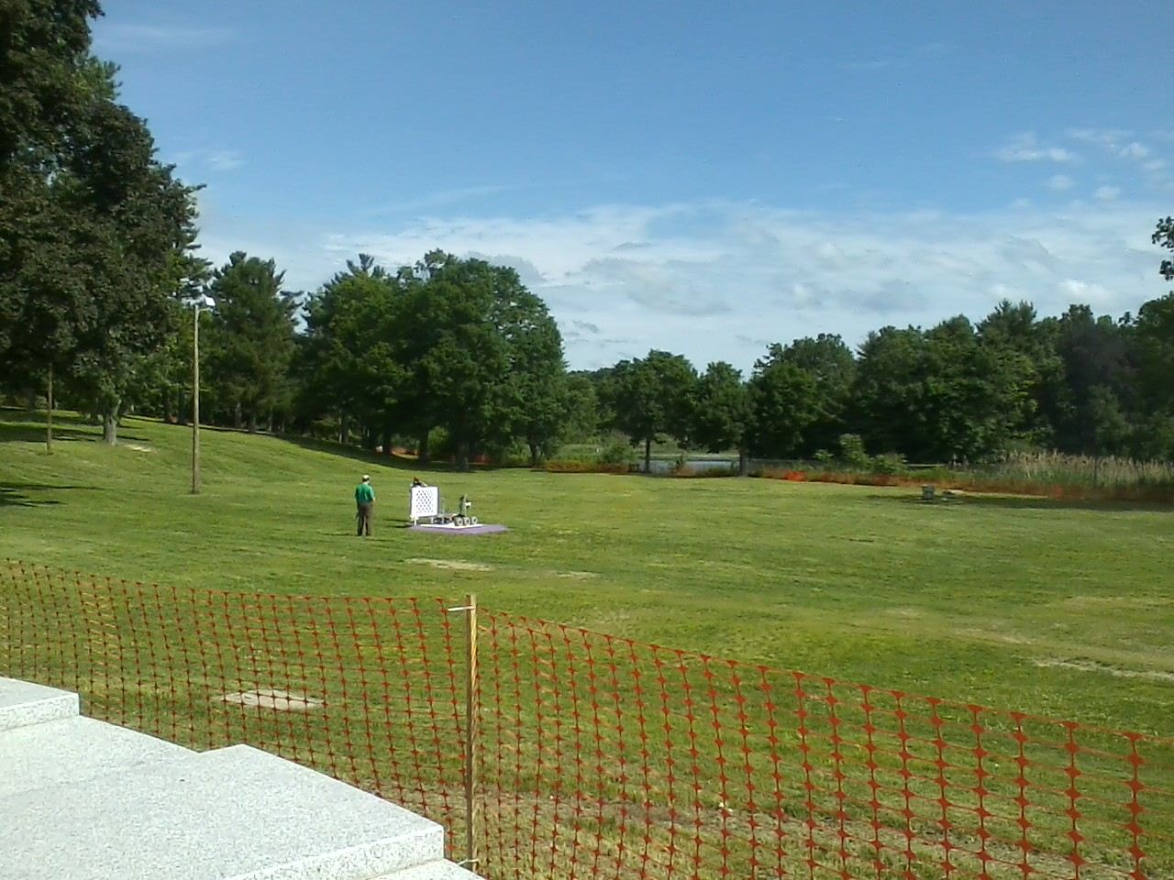

Slide 7
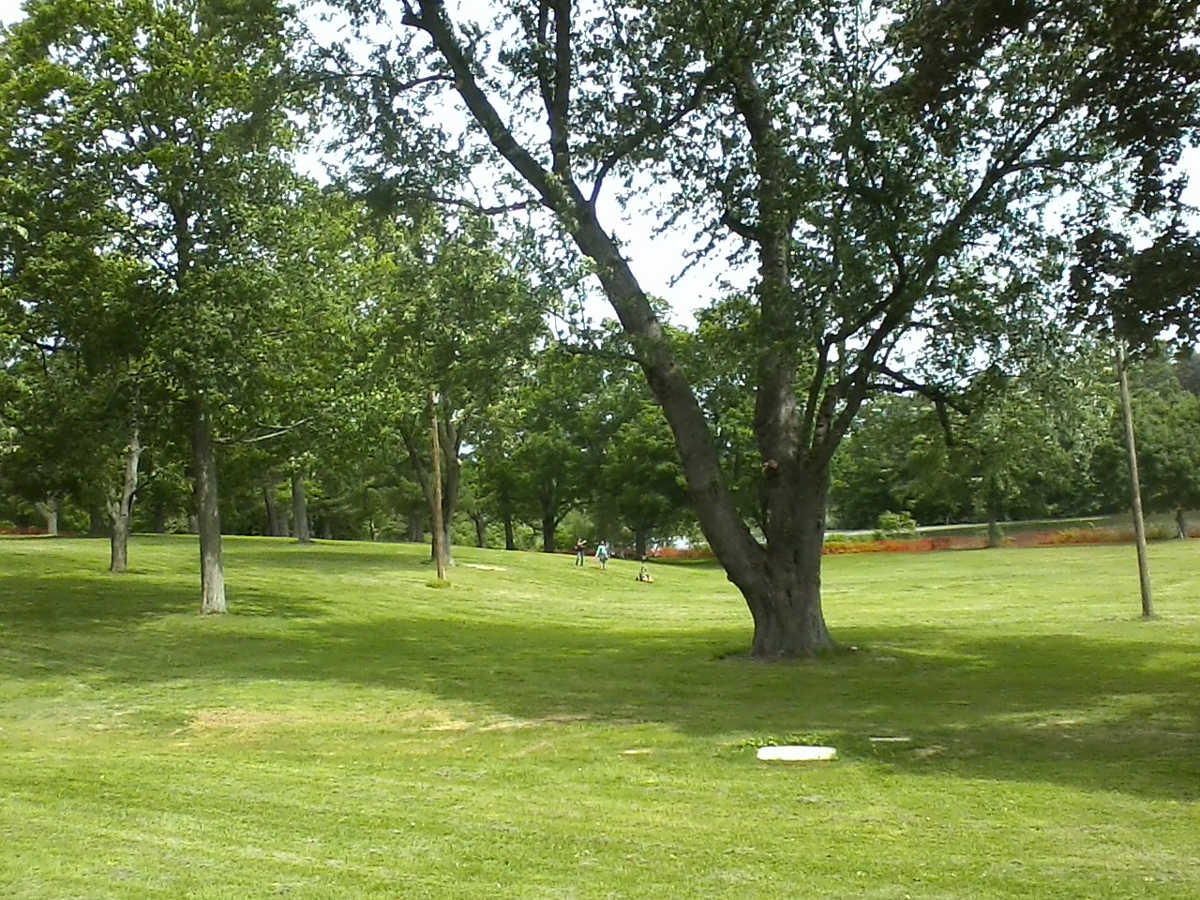

Slide 8
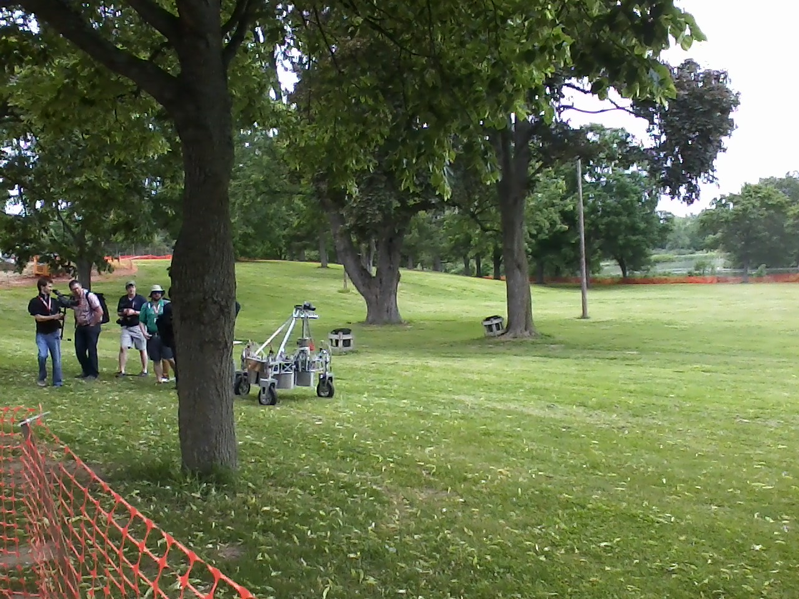

Slide 9
8 (Proposed) Subteams
Chassis/Motors
Power Systems
Storage System
Manipulator
Object Recognition/Detection
Path Planning/Localization
Picking up Objects
System Integration

