Slide 1
MT67
Name
Department Course Number Section Time Location
DATE
GitHub Link :
https://github.com/rcyajour03/XAI.git
R C Yajour Kichenamourty - M24MT006
Sagar Sudhir Pathak - M24MT007
Explainable AI Based Disease Prediction System

Slide 2
Name
Department Course Number Section Time Location
DATE
Problem Statement
Previous Work And Novelty
Methodology
Experimental Settings and Results
Individual Contributions

Slide 3
Problem Statement
Name
Department Course Number Section Time Location
DATE
People nowadays suffer from a variety of diseases because of environmental factors and their lifestyle choices. As a result, disease prediction at an earlier stage becomes a critical task. In the current healthcare landscape, disease prediction and diagnosis often rely on traditional methods, which may not always yield accurate or timely results, especially for complex diseases. With the growing availability of healthcare data from Electronic Health Records (EHRs), medical imaging, and wearable devices, the application of Machine Learning (ML) in healthcare has gained prominence. However, while ML models have shown great potential in disease prediction, they often operate as ”black boxes”, making it difficult for medical professionals and patients to trust and understand the predictions. This lack of transparency limits the adoption of ML system in critical healthcare environments, where explainability and trust are significant.

Slide 4
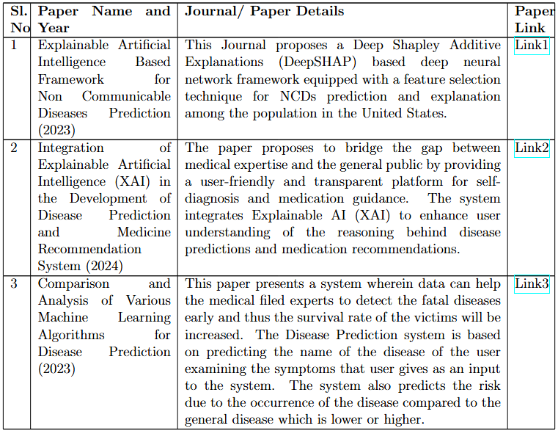
Previous Work and Novelty
Link1
https://ieeexplore.ieee.org/stamp/stamp.jsp?tp=&arnumber=9529216
https://ieeexplore.ieee.org/stamp/stamp.jsp?tp=&arnumber=10503250
Link2
https://ieeexplore.ieee.org/stamp/stamp.jsp?tp=&arnumber=10083509
Link3

Slide 5
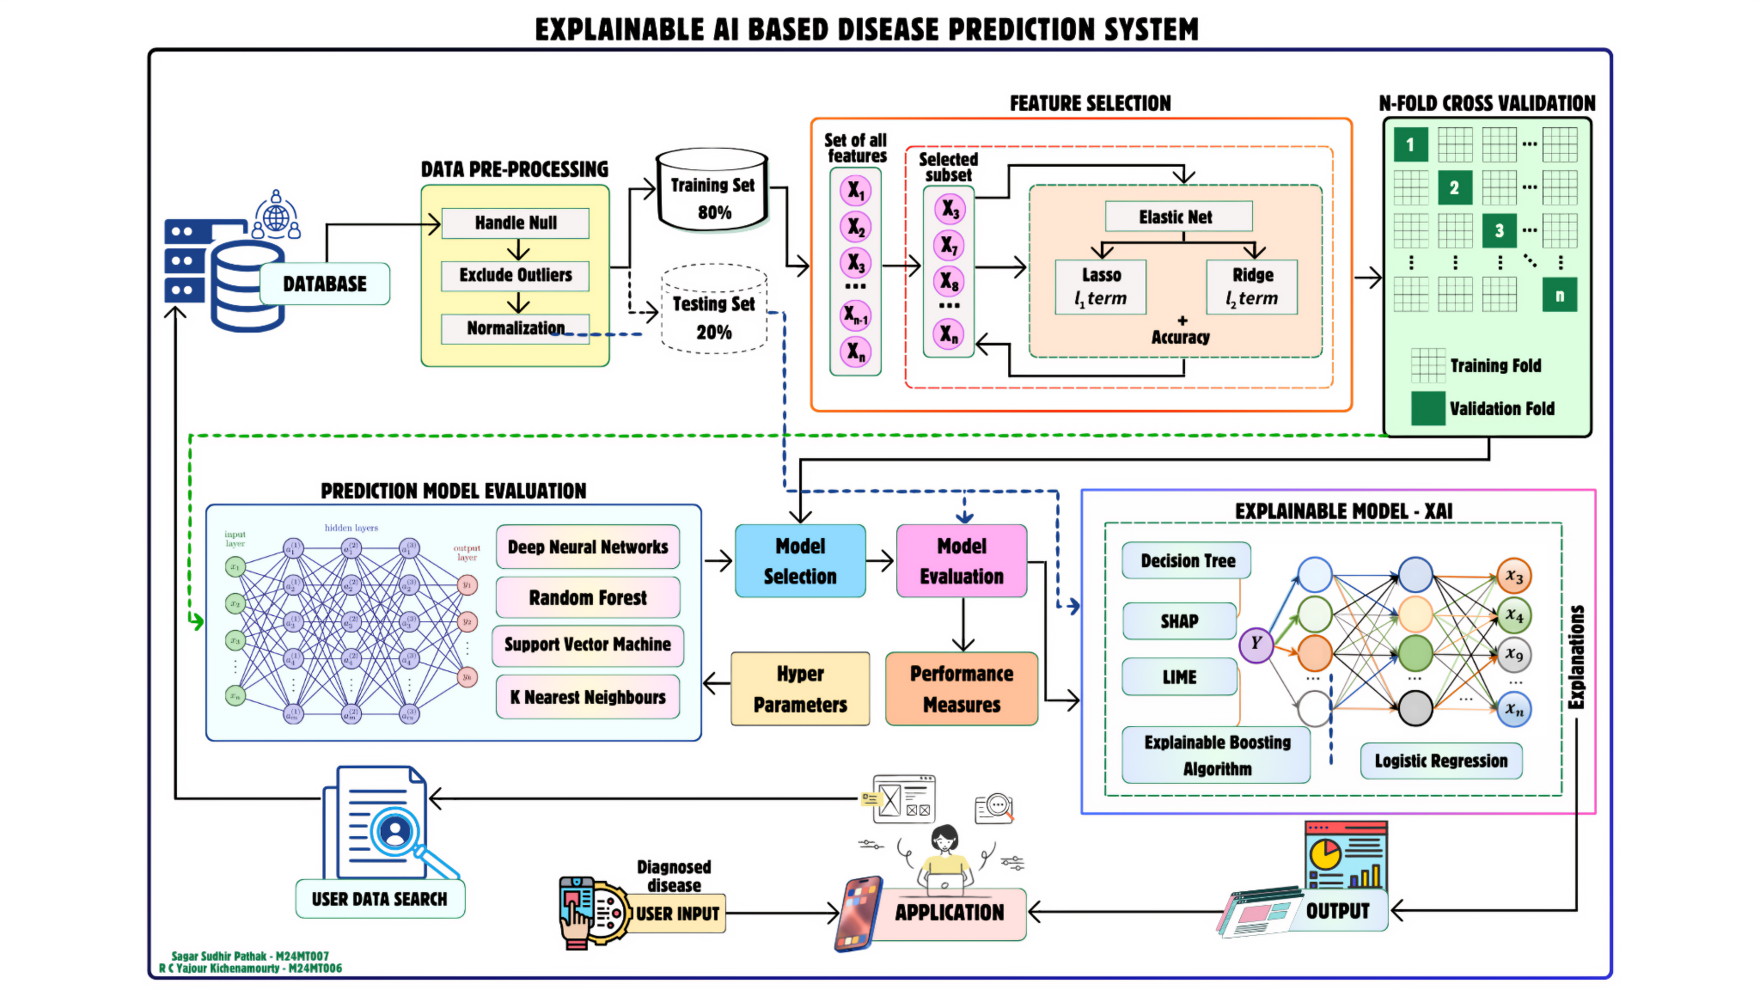
Methodology
DATE

Slide 6
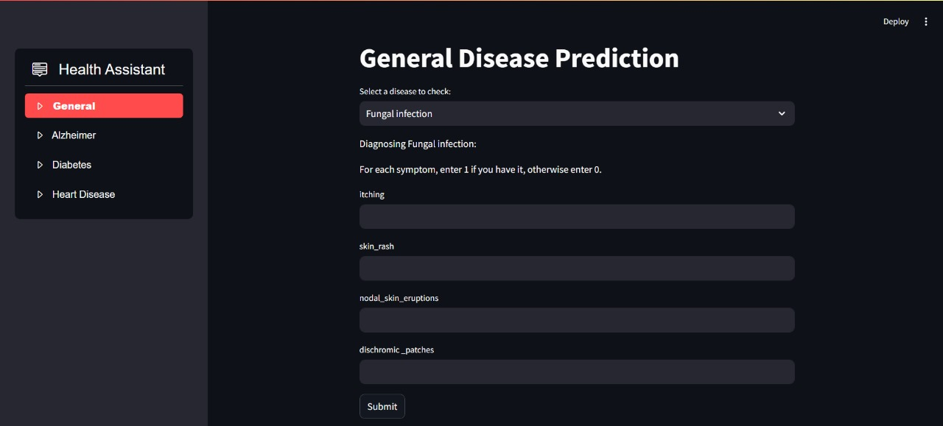
Experimental Settings & Results
Name
Department Course Number Section Time Location
DATE

Slide 7
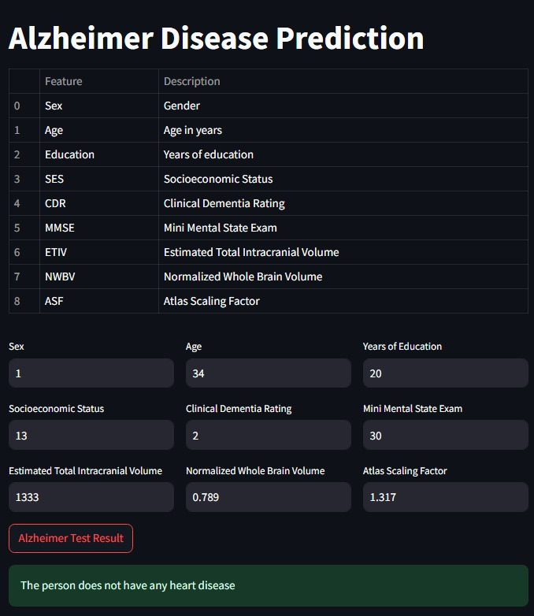
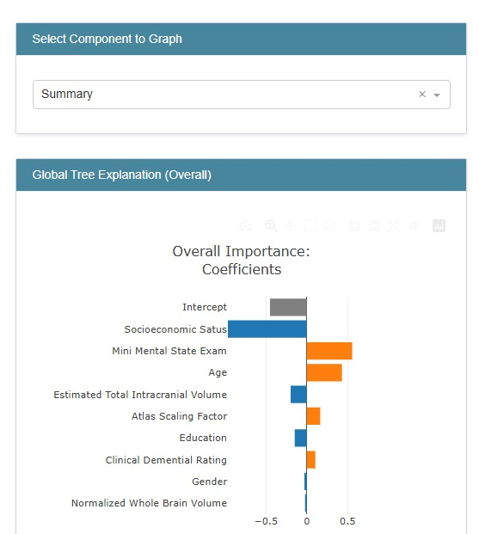


Experimental Settings & Results
Name
Department Course Number Section Time Location
DATE

Slide 8
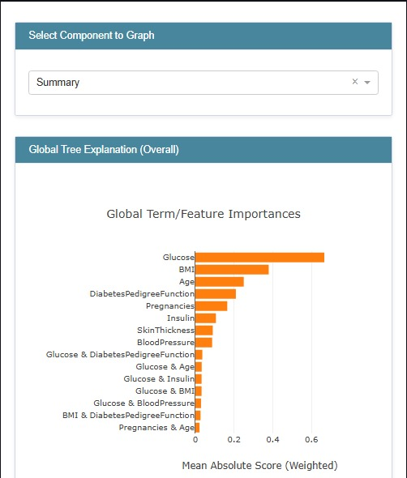
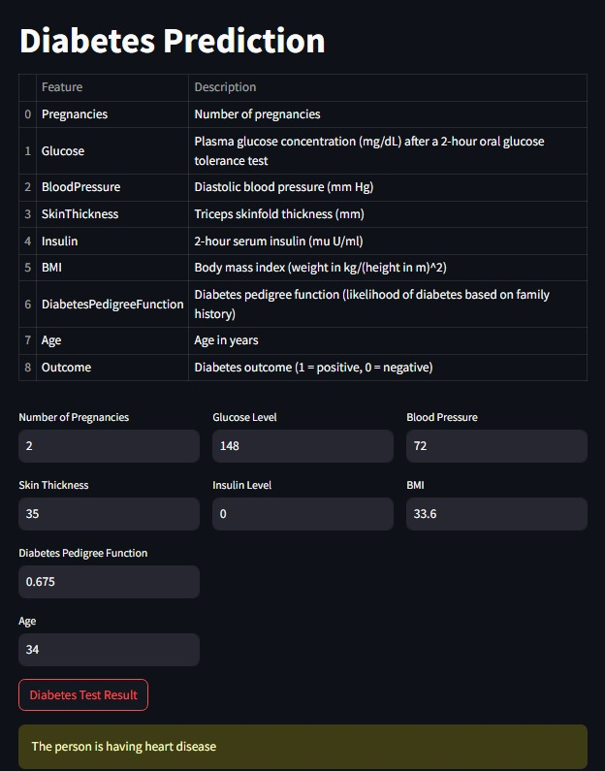
Experimental Settings & Results
Name
Department Course Number Section Time Location
DATE

Slide 9
Individual Contributions
Name
Department Course Number Section Time Location
DATE
R C Yajour Kichenamourty
Sagar Sudhir Pathak
Data Collection
Data Cleaning
Feature Engineering
Model Training
Performance Tuning
Documentation
Exploration of XAI Techniques
Model Integration
System Architecture
Model Evaluation
Application Making

Slide 10
MT67
Name
Department Course Number Section Time Location
DATE
GitHub Link :
https://github.com/rcyajour03/XAI.git
R C Yajour Kichenamourty - M24MT006
Sagar Sudhir Pathak - M24MT007
THANK YOU

