Slide 1
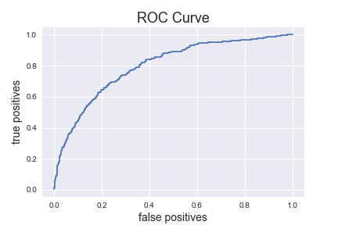
B
A

Slide 2
