Slide 1
FusAtNet GNR 638 Course Project
VIKRANT RANGNEKAR | 18D100023
RITWIK KADU | 180100098
PRATHMESH BELE | 180110020

Slide 2
INTRODUCTION and problem statement
In remote sensing, different types of data sources like Multispectral, Hyperspectral, Synthetic Aperture Radar, Panchromatic as well as Light Detection and Ranging (LiDAR) are available
While each of the source provides a different kind of information for same geographical region, the Hyperspectral and LiDAR are some of the most common sources of data
The LiDAR provides information about the elevation of the region under consideration
The Hyperspectral data has 144 spectrums such that each one of them interacts with the region in different way

Slide 3
INTRODUCTION and problem statement
Even though these datasets from two different sources can be used separately for classification purposes, their fusion results in extraction of more interesting features and better classification accuracy
We shall be implementing FusAtNet, to carryout the classification task using the fusion of data from two sources
This uses attention to put more emphasis on important features
Along with self-attention, cross-modality attention from LiDAR data’s attention map is also used to highlight some features which could have been missed by self-attention

Slide 4
BACKGROUND WORK
several classical techniques such as Support Vector Machines, Random Forest, Extreme Learning Machines have been applied to achieve multimodal fusion.
With the advent of deep learning, it has been actively used in multimodal learning and feature attention.
Spectral attention frameworks have been suggested [2] to discover material-dependent features for better classification accuracy.
Multi-stream models have also been introduced in [3].

Slide 5
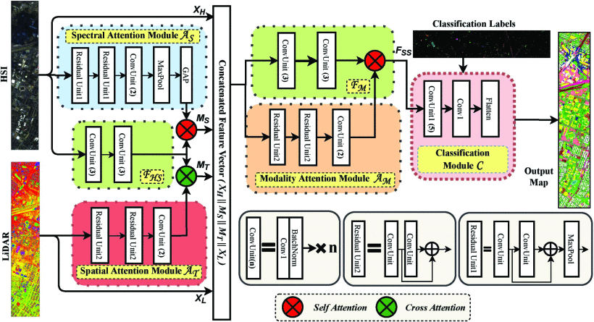
MODEL ARCHITECTURE

Slide 6
DATASETS
While the paper has results obtained using three different datasets, namely, Houston 2013 dataset, MUUFL Gulfport dataset, Trento dataset, we have trained and tested our model on the Houston 2013 dataset
It consists of 144 spectral bands capturing data around the Houston university campus. 15029 ground truth samples are available segregated into 15 classes. There are 2832 training and 12197 testing samples.

Slide 7
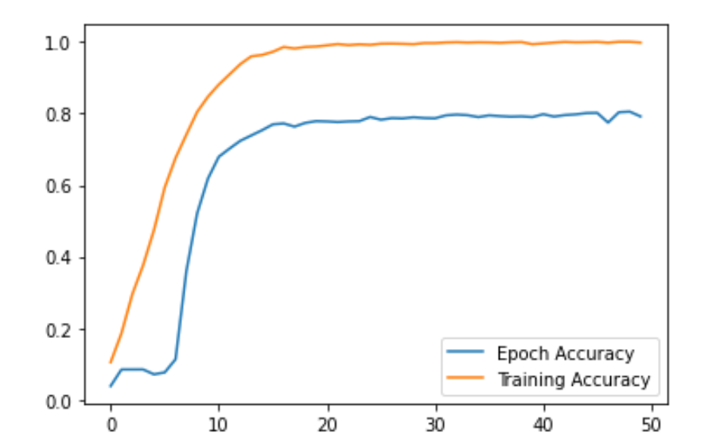
RESULTS
We trained the model for 50 epochs on the Houston 2013 dataset with batch size of 32 using Adam optimizer and sparse cross entropy loss
A testing accuracy of 80% was observed (The maximum accuracy as mentioned in the paper is 89.98% when trained for 1000 epochs)

Slide 8
Reference
S. Mohla, S. Pande, B. Banerjee and S. Chaudhuri, "FusAtNet: Dual Attention based SpectroSpatial Multimodal Fusion Network for Hyperspectral and LiDAR Classification," 2020 IEEE/CVF Conference on Computer Vision and Pattern Recognition Workshops (CVPRW), 2020, pp. 416-425, doi: 10.1109/CVPRW50498.2020.00054.
L. Mou and X. X. Zhu, "Learning to Pay Attention on Spectral Domain: A Spectral Attention Module-Based Convolutional Network for Hyperspectral Image Classification," in IEEE Transactions on Geoscience and Remote Sensing, vol. 58, no. 1, pp. 110-122, Jan. 2020, doi: 10.1109/TGRS.2019.2933609.
Y. Chen, C. Li, P. Ghamisi, C. Shi and Y. Gu, "Deep fusion of hyperspectral and LiDAR data for thematic classification," 2016 IEEE International Geoscience and Remote Sensing Symposium (IGARSS), 2016, pp. 3591-3594, doi: 10.1109/IGARSS.2016.7729930.

