Slide 1

Exploratory Data Analysis on Women's Clothing E-Commerce Reviews
Durgasi, Ranjitha
Ettam, Harshitha
Korapati Murali, Harshitha
Mengane, Dhawalshree Ashok
Nallanagula, Nikhitha Reddy
Group 8
April, 2025

Slide 2
Agenda
1 Project Overview Introduction, abstract, and objective of the study
2 Dataset & Preprocessing Description, source, and data cleaning steps
3 Methodology & Literature Review Analytical approach and relevant background research
4 Results & Insights Key findings from the exploratory data analysis
5 Conclusion & Recommendations Summary, future work, references, and code repository

Slide 3

Abstract
This project involves an Exploratory Data Analysis (EDA) on a dataset consisting of over 23,000 customer reviews of women’s clothing items from an e-commerce platform. Our objective was to uncover meaningful patterns related to customer age, product categories, and ratings, and to understand the sentiment expressed in textual feedback. Through data cleaning, visualization, and analysis, we extracted insights that can help retailers improve product recommendations, inventory choices, and overall customer satisfaction.

Slide 4
Introduction
Online customer reviews are an essential source of feedback in e-commerce, especially in the fashion domain where customer preferences are highly subjective. By exploring customer reviews using EDA, we aim to better understand what customers like, which products receive the highest praise, and how demographic factors influence satisfaction. This project explores these aspects using a large dataset from a women’s clothing store.

Slide 5
Dataset
Source: Kaggle - Women's Clothing E-Commerce Reviews
Total Records: 23,486
Total Columns: 11
Key Columns:
Age: Age of the reviewer
Review Text: The actual written review
Rating: Rating from 1 to 5
Recommended IND: Binary indicator (1 = recommended)
Division Name, Department Name, Class Name: Product categorization
Data Characteristics:
Contains a mix of numerical and textual data
Useful for both statistical and sentiment analysis
Business Name
Section

Slide 6
Preprocessing
Missing Values:
Detected in Title, Review Text, and category columns
Rows with null Review Text were dropped (critical for analysis)
Dropped Columns:
Unnamed: 0 was removed (just an index)
Text Cleaning:
Lowercasing
Removing special characters and stopwords (for future sentiment analysis)
Data Type Checks:
Ensured correct types for Rating, Age, etc.
Outlier Scanning:
Age distribution reviewed to filter any improbable entries
Business Name
Section

Slide 7
Literature Review
Summary of Related Work:
Studies on EDA in e-commerce often highlight the power of text mining and sentiment analysis for understanding customer feedback.
Previous research (e.g., IEEE papers on consumer sentiment) suggests that review length and positivity are strong predictors of product success.
A 2021 study from Stanford found that combining structured features (like rating and age) with unstructured ones (like reviews) leads to better insights.
Our project is inspired by these approaches but tailored to fashion retail, offering a deep dive into product-level feedback.
Business Name
Section

Slide 8
Methodology
Tools & Libraries Used:
Python (Jupyter Notebook)
pandas – data handling
matplotlib & seaborn – visualization
wordcloud – for text-based visuals
TextBlob – sentiment analysis
Key Steps Followed:
Data Cleaning & Preparation
Dropped unnecessary columns
Handled missing values in text and categorical fields
Feature Engineering
Created Review Length and Age Group features
Calculated Sentiment Polarity using review text
Univariate & Bivariate Analysis
Explored rating distributions, age patterns, feedback count, and clothing categories
Analyzed relationships like rating vs recommendation and age vs review length
Visualizations
Bar charts, histograms, boxplots, heatmaps, word clouds
Pivot tables and correlation matrices to reveal deeper structure
Business Name
Section

Slide 9
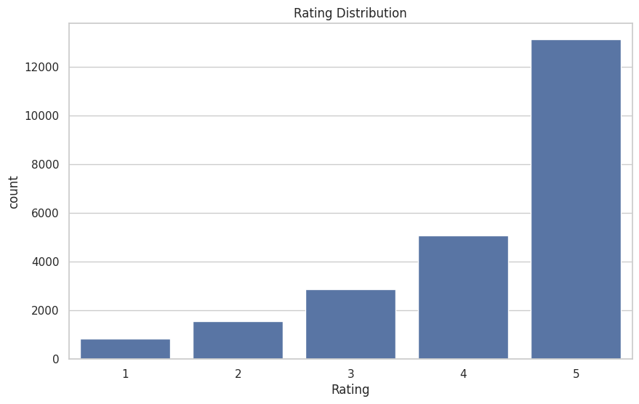
Results – EDA Highlights
Business Name
Section

Slide 10
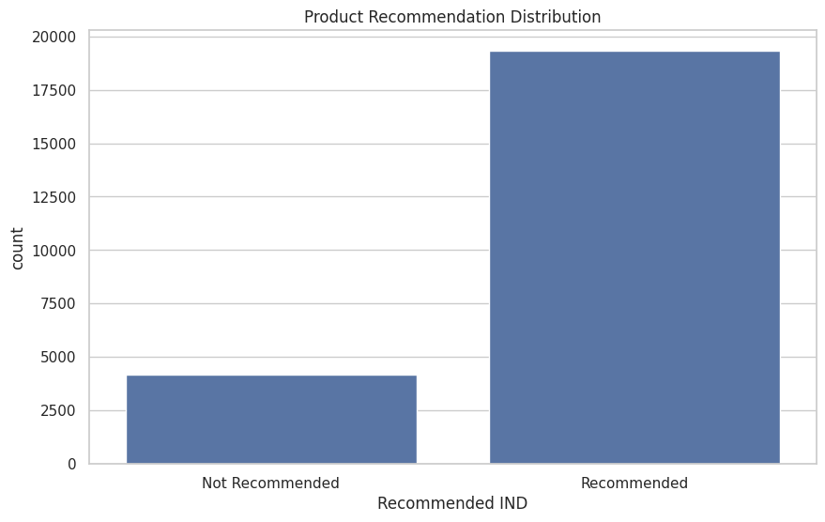
Results – EDA Highlights
Business Name
Section

Slide 11
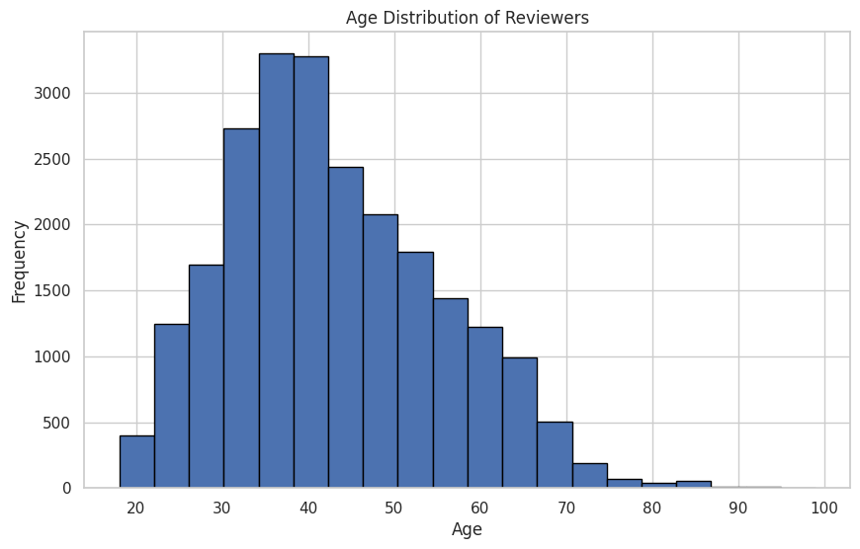
Results – EDA Highlights
Business Name
Section

Slide 12
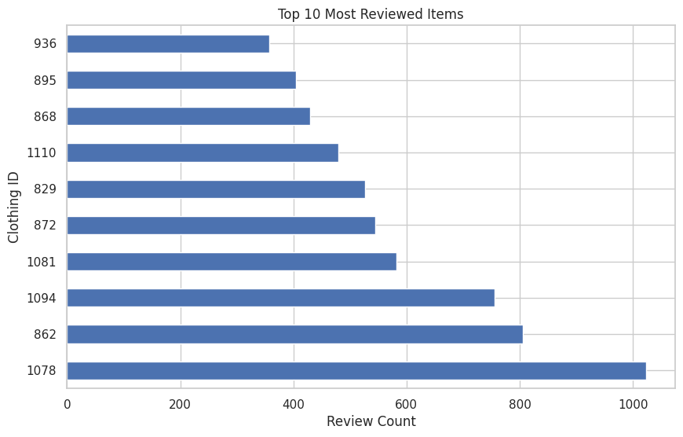
Results – EDA Highlights
Business Name
Section

Slide 13
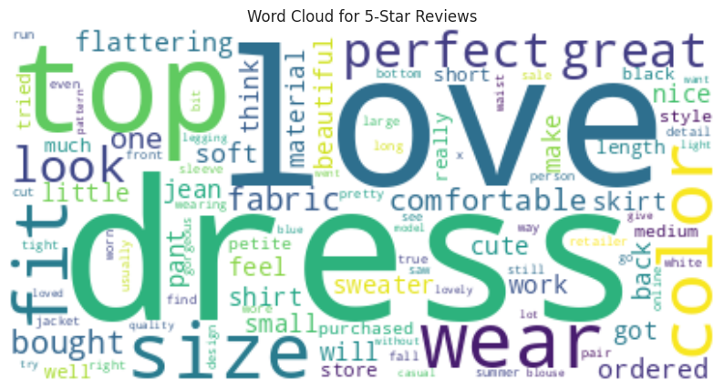
Insights from EDA
Business Name
Section

Slide 14
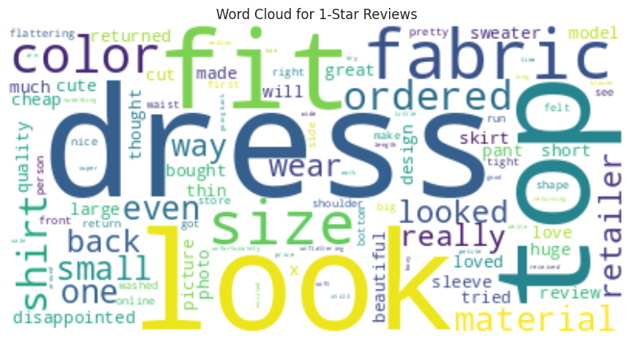
Insights from EDA
Business Name
Section

Slide 15
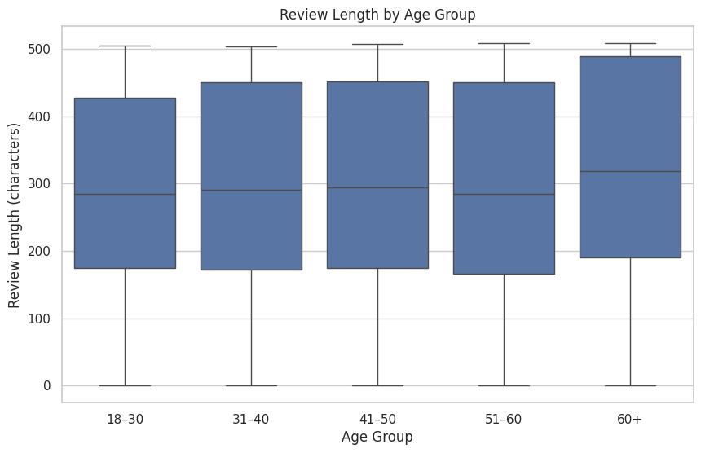
Insights from EDA
Business Name
Section

Slide 16
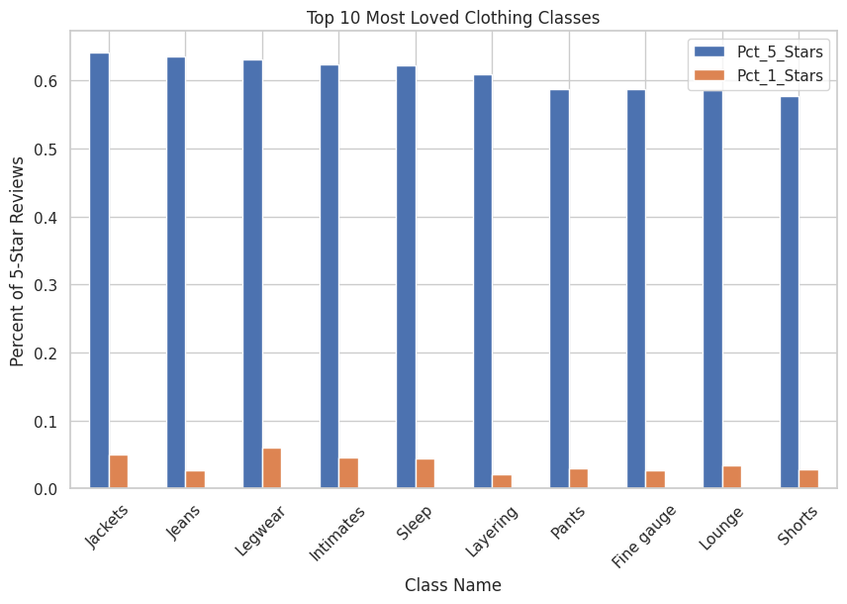
Insights from EDA
Business Name
Section

Slide 17
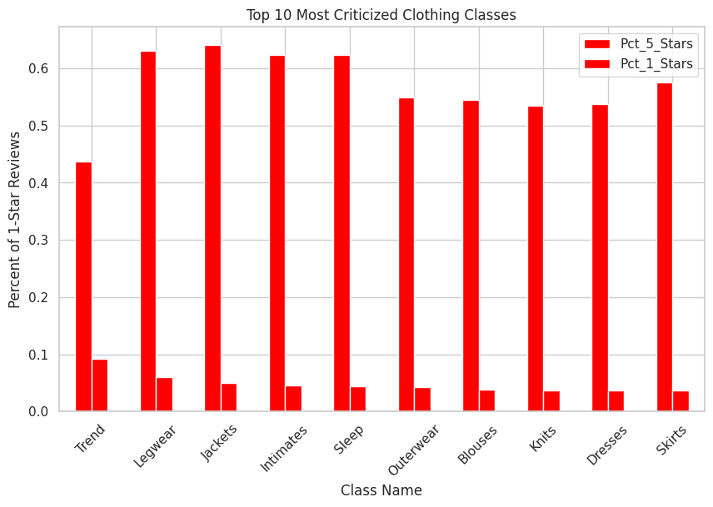
Insights from EDA
Business Name
Section

Slide 18
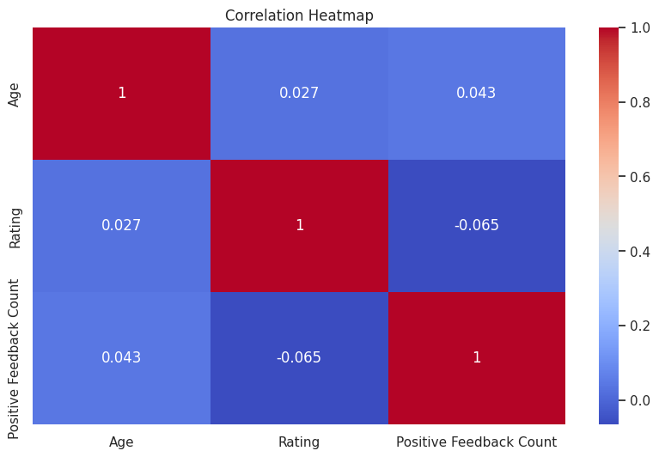
Correlations & Patterns
Business Name
Section

Slide 19
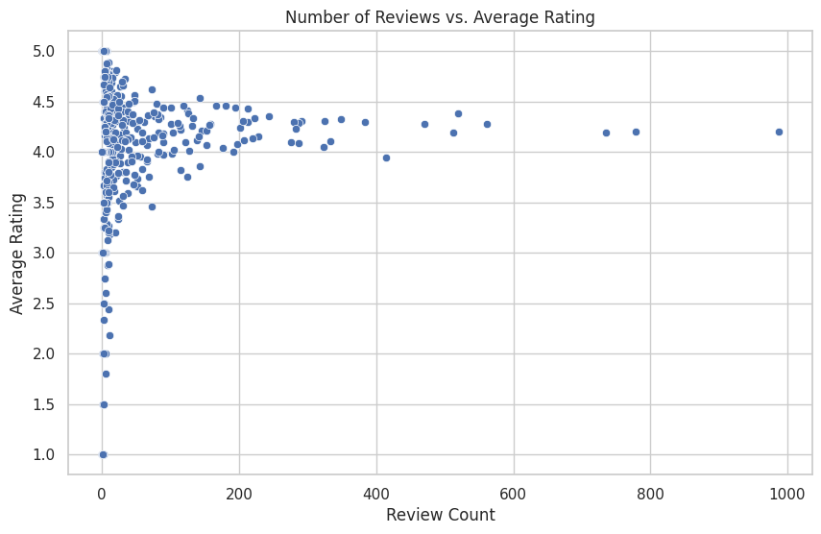
Correlations & Patterns
Business Name
Section

Slide 20

Conclusion
Our exploratory data analysis provided strong evidence of customer satisfaction patterns and product-level feedback within the women's clothing e-commerce dataset.
Key Findings:
Over 55% of reviews are rated 5★, and nearly 99.8% of those recommend the product.
The most active age group is 31–40 years old (≈34%), followed by 41–50 (≈25%).
Top 3 most reviewed classes: Dresses (6319), Knits (4843), and Blouses (3097).
The highest-rated class is Casual Bottoms with an average rating of 4.5★.
The lowest-rated class is Trend with an average rating of ~3.8★.
Text sentiment positively correlates with ratings (correlation = 0.35), confirming consistency between what people write and how they score.
Business Name
Section

Slide 21
Recommendations & Future Work
Business Recommendations:
Market aggressively to the 31–50 age bracket, the most engaged demographic.
Leverage top-rated classes like Casual Bottoms and Dresses in promotions.
Use common positive keywords (e.g., “fit,” “comfortable,” “love”) in product copy.
Address concerns in lower-rated segments like the Trend category with design feedback.
Future Work:
Implement sentiment classification using machine learning (Vader, BERT, etc.).
Analyze temporal trends — how ratings vary over time/seasons.
Integrate return/refund data to study post-purchase satisfaction.
Build a recommendation system using rating + review polarity + demographics.
Business Name
Section

Slide 22
References
Kaggle Dataset – https://www.kaggle.com/datasets/nicapotato/womens-ecommerce-clothing-reviews
IEEE Research on Sentiment Analysis in Retail, 2020
Stanford NLP Group: Customer Text Analysis Studies
Python Libraries: pandas, seaborn, matplotlib, wordcloud, TextBlob
Business Name
Section

Slide 23
Github
https://github.com/rd39257n/Python-Midterm
Business Name
Section

Slide 24

Thank You

