Slide 1
RDMU · MAIB DSC 103 · TOPIC 5
Smart Energy Grid Optimizer
Decision-making under uncertainty: balancing renewables, fossil generation
and storage with constraint programming and reinforcement learning.
Solar
Wind
Gas
Battery

Slide 2
01 · REQUIREMENT UNDERSTANDING
The problem we are solving
Meet demand
Under uncertainty
A smart-city grid must serve a fluctuating daily load every hour without blackouts.
Demand and renewable output are stochastic and only known through noisy forecasts.
Within constraints
Optimise trade-offs
Generator capacities, battery limits and a daily CO₂ cap must never be violated.
Minimise cost and emissions while keeping the grid reliable — a multicriteria goal.

Slide 3
02 · KEY RDMU CONCEPTS APPLIED
Four course concepts — genuinely used
1
Markov Decision Process
Dispatch is modelled as state → action → reward: state = forecasts, battery charge, time, remaining carbon budget.
2
Sequential Decision Making
Battery storage couples hours together — charging now changes what is optimal later across the 24-hour horizon.
3
Methods for Estimation
The agent never sees the truth: it acts on noisy forecasts of demand and renewable availability.
4
Multicriteria Decision Making
Cost, emissions and reliability are competing objectives, resolved as a Pareto trade-off.
Bonus: Utility Theory — the reward function is a utility over the weighted objective.

Slide 4
03 · APPLICATION FLOW CHART
How a decision is made each hour
→
→
→
→
Noisy forecast
Build MDP state
Choose engine
Projection
Apply dispatch
demand · solar · wind
+ battery, time, CO₂ left
LP solver / SAC agent
enforce feasibility
update battery & emissions
The loop repeats for all 24 hours of the simulated day; the projection step guarantees every decision is physically feasible.

Slide 5
04 · PREREQUISITES
What it takes to run
Environment
Python 3.10+ · runs on CPU, no GPU required
Core libraries
numpy · cvxpy (LP) · stable-baselines3 (SAC) · gymnasium
Interface
Streamlit + Plotly dashboard; Colab notebook for reproduction
Artifacts
Pre-trained SAC checkpoint ships in the repo for instant demo

Slide 6
05 · DESCRIPTION OF DATA USED
A calibrated synthetic grid
Why synthetic? A controllable simulator lets us inject known uncertainty and test policies under disruptions a fixed dataset could not provide.
Demand
Double-peak daily curve, 80–162 MW, with Gaussian noise (the uncertainty)
Solar
Midday bell shaped by daylight, scaled by renewable-penetration slider
Wind
Stochastic availability across the day, partly anti-correlated with solar
Sources
Cost ($/MWh) and emission (tCO₂/MWh) factors per generator type

Slide 7
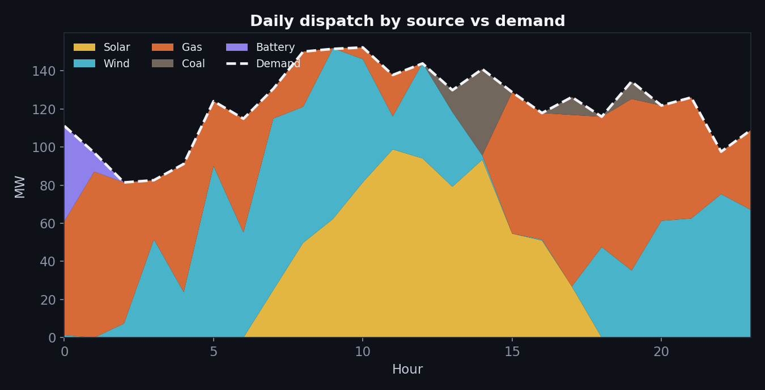
06 · DASHBOARD
Live dispatch control room
Reading the chart
Solar peaks at midday; wind carries mornings and evenings.
Gas fills the residual gap; coal only when forced.
Dashed line = demand. Stack meets it every hour: no blackouts.
Sliders re-run the grid live: penetration, variability, carbon price.

Slide 8
07 · TWO DECISION ENGINES
Constraint solver vs. learned policy
Engine B — Constraint solver
Engine A — SAC + projection
Linear program solved each hour (cvxpy).
Provably optimal for the modelled problem.
Never fails — the reliable baseline.
Embodies Constraint Programming + Multicriteria.
Soft Actor-Critic learns a dispatch policy.
Entropy-driven exploration vs. exploitation.
A projection layer forces every action feasible.
"Safe RL" — adapts to dynamics the LP cannot model.
The LP is the optimal benchmark; the agent trades a little optimality for adaptability — and the projection keeps it safe.

Slide 9
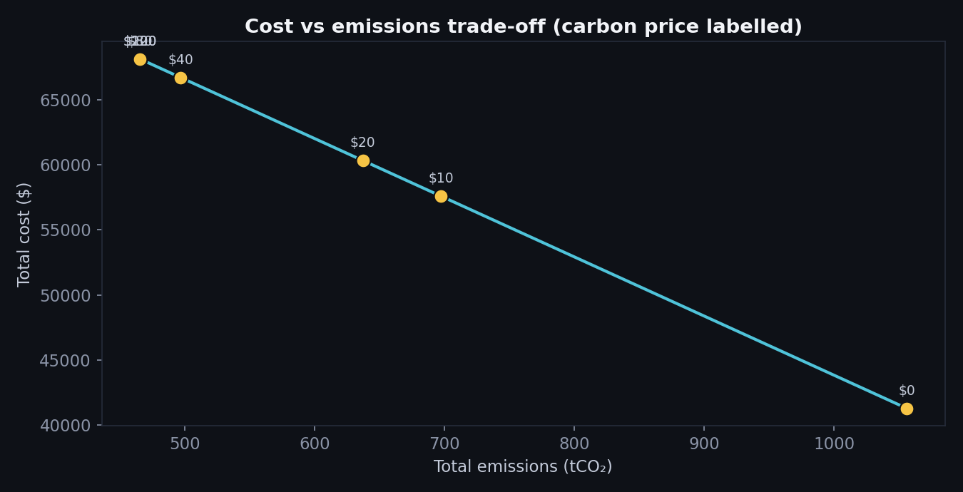
08 · SENSITIVITY ANALYSIS
The cost–emissions trade-off
Multicriteria insight
Each point is a different carbon price ($/tCO₂).
Raising the price cuts emissions sharply at first…
…then flattens — the renewable/storage limit binds.
This frontier is the heart of the decision under uncertainty.

Slide 10
09 · OUTCOMES & METRICS
What the module delivers
63%
0 MWh
~50%
24 h
Renewable share at base settings
Unmet demand — full reliability
Emissions cut as carbon price rises
Sequential horizon optimised
Deliverables: stochastic grid simulator · LP + SAC engines · interactive Streamlit dashboard · Pareto sensitivity · reproducible Colab notebook.
Concepts demonstrated: Markov Decision Process · Sequential Decision Making · Methods for Estimation · Multicriteria Decision Making (+ Utility Theory).

Slide 11
10: REPO LINK & STREAMLIT LINK
Repo Link: https://github.com/rd51/smartgrid
Streamlit Link:
https://smartgrid-e2ravxbaczgefysvkuoa4m.streamlit.app/

