Slide 1
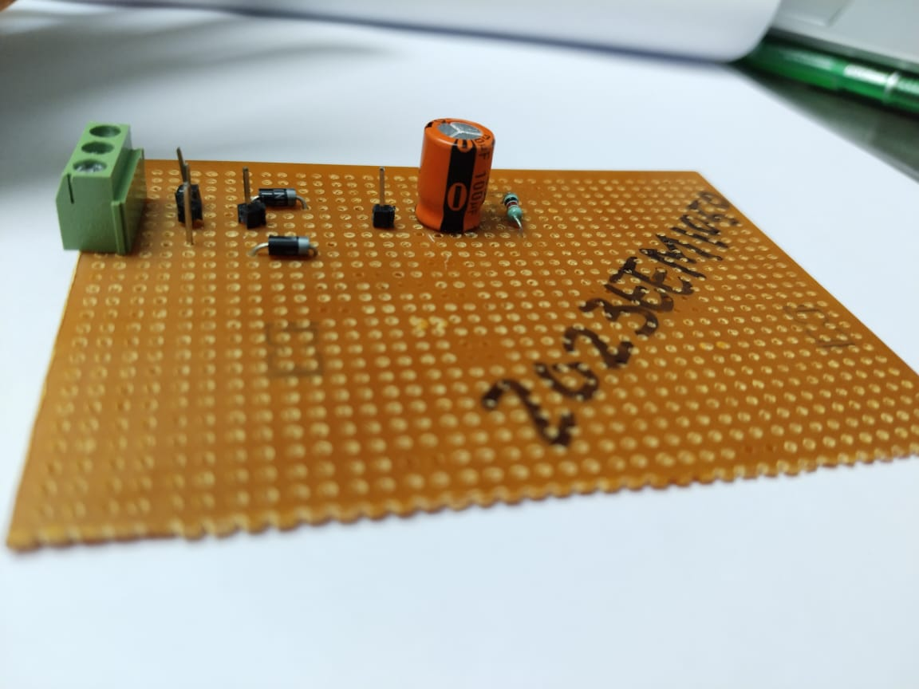
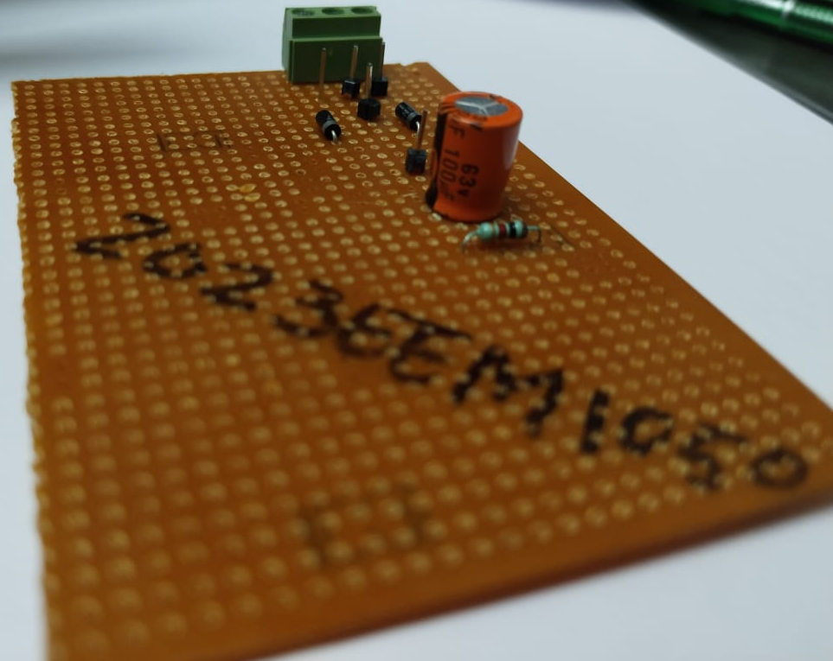
HIGH VOLTAGE ENGINEERING(EE510)
Project Title:Proper Centre Tap Rectifier With Resistive and Capacitive Load
Objective : Ripple and Efficiency in output voltage

Slide 2
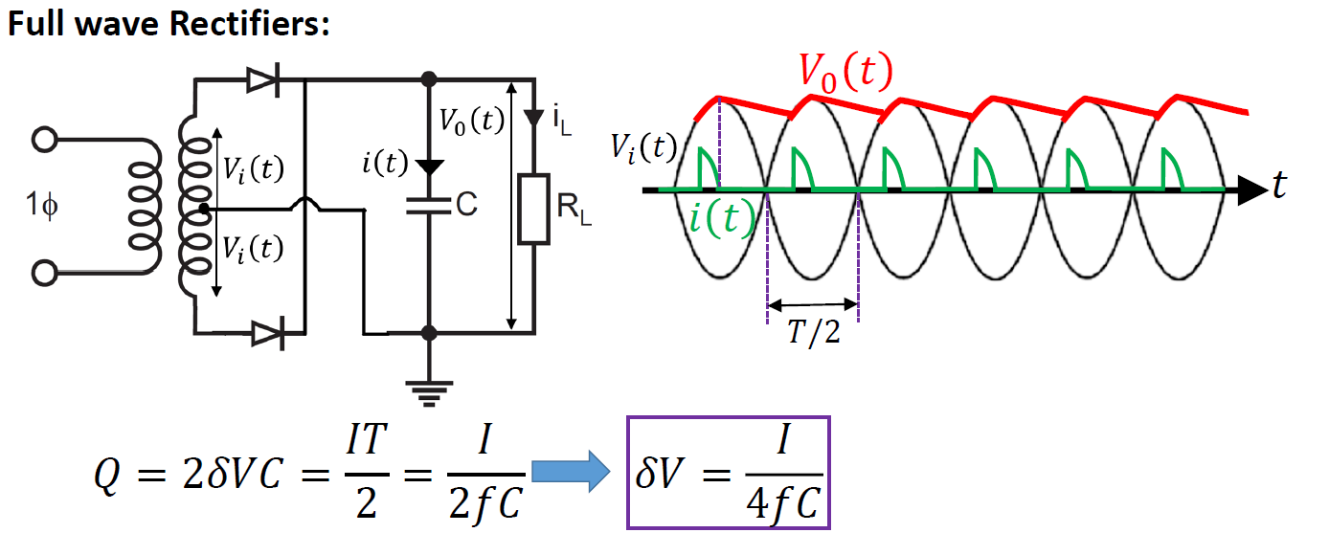
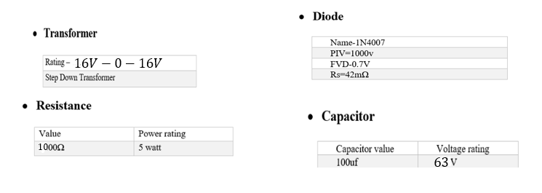

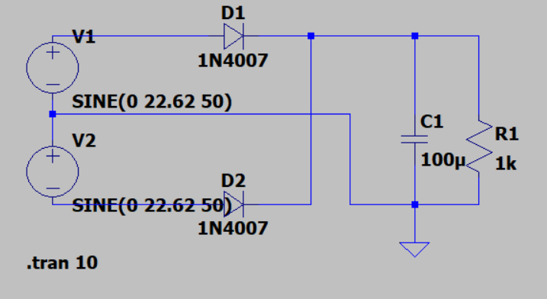

Circuit rating:
$$Ratings$$
Circuit Diagram
Output voltage WRT input voltage
Frequency =50Hz
Ltspice Model

Slide 3
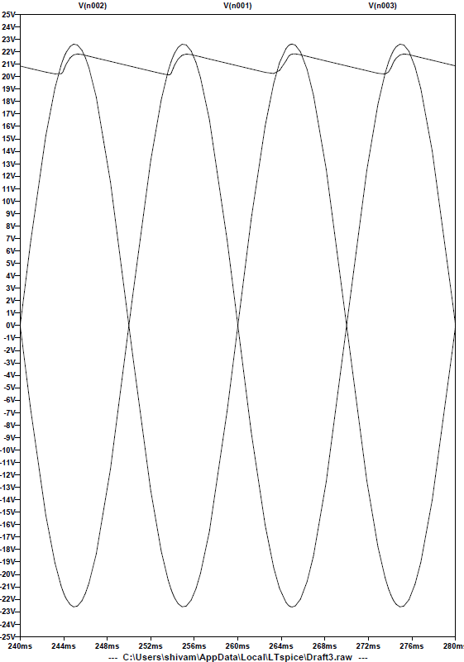
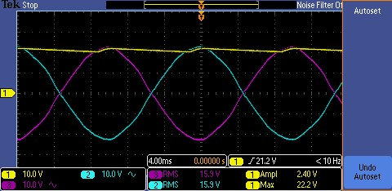
RESULTS
Theory RESULTS (LTspice)
PRACTICAL RESULT

Slide 4
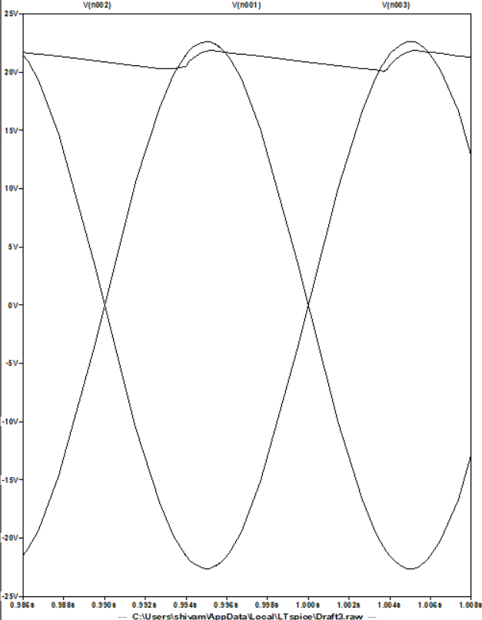
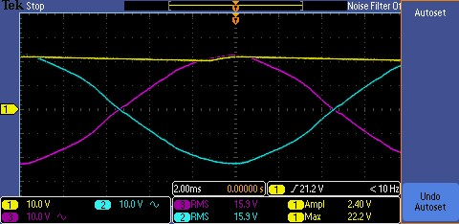


VinPeak = 16 $\sqrt{2}$ V
$δV=\frac{I}{4fC}$
$δV$ = 1.10 V
Pk – Pk Ripple=2$δV$ = 2.20V
$η$ = 97.72811 %
VinPeak = 15.9$\sqrt{2}$ V
$δV=\frac{I}{4fC}$
2$δV$ = 2.40V
Pk- Pk Ripple=2$δV$ = 2.40V
$η$ = 98.72811 %

Slide 5
CONCLUSION
The oscilloscope measurements provide insight into the behavior of a center-tap rectifier circuit with a resistive and capacitive load. The yellow waveform depicts the rectified output voltage across the resistive load, exhibiting a sinusoidal AC signal with appropriate RMS and peak-to-peak values. The addition of the capacitive load helps smooth out the output voltage, reducing ripple and improving stability. Overall, the center-tap rectifier circuit, in conjunction with the resistive and capacitive load, demonstrates effective conversion of AC input to a smoothed DC output, suitable for various electronic applications requiring a stable power source

