Slide 1
Smart Dustbin using Arduino
Automated Waste Management System
Presented by: Shivam saini

Slide 2
Introduction
What is a Smart Dustbin?
An automated dustbin that opens its lid when an object is near, promoting a contactless and hygienic way of waste disposal.
Controlled by an Arduino and ultrasonic sensor.

Slide 3
Components Used
1. Arduino Uno R3
2. Ultrasonic Sensor (HC-SR04)
3. Servo Motor (SG90)
4. 9V Battery
5. Jumper Wires
6. Breadboard
7. Dustbin

Slide 4
Arduino Uno
• Model: Uno R3
• Clock Speed: 16 MHz
• Input Voltage: 7-12V
• Microcontroller: ATmega328
• Flash Memory: 32 KB

Slide 5
Working Principle
1. The ultrasonic sensor detects the distance of an approaching object.
2. If the object is within the set range, the servo motor opens the dustbin lid.
3. After a few seconds, the lid closes automatically.

Slide 6
Code Explanation
• The servo motor is controlled based on the distance measured by the ultrasonic sensor.
• The Arduino code calculates the distance and operates the motor accordingly.
Key Functions: measure(), loop()

Slide 7
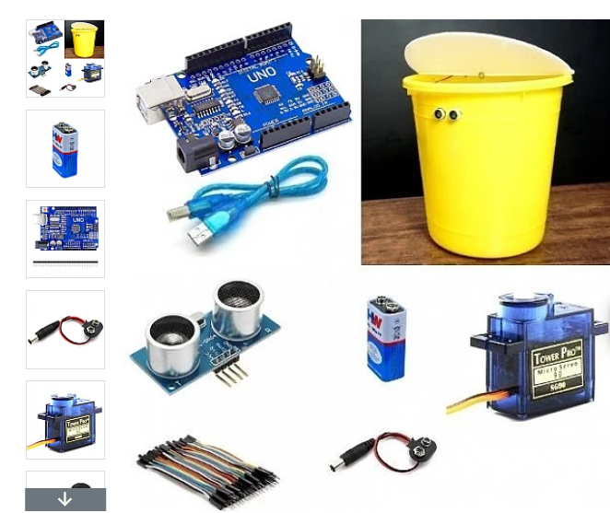
Conclusion
This Smart Dustbin provides a hands-free way of disposing of waste, enhancing hygiene and cleanliness in public spaces.

