Slide 1
ADVANCED CONTROL DESIGN TECHNIQUES FOR POWER CONVERTERS(EE608)
Topic: Current mode control in BUCK converter
Faculty Student
Dr. A.V. Raviteja (Shivam saini ) 2023EEM1050
(Shubham FaujdaR) 2023EEM1051

Slide 2
BUCK CONVERTER CURRENT MODE CONTROL
Objective 1: Simulate a closed loop buck converter with current mode control
Objective 2: Obtain the bode plot before and after the controller design and show that a phase margin of 35 degrees is achieved.
Objective 3: Draw the nyquist plot of open loop gain and confirm the same as in 2
Objective 4:Draw the root-locus of the inductor series resistance variation and show the limits of the inductor series resistance variation for stable operation.

Slide 3









CALCULATIONS
f$=100KHz$
Outer $loop$
Inner loop is faster than outer loop.
Some tolerance is also considered.
Vi$=48V$
Kp=0.08
Vo$=12V$
Ki=704.03
R$=15Ω$
$$Inner loop$$
Kp=0.009
Inductor current ripple: 90 mA (11.25%)
Output voltage ripple: 4.33 mV (0.0361%)
L$=100µ$H
Ki=50.90
C$=26µF$
D$=0.25$

Slide 4
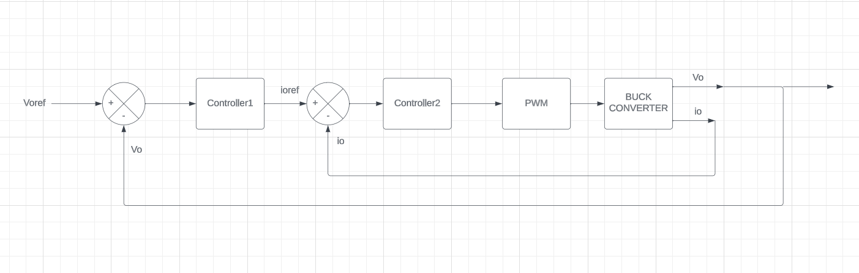
BLOCK DIAGRAM

Slide 5
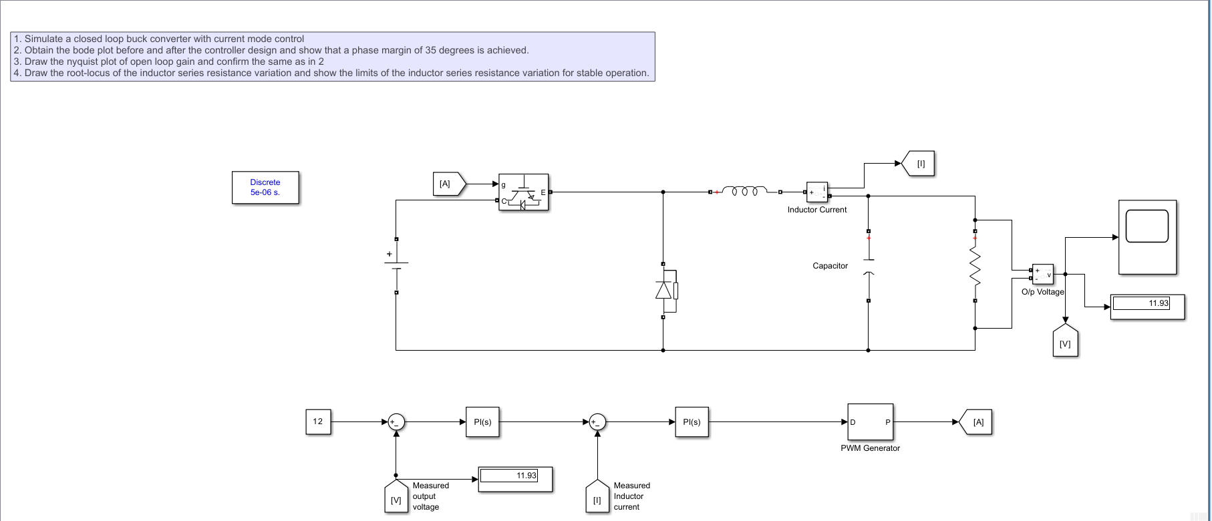

Slide 6
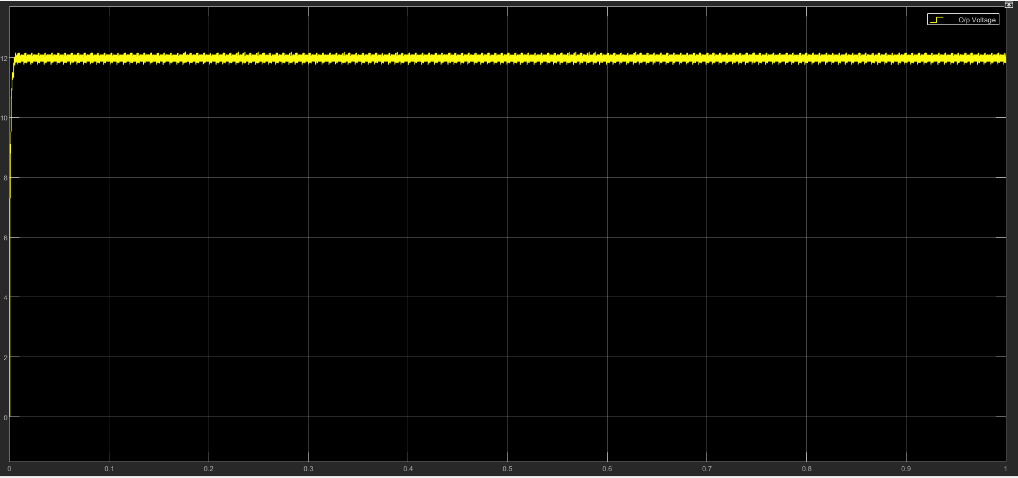
Output Voltage

Slide 7
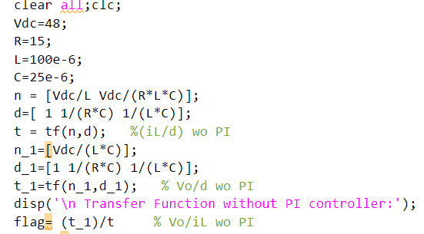
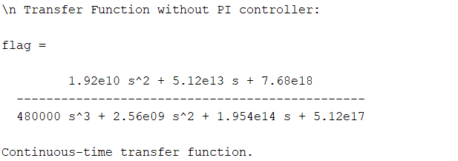
MATLAB CODE FOR FINDING PHASE MARGIN Without Controller

Slide 8
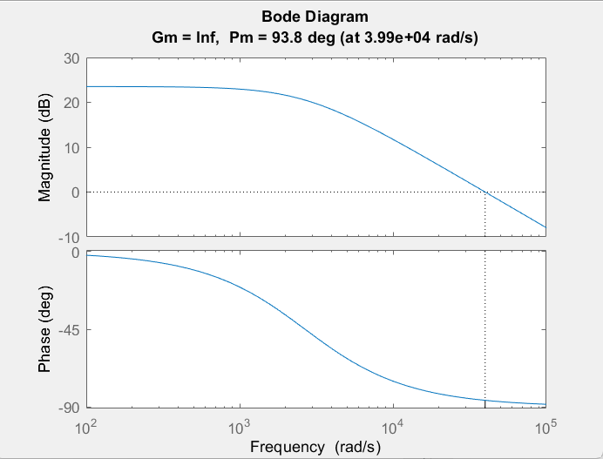

Slide 9
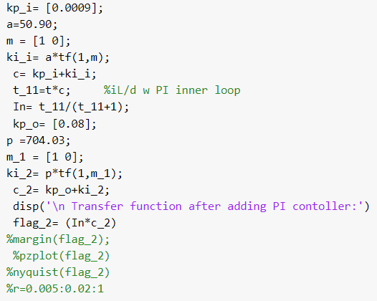
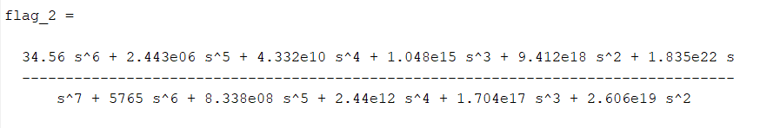
MATLAB CODE FOR FINDING PHASE MARGIN With Controller

Slide 10
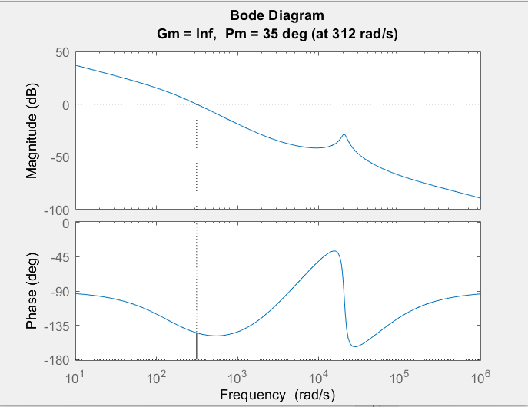
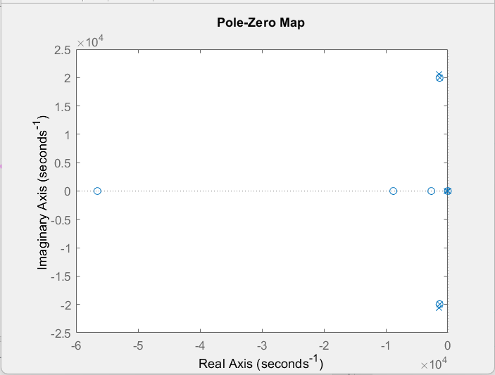

Slide 11
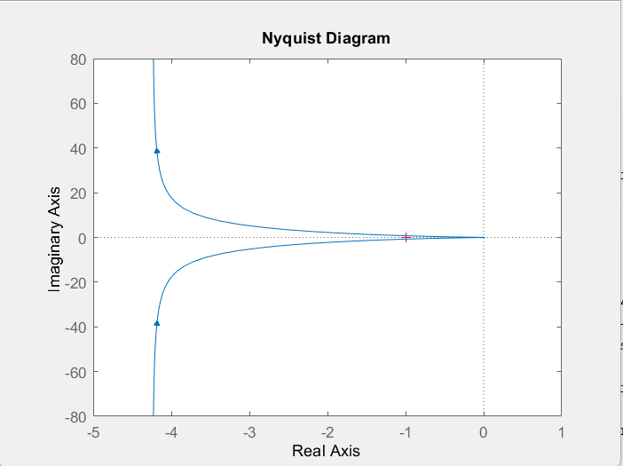
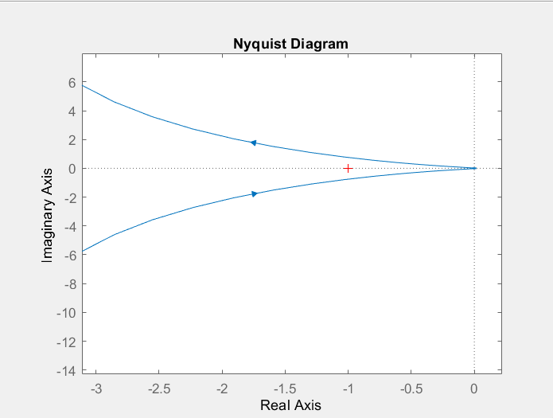

Slide 12
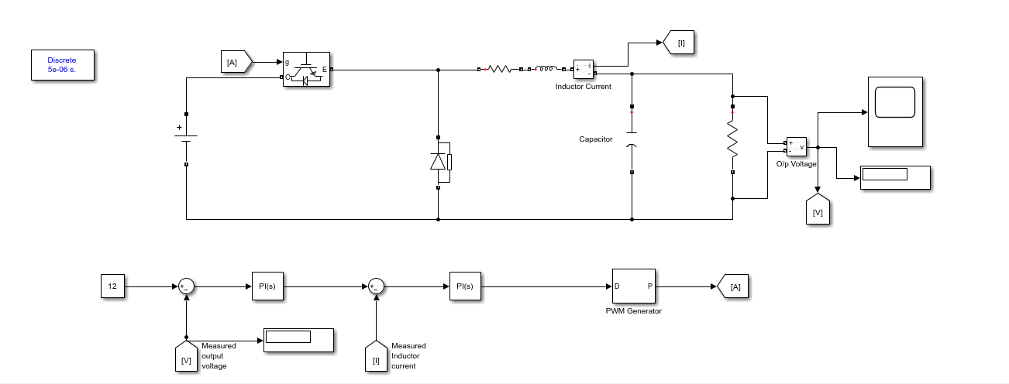
Draw the root-locus of the inductor series Resistance variation and show the limits of the inductor series resistance variation for stable operation.

Slide 13
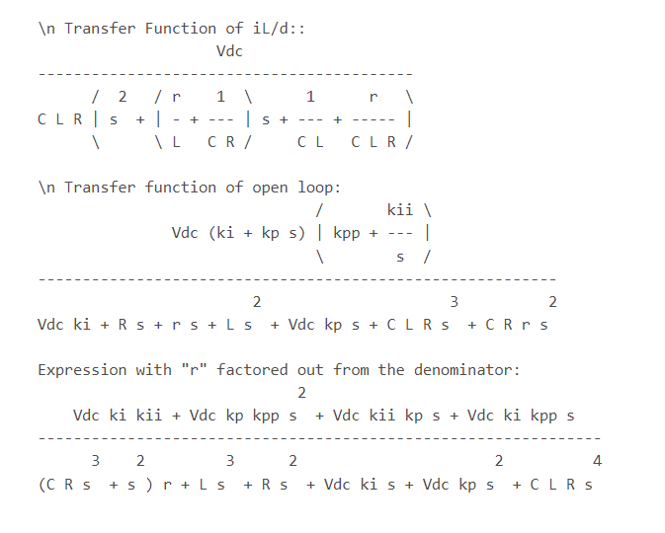

Slide 14
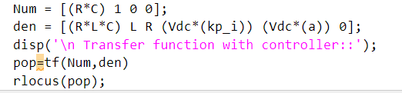

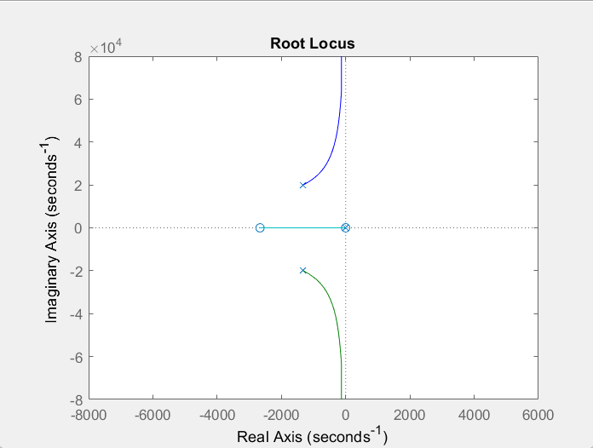
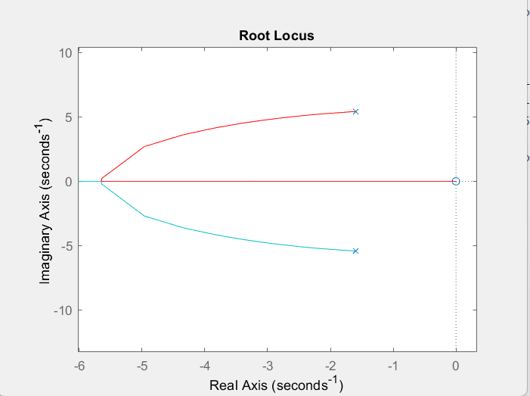

Slide 15
EXTRA TASKS

Slide 16
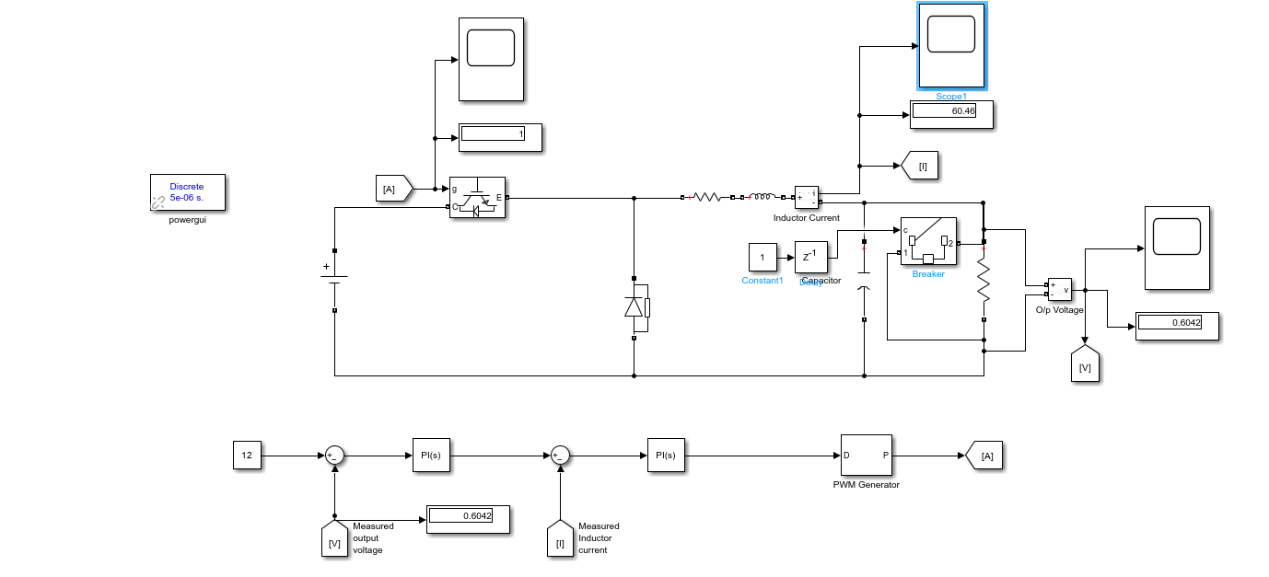
SHORT CIRCUIT

Slide 17
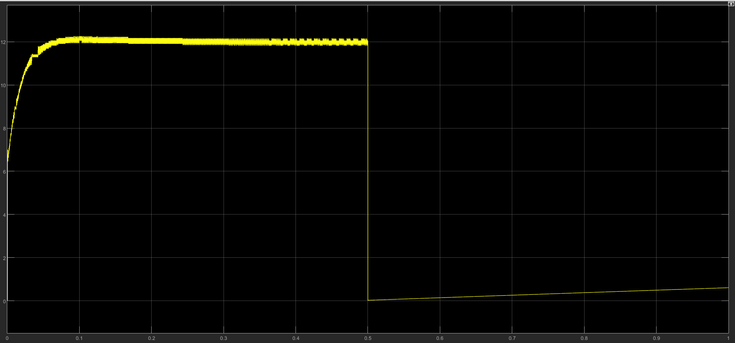
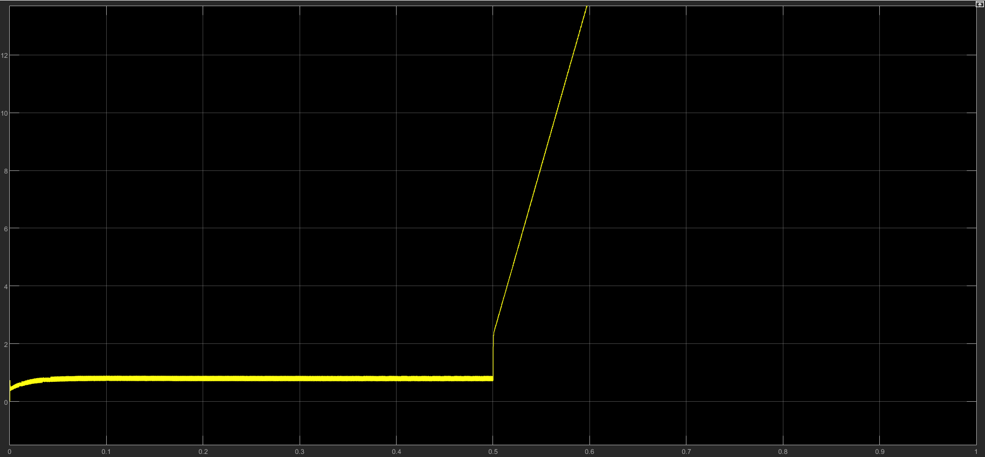

$$Voltage Profile$$
Current Profile

Slide 18
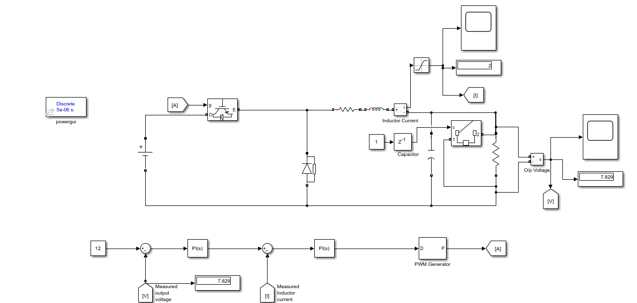
SHORT CIRCUIT WITH SATURATION BLOCK

Slide 19
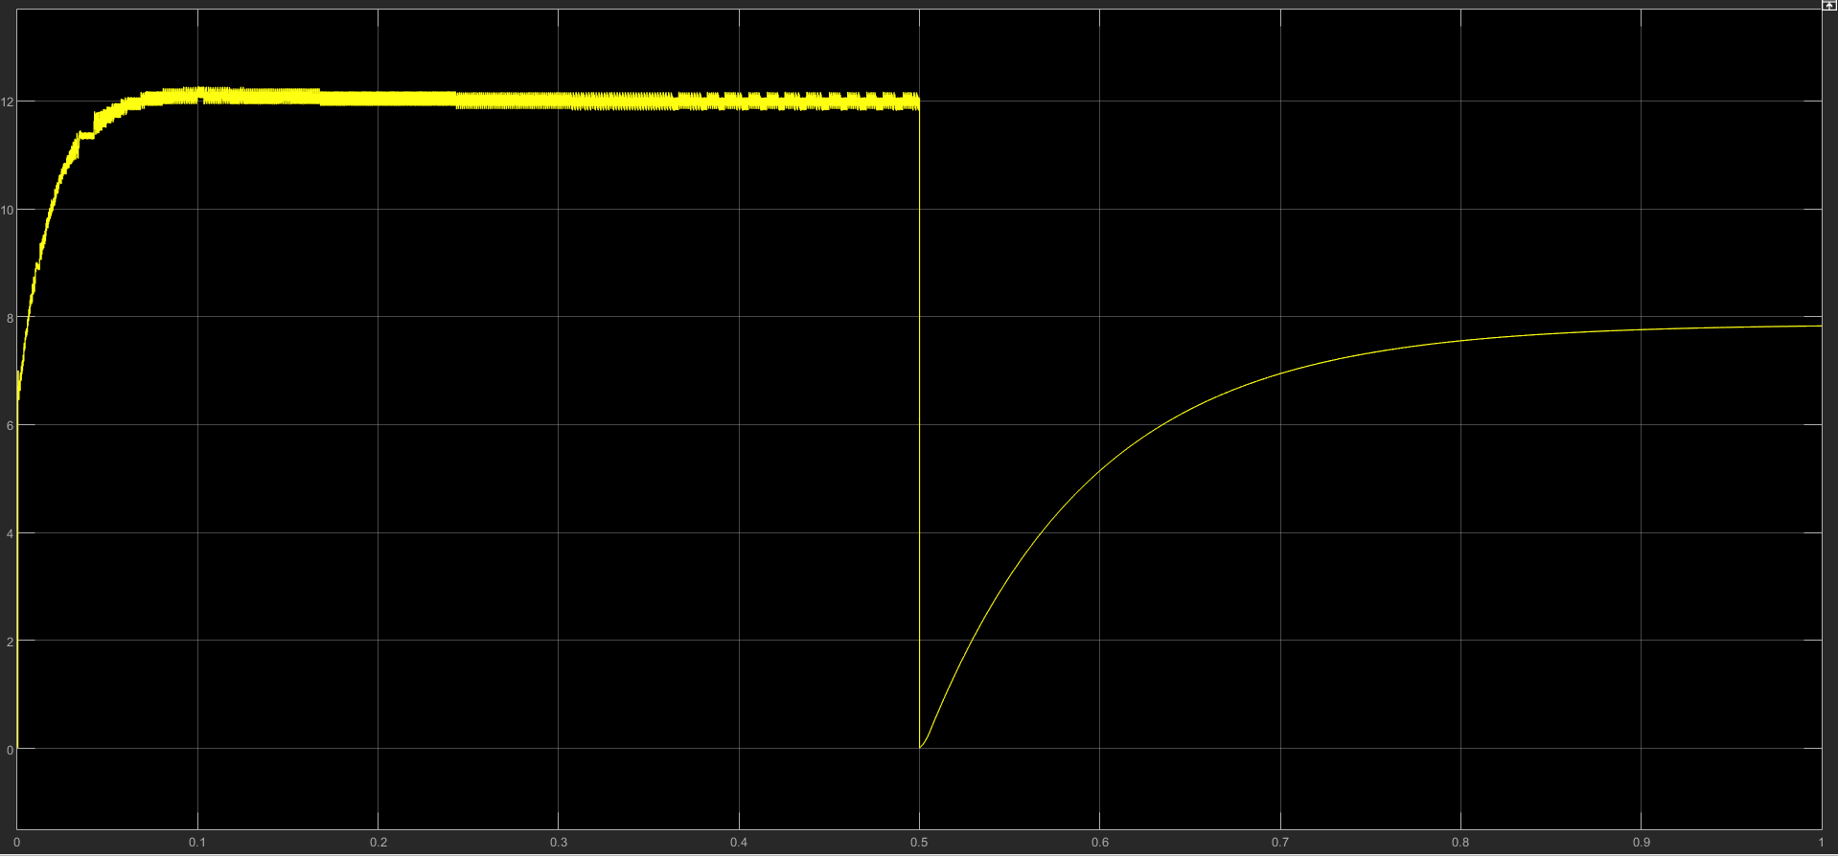
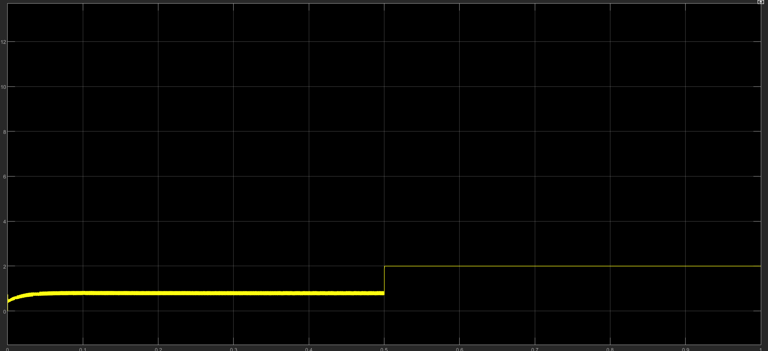
$$Voltage Profile$$
Current Profile

Slide 20
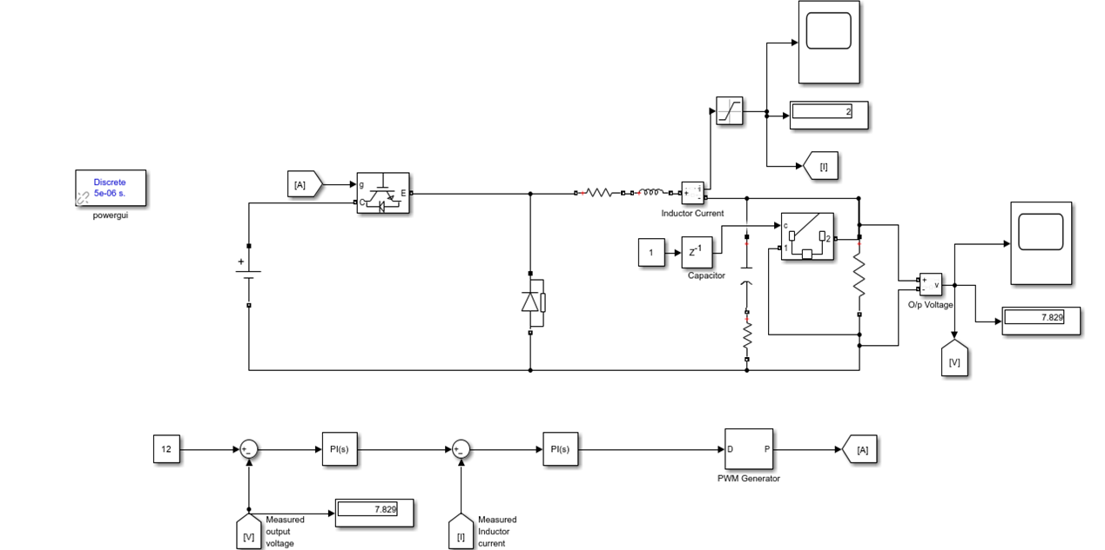
Draw the root-locus of the inductor series Resistance variation and show the limits of the Capacitor series resistance variation for stable operation.

Slide 21
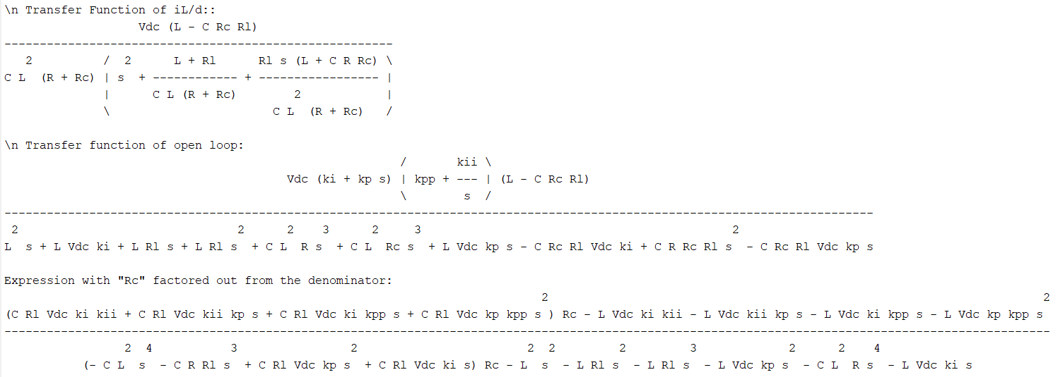

Slide 22
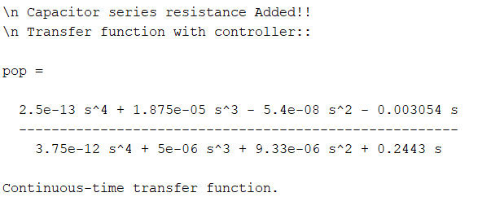
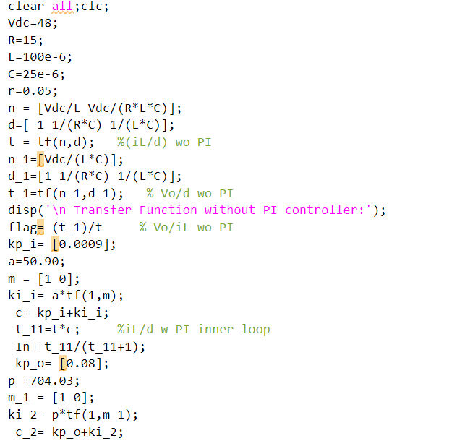
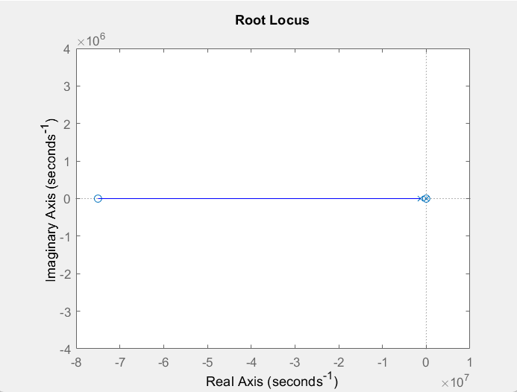
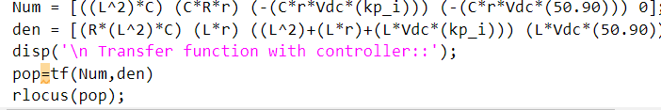

Slide 23
REFERENCE
[1] Hasan Sucu, Taner Goktas, Muslum Arkan ,“Design, Simulation and Application of Buck Converter with Digital PI Controller ”,Balkan journal of electrical & computer engineering, Vol. 9, No. 2, April 2021.
[2] P.C. Sen, Zaohong Yang, “DC-TO-DC buck Converters with novel current mode control”,1999 IEEE

Slide 24
THANK YOU

