Slide 1









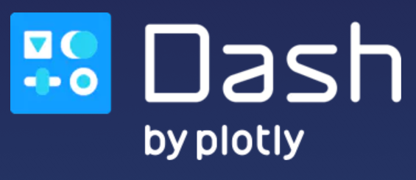
Meet the team
OK!
Let’s build a dashboard to let somebody (not a data scientist) choose a threshold for an assurance scoring model.

Slide 2

Training
Assurance Scoring
Features… | … | Class
 |  | 1
 |  | 0
Test
Features… | … | Class | Score
 |  | 1 | 0.86
 |  | 0 | 0.25
 |  | 0 | 0.5
Features… | … | Class
 |  | 1
 |  | 0
y = f(x)
Features… | … | Class
 |  | 1
 |  | 0
Choose a threshold to turn the score into a predicted class
Features… | … | Class | Predicted Class
 |  | 1 | 1
 |  | 0 | 0
 |  | 0 | 1
Start here

Slide 3
Key points
Dash is very powerful and easy to work with
But took a lot of effort to come up with a nice modular structure
…

