Slide 1
Autopaxos:
Efficiently Achieving Consensus in a Changing Environment
Bob Adolf and Mike Rizzo
Harvard University

Slide 2
Outline
Introduction
Motivation
Design
Evaluation
Conclusions

Slide 3
Introduction
Achieving distributed, fault-tolerant consensus: Paxos!
Applying Paxos in real world situations (cf. Paxos Made Live)
Our implementation

Slide 4
Motivation
Paxos constants: heartbeat frequency and master timeouts
Set based on an initial environment (sweep)
Not often revisited later on even though environment parameters (like latency and node failure rate) might change

Slide 5
A Paxos system that measures and adapts to its environment will perform better than one that does not.

Slide 6
Design: The System
Paxos_Server
- Heartbeat frequency
- master timeout
Paxos_Acceptor
Paxos_Proposer

Slide 7
Measurement
Tracking latency
Tracking drop events
Master notices node drop
Node notices master drop (master timeout)
EWMA (RTT)
Sliding window (drop events)
Telemetry
- average RTT
- logging drop events
- MTBF

Slide 8
Policy and Adaptation
Assess the best overall goodness possible in the current environment

Slide 9
Evaluation
In order to make decisions, we need to measure:
RTT (latency)
MTBF
RTT + MTBF → Goodness scores → better heartbeat frequency + better master timeout

Slide 10
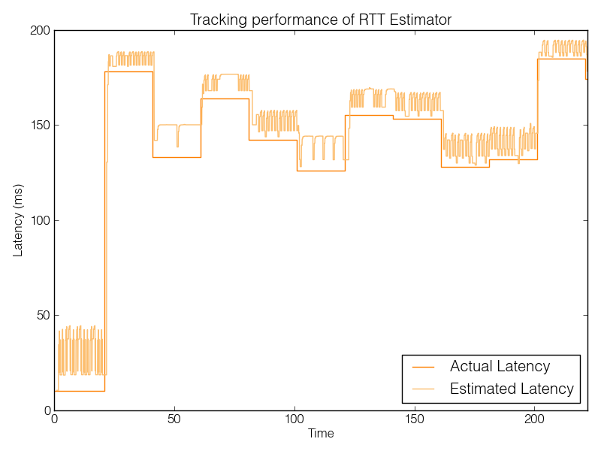

Slide 11
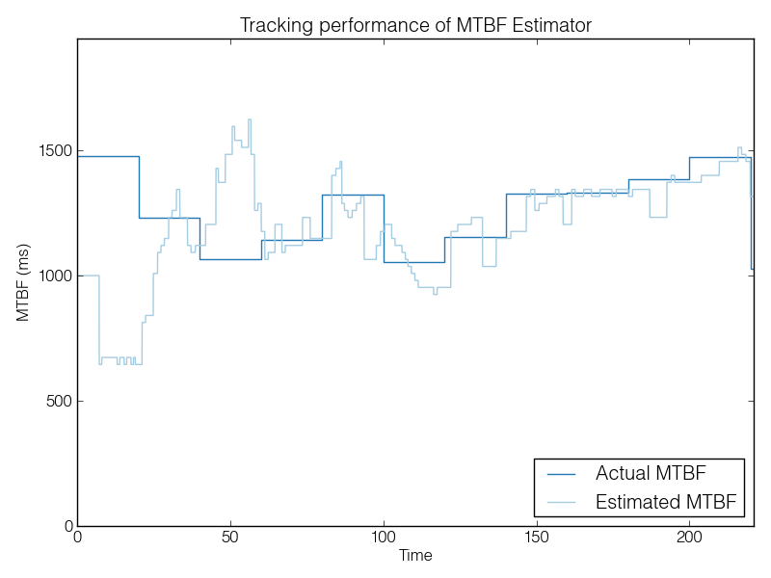

Slide 12
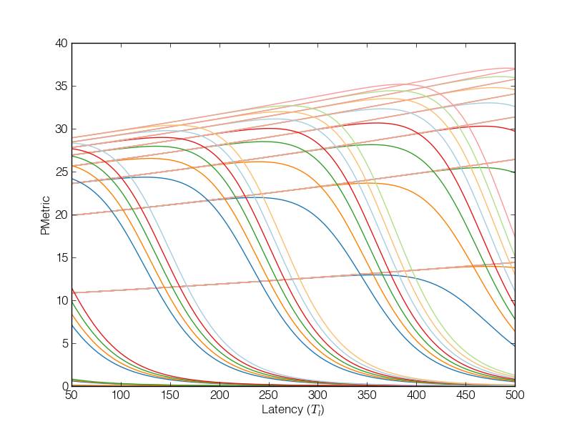
Search Space

Slide 13
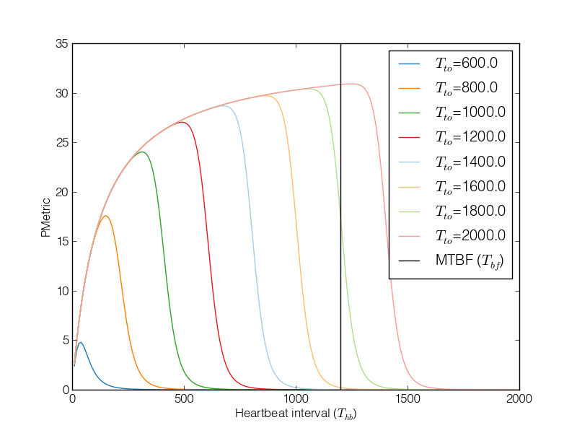
Search Sweep

Slide 14
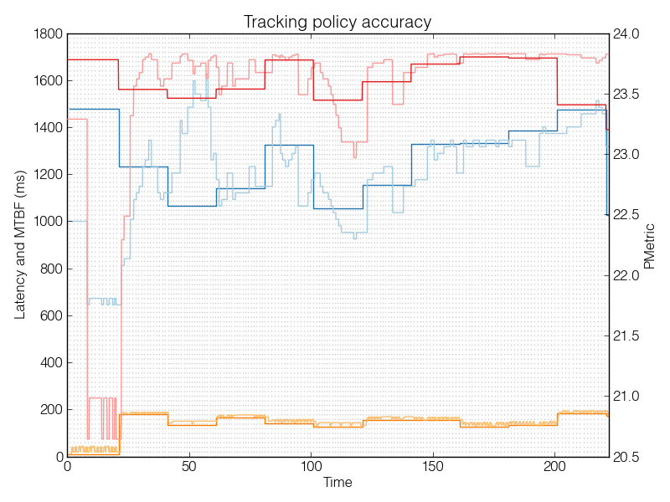

Slide 15
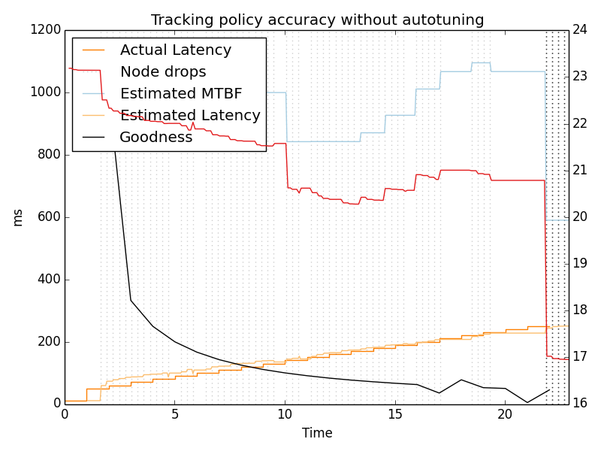
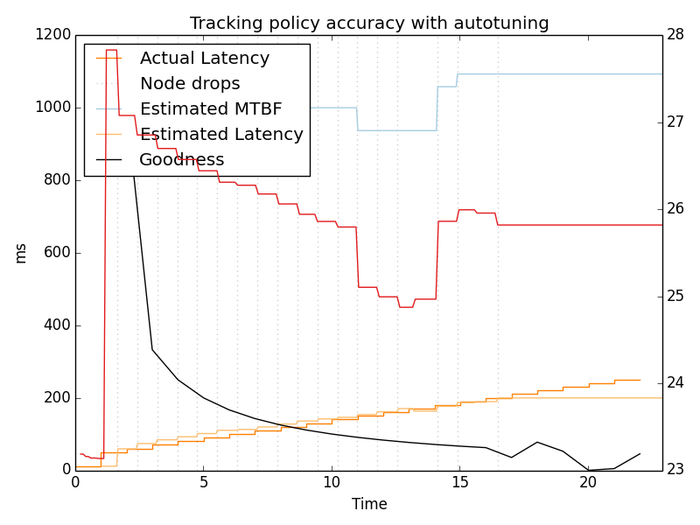
Monotonic Shift

Slide 16
Conclusions
Our policy does a really good job of predicting the best parameters
But these don’t really make a big difference in performance.

