Slide 1
Autopaxos:
Efficiently Achieving Consensus in a Changing Environment
Bob Adolf and Mike Rizzo
Harvard University

Slide 2
Outline
Introduction
Motivation
Design
Evaluation
Conclusions

Slide 3
Introduction
Achieving distributed, fault-tolerant consensus: Paxos!
Applying Paxos in real world situations (cf. Paxos Made Live)
Our implementation

Slide 4
Motivation
Paxos constants: heartbeat frequency and master timeouts
Set based on an initial environment (sweep)
Not often revisited later on even though environment parameters (like latency and node failure rate) might change

Slide 5
A Paxos system that measures and adapts to its environment will perform better than one that does not.

Slide 6
Design: The System
Paxos_Server
- Heartbeat frequency
- master timeout
Paxos_Acceptor
Paxos_Proposer

Slide 7
Measurement
Tracking latency
Tracking drop events
Master notices node drop
Node notices master drop (master timeout)
EWMA (RTT)
Sliding window (drop events)
Telemetry
- average RTT
- logging drop events
- MTBF

Slide 8
Policy and Adaptation
Assess the best overall goodness possible in the current environment

Slide 9
Evaluation
In order to be able to adequately measure:
RTT (latency)
MTBF
Using these, we had to optimize our policy score of goodness using the heartbeat frequency and master timeout parameters

Slide 10
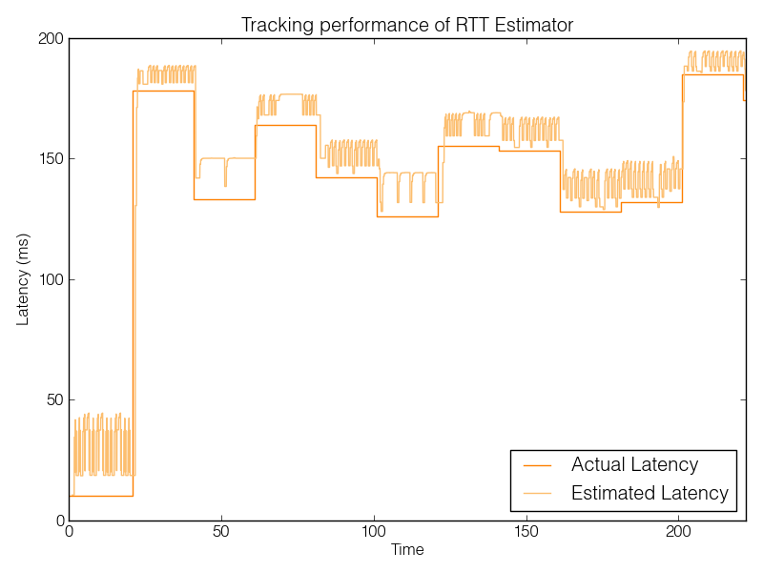

Slide 11
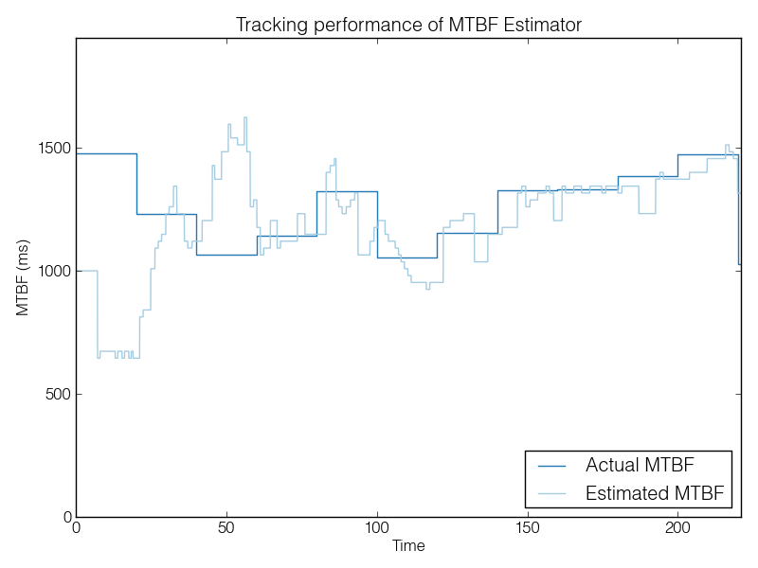

Slide 12
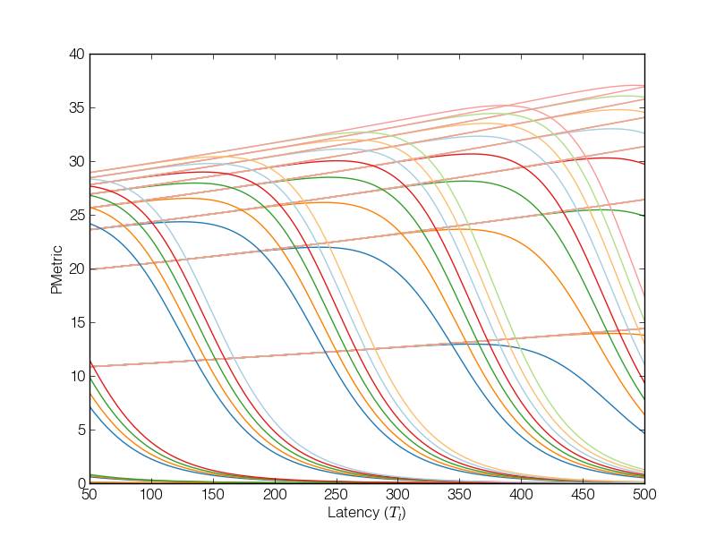
Search Space

Slide 13
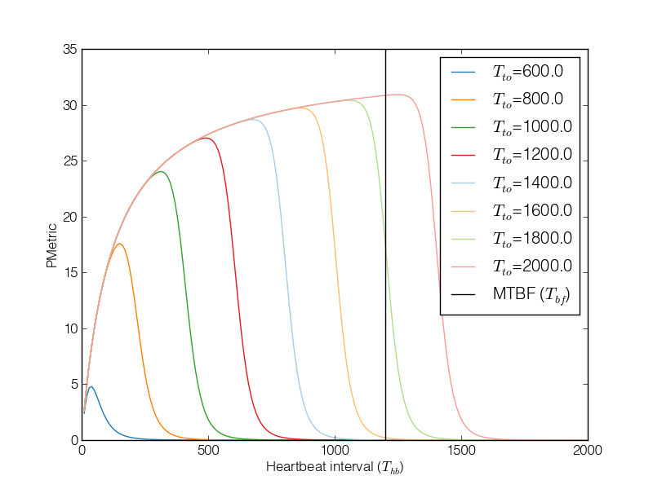
Search Sweep

Slide 14
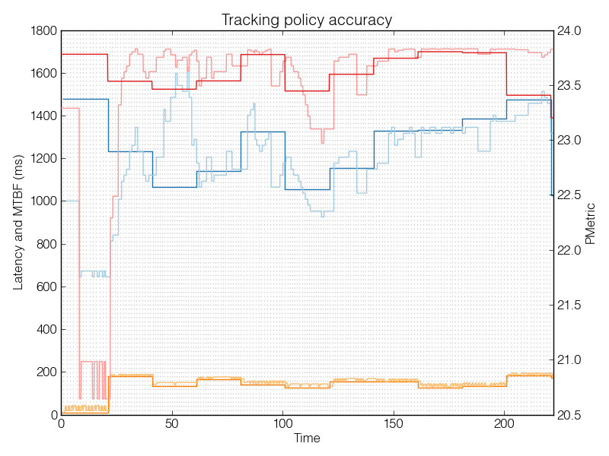

Slide 15
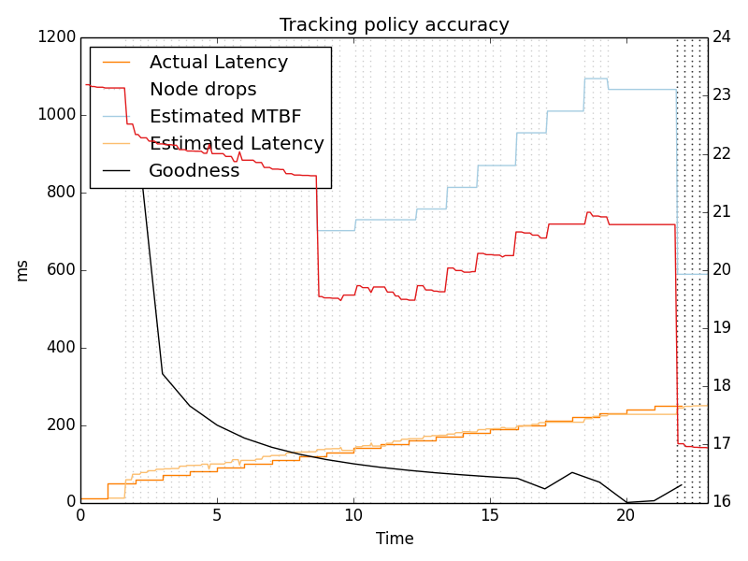
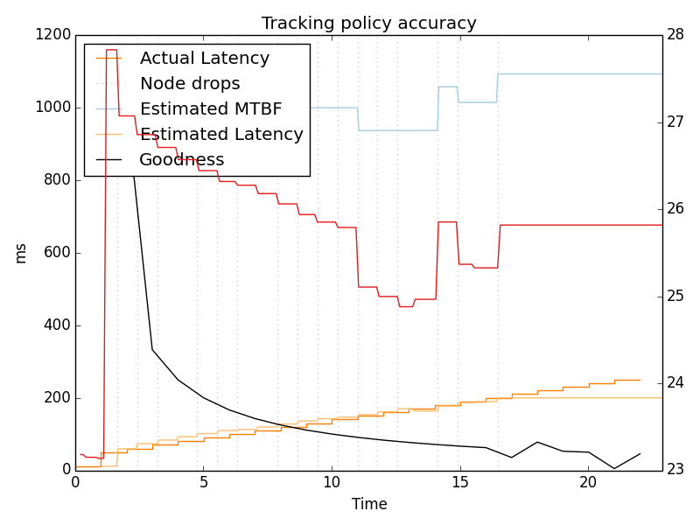
Monotonic Shift

Slide 16
Conclusions
Our policy does a really good job of predicting the best parameters
But these don’t really make a big difference in performance.

