Slide 1
A soft introduction to Snakemake
Ricardo D’O. Albanus
The Parker Lab

Slide 2
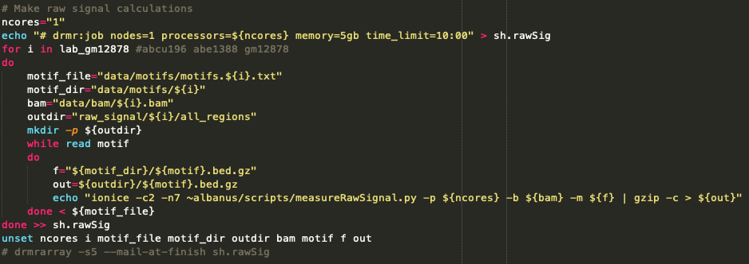
A (not so) simple pipeline

Slide 3
A (not so) simple pipeline
Job scheduler interaction
Loop through biological samples (datasets)
Input files
Loop through genes (features)
Actual command
Job scheduler interaction
Which is the newest sample?

Slide 4
The problem
Step 1
Step 2
Step 3
Step 4
.
.
.
Step n
Notes:
Now imagine that this particular pipeline has multiple steps – I had to go through every one of them to update the samples…

Slide 5
The problem
Pipelines can grow quickly:
New inputs
New parameters
New hypotheses
(…)
Modifying pipelines manually is tedious, but even worse, error prone.
No reproducibility
Terrible portability
Extensive debugging

Slide 6
Snakemake
Snakemake is a pipeline manager developed by the Köster Lab (Duisburg-Essen - Germany) to help solve these issues.
It uses a system of wildcards and rules to organize and manage pipelines, taking into account available resources and multiple user specifications.
http://snakemake.readthedocs.io

Slide 7
What can Snakemake do?
What can’t Snakemake do?
Features:
Wildcards. Smart (mostly) determination of names and handles that get carried throughout the pipeline.
Rules. A system of interconnected steps that allow information flow from the beginning to the end of a pipeline.
Resource management. Any kind of resource can be incorporated into the pipeline.
Flexibility. (Fairly) straightforward integration with DRMAA, Slurm, cloud computing, etc.

Slide 8
dataset_1
gene_1
gene_2
measure_raw_signal.py
analyze.py
dataset_1_results.txt

Slide 9
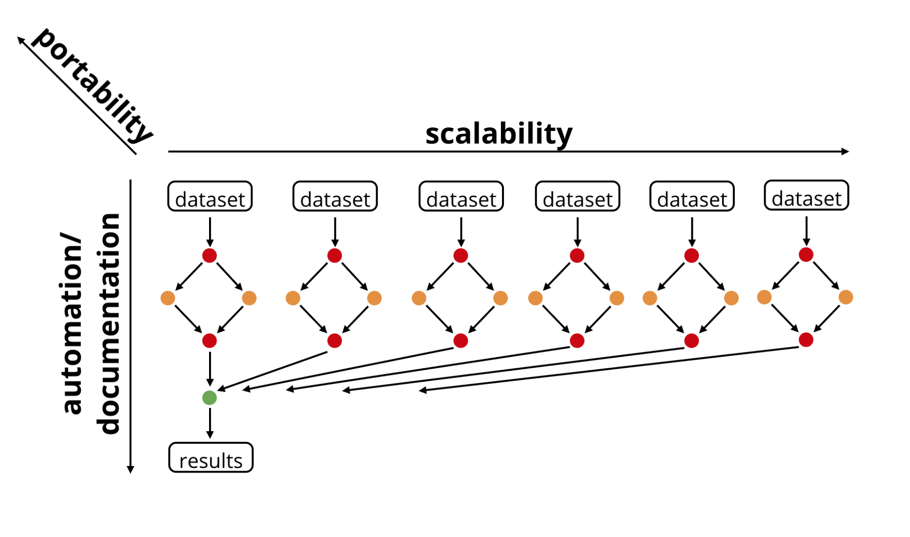

Slide 10
Getting started
The primary Snakemake file is called Snakefile. This is where all the rules are. Rules are the skeleton of any Snakefile. They are composed by:
input: file(s) to be processed
output: resulting file(s)
params: additional parameters (e.g. program flags)
resources: threads, memory, and custom resources
shell, run, script: the actual command to run
shell: runs on shell (bash)
run: executes python commands
script: executes a python, R, etc script

Slide 11
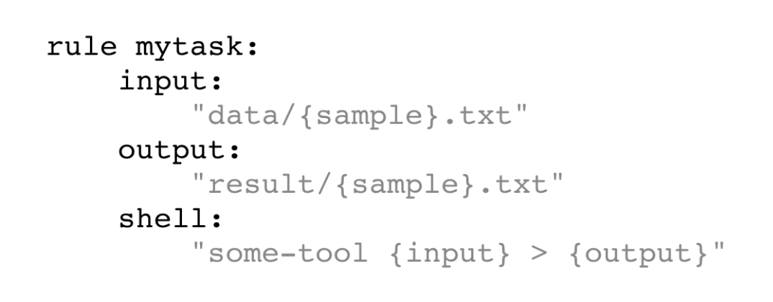
Basic rule syntax
{sample} is a wildcard. The values will be inferred based on the previous rules or by declaring them explicitly (more on this later).

Slide 12
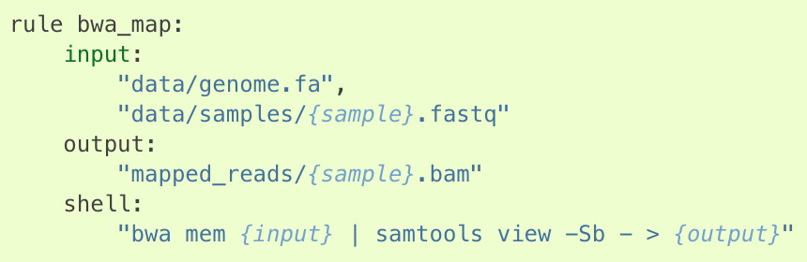
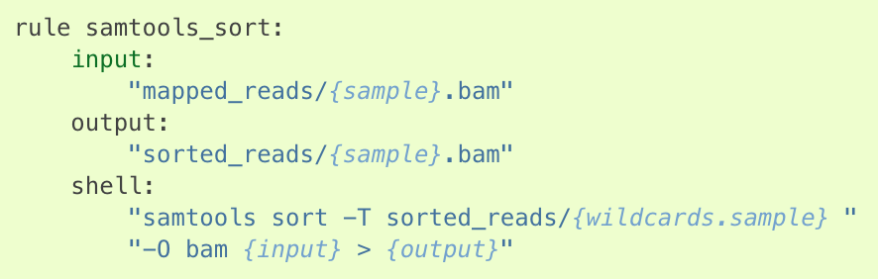
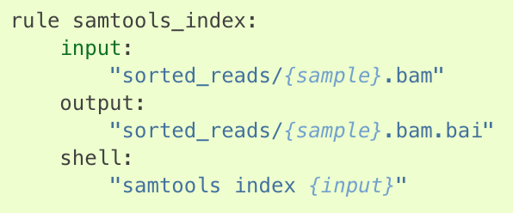
Snakefile
Step 1: Align sequenced reads to genome
Step 2: Align sequenced reads to genome
Step 3: Index alignments

Slide 13
Directed acyclic graphs (DAGs)
One of the interesting things in Snakemake is the ability to generate graphs of the pipeline to aid development/debugging.

Slide 14
Example: Cufflinks RNA-seq pipeline

Slide 15
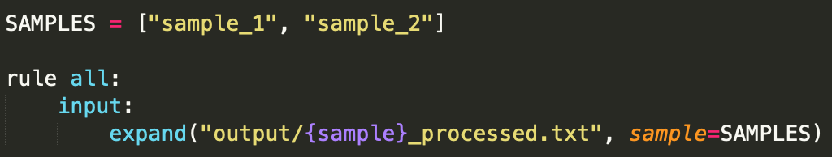
Creating the target rule, all
Snakemake will look for the first rule in the pipeline to determine what rules need to be executed and for what wildcards.
In this example, Snakemake knows that it has to generate the {sample}_processed.txt files in the output folder with the wildcards sample_1 and sample_2.

Slide 16
Useful functions within Snakemake
expand(“path/{wildcard}.extension”, wildcard=list)
Expand the string to all the values in the wildcard argument. Used in the rule all and rules with multiple inputs.
wildcards, = glob_wildcards(“path/{wildcard}.extension”)
Creates a wildcards variable (a named tuple) which contains all the wildcard values based on pattern matching. It is basically listing the directory contents and running a regular expression match for path/(.*).extension. Don’t forget the trailing comma.
.* in RegEx means any character any number of times. There are ways to change this behavior.

Slide 17
Running Snakemake
Snakemake is called by running snakemake from your terminal. It assumes that the instructions are in a Snakefile in the same directory.
Useful flags:
-n does a dry run (don’t execute anything). Great for developing and debugging.
-p and –r will print the reason for each rule being run and the shell command for each rule, respectively.
--snakefile points to the Snakefile path, if not on the main directory.
--configfile points to the config file (more on that later).

Slide 18
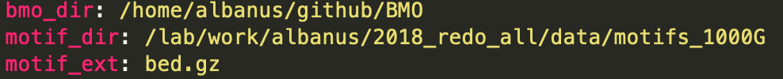
Config files
It’s bad practice to hardcode all your wildcards, input, files, options, etc. in the Snakefile. Use a config file, instead.
Snakemake supports json and yaml formats.
Use the flag --configfile to point to it.
Accessible through the config global variable. Behaves like a dictionary.

Slide 19
More advanced uses
Using params
Output modifiers
temp( ), protected( ), dynamic( ), directory( ), shadow( )
Using anonymous functions inside rules
Using the rules object
Using glob_wildcards( )
Resource management
--resources flag, followed by values (e.g. io_limit = 5, gpus = 4)
threads
Cluster configuration

Slide 20
Let’s get practical
Build our own toy pipeline
Example case: BMO

