Slide 1
L3DSR Load Balancing
Damodharan Rajalingam
December 8, 2012

Slide 2
What are LBs?
network devices that distribute client requests or sessions among many servers (hosts)
Benefits
  Scalability
  Manageability
  Availability
  Security

Slide 3
How they work?
Clients make a request to a Virtual IP (VIP)
Load Balancers forward the request to the appropriate server in its rotation
  Monitor health of servers to know their availability
  Use a distribution algorithm to select a host
The servers can:
  Reply directly to the client (DSR) or
  Reply to the Load Balancer (Inline)

Slide 4
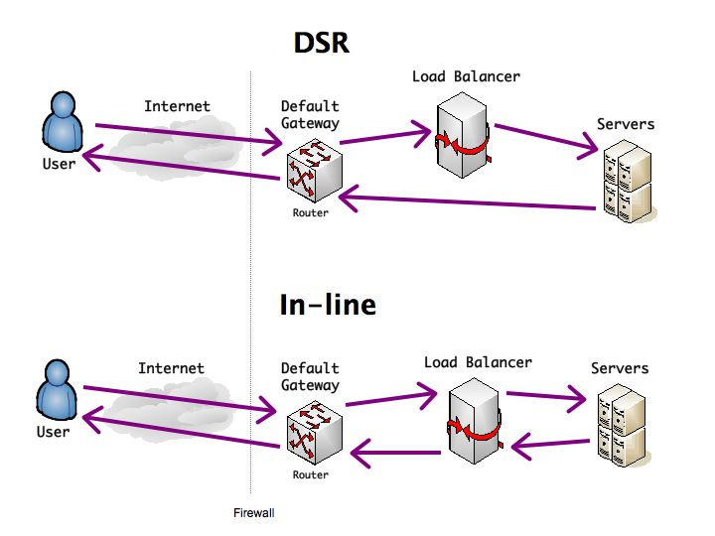
DSR vs Inline

Slide 5
LB Configurations
Inline
  DNAT
  SNAT
DSR
  Layer 2

Slide 6
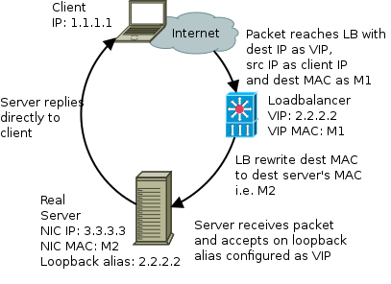
Working of L2 DSR
Client sends SYN packet to VIP which lives on LB
LB figures out which server should handle the request, changes the destination MAC to that of the selected server (rest of the packet is kept intact including the destination and source ip)
Server has VIP IP configured as alias for loopback interface, so it can accept the packet
Application on server has to listen to VIP IP address
Server directly replies to client with Source IP = VIP IP and Destination IP = Client IP

Slide 7
Advantages of L2 DSR
Only sees inbound traffic. This is a huge win for HTTP type services
Outbound bandwidth not limited by bandwidth of LB
LB's can do more VIPs (about 8x more) in comparison to Inline
Doesn't have return-path problem – no need to use SNAT or default route as with inline VIPs
The clients' source addresses are preserved

Slide 8
Limitations of L2 DSR
Cannot inspect L7 details for load balancing decisions (eg. Cookie or url based routing)
Requires host configuration of VIP IP address as loopback alias
Server cannot directly respond to ARP requests for VIP
Port Address Translation is not possible
Servers behind LB are susceptible to SYN attacks
LB and all servers need to be on same L2 segment
  Physical location of servers behind VIP restricted
  Flexibility within datacenter limited

Slide 9
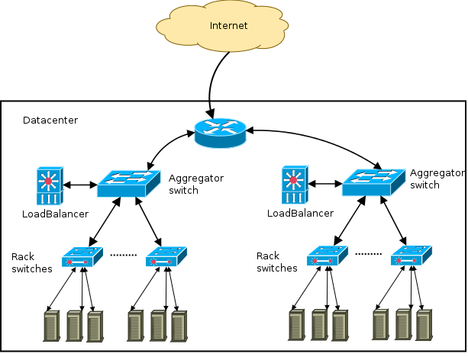
A Simplified View of DC Network (L2 based)

Slide 10
Scaling issues with Layer 2 design
A Layer 2 DSR VIP can only load balance to servers which are on the same Aggregation switch
As servers are added to VIPs over time these will eventually be on separate Aggregation switches (which have no L2 connectivity)
When new servers have no space in existing L2 segment it results in shuffling and migration of servers to place all the servers behind the VIP being expanded in same L2 segment

Slide 11
Layer 3 Load Balancing
To overcome the scalability issue we need Load Balancing to support hosts that are router hops away
Traditional way to do load balancing in Layer 3 environment is to either use SNAT or DNAT
DNAT (Destination NAT or Half-NAT) replaces the destination IP with the IP of real server.
  Servers network must be configured so that reply packets always go through LB so that reply can un-NATed.
SNAT (Source NAT or Full-NAT) replaces the source IP with LB IP in addition to the modification of destination IP.
  Server sees requests as coming from LB and client address is lost.
  LB can add a header to preserve client address but is resource intensive
In both cases the outgoing traffic has to go through the LB
  Bandwidth of LB becomes a bottleneck
  Number of VIPs that can be configured in an LB reduces as SNAT and DNAT are resource intensive

Slide 12
Layer 3 DSR
Layer 3 DSR is a way of implementing DSR across L3 boundaries
Provides the efficiency of DSR VIPS while allowing us to scale beyond L2 segments
L3DSR is a Yahoo! Invention, created by Dave Temkin, Dave Barrow and Igor Gashinsky. Kernel modules written by Quentin Barnes, John Baldwin, David Discher, Jan Schaumann
Kernel modules open sourced at - https://github.com/yahoo/l3dsr/
Supported by 3 vendors: A10, Brocade (Foundary), Citrix (Netscaler)

Slide 13
How to do DSR on L3
Server need to know
  Client source address
  VIP address for which the request was made
LB needs to
  Tell the server behind the VIP the source address of the client
  Send the request to the IP of the server instead of VIP
  Tell the server the original destination address (ie the VIP)
Where to put the extra information?
  In L2DSR both source and destination IP present in respective address fields
  Here the destination IP is the NIC IP of server.
  The DSCP field is used to pass the information about actual destination IP
  DSCP field is 6-bits wide and is used for TOS, QoS, COS – none of these used inside Yahoo!
  Map these bits to VIPs

Slide 14
L3DSR – How it works
LB and Servers need to agree on DSCP <=> VIP mapping. For example DSCP value 0x000100 maps to VIP address 2.2.2.2
On the incoming packet LB sets the DSCP field to the value corresponding to the VIP according to the known value
LB also changes the destination address to the server's real IP address and keeps the client's source address
Server checks DSCP bit
Server rewrites the destination address according to the known mapping to appropriate VIP
VIP configured on loopback alias as with L2DSR
Application binds to VIP address
Server responds to client;s source address from VIP

Slide 15
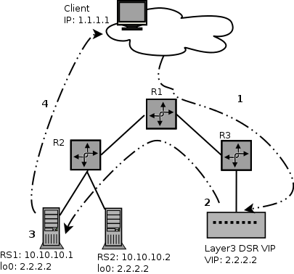
L3DSR Packet Flow
 | ToS bits | Source IP | Destination IP
1 | 0x0 | 1.1.1.1 | 2.2.2.2
2 | 0x4 | 1.1.1.1 | 10.10.10.1
3 | 0x4 | 1.1.1.1 | 10.10.10.1 (to) 2.2.2.2
4 | 0x0 | 2.2.2.2 | 1.1.1.1

Slide 16
L3DSR – Benefits
Location independence of servers within data center
  We can physically move hosts across different Layer 2 segments
  We can rebuild hosts on different Layer 2 segment, then use it to replace broken hosts
  We can add new hosts to existing VIPs without concern for physical location / IP allocation withing same L2 segment
Preservation of clients' source address
DSR performance

Slide 17
L3DSR – Limitations
There is not L7 load balancing capabilities like L2DSR
Configuration more involved than L2DSR
  Requires kernel module, iptable setup and loopback configuration
Use of DSCP precludes using of QoS inside colo
Additional overhead in network latency
  0.04 ms additional latency in our experiments
Limited OS and load balancing vendor support
Like L2DSR this is also susceptible to SYN attacks
DSCP <=> VIP mappings must be tracked

Slide 18
L3DSR Health Checks
Health checks need to be able to check if iptables plugin/kernel module is in place and working correctly
LB sends a HTTP request with following details:
  Source IP: LB_IP
  Destination IP: Server_IP
  DSCP: DSCP mapping for that VIP
Server replies
  Source IP: VIP
  Destination IP: LB_IP
  Status code: 200 OK
Due to destination address rewriting, source/destination on LB does not match. This means LB cannot use regular TCP stack for this health check

Slide 19
L3DSR for IPv6
L3DSR for IPv6 is implemented in a similar fashion to IPv4 – it uses the DSCP field (bits 4-7 of 1st octet and bits 0-1 of 2nd octet) in the IPv6 header (RFC2474)
Yahoo Linux and FreeBSD teams are developing kernel modules
Brocade, A10 and Citrix are all implementing IPv6 L3DSR in future code revisions
Long term plans to develop with vendors IPv6 header extension instead of using DSCP field – might include rich information like VIP IP, ports translated etc

Slide 20
References
Github repository: https://github.com/yahoo/l3dsr
This presentation uses lots of information from following:
  https://github.com/yahoo/l3dsr/blob/master/docs/nanog51.pdf
  http://www.slideshare.net/cwestin63/l3-dsr-lspepresentation20120119

Slide 21
Q & A

