Slide 1
GIT

Slide 2
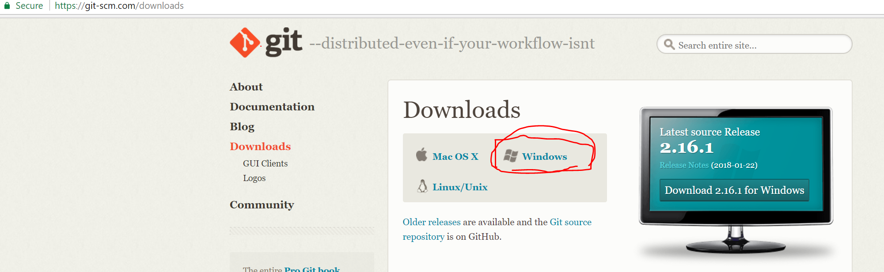
Get Git Bash (Command line Interface or CLI)
Download git bash from https://git-scm.com/downloads

Slide 3
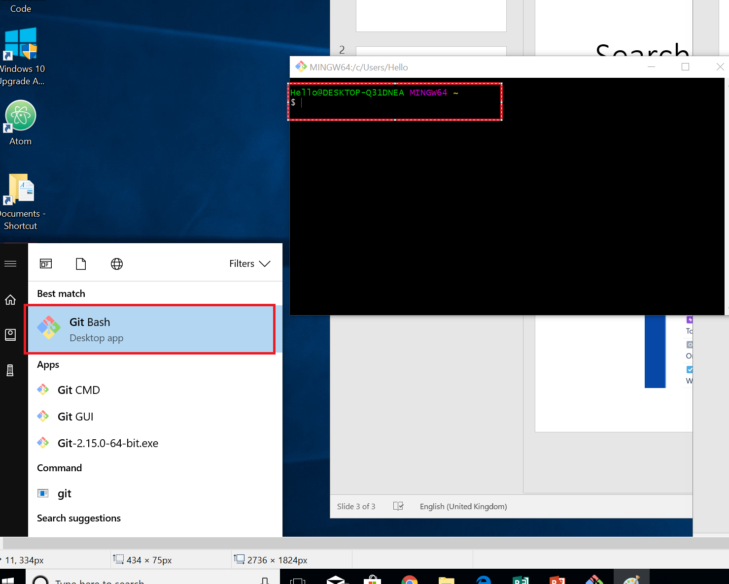
Verify install
Once downloaded double click Git-2.16.1-64-bit.exe to install git.
Verify it by typing git on start menu and you should see git bash.

Slide 4
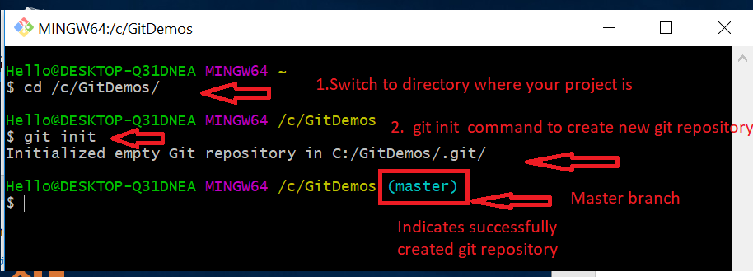
Getting started (Git Bash)
Create folder name gitdemos on your c: or d: drive
Start git bash from start menu
Type command cd /c/gitdemos/ and press enter
Type git init command and press enter

Slide 5
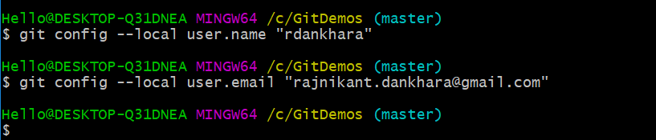
Set username and password on repository
Set username by using git config --local user.name “rdankhara”
Set email by using git config --local user.email “abc.xyx@gmail.com”

Slide 6
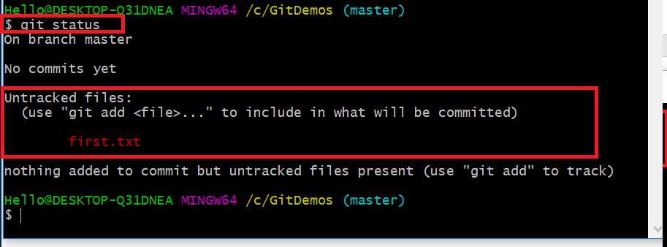
First commit
Create text file named first.txt
Add text this is first line in first file and save it.
Go to git bash and use command git status, it should show if any thing changes since last commit point.

Slide 7
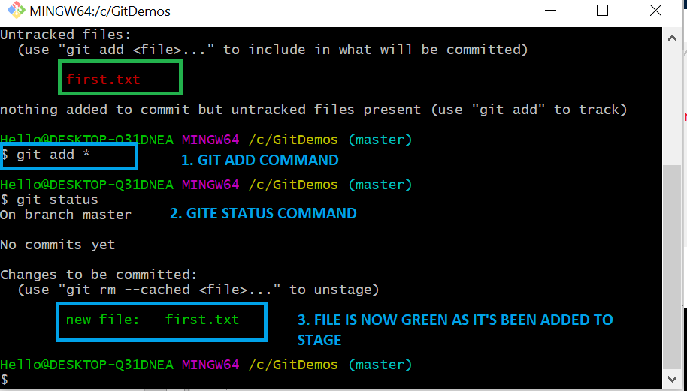
Move changes to stage using git add
Use git add * (or file name ) command to move changes to stage
Use git status command again to verify that file is now moved to stage green.

Slide 8
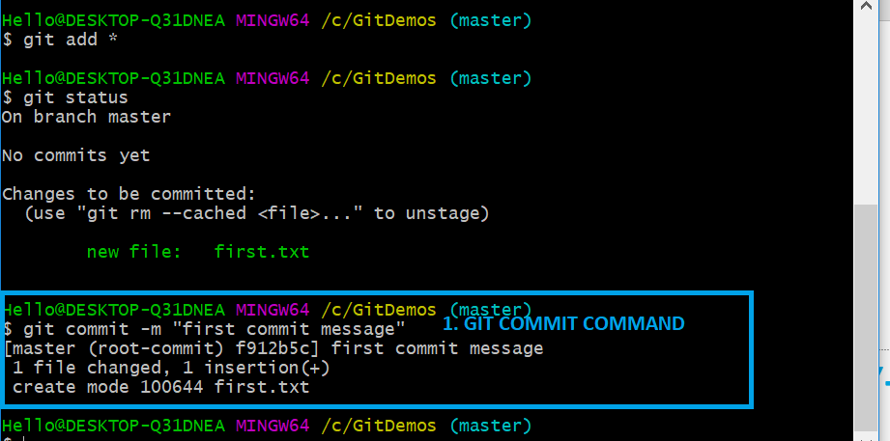
Commit using git commit –m command
Use git commit –m “first commit message” to create commit

Slide 9
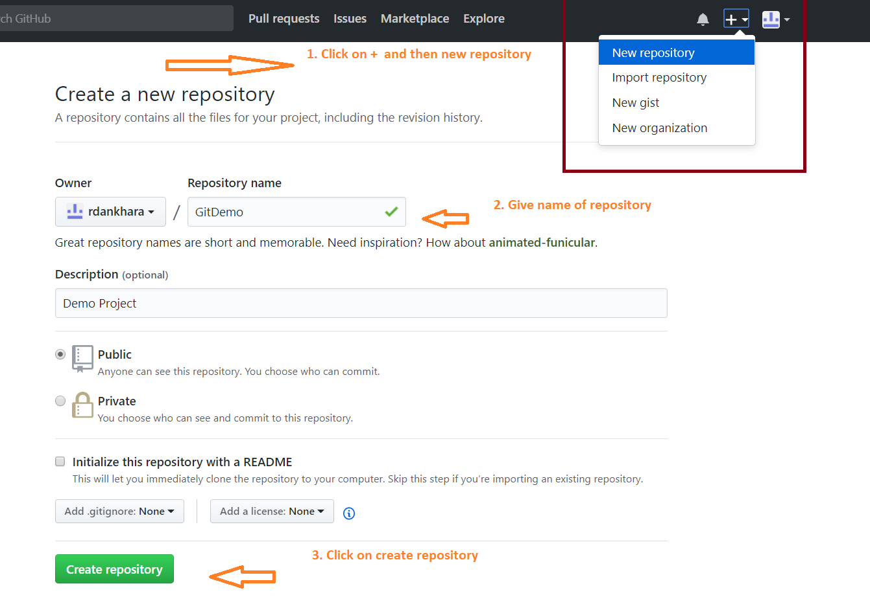
Create repositoroy on Git
Create or sign in to your account on github.com
Create repository by clicking on plus icon on top right corner

Slide 10
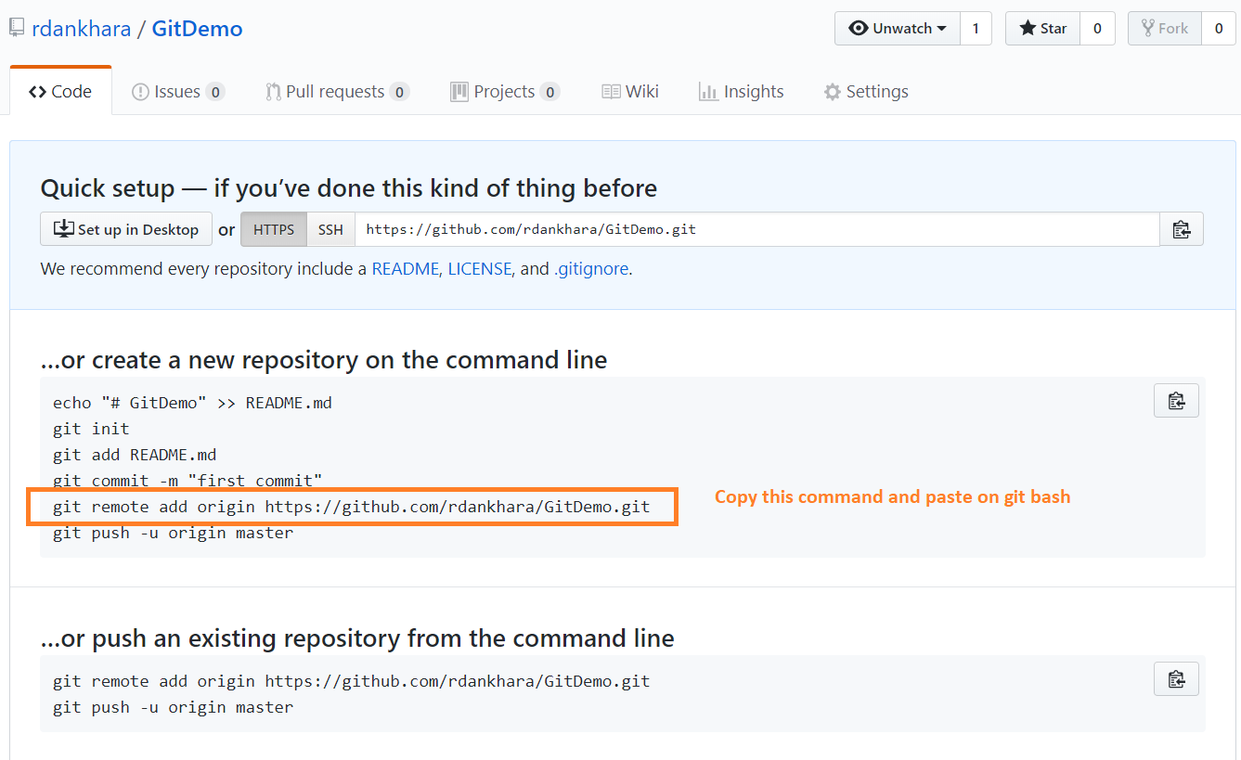
Add remote of existing repository
Go to the repository created, it should open page below
Then copy highlighted command below
git remote add origin https://github.com/rdankhara/githubdemo.git

Slide 11
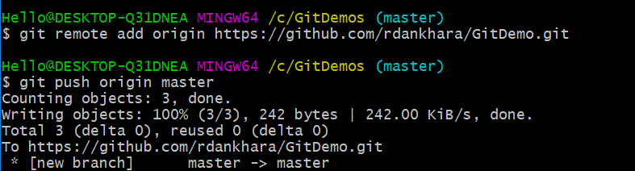
Set origin
git remote add origin https://github.com/rdankhara/GitDemo.git
git push origin master

