Slide 1
JIRA

Slide 2
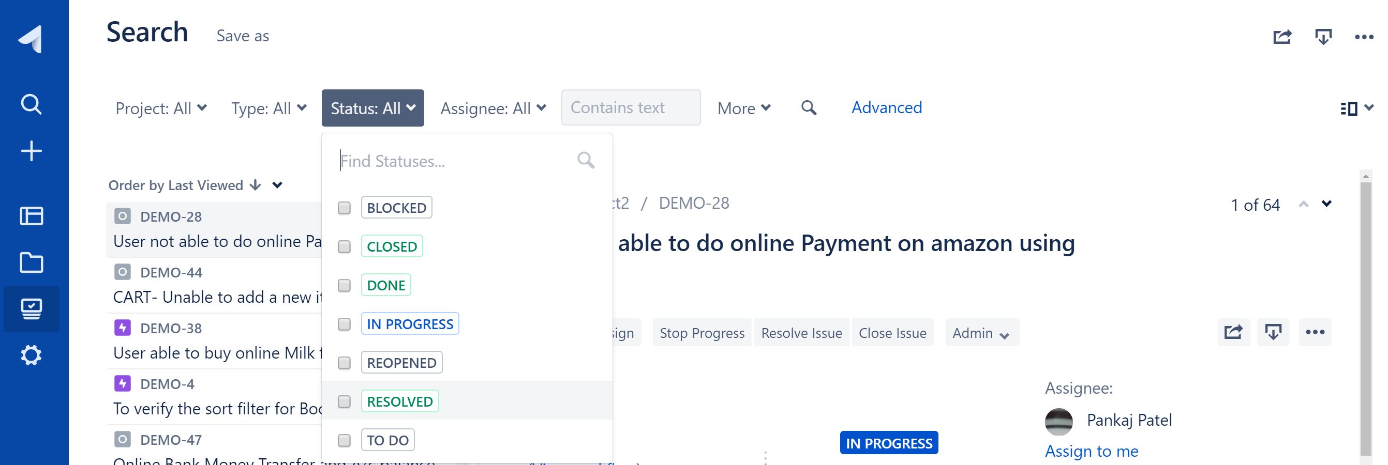
Search
Click on search

Slide 3
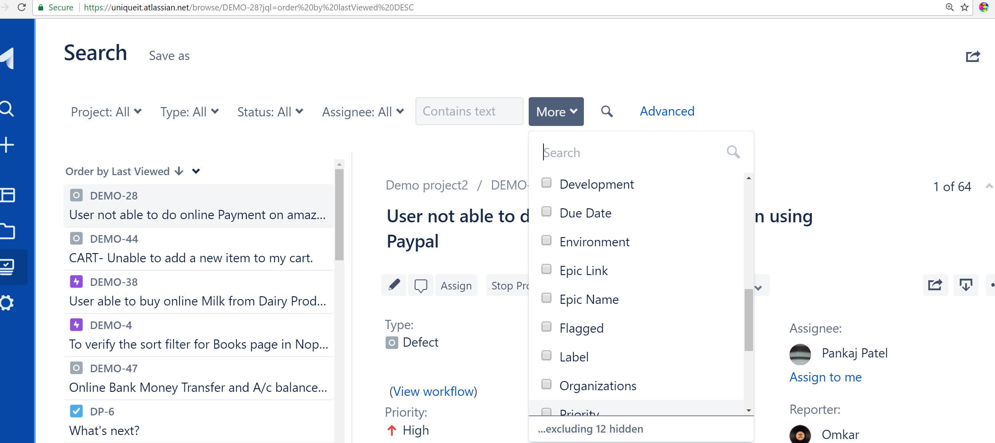
Search by any other field

